Slide 1
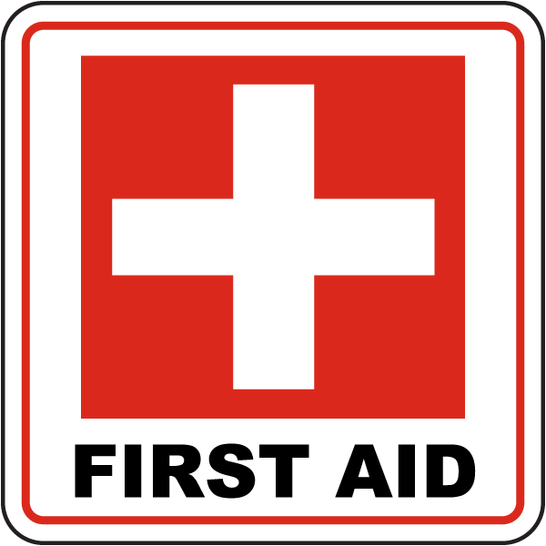
BURNS
AOB

Slide 2
ASSESSING A BURN
When skin is damaged by burning, it can no longer function
effectively as a natural barrier against infection
Body fluid may be lost because blood vessels in the skin leak
serum that may collect under the skin to form blisters or leaks through the surface

Slide 3
There are many possible causes of burns
By establishing the cause of the burn, we may be able to identify any potential problems that could result
For example, a fire in an enclosed space is likely to have produced poisonous carbon monoxide gas, or other toxic
fumes may have been released if burning material was involved

Slide 4
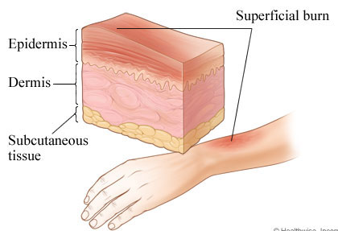
There are three depths: superficial, partial-thickness, and full-thickness
A superficial (first-degree) burn involves only the outermost layer of skin, the epidermis and usually heals well if first aid is given promptly and if blisters do not form (example: sunburn)
Red
Painful to touch
Skin will show mild swelling
Figure: https://www.healthlinkbc.ca/health-topics/tp12226

Slide 5
Treatment
• Apply cool, wet compresses, or immerse in cool, fresh water. Continue until pain subsides
• Cover the burn with a sterile, non-adhesive bandage or clean cloth
• Do not apply ointments or butter to burn; these may cause infection
• Over-the-counter pain medications may be used to help relieve pain and reduce inflammation
• First degree burns usually heal without further treatment
However, if a first-degree burn covers a large area of the body, or the victim is an infant or elderly, seek emergency medical attention
https://www.cdc.gov/masstrauma/factsheets/public/burns.pdf

Slide 6
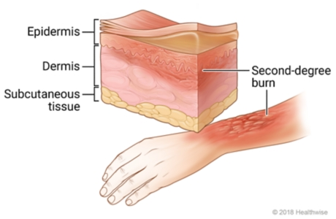
Partial-thickness (second-degree) burns destroy the
epidermis and cause the skin to become red and blistered
They usually heal well, but if they affect more than 20%
percent of the body in an adult and 10% percent in a child, they can be life-threatening
Deep reddening of the skin
Pain
Blisters
Glossy appearance from leaking fluid
Possible loss of some skin
https://www.healthlinkbc.ca/

Slide 7
Treatment
• Immerse in fresh, cool water, or apply cool compresses. Continue for 10 to 15 minutes
• Dry with clean cloth and cover with sterile gauze
• Do not break blisters
• Do not apply ointments or butter to burns; these may cause infection
• Elevate burned arms or legs
• Take steps to prevent shock: lay the victim flat, elevate the feet about 30 cm
• Further medical treatment is required.
Do not attempt to treat serious burns unless you are a trained health professional

Slide 8
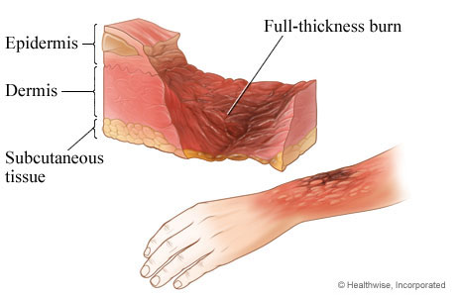
In full-thickness (third-degree) burns, pain sensation is lost,
which masks the severity of the injury
The skin may look waxy, pale, or charred and needs urgent
medical attention
There are likely to be areas of partial and superficial burns
around them
https://www.healthlinkbc.ca/health-topics/tp12214

Slide 9
Treatment
Cover burn lightly with sterile gauze or clean cloth
(Don’t use material that can leave lint on the burn)
Do not apply ointments or butter to burns; these may
cause infection
Take steps to prevent shock: lay the victim flat, elevate
the feet about 30 cm

Slide 10
Treatment
Have person sit up if face is burned. Watch closely for possible breathing problems
Elevate burned area higher than the victim’s head when possible
Keep person warm and comfortable, and watch for signs of shock
Do not place a pillow under the victim’s head if
the person is lying down and there is an airway burn. This can close the airway
Immediate medical attention is required
Do not attempt to treat serious burns unless you are a trained health professional

Slide 11
BURNS TO THE AIRWAY
Any burn to the face, mouth, or throat is very serious because
the air passages may become swollen.
Usually, signs of burning, such as soot or singed nasal hairs, is evident.
The person is likely to have inhaled hot air or gases.
There is no specific first aid treatment for an extreme case of
burns to the airway; the swelling will rapidly block the airway,
and there is a serious risk of hypoxia.
Immediate and specialized medical help is required

Slide 12
CHEMICAL BURN
Certain chemicals may irritate, burn, or penetrate the skin,
causing widespread and sometimes fatal damage.
chemical burns can occur even at home; for instance from dishwasher products (the most common cause of alkali burns in children), oven cleaners, pesticides, and paint stripper
Never attempt to neutralize acid or alkali burns unless trained to do so

