Slide 1
Developments in the Field of Agricultural Supports in the EU Harmonization Process
Within the framework of the fifth opening criterion related to the management and control of agricultural supports, our country submitted its Strategy Document for the Identification of Agricultural Lands and the Development of the National Farmer Registration System to the European Commission in March 2010, and the document was found sufficient by the European Commission. Thus, the fifth opening criterion of the chapter was met.

Slide 2
CMO…
In this context, it was decided that the sugar quotas, which were foreseen to be lifted in 2015, will end at the end of the 2016/2017 in order to allow the transition time necessary for the producers to prepare for the market conditions. In addition, sorghum has been excluded from products covered by grain market intervention; Mandatory special storage support for butter has been terminated; Support for the use of skim milk and milk powder in animal feed and casein, and support for silkworm farming has been removed from the application.

Slide 3
Common Market Organization (CMO)
Developments Regarding the Common Market Organization in the European Union Harmonization Process
The CMO under Agriculture and Rural Development Chapter 11 in the EU accession process is among the areas where our country has achieved a limited level of alignment, but technical studies are carried out in order to harmonize with the EU in this field under the coordination of Ministry of Agriculture and Forestry.
In this context, legislative preparations for the classification of cattle, sheep and goat carcasses are continuing in the working group, which consists of experts from MoAF, Meat and Dairy Authority and Ministry of European Union.

Slide 4
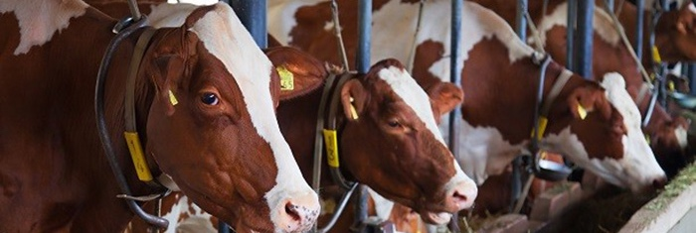
Developments Regarding the Common Market Organization in the European Union Harmonization Process
In Turkey, Veterinary Information System (TURKVET-HAYBIS) is used for the registration of bovine animals, and Sheep and Goat Registration System is used for the registration of ovine animals.
Post-2013 CAP Reform had previously combined common market arrangements for 21 agricultural products / product groups.
With the Regulation (EU) No 1308/2013 published in December 2013, the Common Market Organization was expanded to cover the entire agricultural product / product group with the addition of 23 agricultural product / product groups as well as other agricultural products.

Slide 5
Developments in Organic Agriculture in the European Union Harmonization Process
The application made by our country through the Ministry of Foreign Affairs in 2003 to enter the EU's list of third countries is under review in the European Commission. Changes to national legislation since the date of initial application are regularly reported to the European Commission.
Our organic agriculture legislation currently in force; In June 2013, except for the number of certificates, the re-certification in the import regime, the transition process, the procedures for sampling and risk assessment, and the non-compliance notification our legislation is in accordance with the EU legislation.
In 2013, audits were carried out for organic farming control and certification institutions and entrepreneurs operating in İzmir and its surroundings by a delegation of European Commission experts who examined the technical file of our country. Studies continue within the framework of the audit report.

Slide 6
Developments in the Area of Geographical Signs in the European Union Harmonization Process
The registration and protection of geographical signs in our national legislation is regulated by the Decree Law No. 555 on Protection of Geographical Signs (KHK), which came into force in 1995.
Within the scope of product groups such as natural products, agriculture, mining and handicraft products and industrial products, geographical indication applications can be made to the Turkish Patent Institute (TPE) under the title of origin and the sign of origin.
On the other hand, the EU has five registration applications made by Turkey to the European Commission in line with the above-mentioned procedures for third countries. Three of these applications are within the scope of the sign and two are under the name of origin.

Slide 7
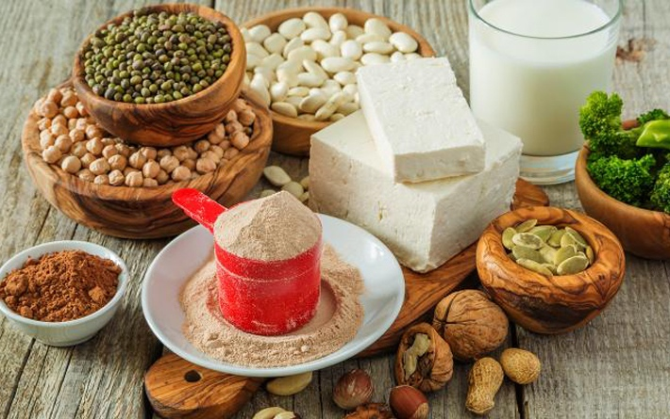
Developments in the Area of Geographical Signs in the European Union Harmonization Process
The first application concerns the registration of Aydın Fig as origin name on August 24, 2008. The second application was related to the registration of Antep Baklava as an alien sign and was made on 10 July 2009. The third application was on August 13, 2012, the application of the sign of destiny for Afyon Sausage and Afyon Pastrami.
Our other applications are still being reviewed by the European Commission. Within this framework, our country will be able to apply to the European Commission in terms of agricultural products and foods. The conclusion of the application varies depending on whether there is an objection or not, in any case it takes more than a year.

Slide 8
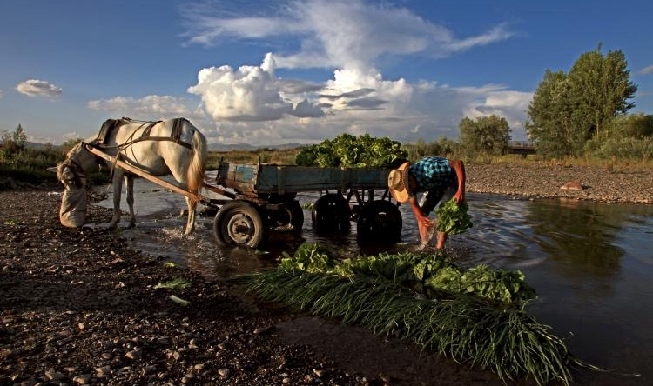
Developments in the Rural Development Area in the European Union Harmonization Process
Grant support for the candidate and potential candidate countries by the EU is through the Instrument for Pre-Accession Assistance (IPA) for the political, economic, legal and administrative measures to be taken for harmonization and implementation of the EU acquis in the accession process.
Grant supports allocated to Turkey by the EU for the use of producers of agriculture, fisheries and rural development, is given in context of said the Pre-Accession, which is a component of the mechanism Instrument-Rural Development (IPARD).

Slide 9
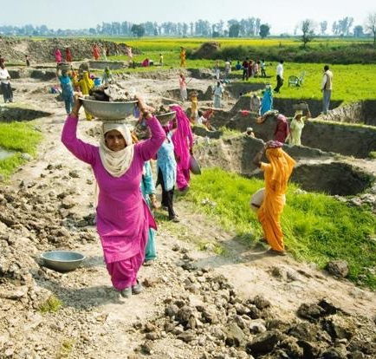
Financial supports from the EU in agriculture and rural development
Since 2002, the scope of Turkey-EU financial cooperation aimed at institutional capacity building as programmed 9 total budget of the project is 61 million euros. These projects are listed below:
Development of Organic Agriculture and Compliance with EU Legislation
Preparation for the Implementation of the EU Common Agricultural Policy
Pre-Accession Assistance Tool (IPA) Rural Development Agency Establishment
Establishment of Pilot Turkish Farm Accounting Data Network
Strengthening the Statistical Capacity of the Ministry of Food, Agriculture and Livestock

Slide 10
Financial supports from the EU in agriculture and rural development
Preparation for the Implementation of Environment and Rural Measures under the Pre-Accession Assistance Instrument Rural Development Component (IPARD)
Expansion of Pilot Farm Accounting Data Network Project and Ensuring Sustainability
Digitization of Land Parcel Identification System
Building the Integrated Administration and Control System Capacity

Slide 11
Any Questions?!?

