Slide 1
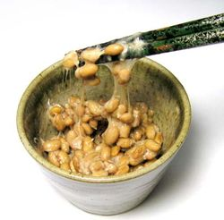
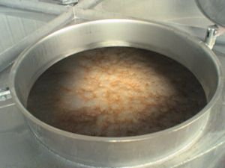
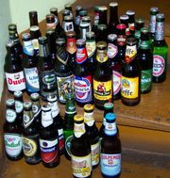
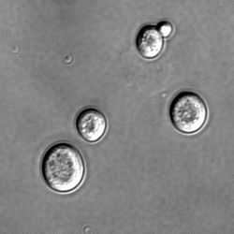
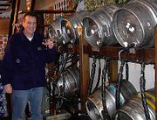
BÖLÜM 5
FERMANTASYON ENDÜSTRİLERİ

Slide 2
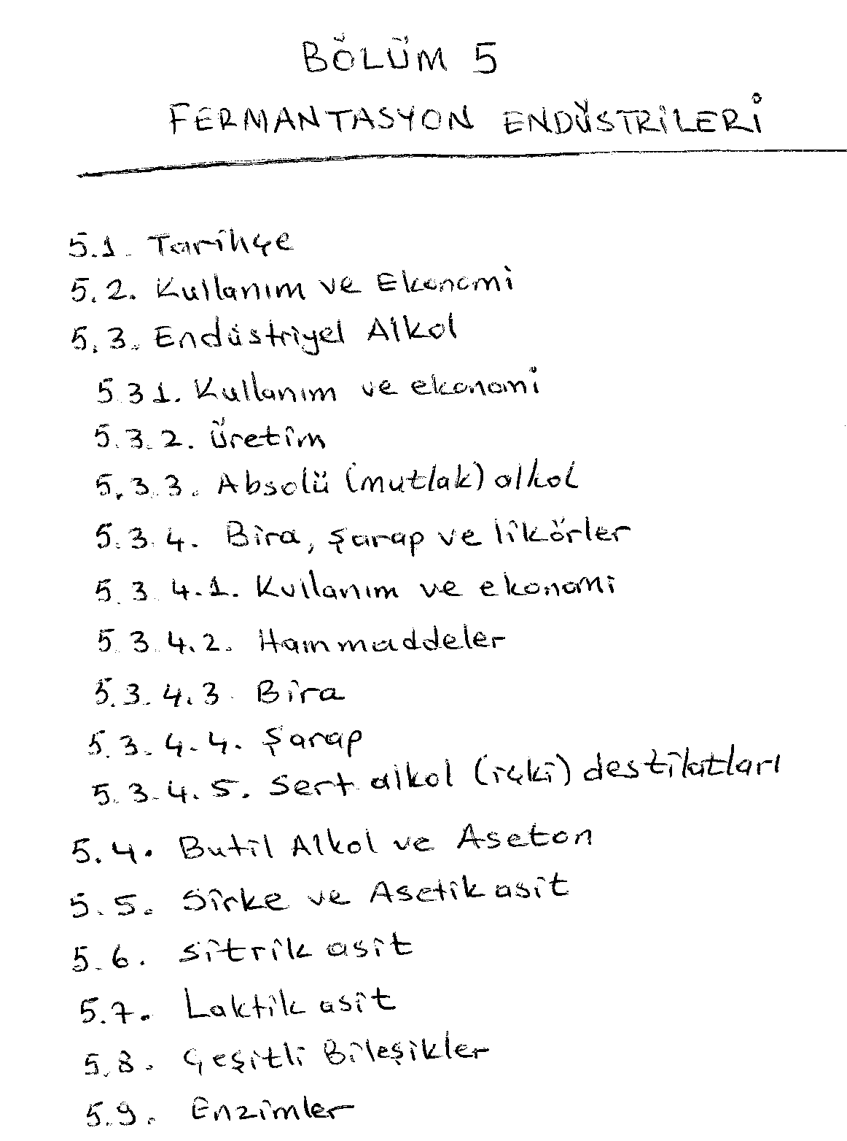

Slide 3
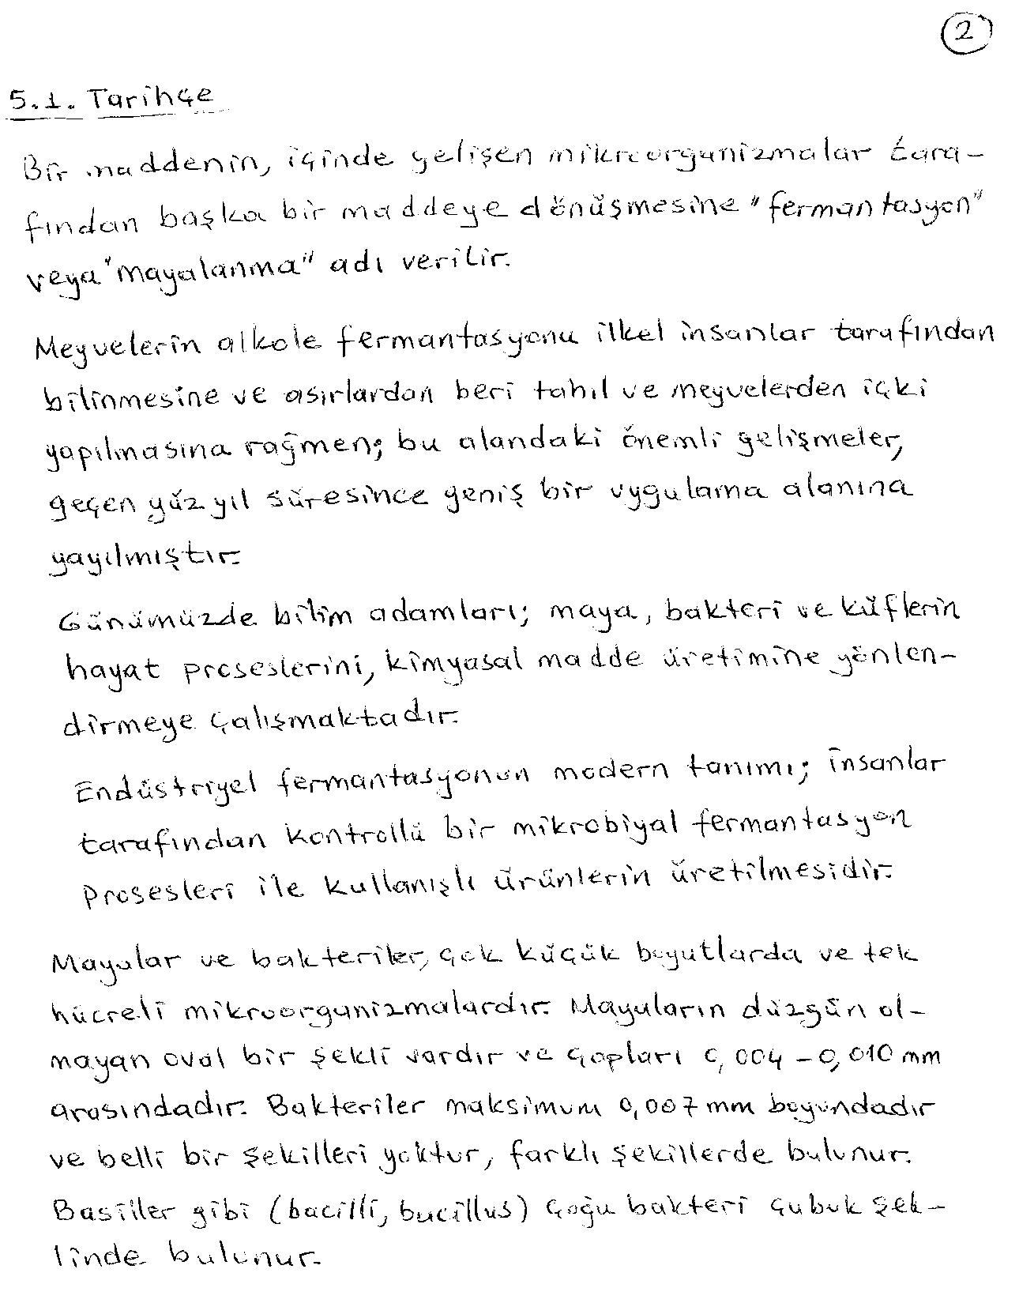

Slide 4
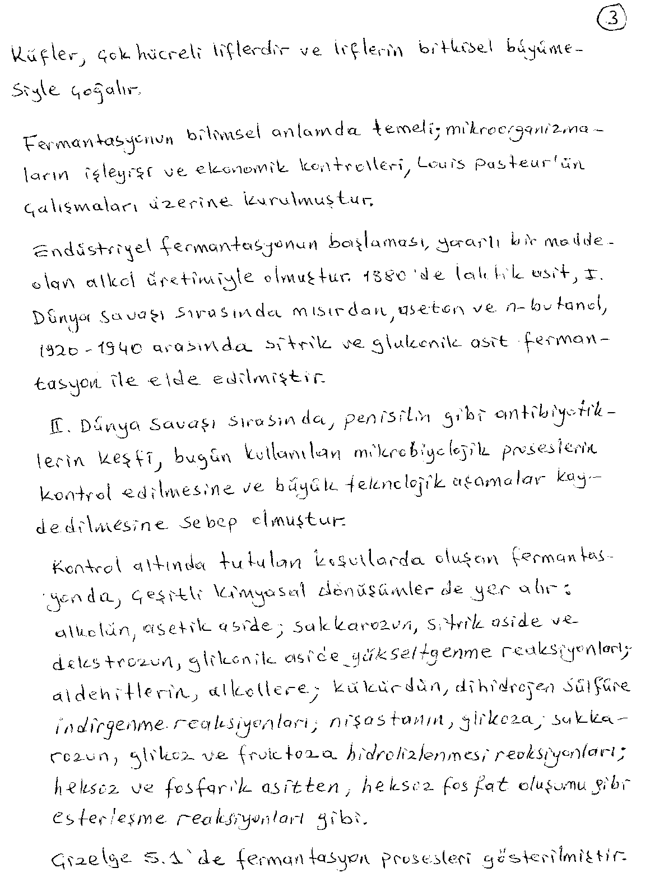

Slide 5
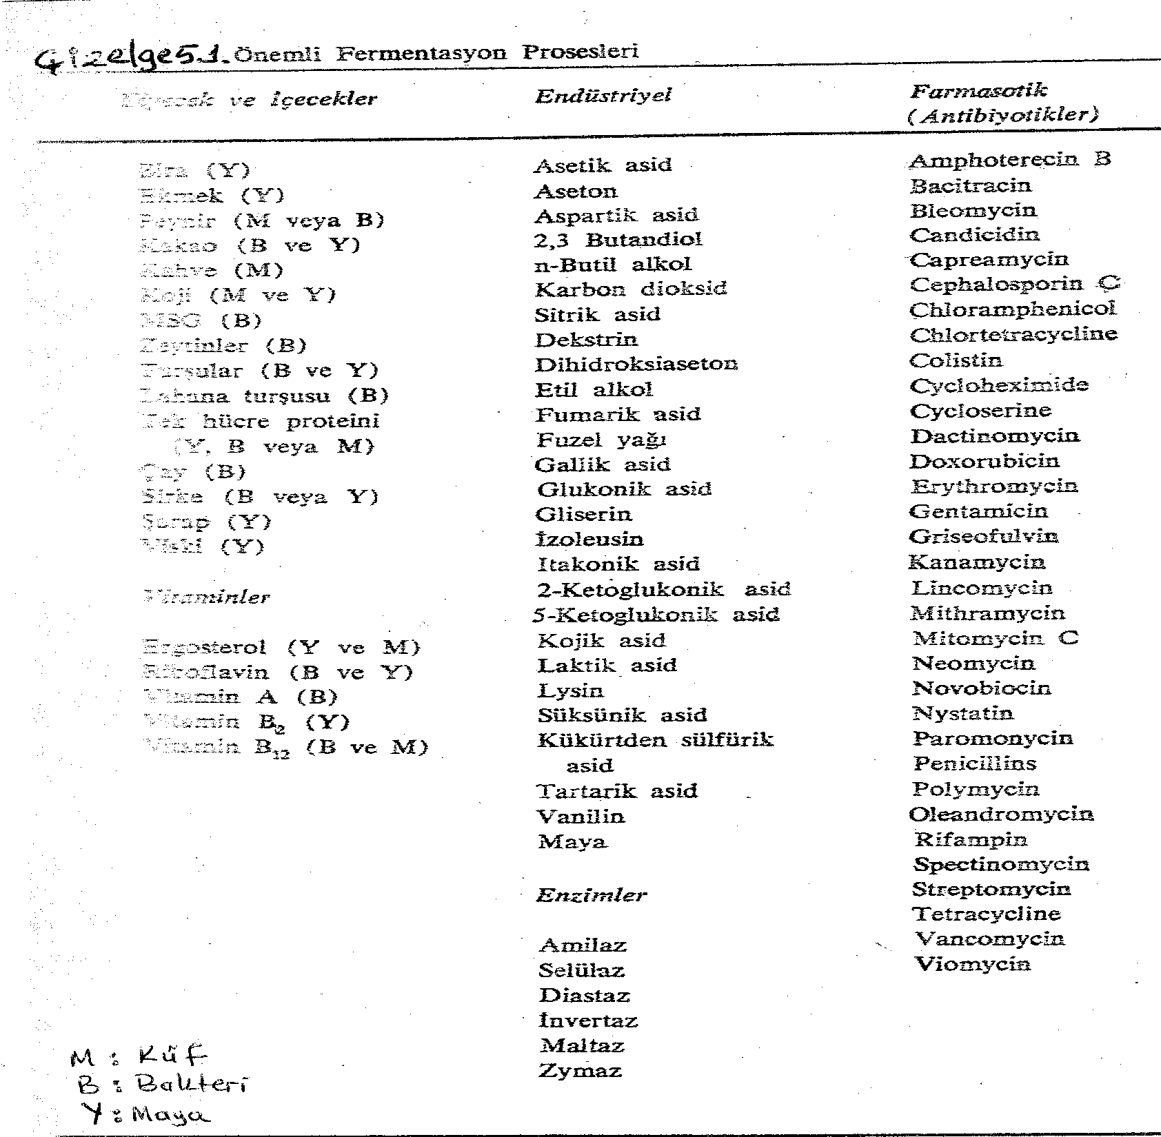

Slide 6
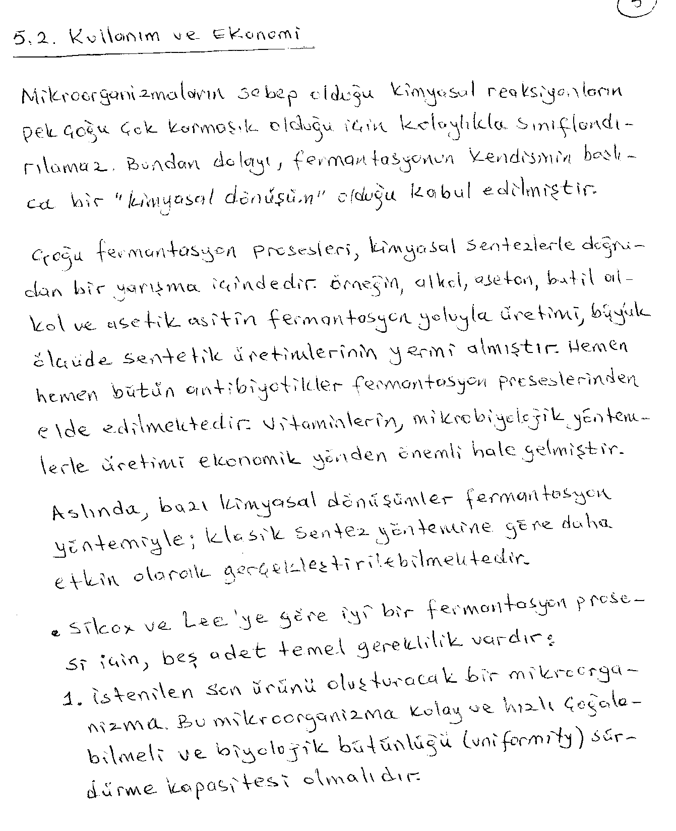

Slide 7
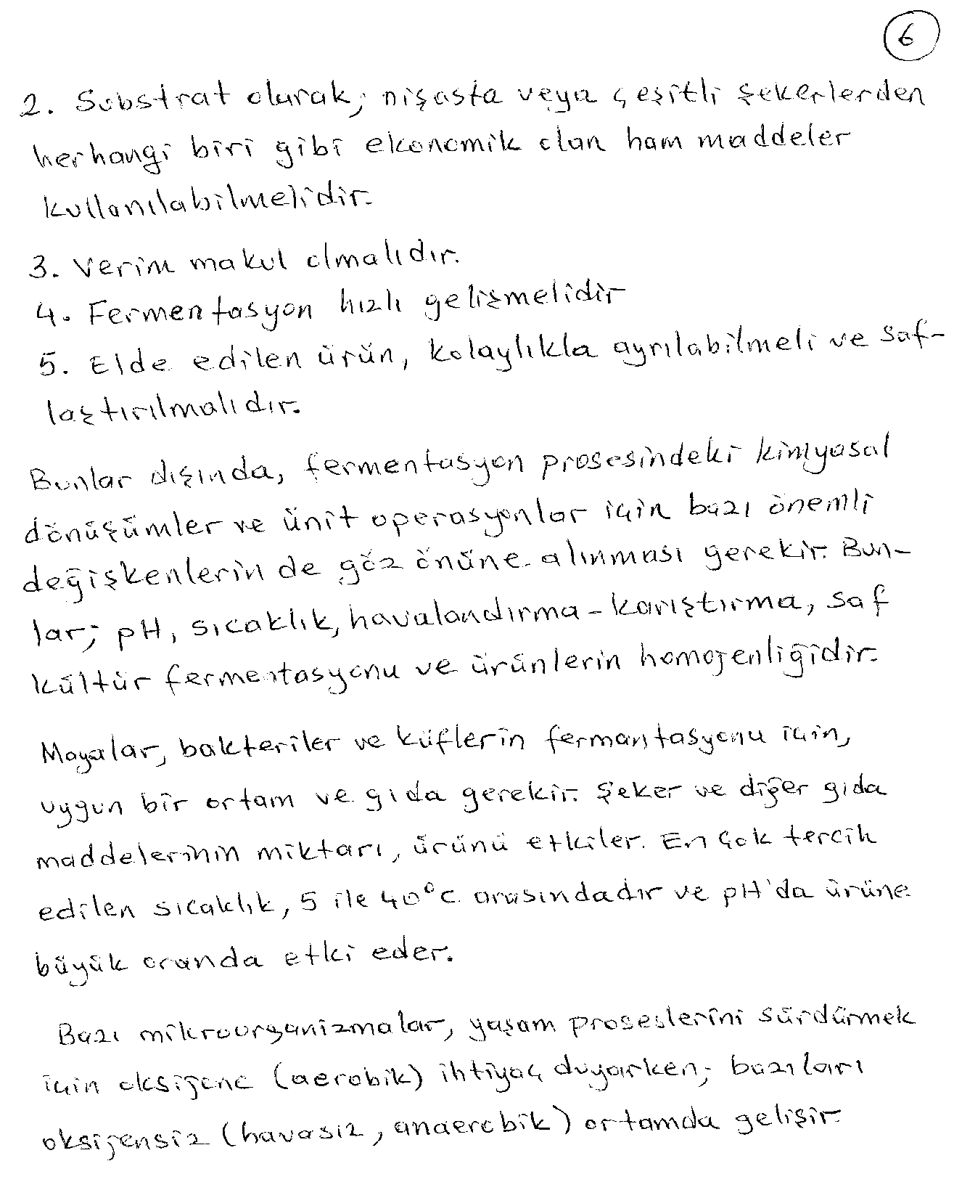

Slide 8
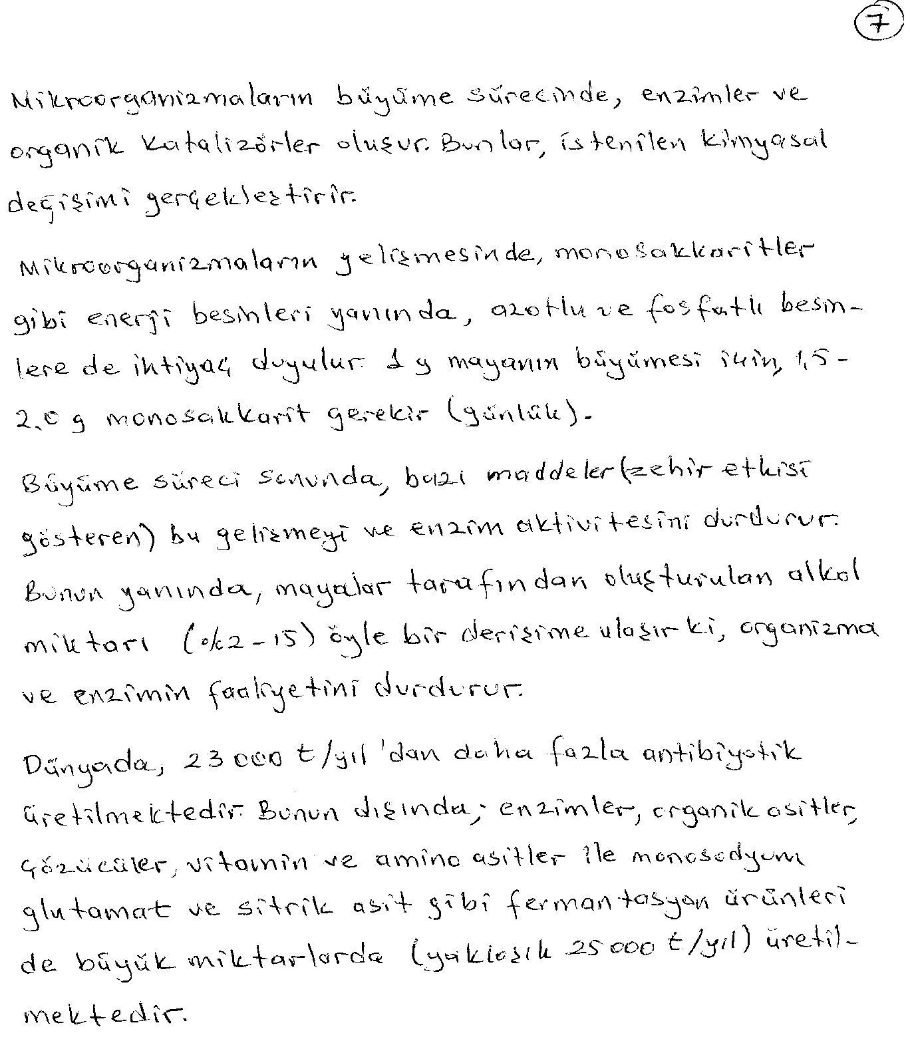

Slide 9
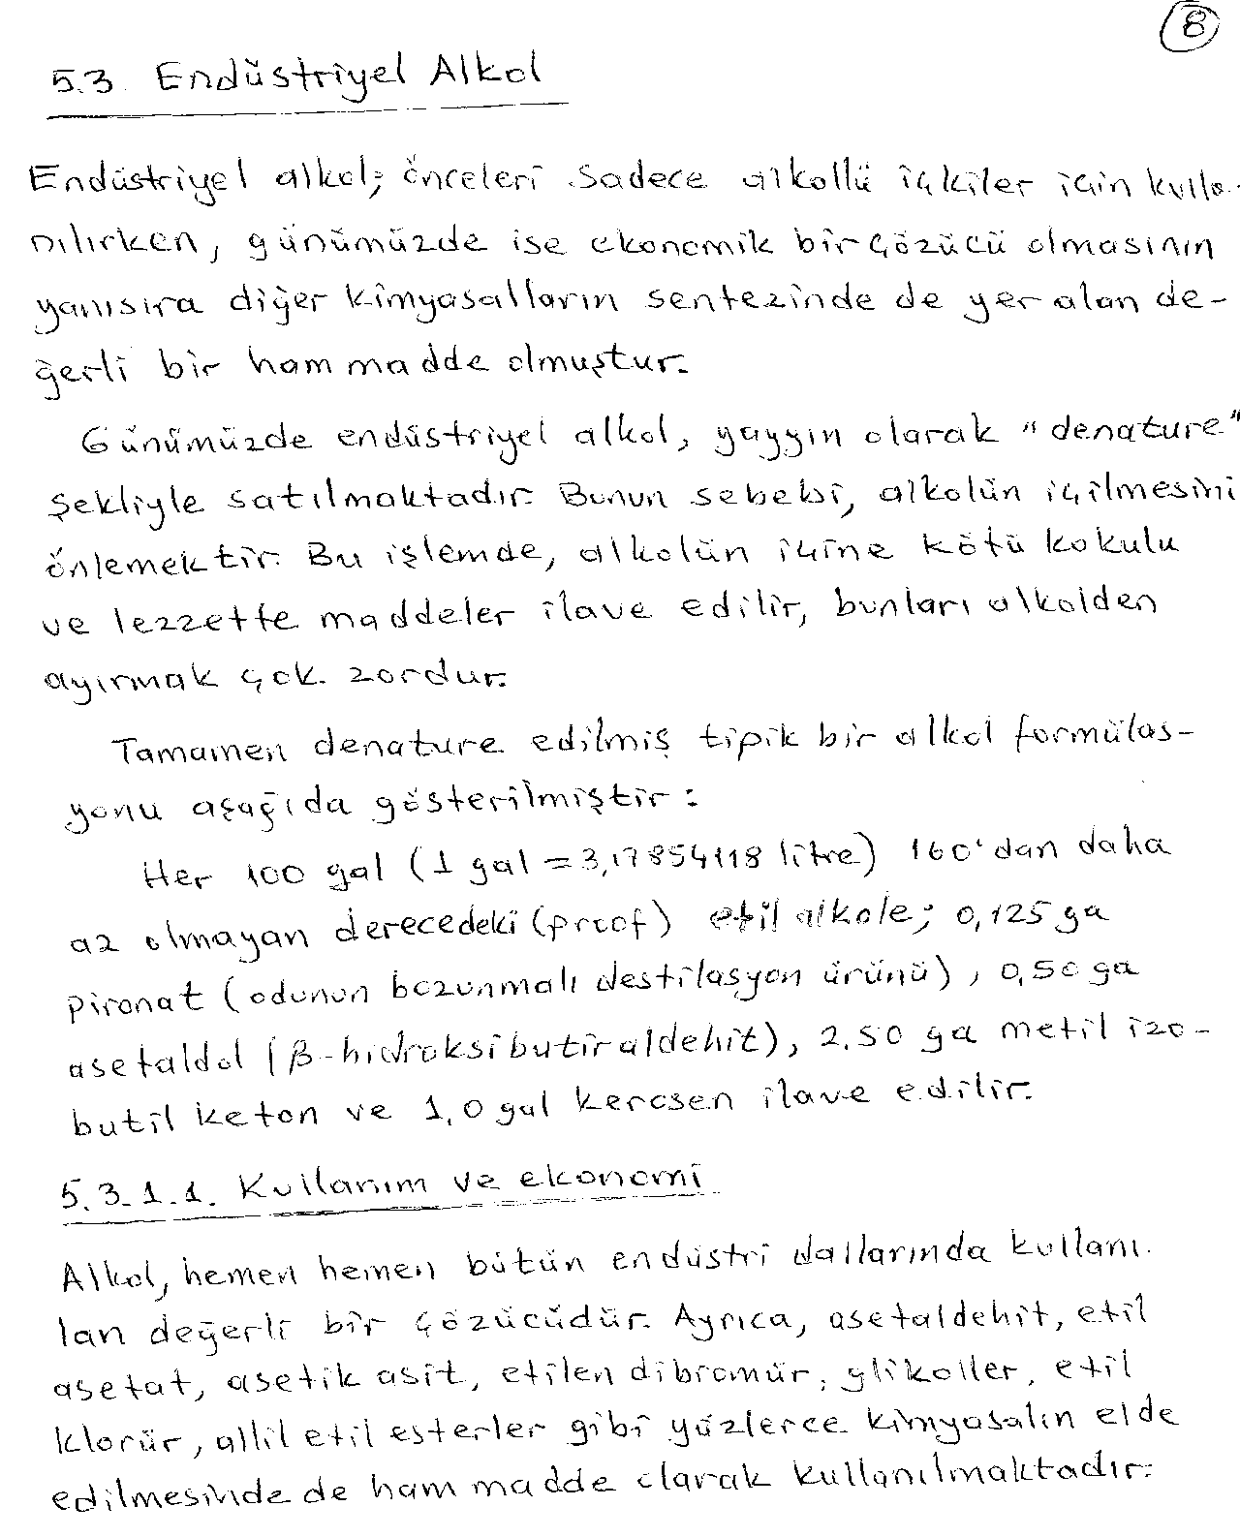

Slide 10
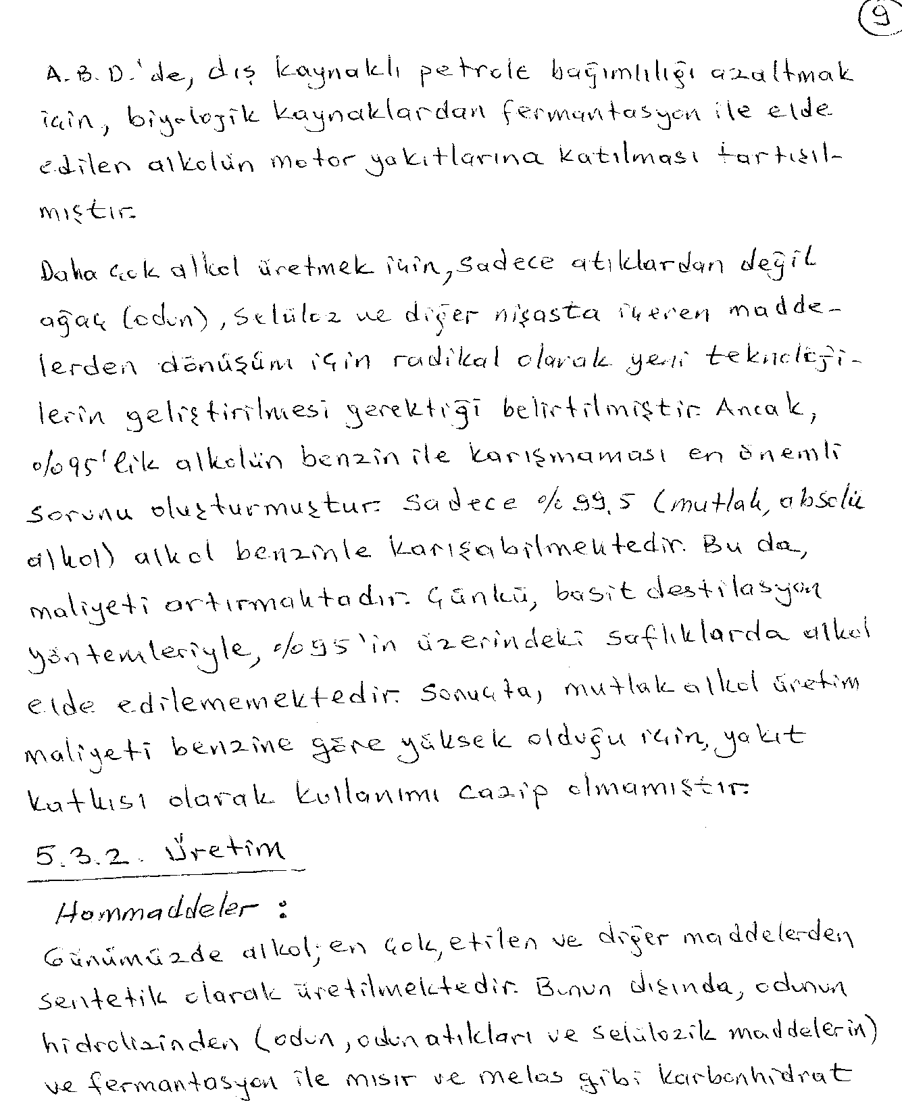

Slide 11
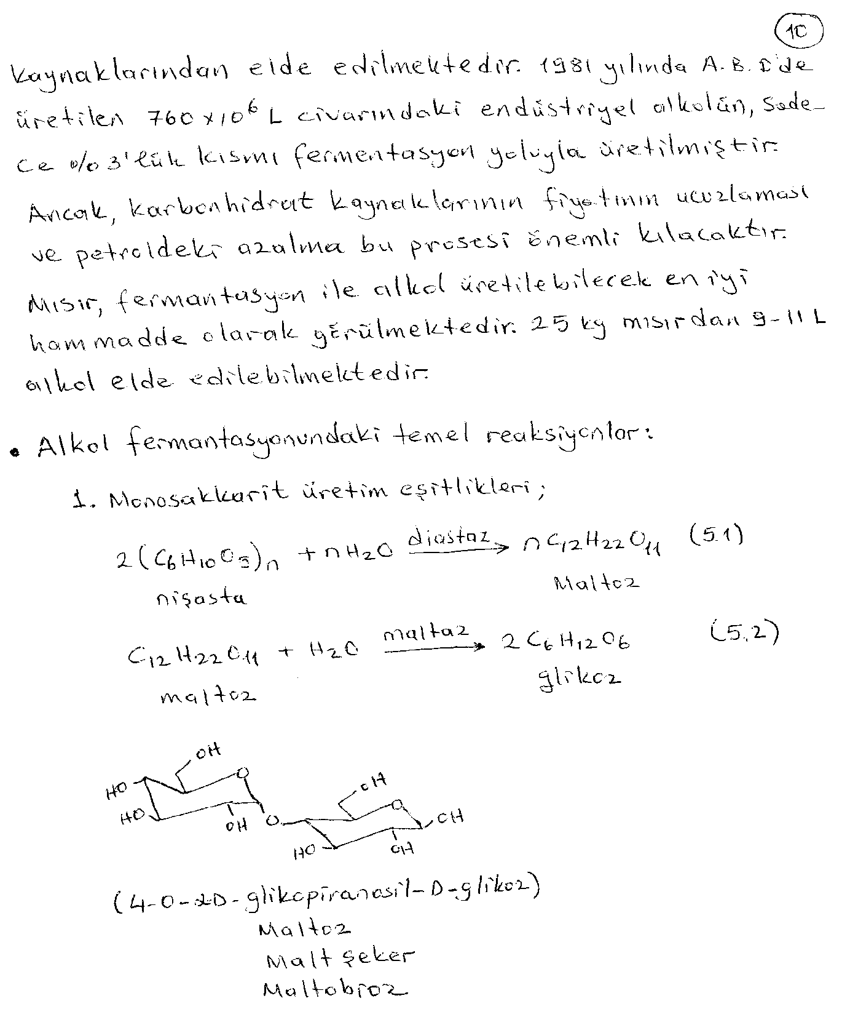

Slide 12
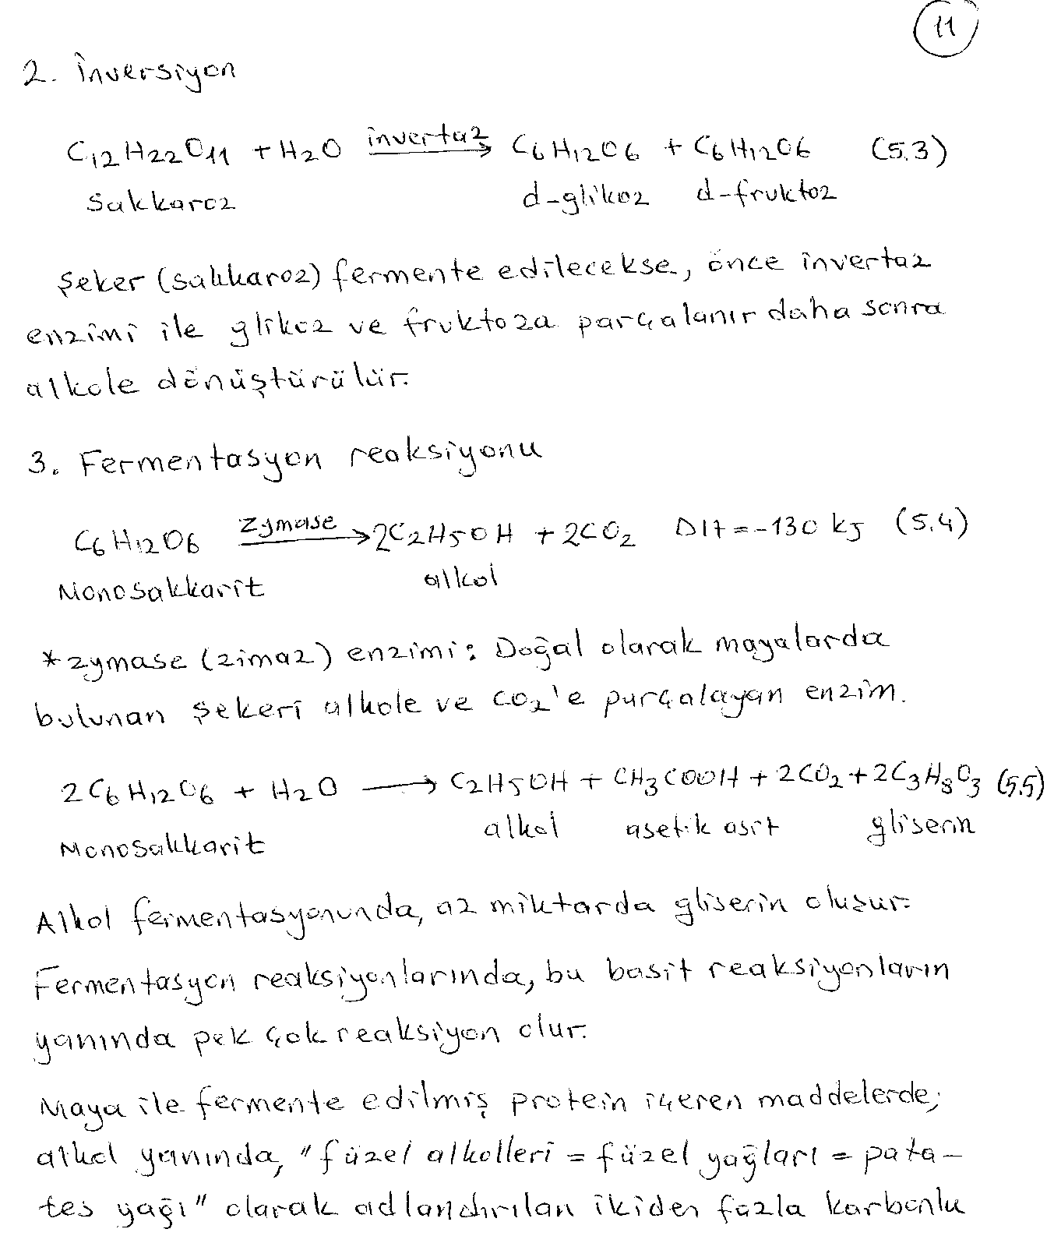

Slide 13
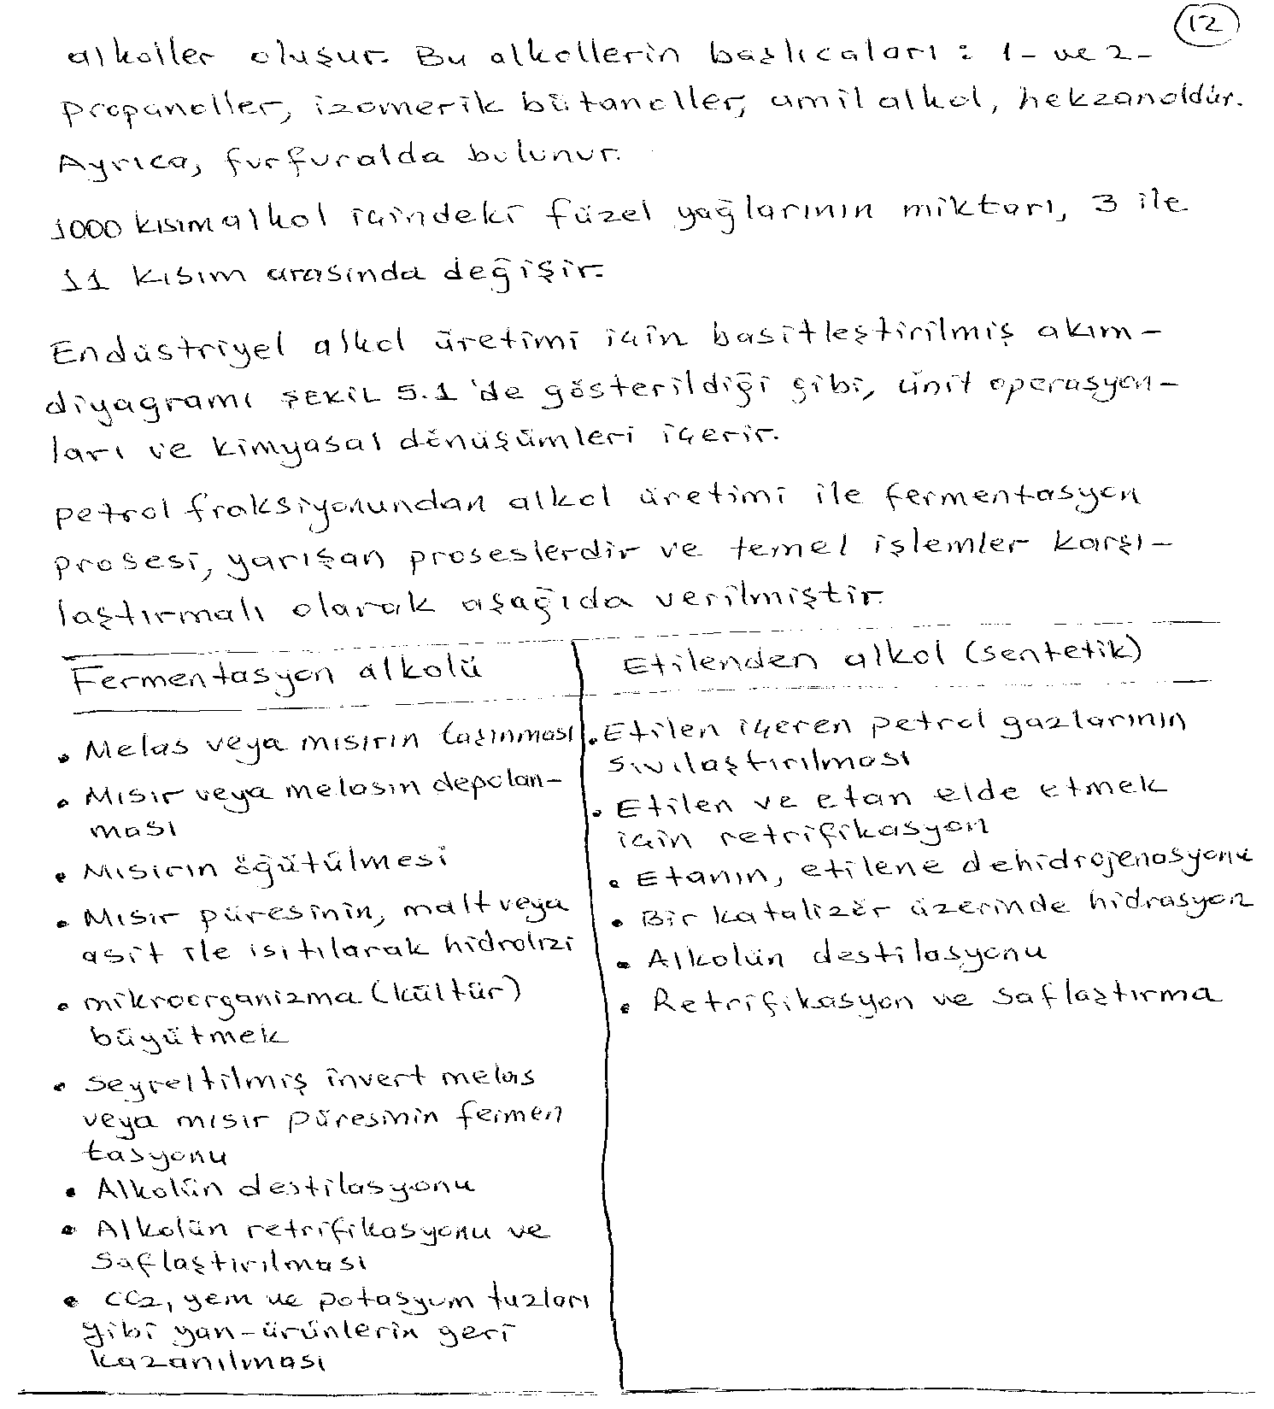

Slide 14
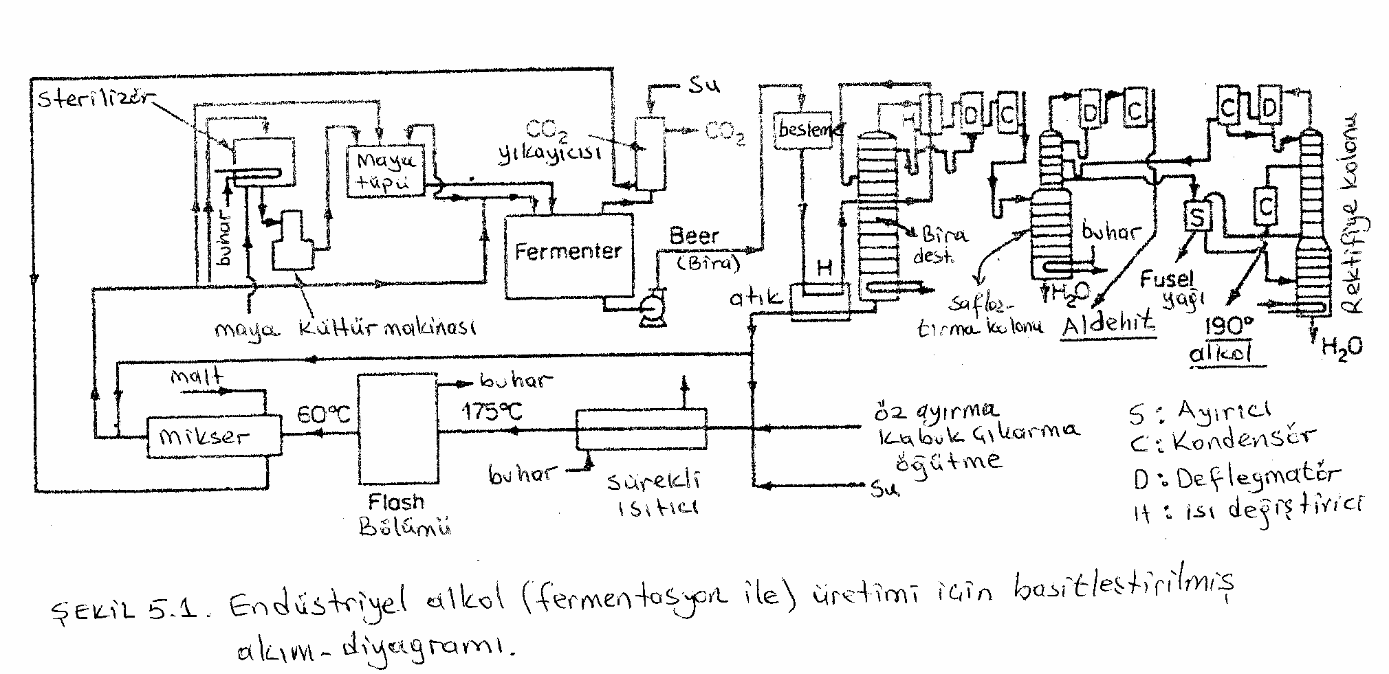

Slide 15
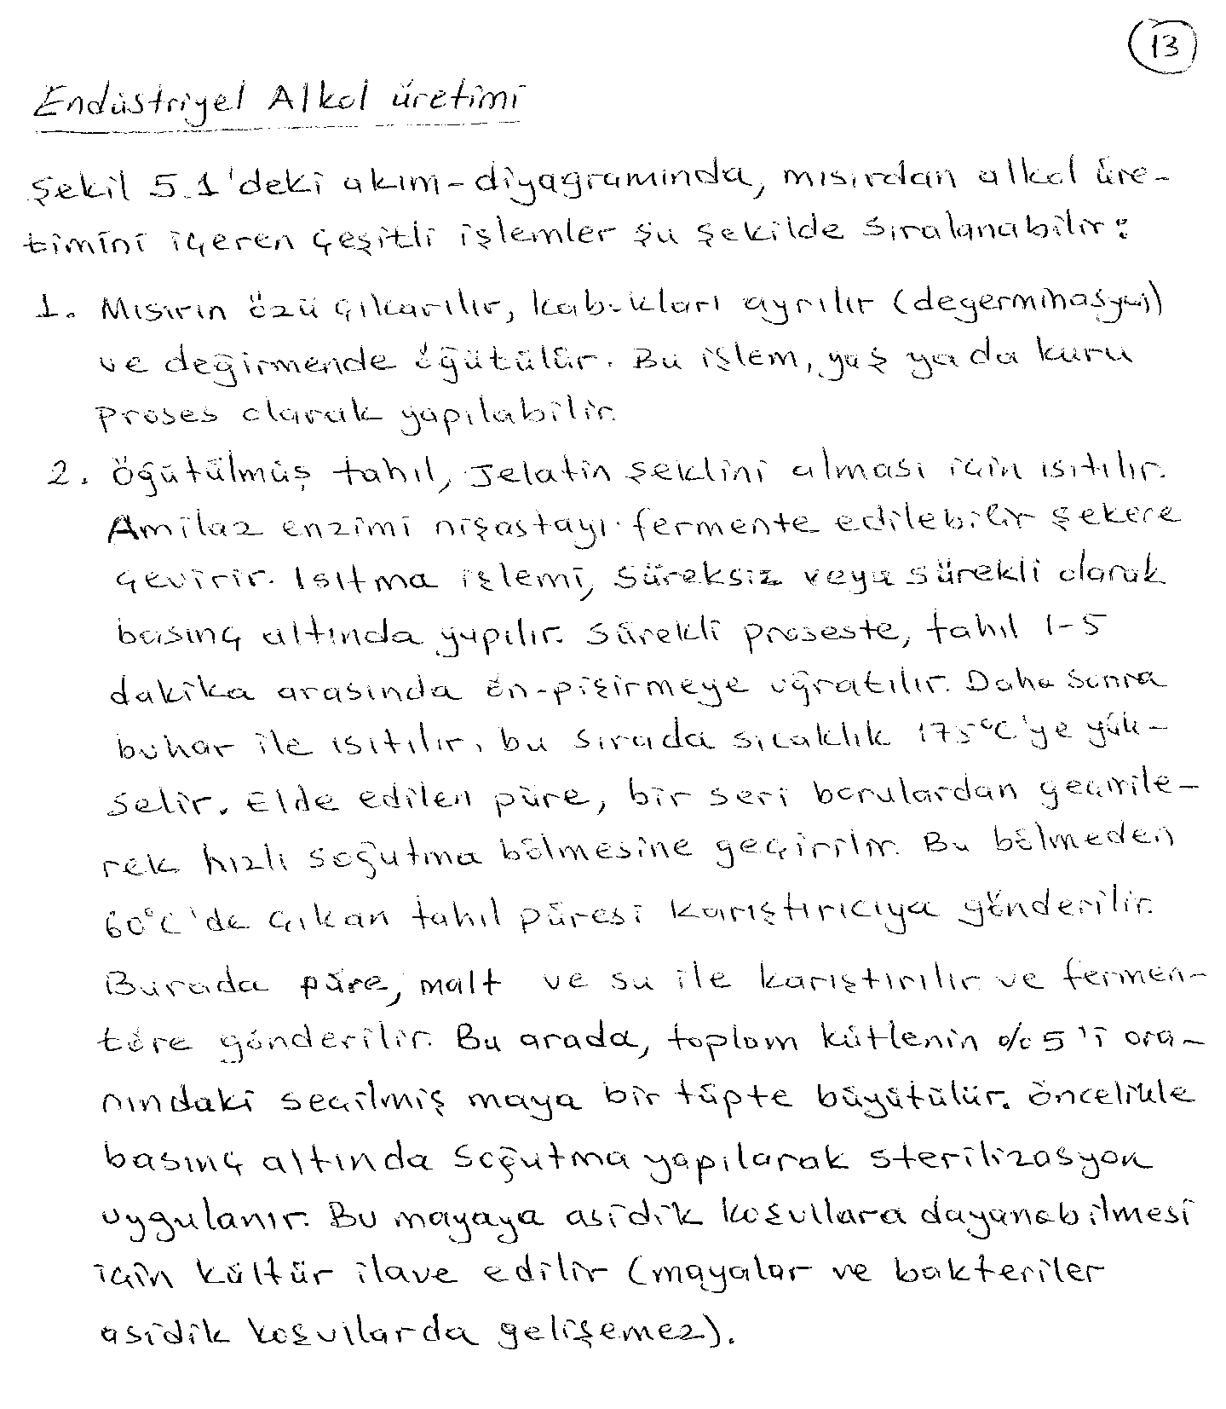

Slide 16
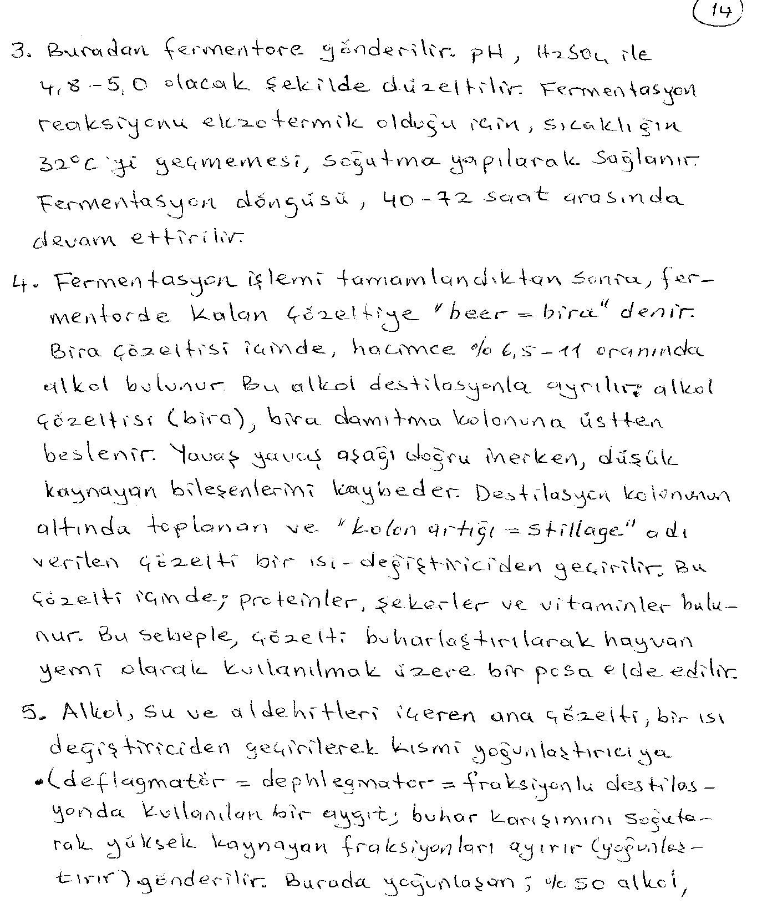

Slide 17
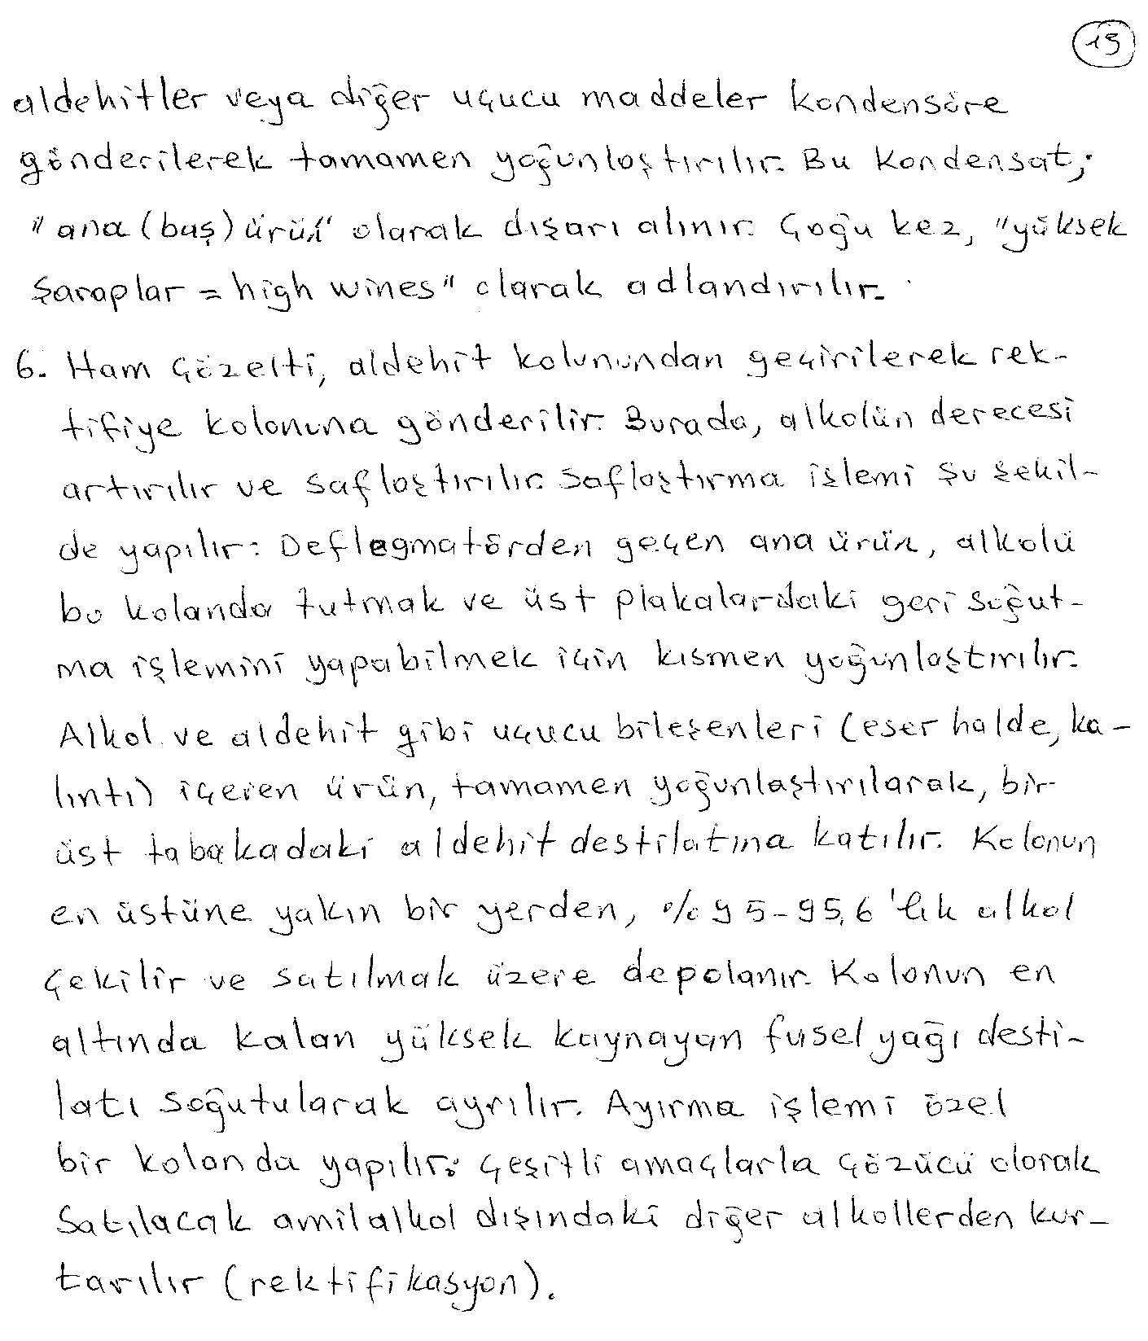

Slide 18
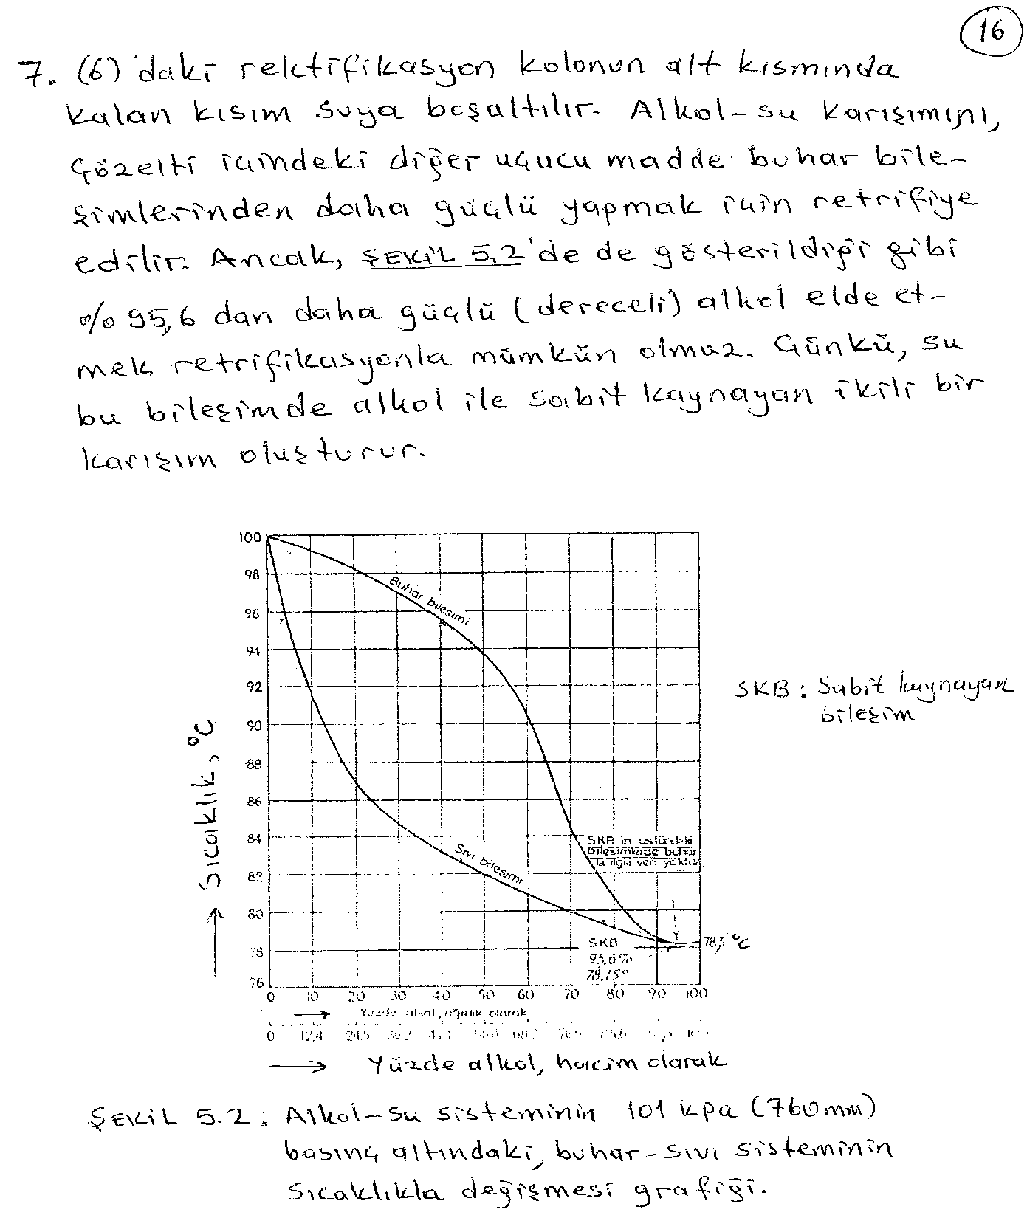

Slide 19
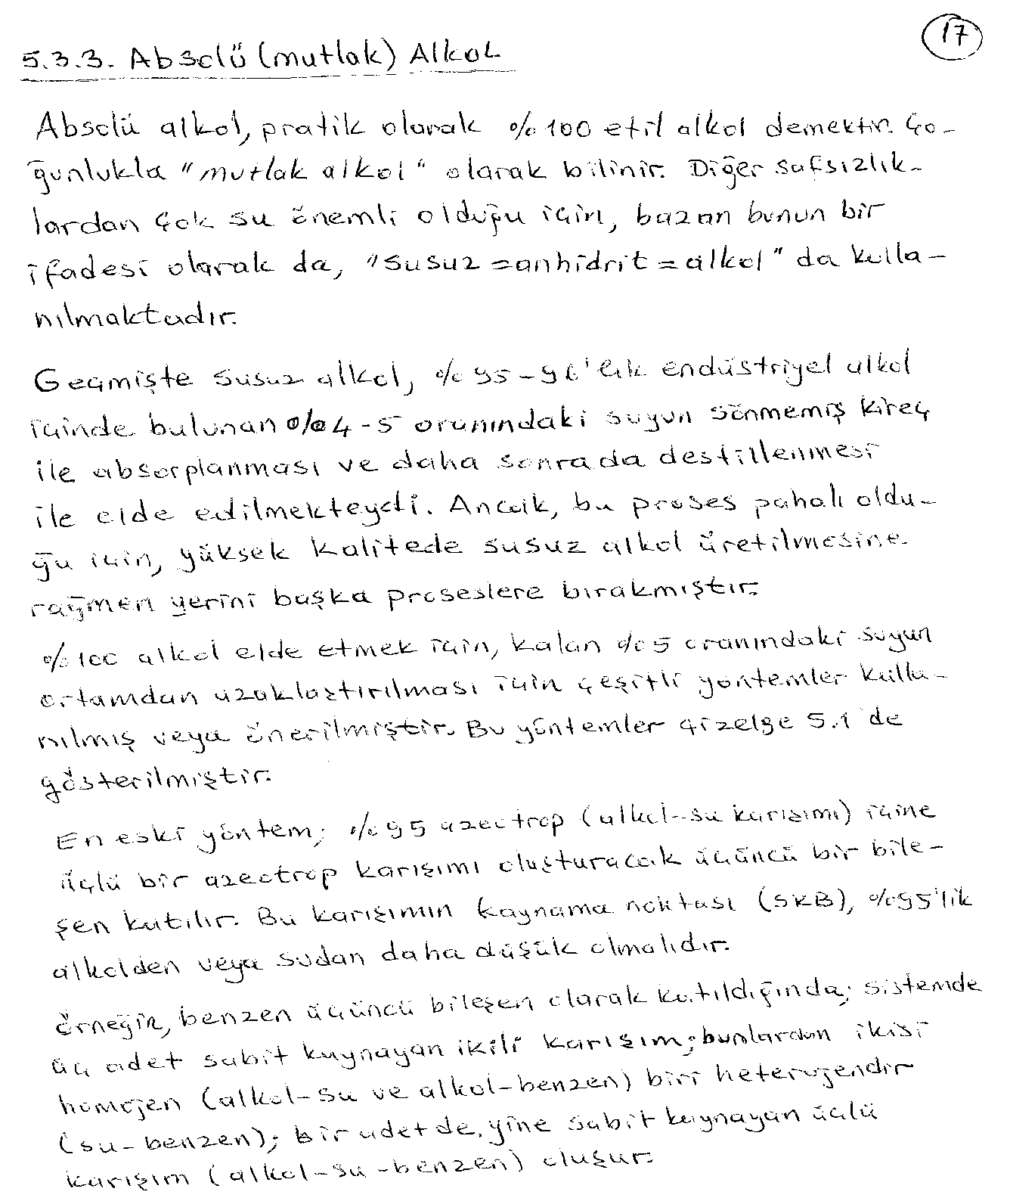

Slide 20
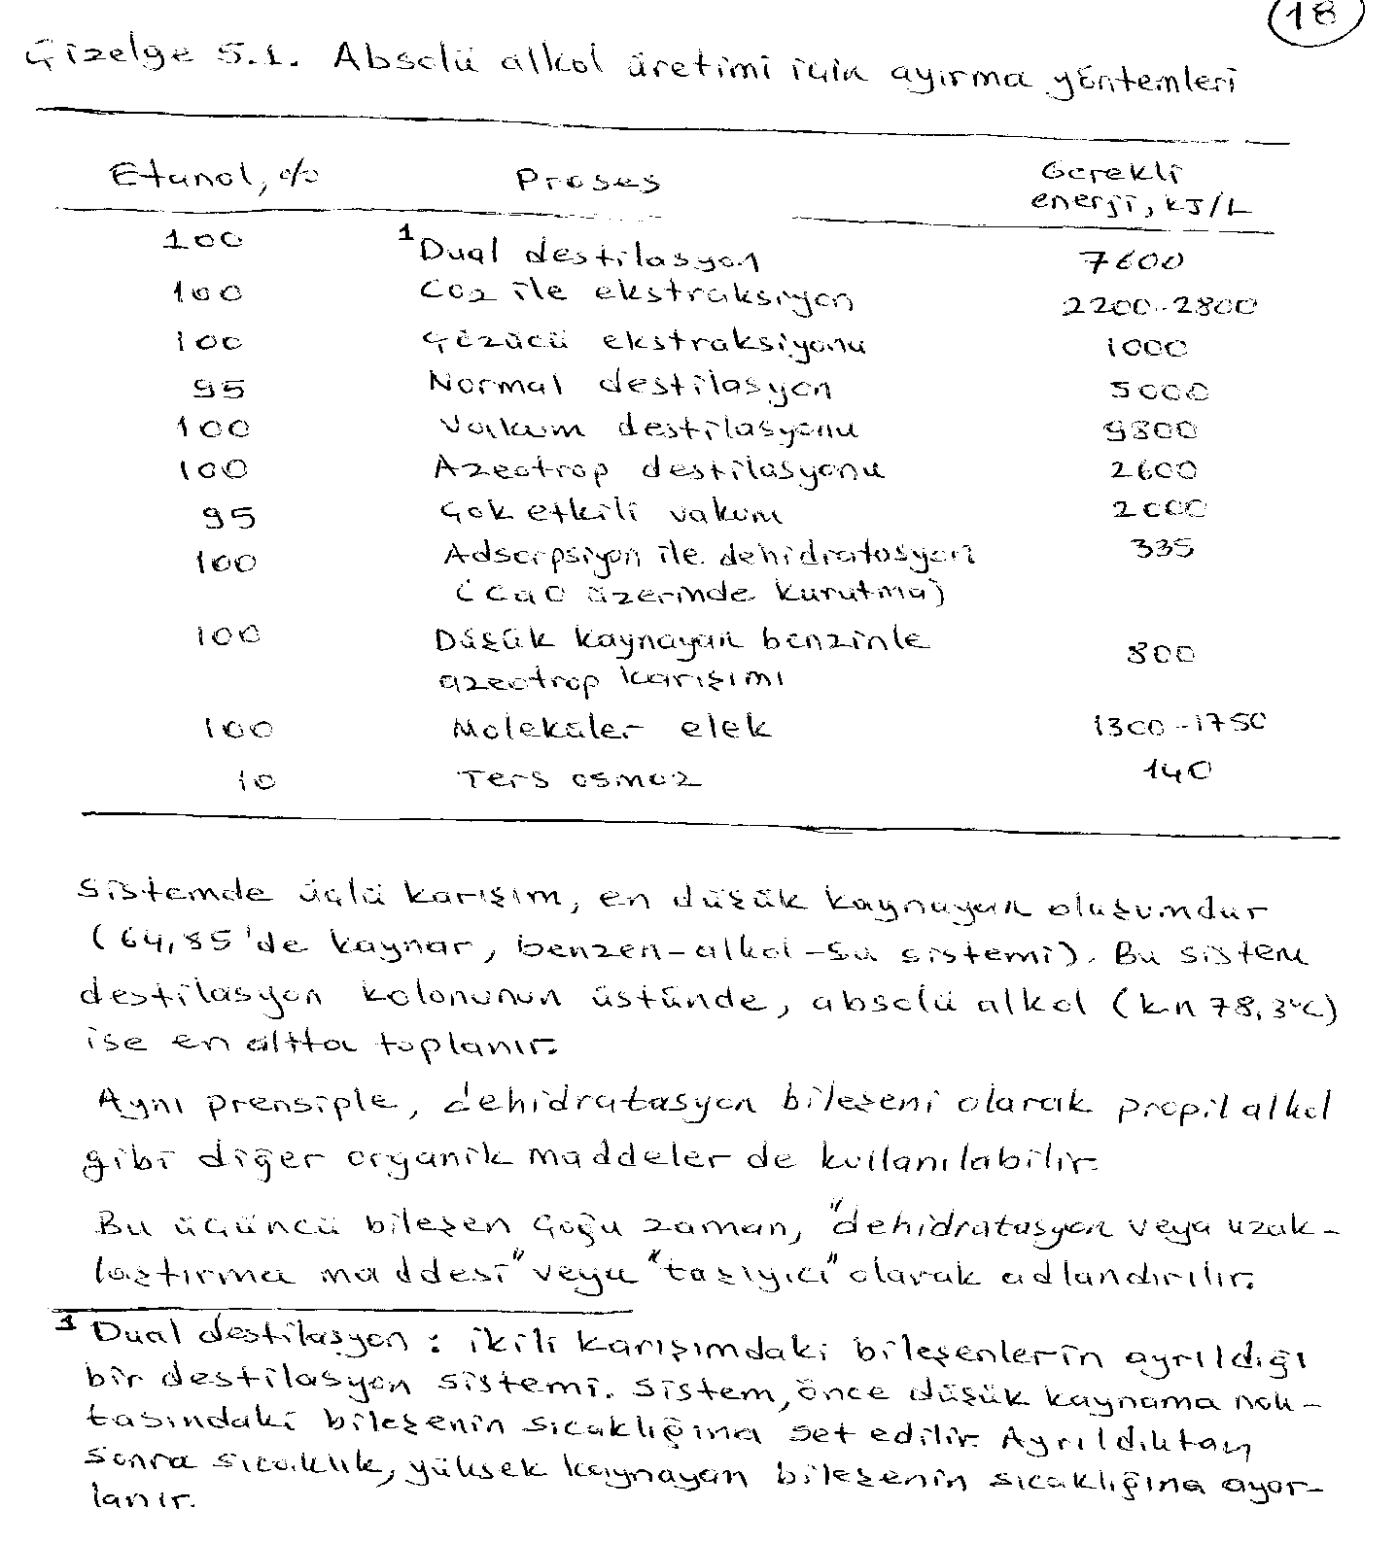

Slide 21
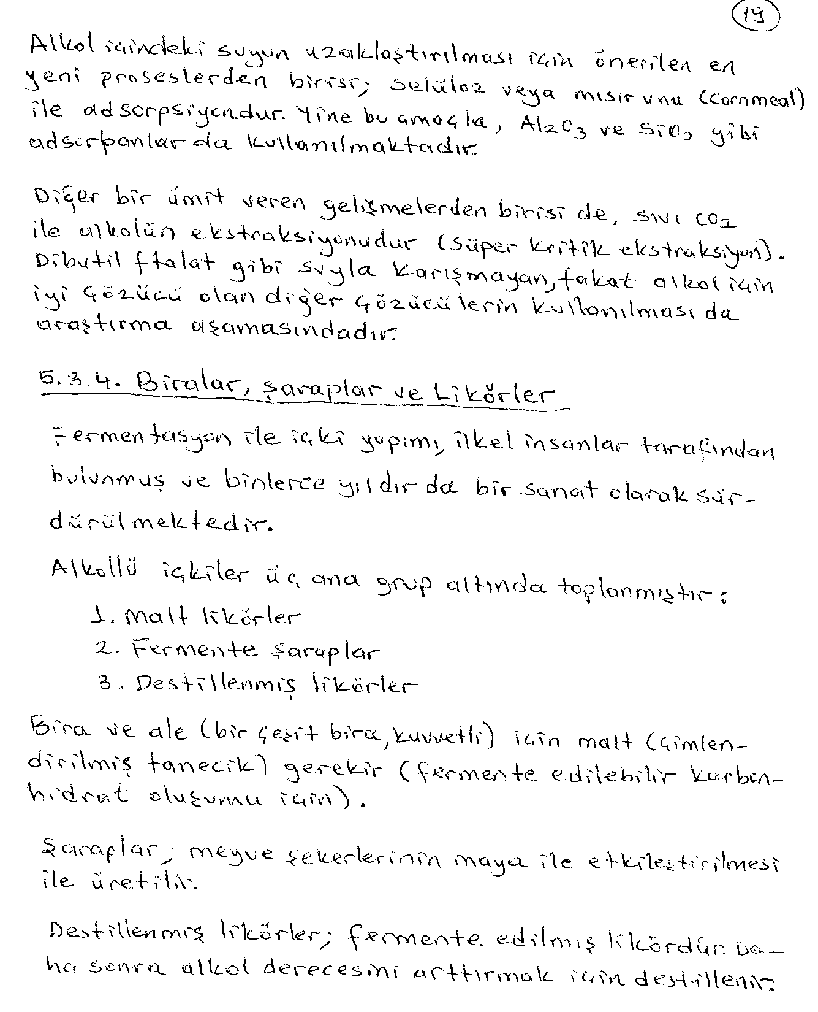

Slide 22
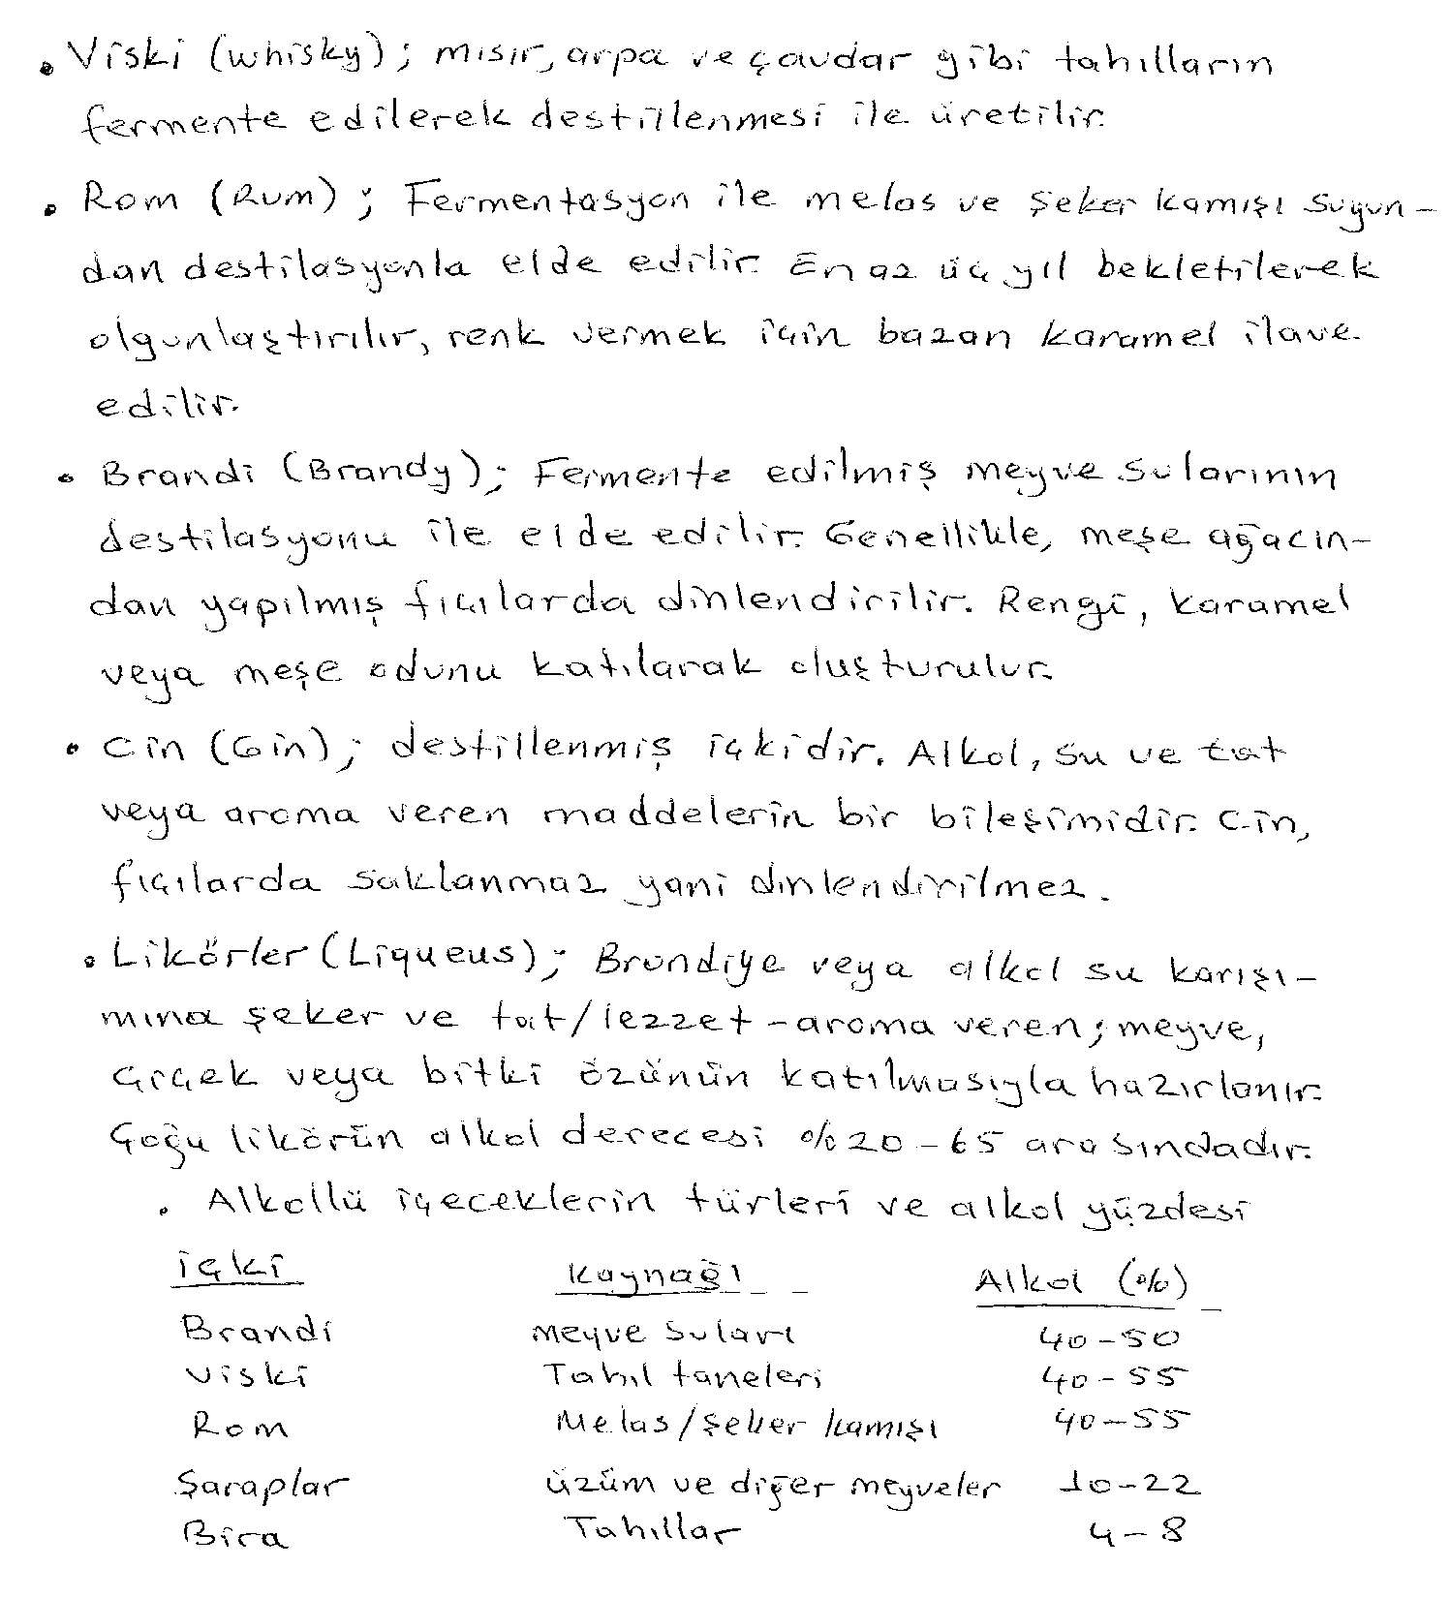

Slide 23
ALCOHOL CONTENT IN VARIOUS BEVERAGES
BEVERAGE | PERCENT ALCOHOL | PROOF
BEER | 4 – 6 | 8 – 12
WINE | 7 – 15 | 14 - 30
CHAMPAGNE | 8 – 14 | 16 – 28
DISTILLED SPIRITS | 40 – 95 | 80 - 190

Slide 24
Alkol fermentasyonu için hammadde kaynakları
Nutrient | Raw material
Carbon
Glucose | Corn sugar, Starch, Cellulose
Sucrose | Sugarcane, Sugar beet molasses
Lactose | Milk whey
Fats | Vegetable oils
Hydrocarbons | Petroleum fractions
Nitrogen
Protein | Soybean meal, Cornsteep liquor, Distillers' solubles
Ammonia | Pure ammonia or ammonium salts Urea
Nitrate | Nitrate salts
Phosphorus source | Phosphate salts
Trace elements : Fe, Zn, Cu, Mn, Mo, Co

Slide 25
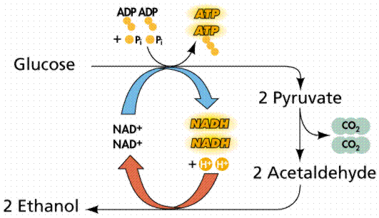
Glikozun fermantasyonu
C₆H₁₂0₆
2CH₃CH₂OH
+
2CO₂
in the presence of yeast

Slide 26
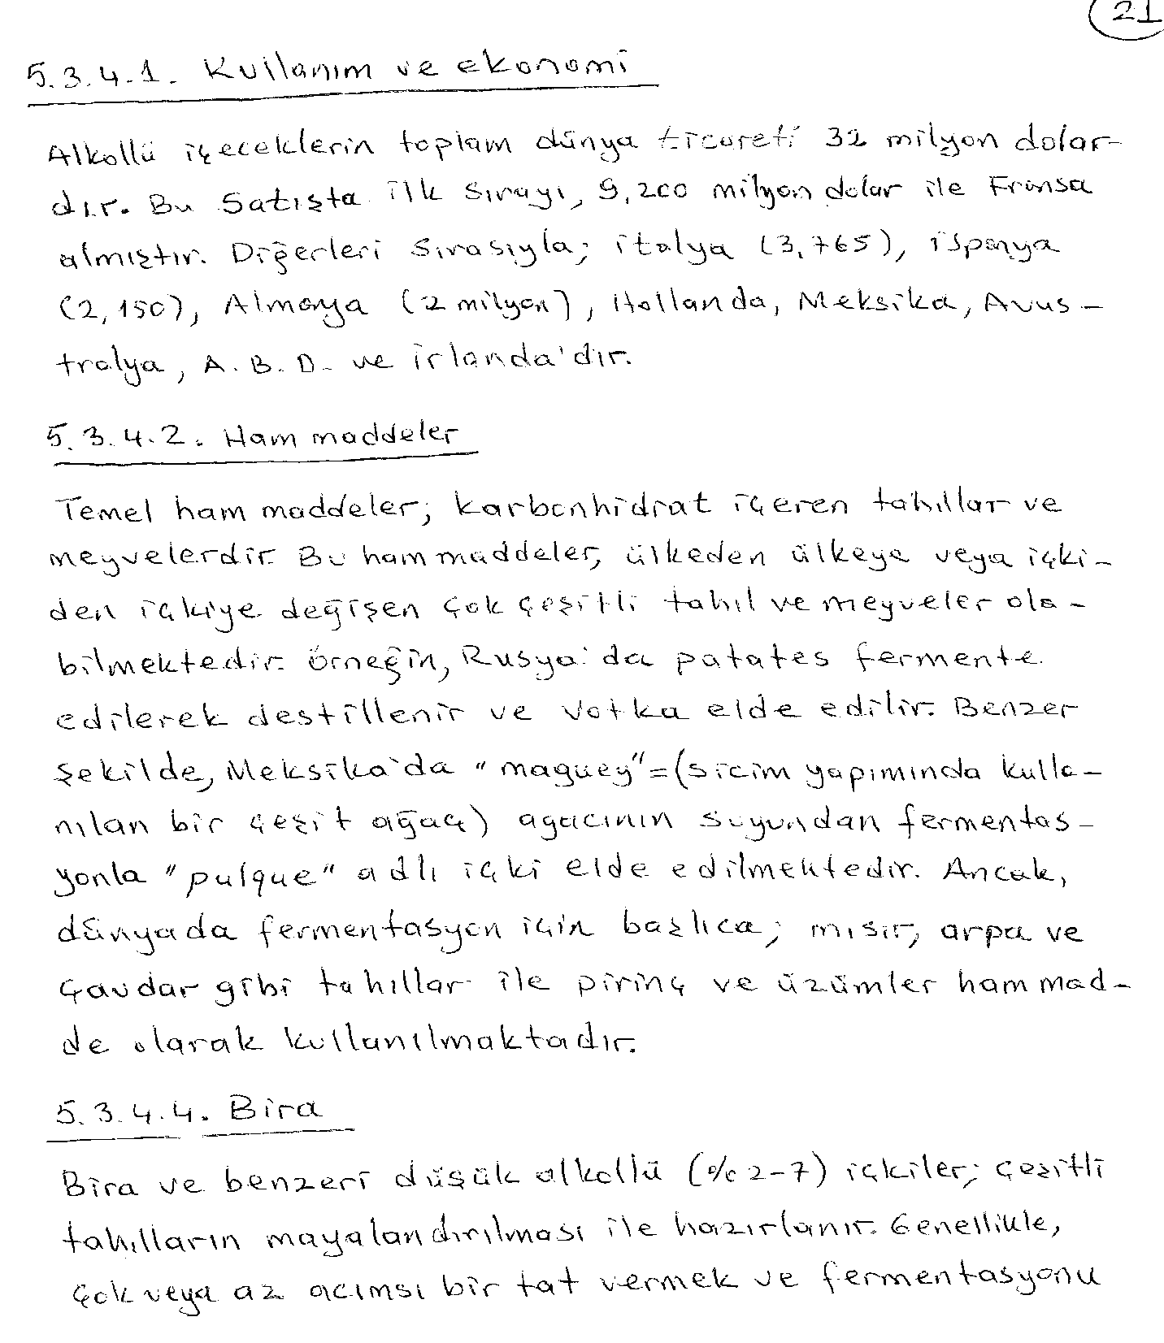

Slide 28
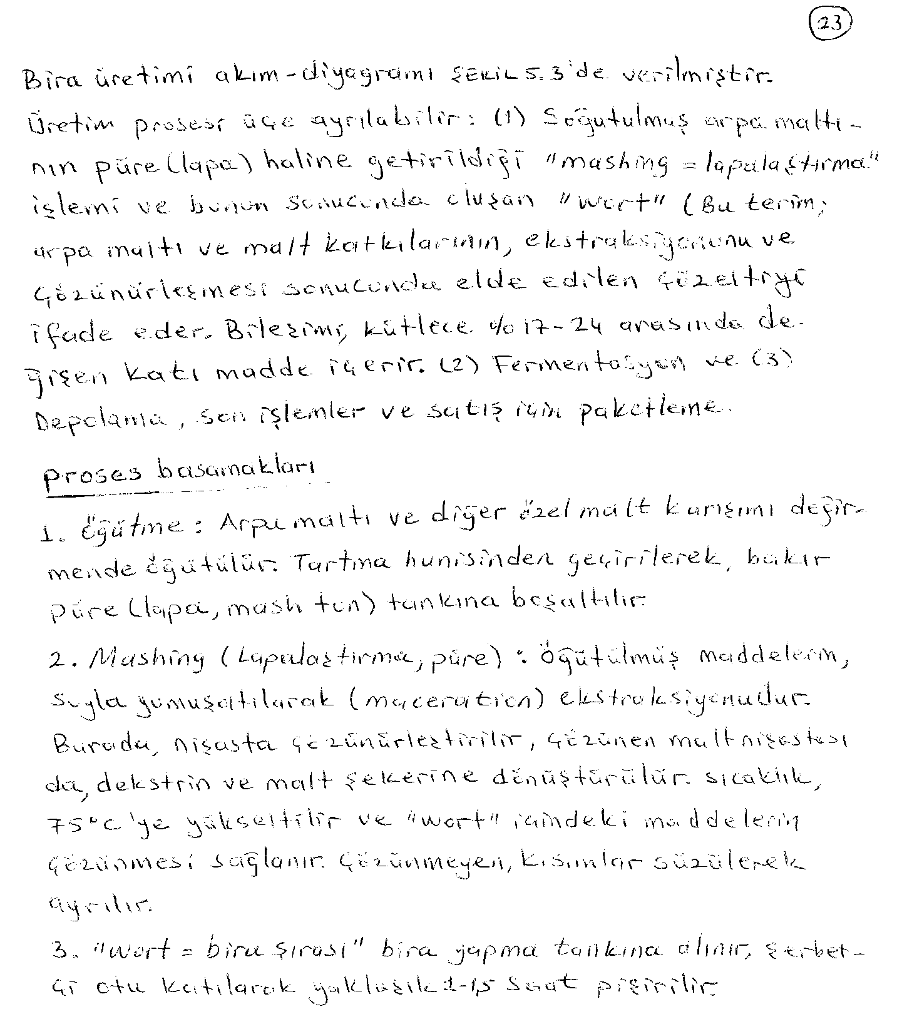

Slide 29
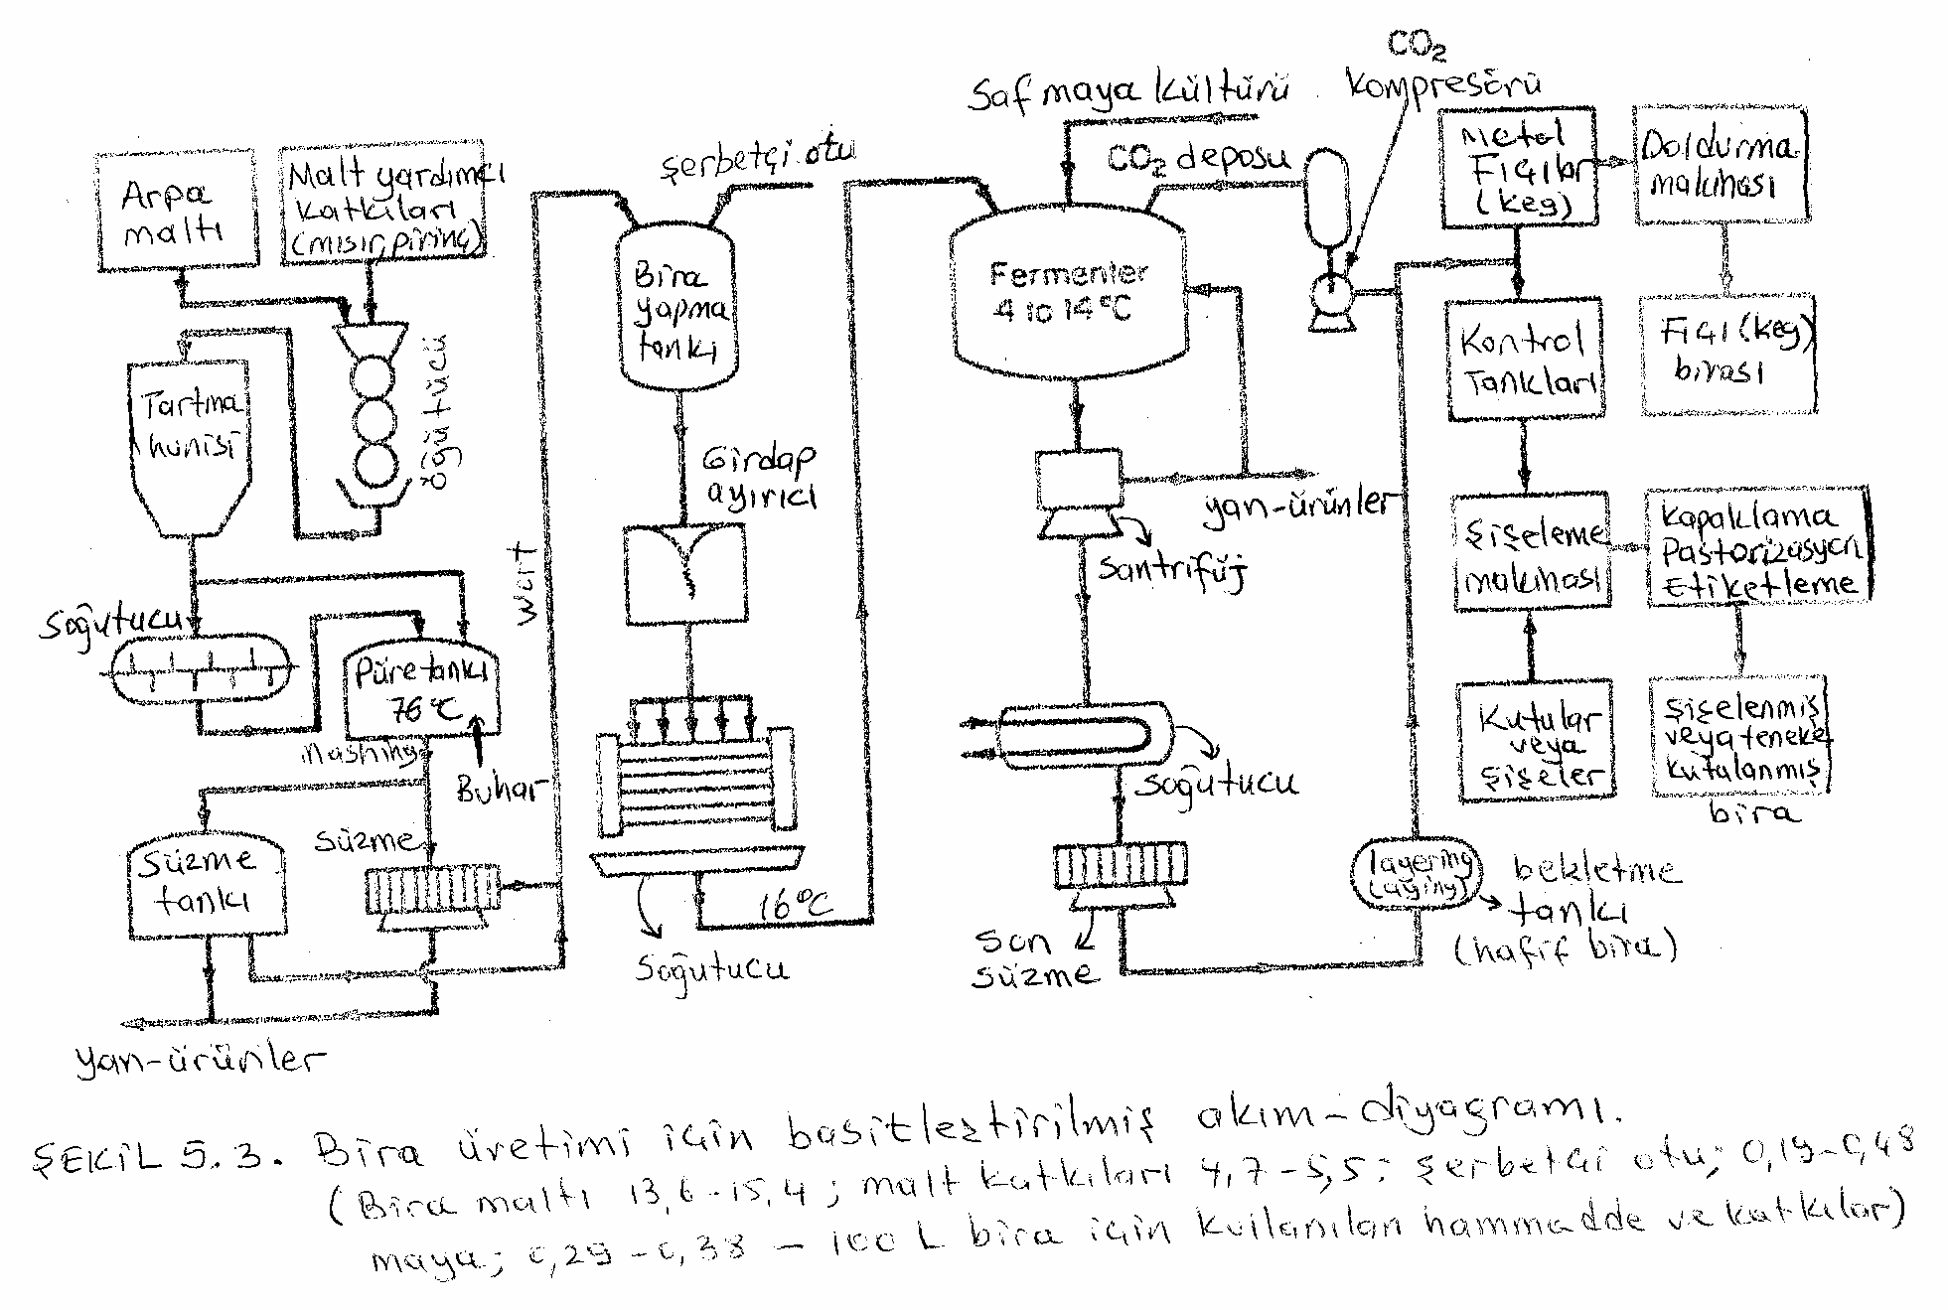

Slide 30
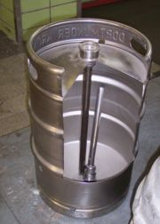
A keg is a metal container (usually constructed of stainless steel) used to hold beer and other alcoholic or non-alcoholic drinks, carbonated or not carbonated, generally under pressure. The keg was introduced in the early 1960's to allow for more efficient cleaning and filling in the brewery.

Slide 31
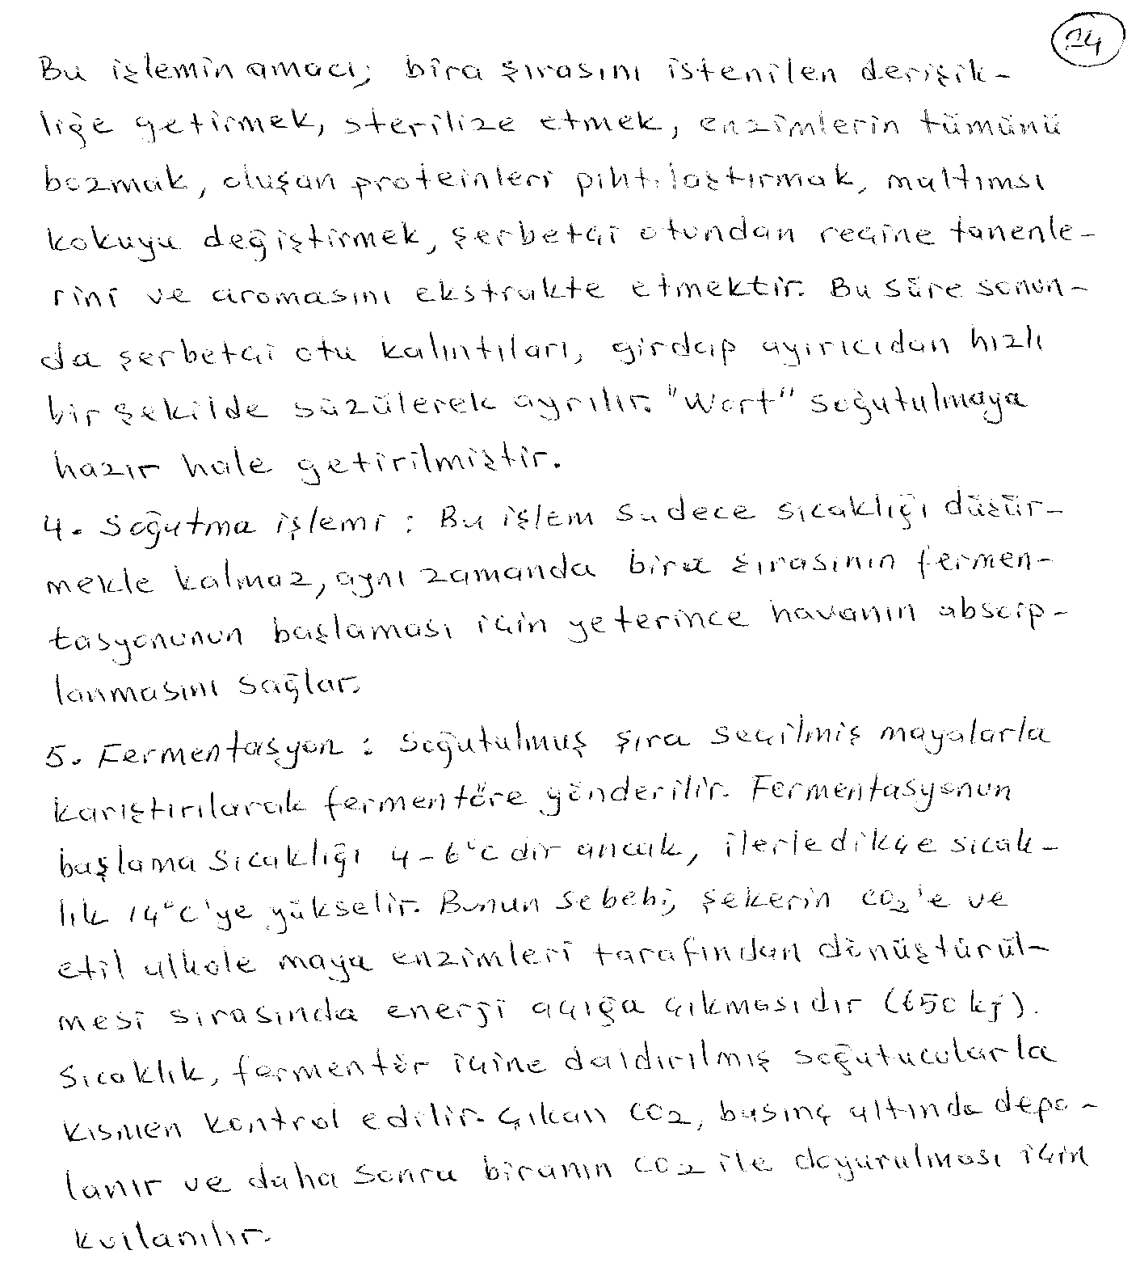

Slide 32
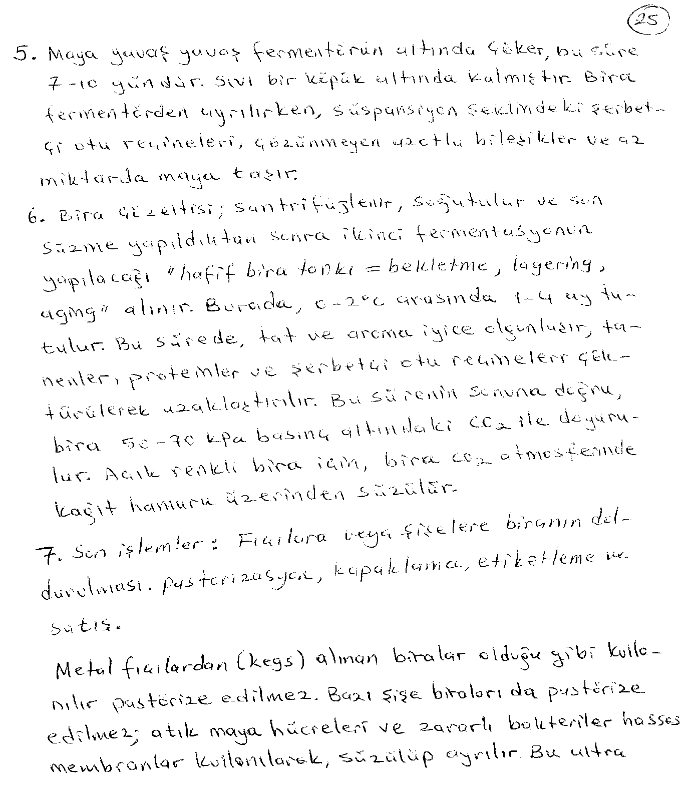

Slide 33
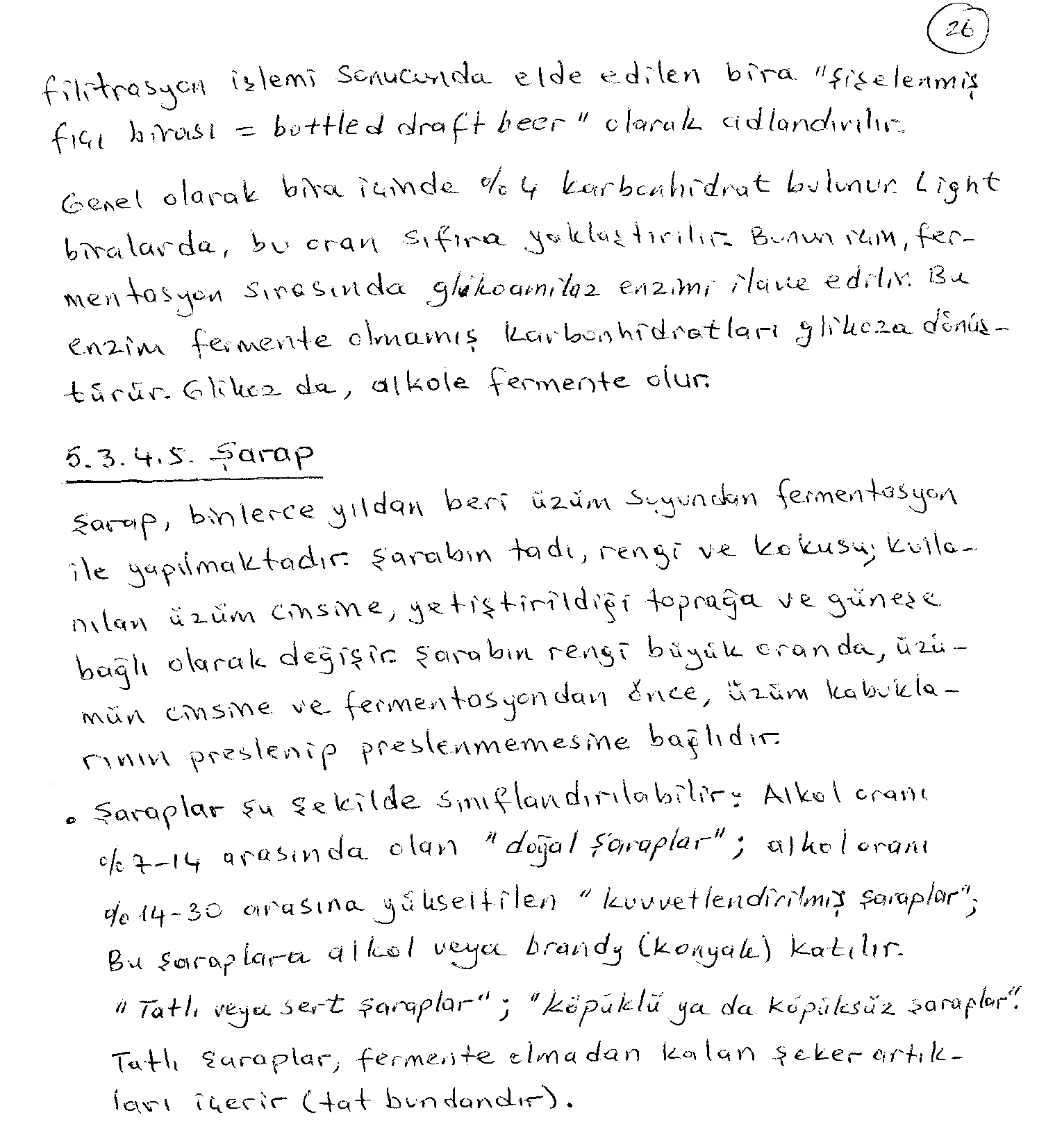

Slide 34
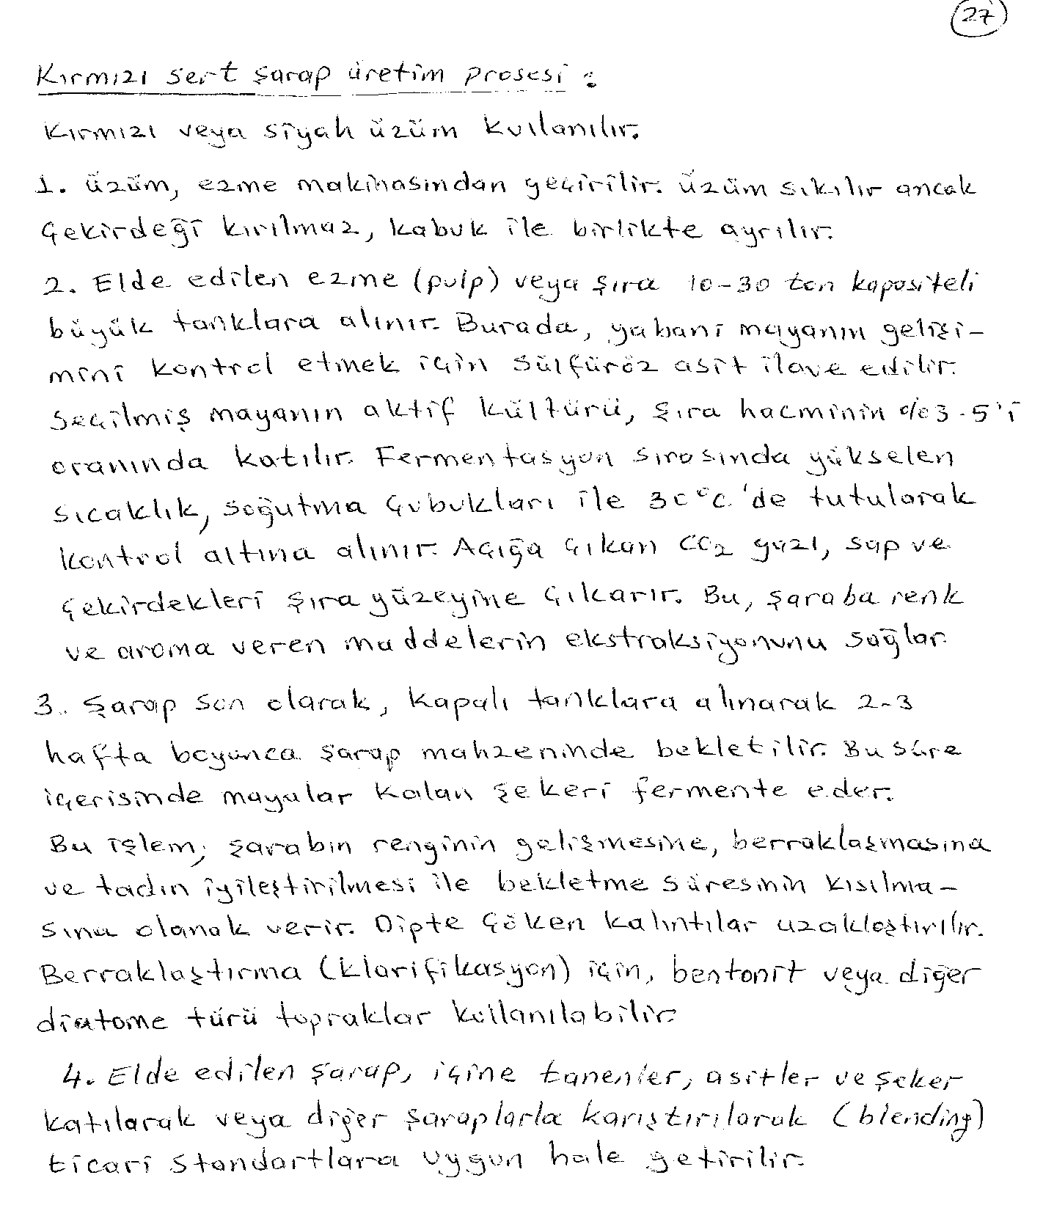

Slide 35
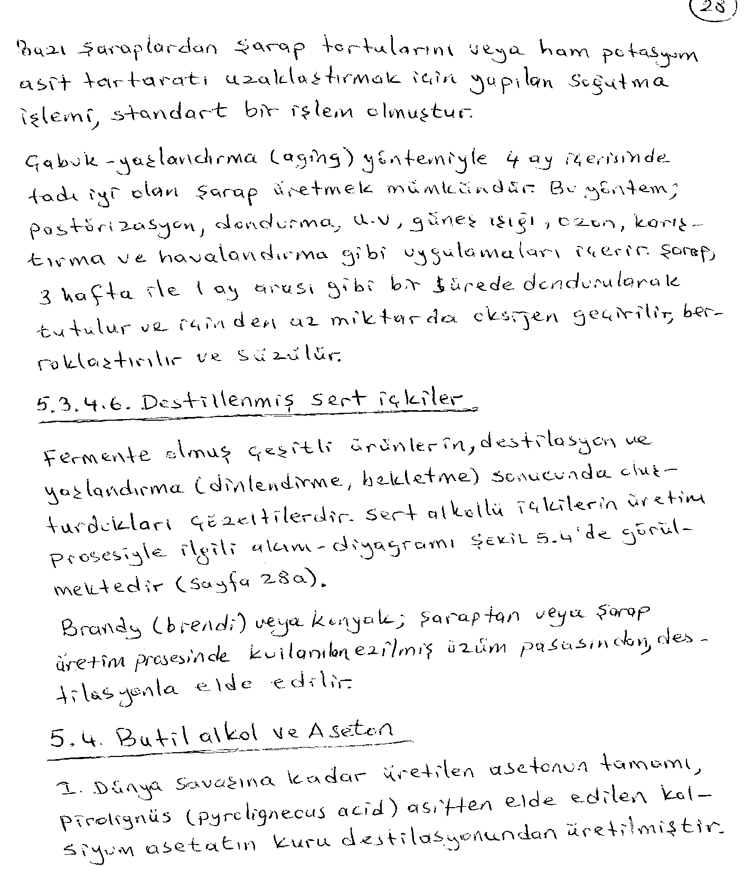

Slide 36
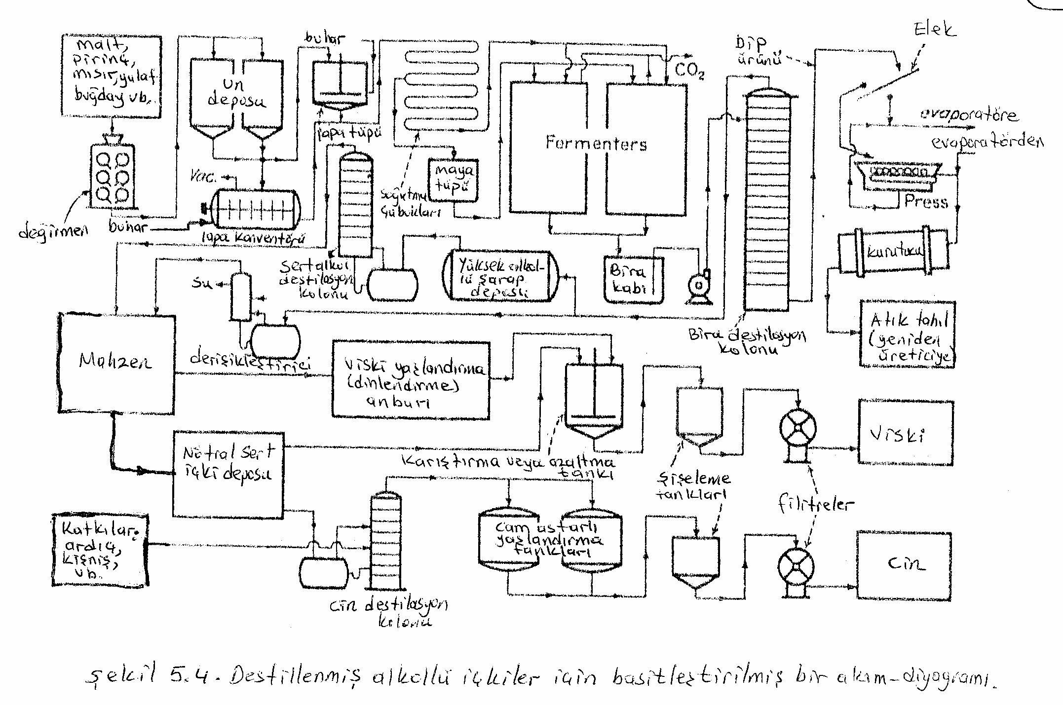

Slide 37
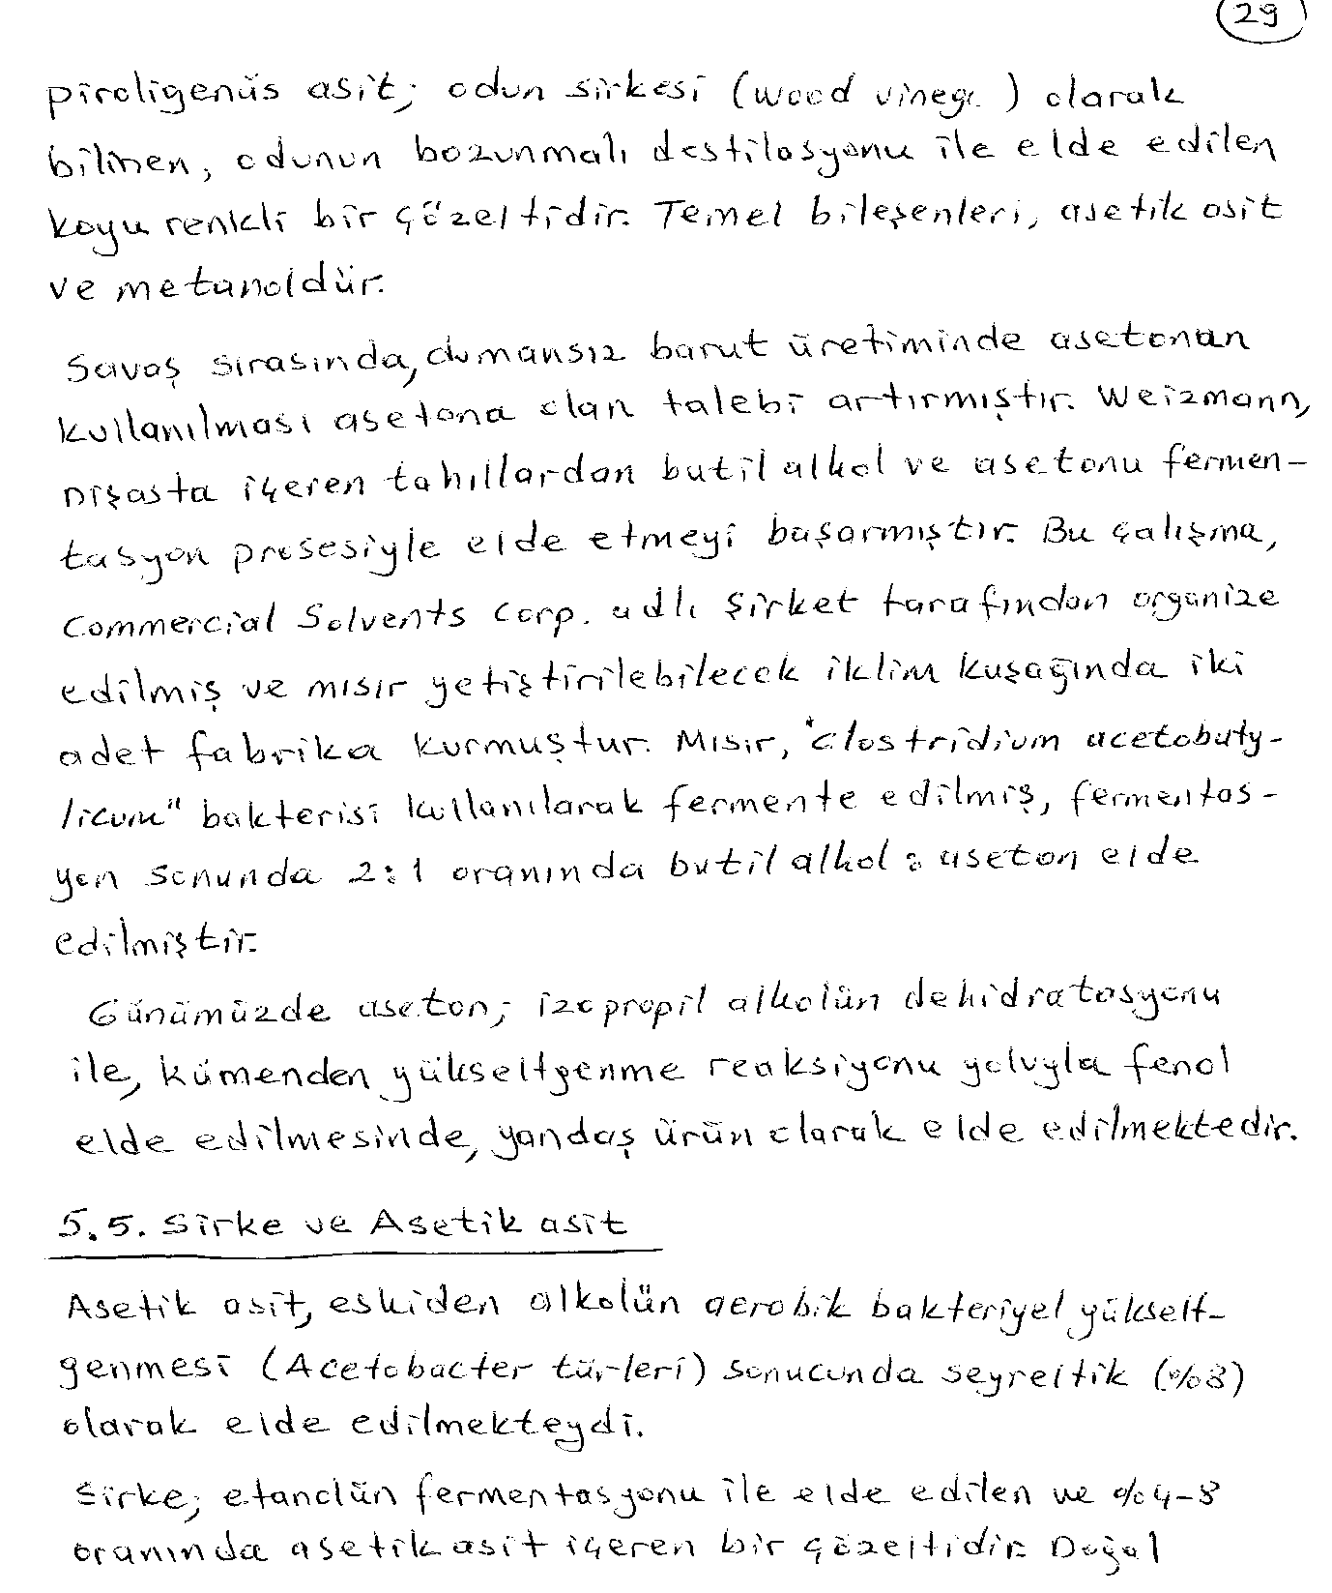

Slide 38
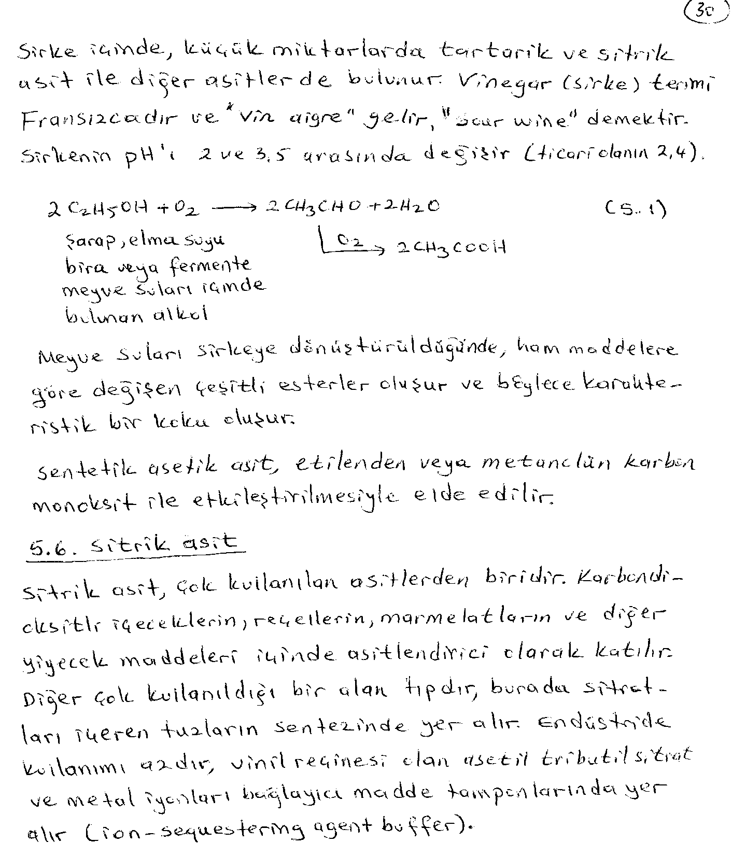

Slide 39
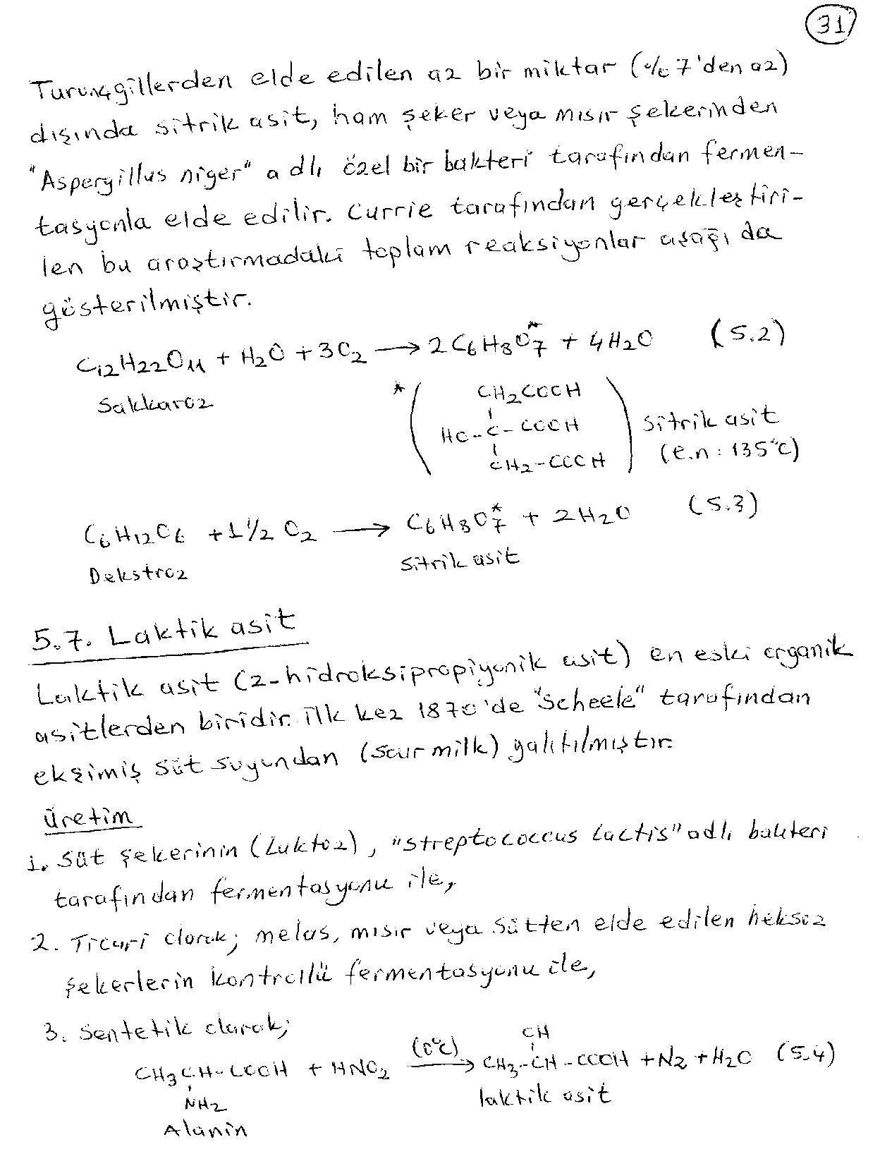

Slide 40
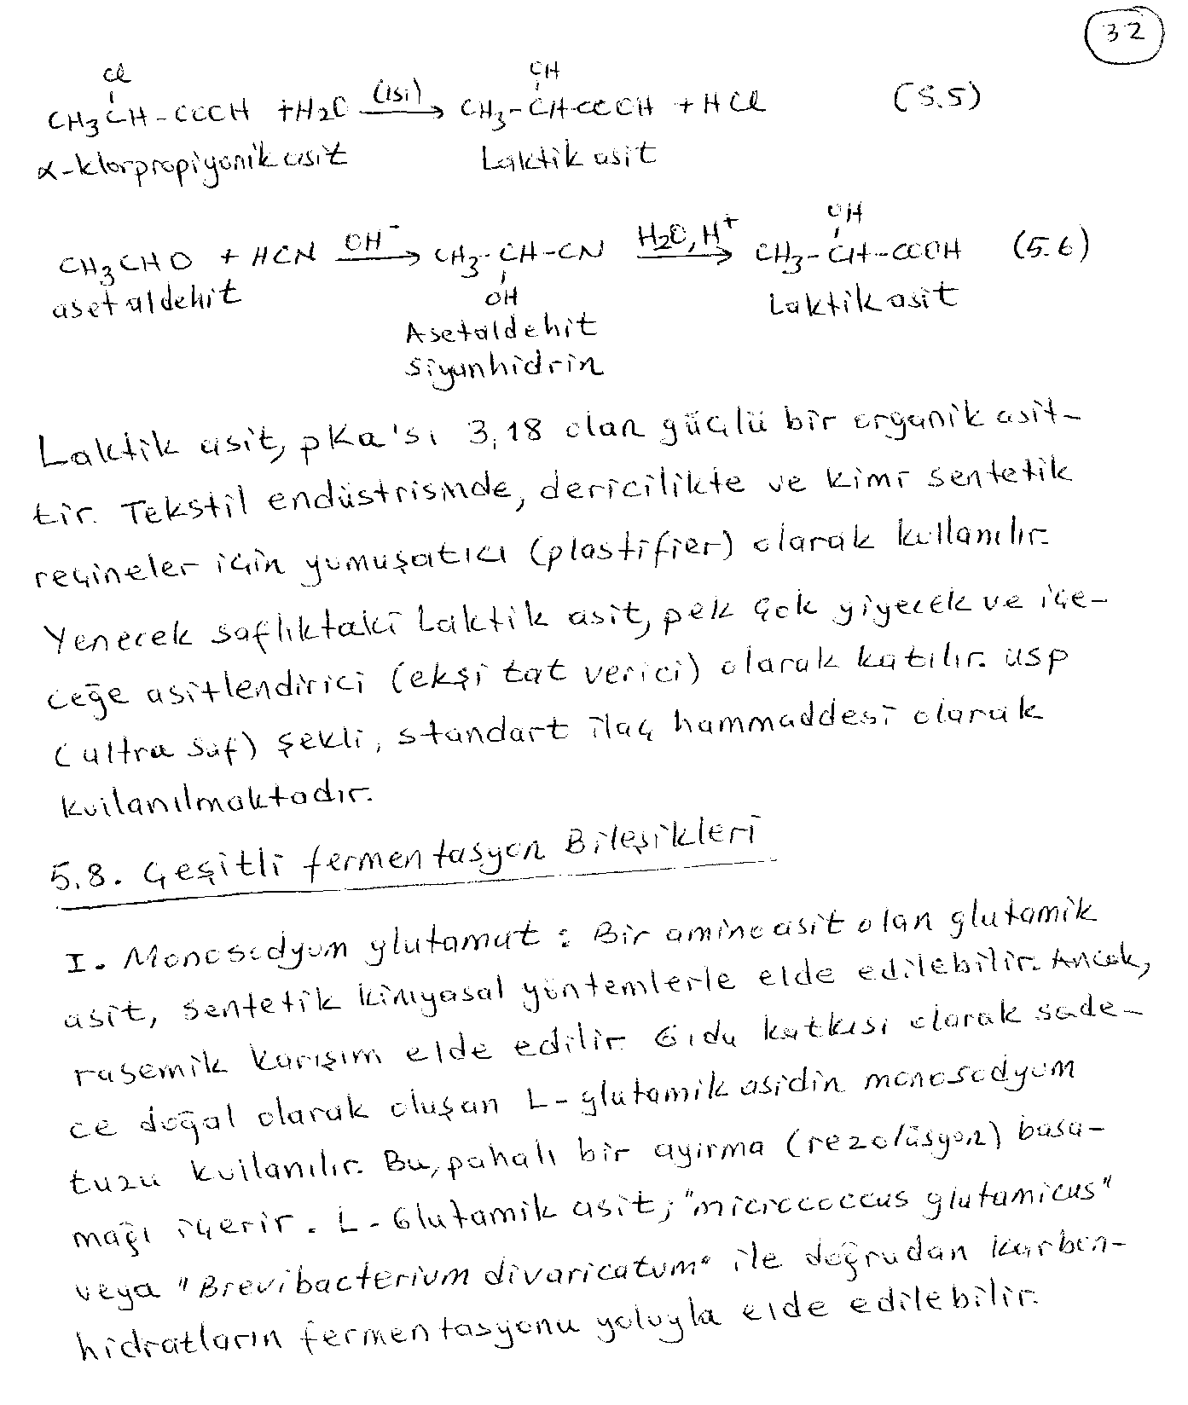

Slide 41
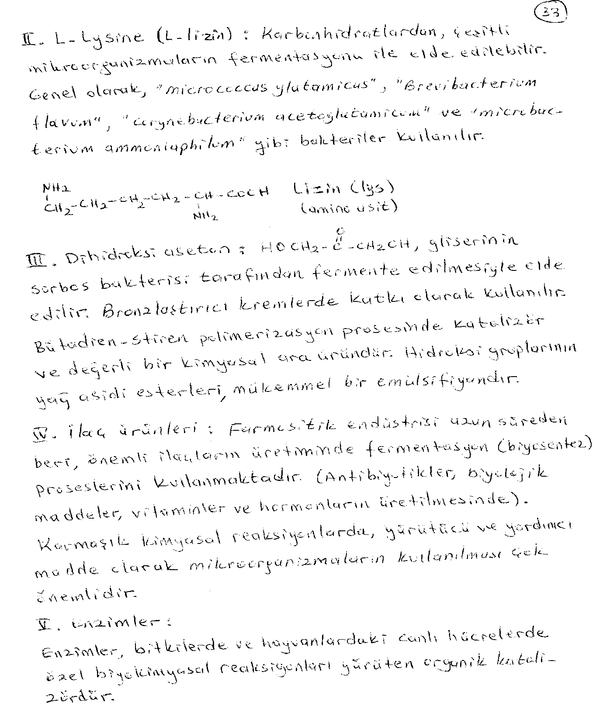

Slide 42
