Slide 1
Polymer Technology
Chapter 3
Polymer Synthesis

Slide 2
Polymer Synthesis
The useful classification of all macromolecules is based on the kinetics of the polymerization reactions and types.
The step-growth polymerization is defined as the polmerization reaction, which includes a random reaction between two molecules that may be any combination of monomer, oligomer, or longer-chain molecule.
With the step-growth polymerization, high-molecular-weight polymer can be formed only near the end of the polymerization reaction when most of the monomer has been reacted or consumed.
With the chain-growth polymerization, the only chain-extension reaction is that of attachment of a monomer to an “active” chain, which is known as radicalic site or ionic site.
High-molecular-weight polymer can be obtained in the early stages of a chain-growth polymerization.

Slide 3
Polymer Synthesis
The step-growth polymerization reaction includes a series of reactions in which any two reacting species (monomers, dimers, trimers, etc.) can react at any time, which leads to a larger molecule.
Most of the step-growth polymerization reactions includes a classical condensation reaction like esterification, ester interchange, or amidization.
With the step-growth polymerization reactions, the stepwise reaction takes place between pairs of chemically reactive or functional groups on the reacting molecules.
Most of the times, the step-growth polymerization reaction is accompanied with the elimination of a small molecule like water as a by-product of the specified reaction.

Slide 4
Polymer Synthesis
A commercial step-growth polymerization of the condensation class is the formation of the commercial polyester via the reaction of a glycol and a dicarboxylic acid, as shown below.
The step-growth polymerization reactions include either one or more types of monomers.
In either case, each reacting unit ‘monomer’ has at least two reactive or functional groups.
In the reaction type, where only one type of monomer is included, the functional groups on the monomer are different and capable of intramolecular reactions.

Slide 5
Polymer Synthesis
In certain cases, where more than one type of reacting units ‘molecule’ is involved, the functional groups on each type of monomer are the same, but capable of intermolecular reaction with the other type of monomer.
This kind of reaction is known as the A–A/B–B step-growth polymerization.
The commerial example for the preparation of A–A/B–B step-growth polymerization can be given with poly(ethylene terephthalate).
The step-growth polymerization reactions can be divided into two main class: polycondensation, where a small molecule is extracted at each step, and polyaddition, where monomers react without the elimination of a small molecule.

Slide 6
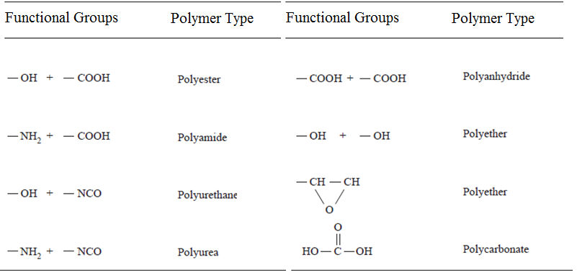
Polymer Synthesis
The functional groups in step-growth polymers is not identical chemically to the structure of the starting monomer(s).

Slide 7
Polymer Synthesis
Polymers with high-molecular-weight structure can be obtained in the step-growth polymerization only if the following reaction conditions are provided
-High monomer conversion
-High monomer purity
-High reaction yield
-Stoichiometric equivalence of functional groups (in A~A/B~B polymerizations)
The reaction rate of the polymerization reaction can be expressed as the time rate of change of monomer concentration.

Slide 8
Polymer Synthesis
It there isno catalyst within the polymerization reaction of type A~A/B~B polymerization, this polymerization rate, which is also defined with the rate of disappearance of monomer, is second-order in monomer concentration, as given by the expression:
In which k is the polymerization reaction rate constant and the brackets illustrates monomer concentration of A-A and B-B types.
The number-average degree of polymerization is a function of time.
For a second-order step-growth reaction, the number-average degree of polymerization

Slide 9
Polymer Synthesis
In contrast to the step-growth polymerization reactions, the chain-growth polymerization reactions require the presence of an initiating or a starting molecule that can react with a monomer molecule at the start of the polymerization reaction.
The initiating or the starting species can be a radical, anion, or cation.
The polymerization reactions of free-radical, anionic, and cationic type share three common steps :
initiation,
propagation,
termination.
With the chain-growth polymerization of vinyl monomers, the polymerization mechanism depends on the chemical nature of the substituent group.

Slide 10
Polymer Synthesis
Similar to other chain-growth polymerizations, the free-radical polymerization has three common reaction steps:
-Initiation of the active monomer
-Propagation or growth of the active chain by sequential addition of other monomers
-Termination of the active chain to give the final macromolecular product
The dissociation of the initiator molecule to result two free-radical initiator species (I•) can be illustrated as following:
Initiator molecules for free-radical polymerization reactions are any organic compound with a chemical group capable of cleavage like azo (–N=N–), disulfide (–S–S–), or peroxide (–O–O–) compound.

Slide 11
Polymer Synthesis
Then comes the second step of initiation, which is known as an association step.
At the step of the initiation reaction, a monomer molecule (M) is attached to the initiator radical, which can be represented as
Then comes the propogation step.
In this step, additional monomer units are attached to the initiated monomer species as shown below:
Additional monomers are attached sequentially during the propagation step of the chain growth reaction, as shown below:

Slide 12
References
Robert O. Ebewele, «POLYMER SCIENCE AND TECHNOLOGY», CRC Press, 2000.
Fried, Joel R., «Polymer science and technology», Prentice Hall, Third edition.

