Slide 1
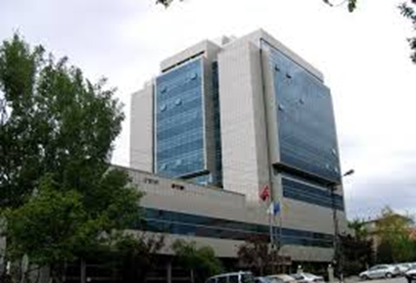
History Taking and Physical Examination of Cardiovascular System-The Essentials
Assoc.Prof, D. Menekşe Gerede Uludağ
Ankara University School of Medicine, Department of Cardiology

Slide 2
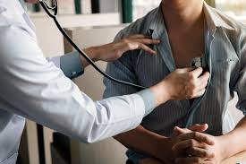
History taking & Physical Examination
Fundamental to accurate diagnosis!
Cheap, fast, and powerful tools!!

Slide 3
Opening the consultation/ Warm up
Introduce yourself – name / role
Confirm patient details – name / DOB
Explain the need to take a history & PE
Informed consent
Ensure the patient is comfortable

Slide 4
The history/Anamnesis taking process..
History of presenting complaint
Past medical history
Drug history
Family history
Social history
Systemic enquiry
Summarizing
Provisional diagnosis based on history

Slide 5
Presenting complaint
It’s important to use open questioning to elicit the patient’s presenting complaint
“What’s your complaint?” or “Tell me about your symptoms”
Allow the patient time to answer, trying not to interrupt or direct the conversation.
Facilitate the patient to expand on their presenting complaint if required.
“Ok, so tell me more about that” or “Can you explain what that pain was like?”

Slide 6
A patient with a cardiological problem is likely to have one or more of six main symptoms:
chest pain/discomfort
shortness of breath/dyspnea
fatigue
palpitations
syncope
edema

Slide 7
Other symptoms..
Cough
Hemoptysis
Cyanosis
Claudication
Limb pain
Skin discoloration
can indicate a vascular disorder !!

Slide 8
History of presenting complaint
Onset – When did the symptom start? / Was the onset acute or gradual?
Duration – minutes / hours / days / weeks / months / years
Severity – e.g. if symptom is chest pain, how bad is it on a scale of 1 to 10?
Course – is the symptom worsening, improving, or continuing to fluctuate?
Intermittent or continuous – is the symptom always present or does it come and go?
Precipitating factors – are there any obvious triggers for the symptom?
Relieving factors – does anything appear to improve the symptoms e.g. GTN spray
Associated features –are there other symptoms that appear associated e.g. fever / malaise
Previous episodes – has the patient experienced this symptom previously?

Slide 9
If the chest pain is a major symptom..
Pain – if the pain is a symptom, clarify the details of the pain using SOCRATES acronym.
Site – where is the pain?
Onset – when did it start? / sudden vs gradual?
Character – sharp / dull ache / burning
Radiation – does the pain move anywhere else?
Associations – other symptoms associated with the pain?
Time course – worsening / improving / fluctuating / time of day dependent
Exacerbating / Relieving factors – anything make the pain worse or better?
Severity – on a scale of 0-10, how severe is the pain?

Slide 10
The history taking process..
History of presenting complaint
Past medical history
Drug history
Family history
Social history
Systemic enquiry
Summarizing
Provisional diagnosis based on history

Slide 11
Past medical history (Disease or risk factor)
Cardiovascular disease:
Angina
Myocardial infarction – bypass grafts / stents
Atrial fibrillation
Stroke
Peripheral vascular disease
Hypertension
Hyperlipidemia
Rheumatic fever
Habits- smoking, alcohol, drugs
Other medical conditions – e.g. hyperthyroidism
Surgical history – bypass graft / stents / valve replacements
Acute hospital admissions? – when and why?

Slide 12
Drug history
Cardiovascular medications:
Beta blockers
Calcium channel blockers
ACE inhibitors
Diuretics
Statins
Antiplatelets
Anticoagulants
Glyceryl trinitrate spray (GTN spray)
Other regular medications
Contraceptive pill – increased risk of thromboembolic disease
Over the counter drugs – NSAIDS / Aspirin
Herbal remedies – e.g. St John’s Wort – enzyme inducer (can affect Warfarin levels)
ALLERGIES – ensure to document these clearly

Slide 13
Family history
Cardiovascular disease at a young age
(for men <55 years old, for women <65 years old in first degree relatives)– myocardial infarction
Are the parents still in good health? –
if deceased sensitively determine age and cause
of death
Any unexplained deaths in young relatives? –
e.g. long QT syndrome / channelopathies

Slide 14
Social history
Smoking – How many cigarettes a day? How many years have they smoked for?
Alcohol – How many units a week? – type / volume / strength of alcohol
Recreational drug use – e.g. Cocaine – coronary artery vasospasm
Diet – Overweight? Fatty foods? Salt intake? – cardiovascular risk factors
Exercise – baseline level of patient’s day to day activity
Living situation:
House/bungalow? – adaptations / stairs
Who lives with the patient? – is the patient supported at home?
Any carer input? – what level of care do they receive?
Activities of daily living:
Is the patient independent and able to fully care for themselves?
Can they manage self hygiene / housework / food shopping?
Occupation– sedentary jobs – ↑ cardiovascular risk – e.g. lorry driver

Slide 15
Systemic enquiry
Systemic enquiry involves performing a brief screen for symptoms in other body systems.
This may pick up on symptoms the patient failed to mention in the presenting complaint.
Some of these symptoms may be relevant to the diagnosis (e.g. reduced urine output in dehydration).

Slide 16
Systemic enquiry
Cardiovascular – Chest pain / Palpitations / Dyspnea / Syncope / Orthopnea / Peripheral oedema
Respiratory – Dyspnea / Cough / Sputum / Wheeze / Haemoptysis / Chest pain
GI – Appetite / Nausea / Vomiting / Indigestion / Dysphagia / Weight loss / Abdominal pain / Bowel habit
Urinary – Volume of urine passed / Frequency / Dysuria / Urgency / Incontinence
CNS – Vision / Headache / Motor or sensory disturbance/ Loss of consciousness / Confusion
Musculoskeletal – Bone and joint pain / Muscular pain
Dermatology – Rashes / Skin breaks / Ulcers / Lesions

Slide 17
Closing the consultation
Thank the patient!
Summarise the history!

Slide 18
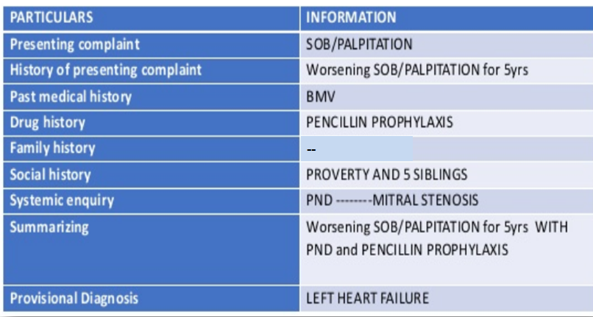
An example: Mitral stenosis

Slide 19
PHYSİCAL EXAMINATION OF CARDIOVASCULAR SYSTEM

Slide 20
Physical Examination of Cardiovascular system
General appearance/Inspection of the patient
Measurement of the blood pressure
Examination of the arterial pulse
The examination of jugular vein
The examination of the precordium
The examination of edema

Slide 21
General Appearance
The physical examination, including the general appearance of the patient, is an extremely important component of cardiology examinations!!
It begins as soon as the physician sees the patient.
Breathlessness, signs of anxiety or discomfort, cyanosis, jaundice, and anaemia are very important.
Important clues to a cardiac diagnosis can be obtained from inspection of the patient.

Slide 22
The examination begins with an evaluation of the general appearance of the patient, including;
His/her age
Height, weight
Posture (sitting or lying)
Demeanor/behavior
Respiratory pattern

Slide 23
Chest shape (pectus excavatum, pectus carinatum)
Skin color (pallor: anemia, cyanosis: peripheral or central, jaundice)
Extremities (edema, clubbing, splinter haemorrhages, peripheral cyanosis)
Face (xanthelasma, telangiectasia, high facial colouring, central cyanosis and corneal arcus (abnormal below the age of 50)).
Conjunctivae (anaemia, jaundice and conjunctival haemorrhages, and the tongue examined for cyanosis)

Slide 24
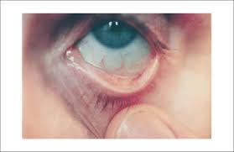
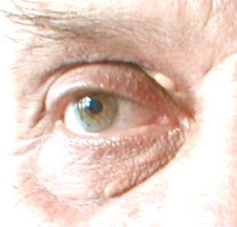
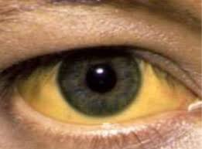
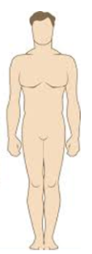
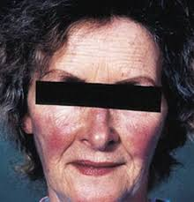
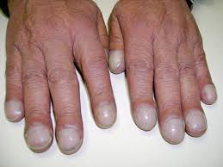
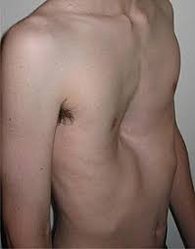
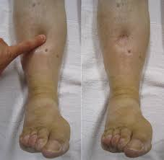
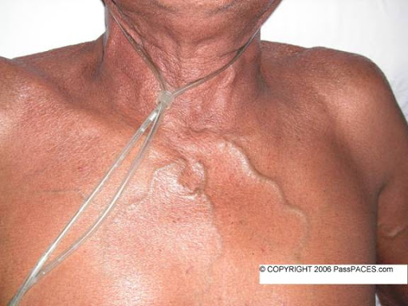
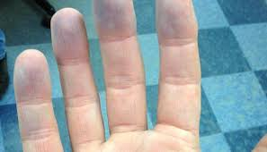
Pallor of conjunctiva: anemia
Jaundice
Xanthelesma: HL
Central cyanosis
Facial rush
Clubbing
Pectus carinatum
Cutaneous venous collaterals
Acrocyanosis
Edema

Slide 25
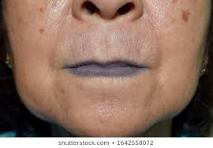
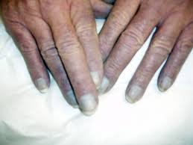
Cyanosis
Cyanosis is a bluish discoloration of the skin and mucous membranes resulting from abnormal perfusion by either an increased amount of reduced hemoglobin or abnormal hemoglobin.
Central
Peripheral
Differential

Slide 26
Central cyanosis is characterized by decreased arterial oxygenation (in arterial saturation ≤ 85%). It is present with significant right-to-left shunting at the level of the heart or lungs, which allows deoxygenated blood to reach the systemic circulation.It is also a feature of hereditary methemoglobinemia.
Peripheral or acrocyanosis of the fingers, toes, nose, and ears reflects reduced blood flow because of small vessel constriction seen in severe heart failure, shock, or peripheral vascular disease.
Differential cyanosis affecting the lower but not the upper extremities occurs with a patent ductus arteriosus (PDA) and pulmonary artery (PA) hypertension with right-to-left shunting at the great vessel level.

Slide 27
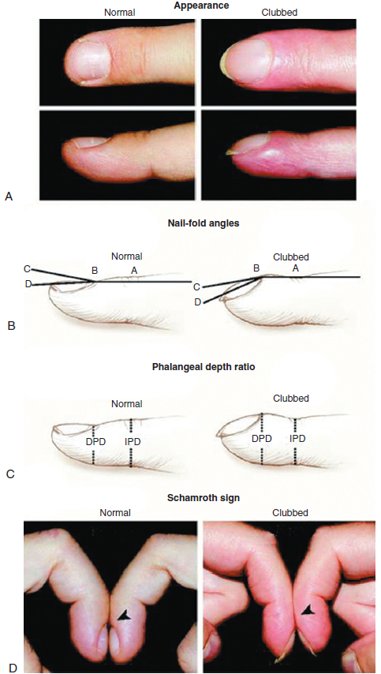
Clubbing
Clubbing refers to the swelling of the soft tissue of the terminal phalanx of a digit with subsequent loss of the normal angle between the nail and the nail bed.
The clubbed finger on the right shows increased profile and increased nail fold angles.
Distal phalangeal finger depth (DPD)–interphalangeal finger depth (IPD) represents the phalangeal depth ratio.
In normal fingers, the IPD is greater than the DPD. In clubbing, this relationship is reversed. DPD>IPD
‘’Schamroth sign’’→ In the absence of clubbing, nail to nail opposition of the index fingers creates a diamond-shaped window. In clubbed fingers, the loss of the profile angle caused by the increase in tissue at the nail bed causes obliteration of this space.
Braunwald, 9. Edition, 2013

Slide 28
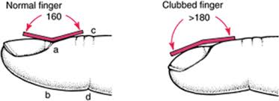
Causes of Clubbing
Pulmonary malignancy
Chronic infection (or inflammation): bronchiectasis, lung abscess, empyema, pulmonary tuberculosis, infective endocarditis, crohn disease
Cyanotic congenital heart disease
Rutherford, Circulation. 2013;127:1997–1999

Slide 29
Clinical Clues to Specific Cardiac Abnormalities Detectable from the General Examination (some examples)
Condition | Appearance | Associated Cardiac abnormalities
Marfan syndrome | Tall, Long extremities | Aortic root dilatation, Mitral valve prolapse
Jaundice | Yellow skin or sclera | Right-sided congestive heart failure, Prosthetic valve dysfunction (hemolysis)
Thoracic bony abnormality | Pectus excavatum Straight back syndrome | Mitral valve prolapse
Pickwickian syndrome | Severe obesity, Somnolence | Pulmonary hypertension
Right-to-left intracardiac shunt | Cyanosis and clubbing of distal extremities, Differential cyanosis and clubbing | Any of the lesions that cause Eisenmenger syndrome, Reversed shunt through patent ductus arteriosus
Anaemia | Pallor of the conjunctivae | Chronic heart failure
Down syndrome | Mental retardation Simian crease of palm Characteristic facies | Endocardial cushion defect
Scleroderma | Tight, shiny skin of fingers with contraction Characteristic taut mouth and facies | Pulmonary hypertension

Slide 30
Physical Examination of Cardiovascular system
General appearance/Inspection of the patient
Measurement of the blood pressure
Examination of the arterial pulse
The examination of jugular vein
The examination of the precordium
The examination of edema

Slide 31
Measurement of the blood pressure
Blood pressure should always be measured in both arms.
If systolic blood pressure differs between arms by more than 10 mm Hg, it is abnormal.

Slide 32
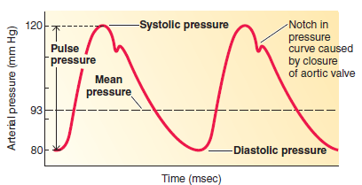
Arterial blood pressure
Sherwood, Fundamentals of Human Physiology, 4.edition, CH 10, 2012

Slide 33
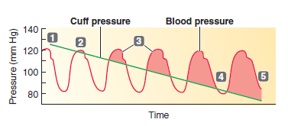
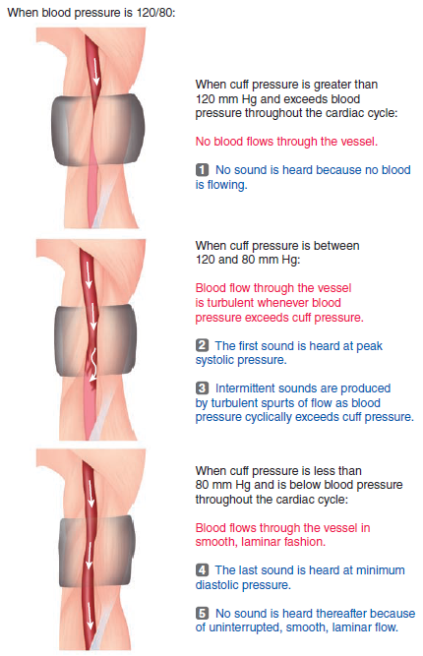
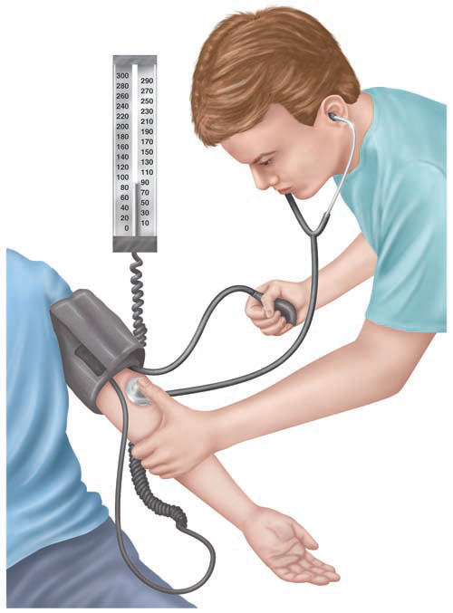
Measuring blood pressure
Use of a sphygmomanometer in determining blood pressure
Blood flow through the brachial artery in relation to cuff pressure and sounds

Slide 34
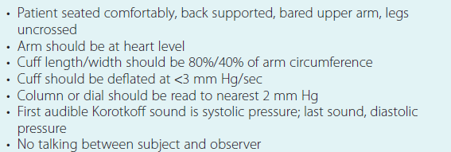
Important aspects of blood pressure measurements
Braunwald’s Heart Disease, 9. Ed, 2013

Slide 35
Physical Examination of Cardiovascular system
General appearance/Inspection of the patient
Measurement of the blood pressure
Examination of the arterial pulse
The examination of jugular vein
The examination of the precordium
The examination of edema

Slide 36
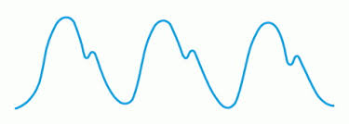
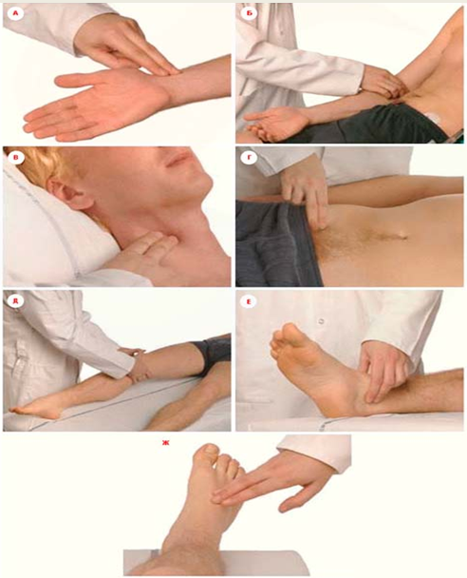
Examination of the pulse and heart rate
A pulse wave is produced by ventricular contraction during systole.
Three finger method: palpation with 2nd–4th fingertips
Palpation of the common carotid artery, radial artery, femoral artery, popliteal artery, tibialis posterior artery, and dorsalis pedis artery.
The thumb of the examiner should never be used to take the pulse as it has its own strong pulse, which might be mistaken for the patient's pulse!

Slide 37
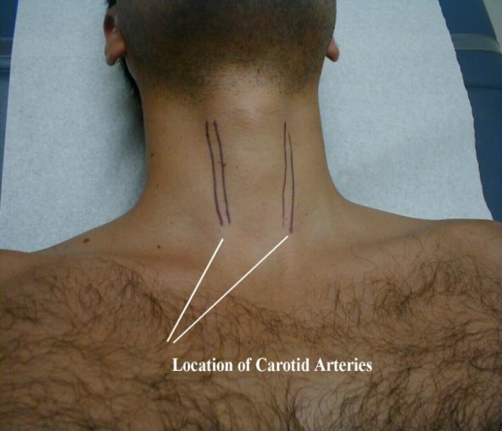
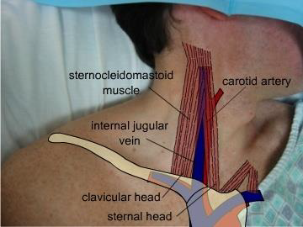
Carotid Arteries
The pulse of the carotid artery should never be palpated bilaterally and simultaneously!
Each side separately!
Risk of compression of vessels → cerebral hypoperfusion → syncope
Risk of hyperstimulation of the carotid sinus reflex → bradycardia/low blood pressure → cerebral hypoperfusion → syncope

Slide 38
Assesment of the arteriel pulse
Abnormality can be in the:
Rate (60-100 bpm)
Rhythm (Regular, irregular)
Volume
Character
Condition of vessel wall
Radiofemoral delay

Slide 39
Physical Examination of Cardiovascular system
General appearance/Inspection of the patient
Measurement of the heart rate and blood pressure
Examination of the arterial pulse
The examination of jugular vein (pulse/ pressure / distention)
The examination of the precordium
The examination of edema

Slide 40
Jugular venous examination (pulse/ pressure / distention)
The left internal and external jugular veins anatomically are opened to the vena cava superior by angling.
The right internal jugular vein connecting to the right brachiocephalic vein is in direct line with superior vena cava, so right jugular veins are used in the assessment.

Slide 41
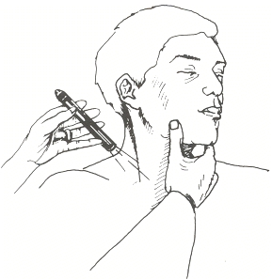
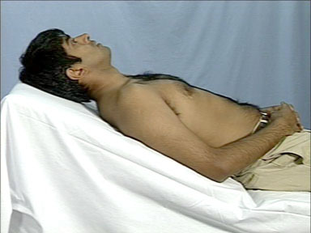
Jugular venous examination technique
Ensure the patient is positioned at 45°
Examiner stands at the right side of the table
Ask patient to turn their head away from you
A penlight can help to enhance visualization.

Slide 42
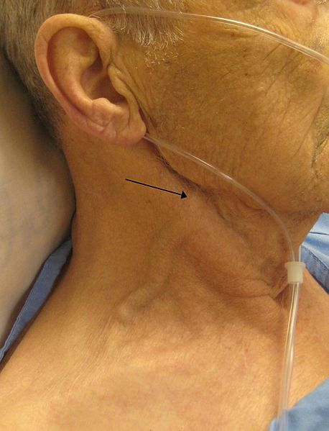
Assessment of Jugular venous distention (JVD)
JVD is when the increased pressure of the superior vena cava causes the jugular vein to bulge, making it most visible on the right side of a person's neck.
The right external jugular vein is used for venous distention assessment.

Slide 43
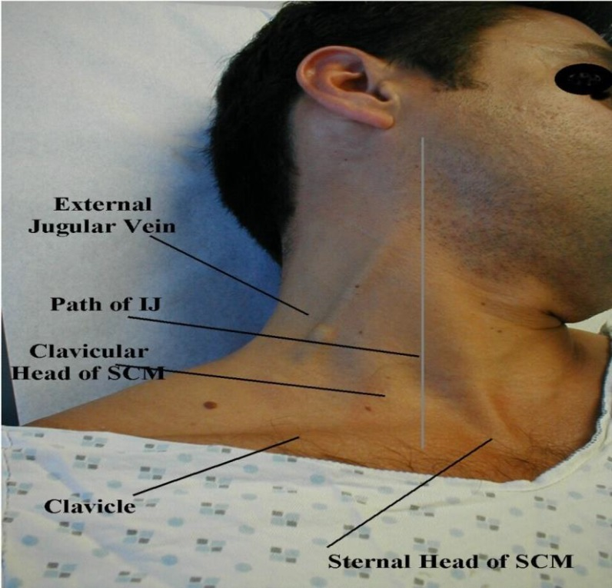
Examination of the Jugular Venous Pressure (JVP)
The JVP reflects pressure in the right atrium (central venous pressure-CVP)
Estimation of volume status (Non-invasive hemodynamic assessment)
Observe the neck for the JVP – located inline with the sternocleidomastoid muscle
The right internal jugular vein is preferred because the EJV is valved and is not directly in line with the superior vena cava and right atrium.
http://sfgh.medicine.ucsf.edu

Slide 44
JVP Technique
Find correct area – helps to first identify SCM & triangle it forms with clavicle
Anatomy of Internal Jugular Vein →Straight line with RA
Look for multi-phasic pulsations (‘a’, ‘c’ & ‘v’ waves)
Isolate from carotid pulsations, respirations

Slide 45
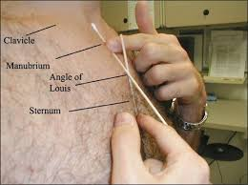
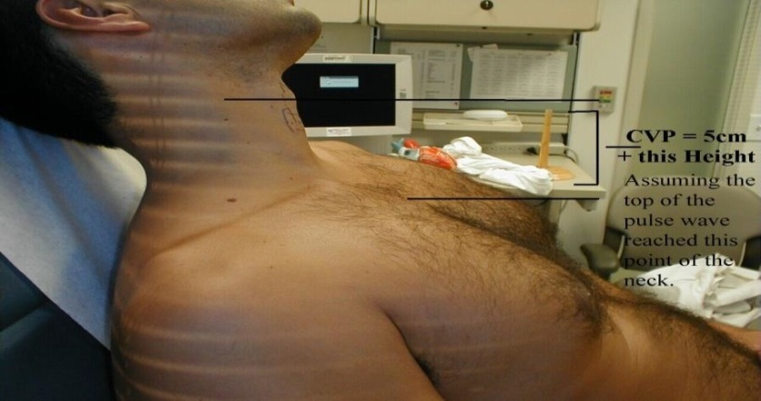
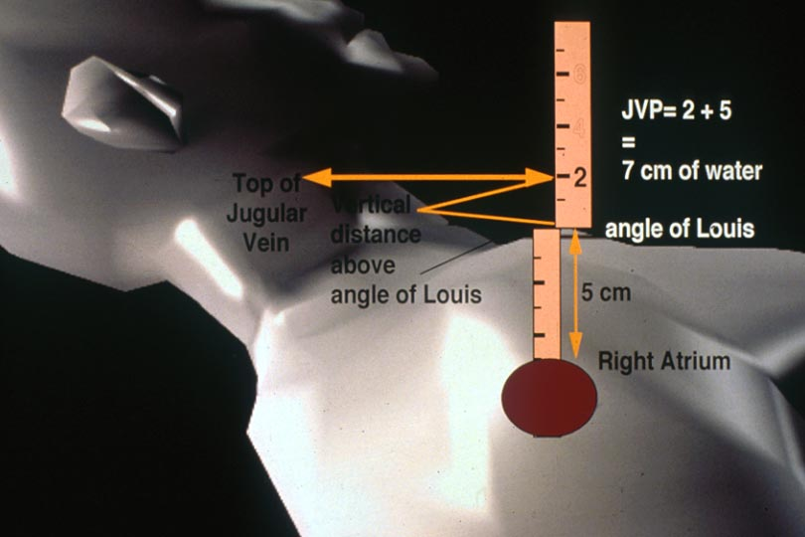
JVP Technique
The JVP is estimated to be the vertical distance between the highest point of pulsation and the right atrium.
The distance between the angle of Louis and center of RA is about 5 cm.
It is measured as the vertical height of the venous pulsation above the angle of Louis by ruler- up to 4 cm being considered normal
Courtesy Chinese University of Hong Kong
http:www.cuhk.edu.hk/cslc/materials/pclm1011/pclm1011.html
https://meded.ucsd.edu/clinicalmed/cvp_movie.htm

Slide 46
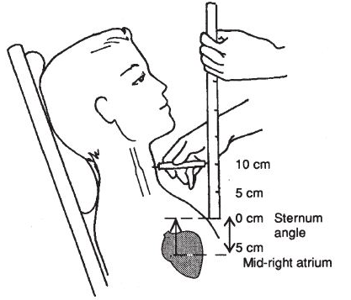
JVP= 5 cm+ vertical distance from sternal-manubrial angle to top of pulse wave
Normal:
JVP is 6 to 8 cm above the right atrium
Abnormal/ Elevated:
JVP is > 9 cm above the right atrium (> 4 cm above the sternal angle)

Slide 47
JVP
Normal JVP →↓↓↓ w/ inspiration and ↑↑↑ w/expiration.
Kussmaul sign is a parodoxical rise in JVP on inspiration. (constrictive pericarditis, pulmonary embolism, or RV infarction)

Slide 48
Elevated JVP causes
Volume overload
Right/left heart failure
Pulmonary embolism
Pulmonary hypertension
Tricuspid stenosis or regurgitation
Constrictive pericarditis
Pericardial compression/tamponade
Superior vena cava obstruction

Slide 49
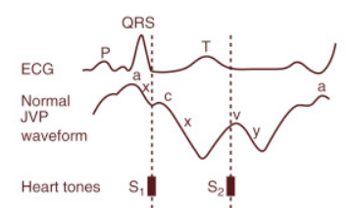
Juguler venous pulse waveform
The right IJV is used the assessment for the jugular venous pulsation.
The venous waveforms include three positive waves–a,c and v ; negative waves x, x’ and y
The a wave reflects RA presystolic contraction, occurs just after the electrocardiographic P wave, and precedes S1.
‘
A= atrial contraction
X= atrial relaxation
C= tricuspid valve closure
X’=ventricular systole
V= atrial filling
Y= atrial emptying

Slide 50
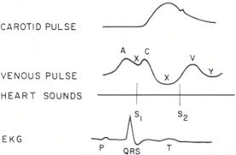
The x descent reflects the fall in RA pressure after the a wave peak.
The c wave interrupts this descent as ventricular systole pushes the closed TV into the RA.
The x′ descent follows because of atrial diastolic suction created by ventricular systole pulling the TV downward.
The v wave represents atrial filling, occurs at the end of ventricular systole, and follows just after S2.
The y descent follows the v wave peak and reflects the fall in RA pressure after TV opening.
A= atrial contraction
X= atrial relaxation
C= tricuspid valve closure
X’=ventricular systole
V= atrial filling
Y= atrial emptying

Slide 51
In normal individuals, the x′ descent is the predominant waveform in the jugular venous pulse.
The a wave is normally larger than the v wave, and the x descent is more marked than the y descent.

Slide 52
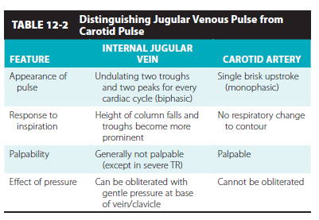
Braunwald’s Heart Disease, 9. Ed, 2013

Slide 53
Physical Examination of Cardiovascular system
General appearance/Inspection of the patient
Measurement of the heart rate and blood pressure
Examination of the arterial pulse
The examination of jugular vein (pulse/ pressure / distention)
The examination of edema
The examination of the precordium

Slide 54
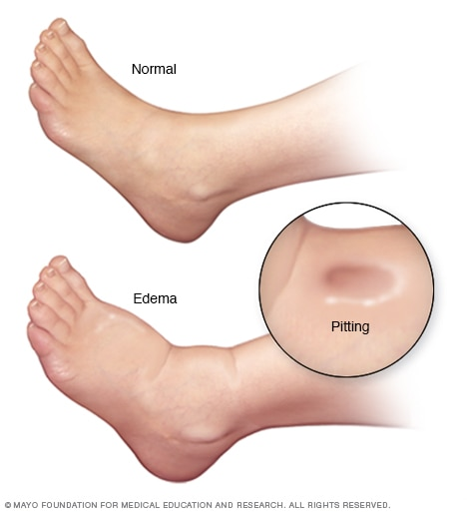
Check for pedal edema
Over medial malleolus or 5 cm above it with right thumb..
Apply pressure for minimum 30 seconds…and look for dimple→ pitting edema

Slide 55
Examination of Pedal edema
Some medications (eg. Ca CB)
Pregnancy
Deep venous thrombosis
Congestive heart failure
Chronic renal disease
Liver cirrhosis

Slide 56
Physical Examination of Cardiovascular system
General appearance/Inspection of the patient
Measurement of the blood pressure
Examination of the arterial pulse
The examination of jugular vein
The examination of edema
The examination of the precordium

Slide 57
Physical Examination of Cardiovascular system
The precordial cardiac examination:
4 basic components:
Inspection
Palpation
Percussion (omitted in cardiac exam)
Auscultation

Slide 58
Inspection
Pay attention to:
Chest shape (pectus excavatum, pectus carinatum)
Shortness of breath (rest or walking ?)
Sitting upright? Able to speak?
Visible impulse on chest wall from vigorously contracting ventricle ?

Slide 59
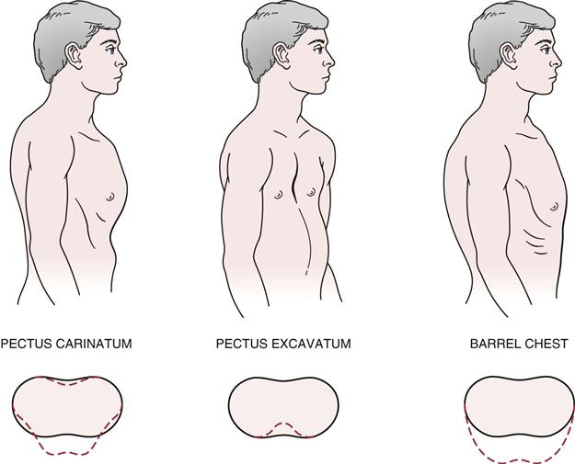
Chest wall deformities
Pectus carinatum
(pigeon chest)
Pectus excavatum
(funnel or sunken chest)
Barrel chest
Pectus carinatum= the sternum and ribs are prominently in an outward position
Pectus excavatum= the sternum and ribs are prominently in an inward position
Barrel chest= Elevated anteroposterior torax diameter, the AP to transverse diameter is 1:1, seen in COPD.
Thoracic deformities can affect the functions of the heart and lungs.

Slide 60
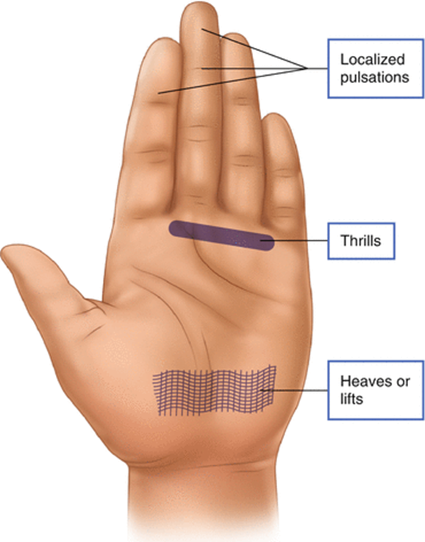
Palpation
Apical impulse
Thrills
Parasternal lift

Slide 61
Apex beat
The apex beat also called the apical impulse, is the pulse felt at the point of maximum impulse (PMI).
The PMI is normally over the left ventricular apex in the midclavicular line at the 5th intercostal space.
It is <2 cm in diameter, and moves quickly away from the fingers.
It is best felt at end-expiration, when the heart is closest to the chest wall.
http://fourthstage2017.byethost16.com/[OSCE]/Cardiovascular%20Examination%20HDD.pdf?i=1

Slide 62
Apex beat
Supine position
Left lateral decubitis position
The apical impulse of LV enlargement is usually widened or diffuse (>3 cm in diameter), can be palpated in 2 interspaces, and is displaced leftward.

Slide 63
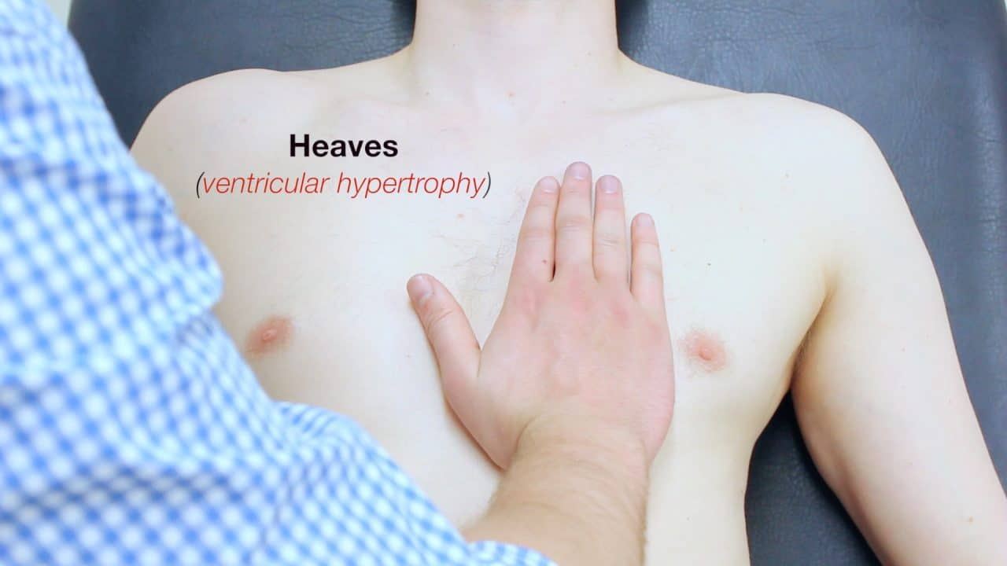
Parasternal lift
Precordial motion in the lower sternal area usually reflects RV motion.
RV pressure overload (eg, in pulmonary stenosis) or volume overload (eg, in ASD) causes a sustained outward lift. It is called ‘’parasternal lift’’.
http://fourthstage2017.byethost16.com/[OSCE]/Cardiovascular%20Examination%20HDD.pdf?i=1

Slide 64
Thrills
Palpable vibrations
Thrills signify turbulent, high-velocity blood flow, and help localize the origins of heart murmurs.
It can be palpated in murmurs of 4th degree and above.
http://fourthstage2017.byethost16.com/[OSCE]/Cardiovascular%20Examination%20HDD.pdf?i=1

Slide 65
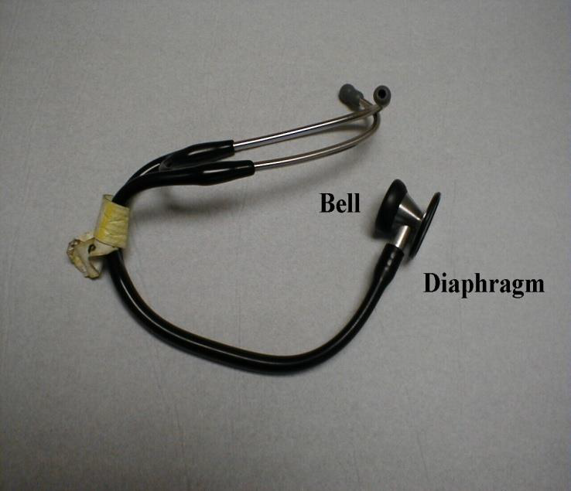
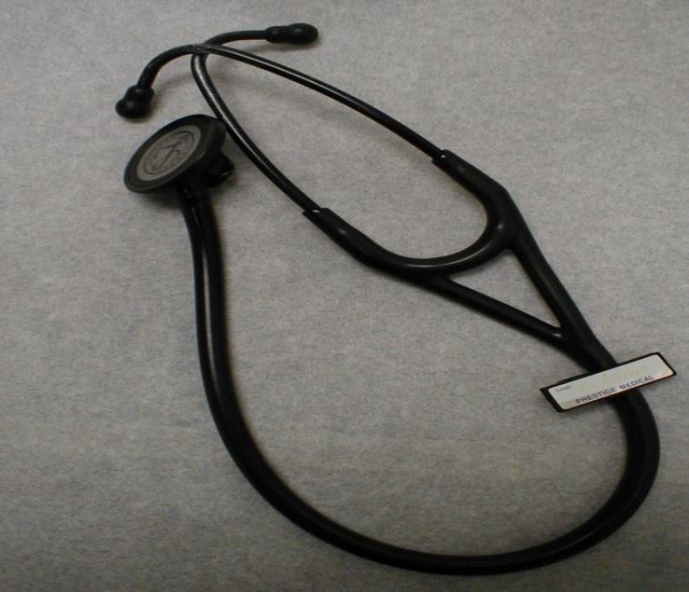
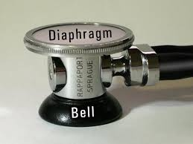
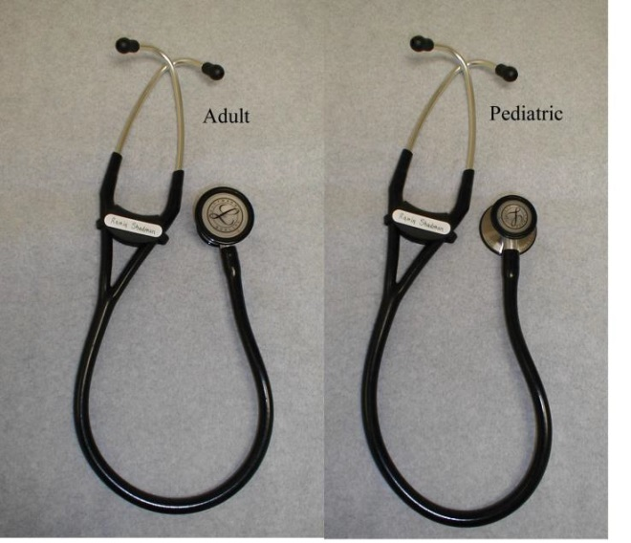
Auscultation: Using your stethescope
Diaphragm →Higher pitched sounds
Bell → Lower pitched sounds

Slide 66
Auscultation Technique
Patient lying at 30-45 degree incline position
Don’t examine over clothes
–need to see area where placing stethescope
–stethescope must contact skin
Stethescope with diaphragm at first (higher pitched sounds)

Slide 67
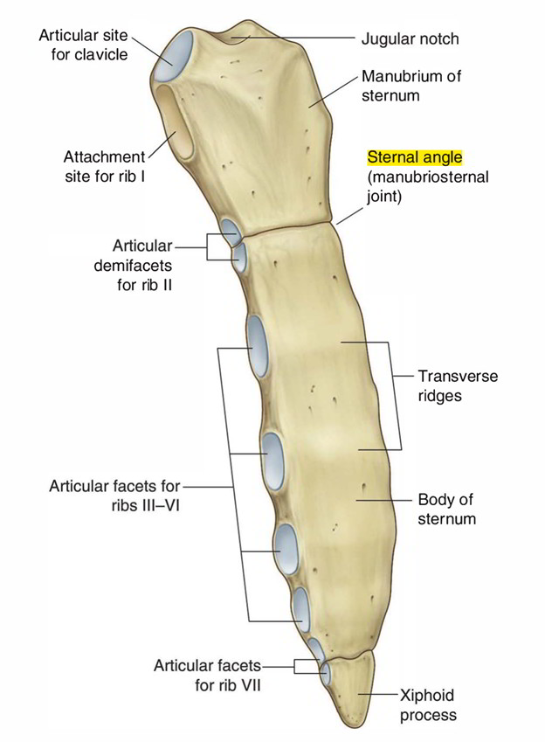
Angle of Louis
The sternal angle (also known as the angle of Louis or manubriosternal junction) is the synarthrotic joint formed by the articulation of the manubrium and the body of the sternum.
The sternal angle is a palpable clinical landmark in surface anatomy.
Joshi S et al, Indian J Crit Care Med 2010;14:180-4.
https://www.earthslab.com/anatomy/sternal-angle/

Slide 68
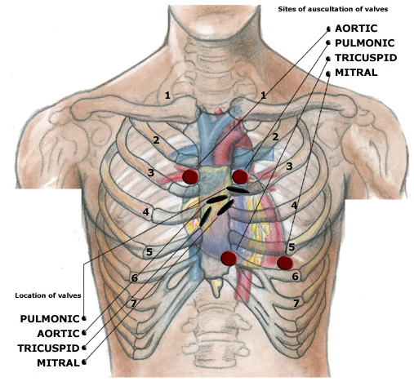
Auscultatory sites
There are four important areas used for listening to heart sounds.
These are:
Aortic area→ 2nd intercostal space to the right of the sternum
Pulmonic area→ 2nd intercostal space to the left of the sternum
Tricuspid area→ 5th intercostal space to the left of the sternum
Mitral Area (Apex) → The intersection of the 5th intercostal space with the midclavicular line
http://www.stethographics.com/heart/main/sites.htm

Slide 69
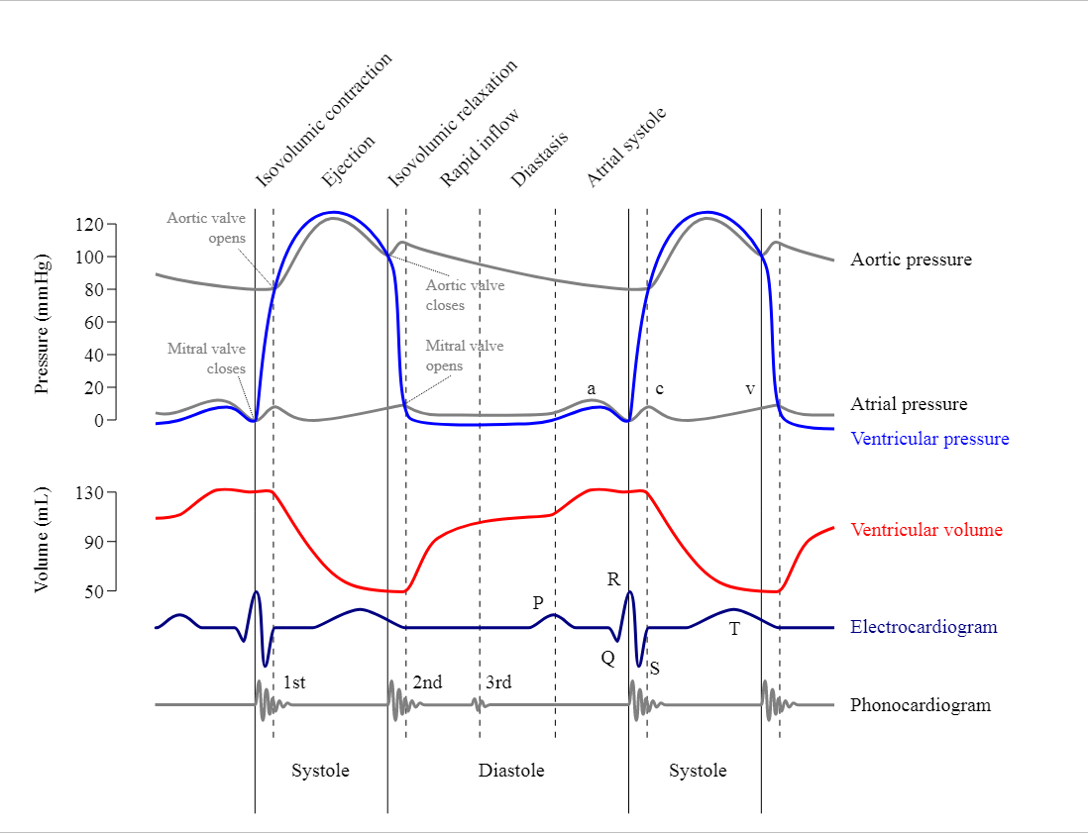
What are we listening for?
Normal valve closure creates sound
First Heart Sound = S1→ closure of Mitral, Tricuspid valves
Second Heart Sound = S2→ closure of Aortic, Pulmonic valves

Slide 70
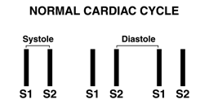
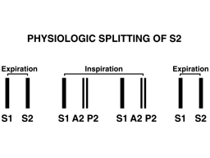
What are we listening for?
Systole =time between S1 & S2;
Diastole = time between S2 & S1
Normally, S1 & S2 = distinct sounds
Physiologic splitting =S2 components of second heart sound (Aortic & Pulmonic valve closure) audible with inspiration

Slide 71
References
Essentials of Bedside Cardiology (2nd Edition); Jules Constant; Humana Press, New Jersey, 2003.
Braunwald’s Heart Disease, 9. edition, 2013
Sherwood, Fundamentals of Human Physiology, 4.edition, 2012
Mayo Clinic Cardiology: Concise Textbook, 4.edition, 2013
Bates’ Guide to Physical Examination and History Taking (12th Edition); Lynn S. Bickley; Wolters Kluwer, 2017.
Charlie Goldberg, Exam of the CVS, images on ppt
https://www.slideshare.net/AryaAnish/pulse-abnormal-findings-59418571
https://www.amboss.com/us/knowledge/Cardiovascular_examination
https://geekymedics.com/cardiovascular-history/

Slide 72
Thank you…

