Slide 2
Hypothyroidism in dogs

Slide 3
Hypothyroidism describes thyroid hormone deficiency
It is diagnosed by clinical features such as lethargy, weight gain, obesity, hair coat changes, and low serum thyroid hormone concentrations.
Management includes daily thyroid hormone replacement.
In hypothyroidism, impaired production and secretion of thyroid hormones result in a decreased metabolic rate. This disorder is most common in dogs but also develops rarely in other species, including cats

Slide 4
Etiology- primary hypothroidism
Thyroid hormone deficiency, more than 95% of clinical cases of hypothyroidism in dogs appear to result from destruction of the thyroid gland itself (primary hypothyroidism).
The two most common causes of adult-onset primary hypothyroidism in dogs include lymphocytic thyroiditis and idiopathic atrophy of the thyroid gland.
Lymphocytic thyroiditis, probably immune-mediated, is characterized histologically by a diffuse infiltration of the gland by lymphocytes, plasma cells, and macrophages and results in progressive destruction of follicles and secondary fibrosis.
Idiopathic atrophy of the thyroid gland is characterized histologically by loss of thyroid parenchyma and replacement by adipose tissue

Slide 5
Etiology- secundary hypothroidism
In dogs, the most common cause of secondary hypothyroidism is destruction of pituitary thyrotrophs by an expanding, space-occupying tumor. Because of the nonselective nature of the resulting compressive atrophy and replacement of pituitary tissue by such large tumors, deficiencies of other (one or more) pituitary hormones also usually occur.

Slide 6
Naturally occurring hypothyroidism is an extremely rare disorder in adult cats
In cats, iatrogenic hypothyroidism is the most common form. Hypothyroidism develops in these cats after
treatment for hyperthyroidism with radioiodine,
surgical thyroidectomy, or use of an antithyroid drug.

Slide 7
Hypothyroidism is most common in dogs 4–10 years old. It usually affects mid- to large-size breeds and is rare in toy and miniature breeds.
Breeds reported to be predisposed to hypothyroidism include:
Golden Retriever
Doberman Pinscher
Irish Setter
Miniature Schnauzer
Dachshund
Cocker Spaniel
Airedale Terrier

Slide 8
Clinical Findings
Dogs,
The most common clinical signs include bilaterally symmetrical alopecia, skin hyperpigmentation, seborrhea, a dull hair coat, and letargy. Cold intolerance, mild weight gain, constipation, infertility,
Less common or atypical clinical signs include a slow stiff gait(myopathy), lameness, proprioceptive deficit, nystagmus or head tilt, and CNS dysfunction
Cats,
Matted hair, hair loss, and seborrhea are most common

Slide 9
Scintigraphic image of the thyroid gland after using radioactive iodine
unilateral tumor formation
thyroid glands in normal healthy dog

Slide 10
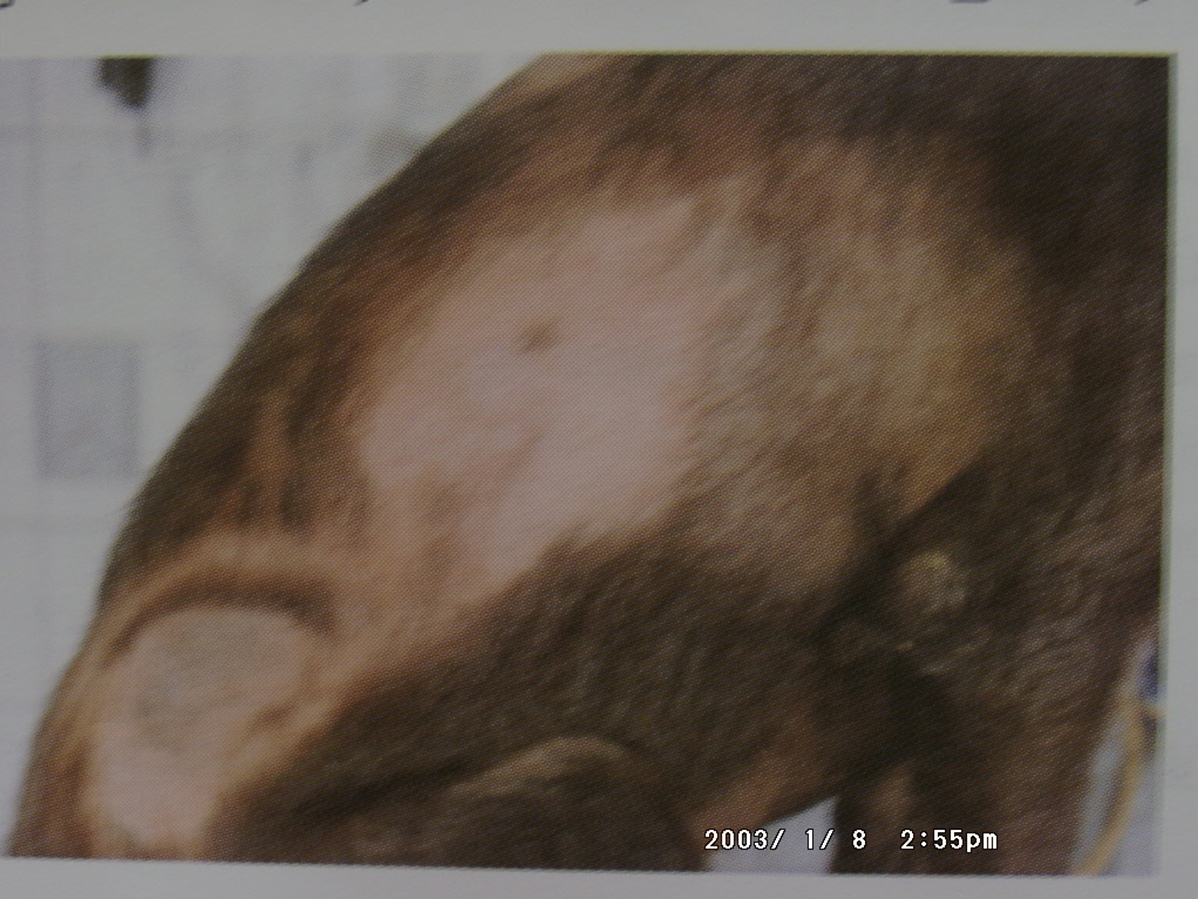
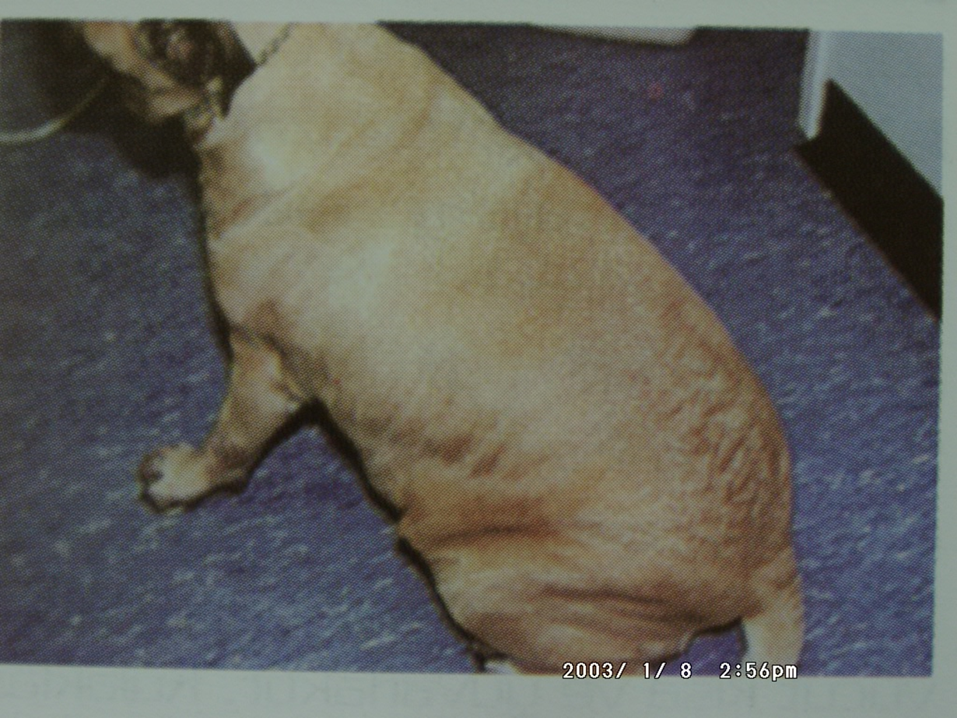
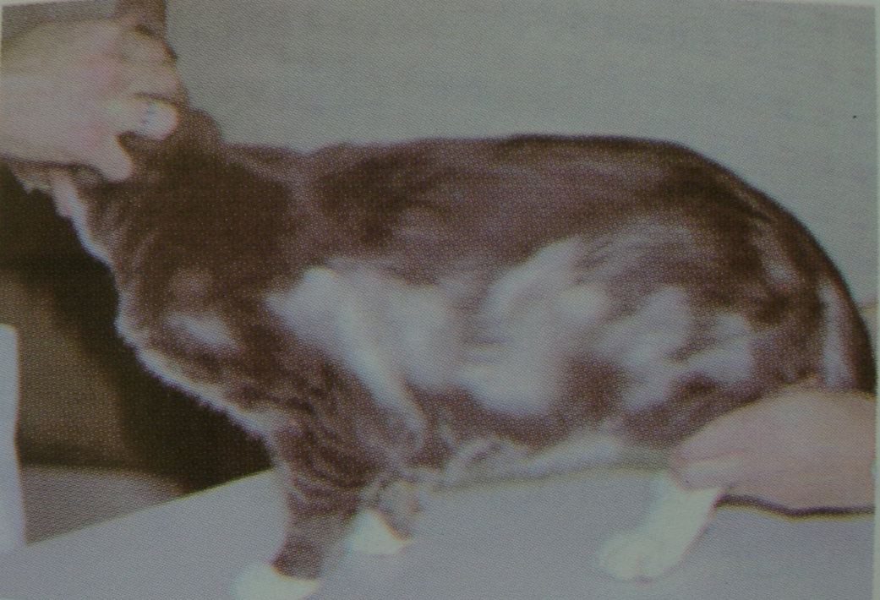
bilateral symmetrical alopecia of the chest and flanks in the dog
Obesity
Bilateral symmetrical alopecia of the chest and flanks in the dog

Slide 11
Skin hyperpigmentation and generalized alopecia
skin folds, hair thinning and shedding

Slide 12
Laboratory findings
T-4 (Thyroxine) and T-3(Triiodothyronine), levels fall in the blood. The T-4 level is faster and more pronounced. T-3 is slower.
Hypercholesterolemia, hypertriglyceridemia are common. This is an important indicator.
Nonregenerative anemia (normocytic, normochromic) and thrombocytopenia may occur

Slide 13
Diagnosis
Clinical findings
Low T-4 value
TSH stimulation test for definitive diagnosis
Serum T-4 value is measured
2-5 IU TSH is given
After 6 hours, the T-4 value is measured again.
There is little or no change in T-4 levels in hypothyroidism
In normal animals, the T-4 value rises to the normal level.

Slide 14
Treatment
Synthetic thyroxine (L-T-4) Na-levotroxin is administered at a dose of 0.02 mg / kg / day orally, divided into two application.
Skin lesions begin to heal in a 2-3 months
It can also be used in cats at a dose of 0.01-0.02 mg / kg / day.

