Slide 1
Nucleotides and Nucleic Acids-2
© 2009 W. H. Freeman and Company

Slide 2
Covalent Structure of DNA (1868-1935)
Friedrich Miescher isolates “nuclein” from cell nuclei
Hydrolysis of nuclein:
phosphate
pentose
and a nucleobase
Chemical analysis:
phosphodiester linkages
pentose is ribofuranoside
Structure of DNA:
1929
(Levene and London)
Structure of DNA:
1935
(Levene and Tipson)

Slide 3
Road to the Double Helix
Franklin and Wilkins:
“Cross” means helix
“Diamonds” mean
that the phosphate-
sugar backbone
is outside
Calculated helical
parameters
Watson and Crick:
Missing layer means
alternating pattern
(major & minor groove)
Hydrogen bonding:
A pairs with T
G pairs with C
Double helix fits the data!
Watson, Crick, and Wilkins shared
1962 Nobel Prize
Franklin died in 1958

Slide 4
Watson-Crick Model of B-DNA

Slide 5
Complementarity of DNA strands
Two chains differ in sequence
(sequence is read from 5’ to 3’)
Two chains are complementary
Two chains run antiparallel

Slide 6
Replication of Genetic Code
Strand separation occurs first
Each strand serves as a template
for the synthesis of a new strand
Synthesis is catalyzed by enzymes
known as DNA polymerases
Newly made DNA molecule has one
daughter strand and one parent strand.
“It has not escaped our notice that the specific pairing
we have postulated immediately suggests a possible
copying mechanism for the genetic material”
Watson and Crick, in their Nature paper,1953

Slide 7
Palindromic Sequences can form Hairpins and Cruciforms
Palindromes: words or phases that are the same when read backward or forward:
Saippuakuppinippukauppias: (Finnish word for "soap cup batch trader“)
'Nipson anomémata mé monan opsin' (Ancient greek fountain text: 'Wash the sin as well as the face’

Slide 8
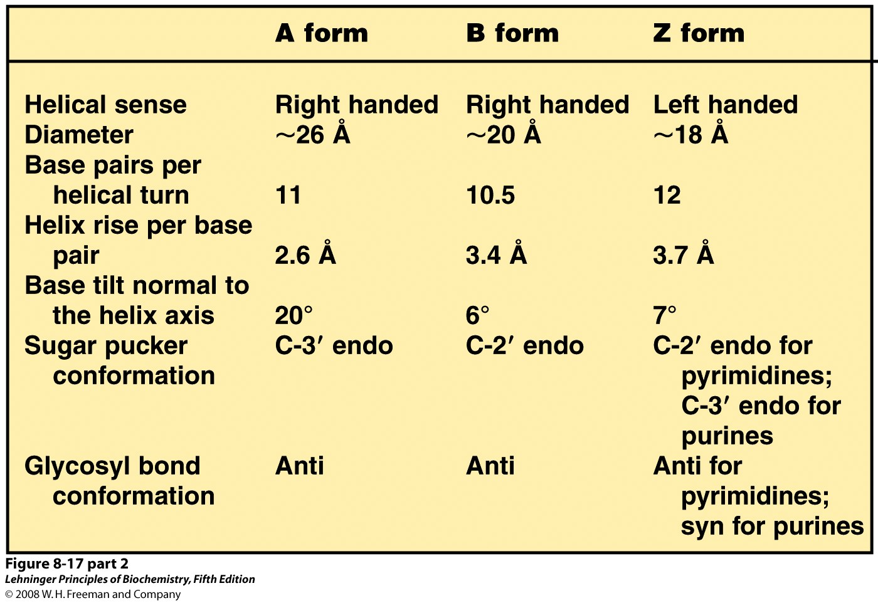
Dry environment, mostly in cells
Wet environment, mostly in cells
High salt concentration
Notes:
FIGURE 8-17 (part 2) Comparison of A, B, and Z forms of DNA. Each structure shown here has 36 base pairs. The bases are shown in gray, the phosphate atoms in yellow, and the riboses and phosphate oxygens in blue. Blue is the color used to represent DNA strands in later chapters. The table summarizes some properties of the three forms of DNA.

Slide 9
Messenger RNA: Code Carrier for the Sequence of Proteins
Is synthesized using DNA template
Contains ribose instead of deoxyribose
Contains uracil instead of thymine
One mRNA may code for more than
one protein

Slide 10
Transfer RNA: Matching Amino Acids with the mRNA Code
tRNA molecules have quite complex structures, this is an actively studied field

Slide 11
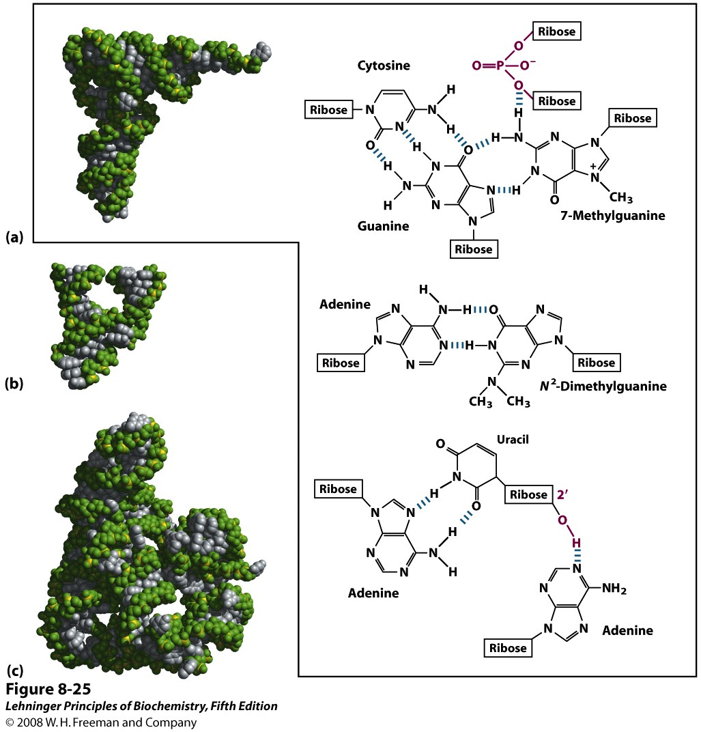
Notes:
FIGURE 8-25 Three-dimensional structure in RNA. (a) Three-dimensional structure of phenylalanine tRNA of yeast (PDB ID 1TRA). Some unusual base-pairing patterns found in this tRNA are shown. Note also the involvement of the oxygen of a ribose phosphodiester bond in one hydrogen-bonding arrangement, and a ribose 2′-hydroxyl group in another (both in red). (b) A hammerhead ribozyme (so named because the secondary structure at the active site looks like the head of a hammer), derived from certain plant viruses (derived from PDB ID 1MME). Ribozymes, or RNA enzymes, catalyze a variety of reactions, primarily in RNA metabolism and protein synthesis. The complex three-dimensional structures of these RNAs reflect the complexity inherent in catalysis, as described for protein enzymes in Chapter 6. (c) A segment of mRNA known as an intron, from the ciliated protozoan Tetrahymena thermophila (derived from PDB ID 1GRZ). This intron (a ribozyme) catalyzes its own excision from between exons in an mRNA strand (discussed in Chapter 26

Slide 12
DNA Denaturation
Covalent bonds remain intact
Genetic code remains intact
Hydrogen bonds are broken
Two strands separate
Base stacking is lost
UV absorbance increases
Denaturation can be induced by high temperature, or change in pH
Denaturation may be reversible:annealing

Slide 13
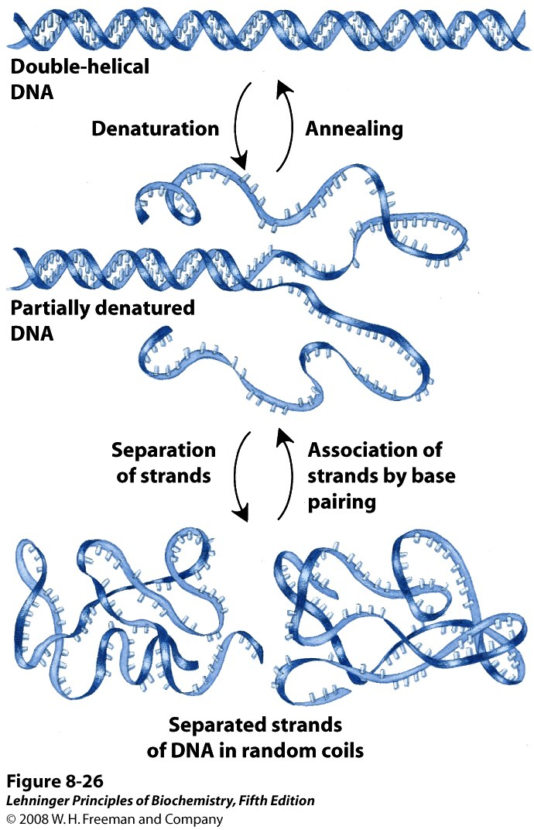
Notes:
FIGURE 8-26 Reversible denaturation and annealing (renaturation) of DNA.

Slide 14
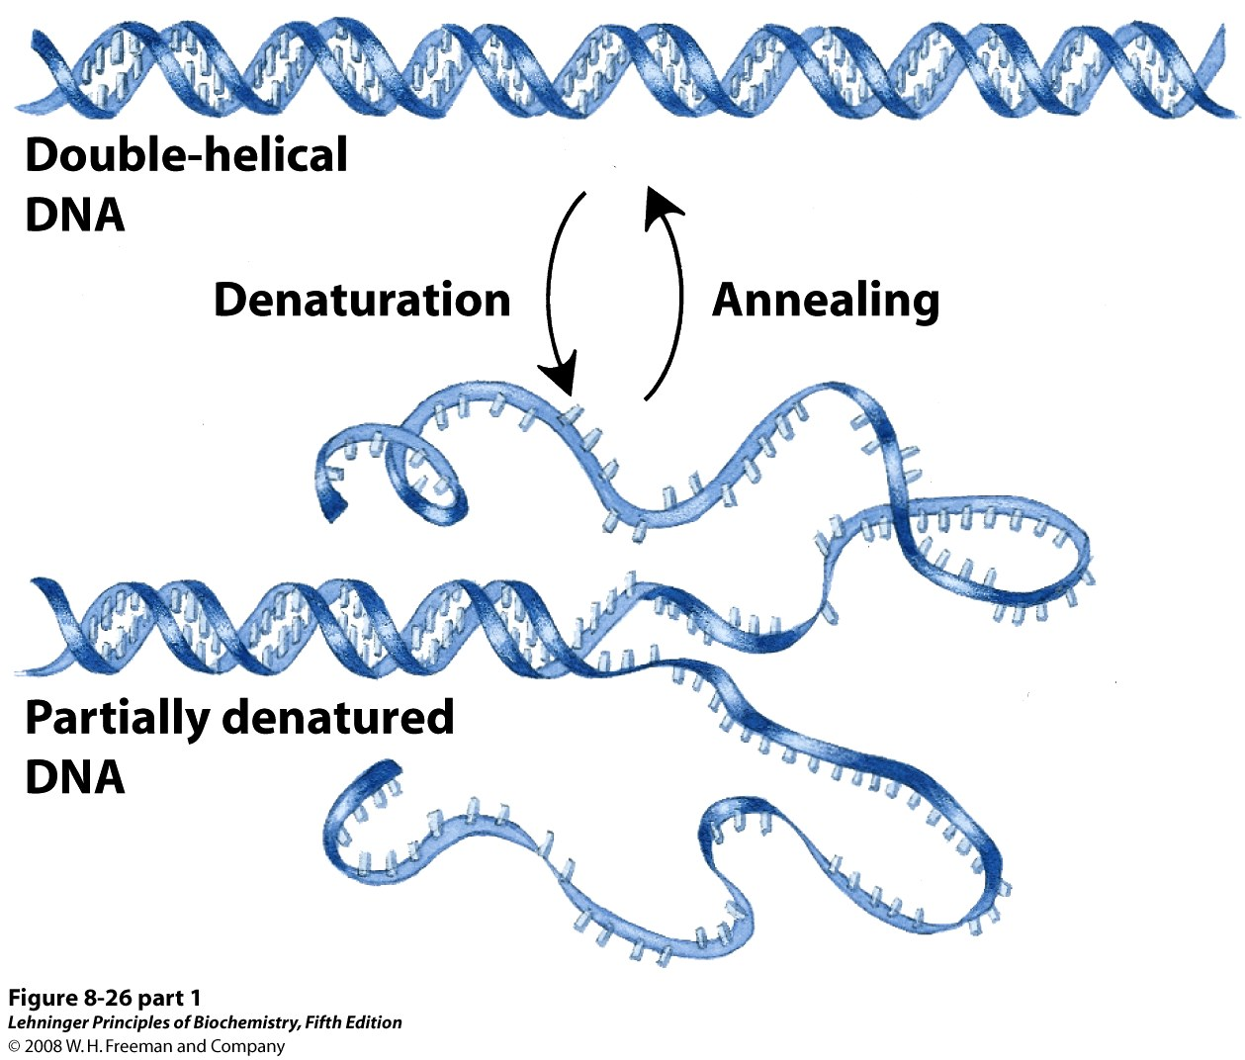
Notes:
FIGURE 8-26 (part 1) Reversible denaturation and annealing (renaturation) of DNA.

Slide 15
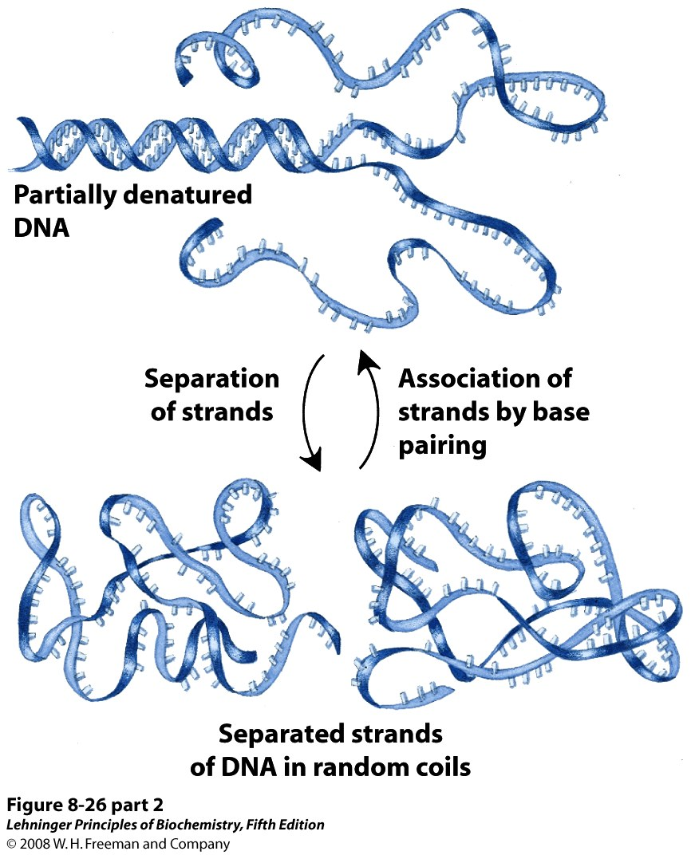
Notes:
FIGURE 8-26 (part 2) Reversible denaturation and annealing (renaturation) of DNA.

Slide 16
Thermal DNA Denaturation (Melting)
DNA exists as double helix at normal temperatures
Two DNA strands dissociate at elevated temperatures
Two strands re-anneal when temperature is lowered
The reversible thermal denaturation and annealing form basis for the polymerase chain reaction
DNA denaturation is commonly monitored by UV spectrophotometry at 260 nm

Slide 17
Factors Affecting DNA Denaturation
The midpoint of melting (T_{m}) depends on base composition
high CG increases T_{m}
T_{m} depends on DNA length
Longer DNA has higher T_{m}
Important for short DNA
T_{m} depends on pH and ionic strength
High salt increases T_{m}

Slide 18
Denaturation of Large DNA Molecules is not Uniform
AT rich regions melt at a lower temperature than GC-rich regions

Slide 19
Two Near-Complementary DNA Strands Can Hybridize
Detection of a specific DNA molecule in complex mixture
- radioactive detection
- fluorescent DNA chips
Amplification of specific DNA
- polymerase chain reaction
- site-directed mutagenesis
Evolutionary relationships
Antisense therapy

Slide 20
Molecular Mechanisms of Spontaneous Mutagenesis
Deamination
Very slow reactions
Large number of residues
The net effect is significant: 100 C → U
events /day in a mammalian cell
Depurination
N-glycosidic bond is hydrolyzed
Significant for purines: 10,000 purines
lost/day in a mammalian cell
Cells have mechanisms to correct most of these modifications.

Slide 21
Molecular Mechanisms of Oxidative and Chemical Mutagenesis
Oxidative damage
Hydroxylation of guanine
Mitochondrial DNA is most susceptible
Chemical alkylation
Methylation of guanine
Cells have mechanisms to correct most of these modifications

Slide 22
Molecular Mechanisms of Radiation-Induced Mutagenesis
UV light induces dimerization of pyrimidines, this may be the main mechanism for skin cancers
Ionizing radiation (X-rays and γ-rays) causes ring opening and strand breaking. These are difficult to fix
Cells can repair some of these modifications, but others cause mutations. Accumulation of mutations is linked to aging and carcinogenesis

