Slide 1
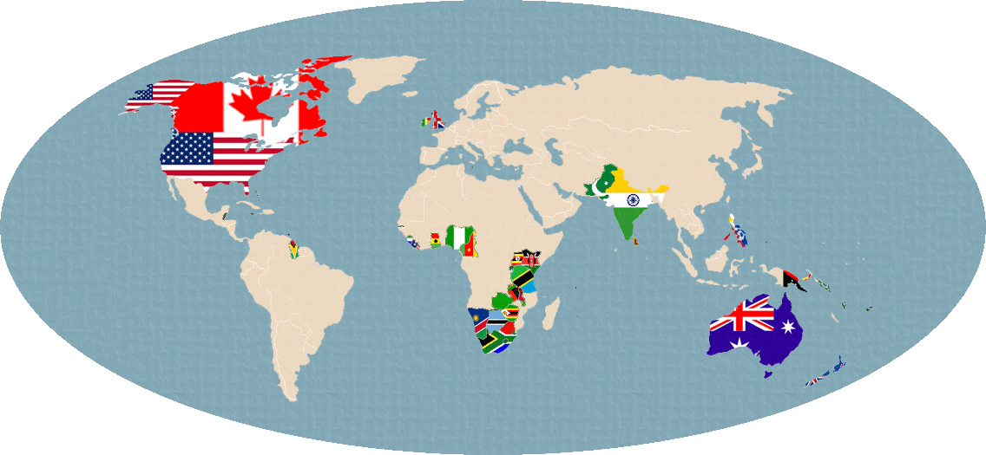

Slide 2
‘’The Thing Around Your Neck’’ (2009)
By Chimamanda Ngozi Adichie

Slide 3
ANGLOPHONE LITERATURE

Slide 4
literature written in English.
literature written outside of Great Britain.
Concentrating on literature of West and South Africa, India, and the Caribbean (Third World).
Described by some critics as the “empire writing back.”

Slide 5
Emigration, Immigration and Migration

Slide 6
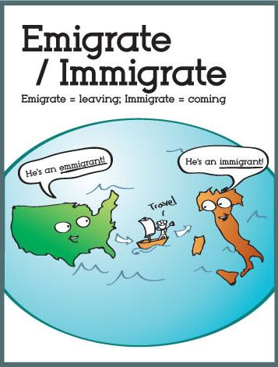

Slide 7
People are always saying there's no quality of life in Nigeria, and everyone wants to emigrate," she said.
Citizens from various Third World countries were given freedom to immigrate to Britain during post-war period.
Swallows migrate south in winter.

Slide 8
Why People Emigrate?
What are the real reasons, push factors or objectives of immigration?
Which countries do they dream of immigrating?

Slide 9
THE FLAG OF NIGERIA

Slide 10
Colonial History in Nigeria

Slide 11
In 1472, Portuguese reached Nigerian coast.
16-18th Centuries, Slave trade: Millions of Nigerians forcibly sold/sent to the Americas.
1880s-1886, Civil Wars in the South.
1861-1914, British colonisation – ‘indirect rule’.
1922, Cameroon is added to Nigeria under League of Nations mandate.
1960, Independence, with Prime Minister Sir Abubakar Tafawa Balewa leading.

Slide 12
After Independence
1962-1963, controversial census fuels regional and ethnic tensions.
1966 January, Balewa killed in coup. Major-General Johnson Aguiyi-Ironsi military rule.
1966 July, Ironsi killed in counter-coup, replaced by Lieutenant-Colonel Yakubu Gowon.
1967, Republic of Biafra created by 3 states combining - causing a bloody civil war.

Slide 13
1970, Biafran leaders surrender, former Biafran regions reintegrated into country.
1975, Biafran leaders surrender, former Biafran regions reintegrated into country.
Nigeria regained democracy in 1999 when it elected Olusegun Obasanjo, the former military head of state, as the new President of Nigeria.

Slide 14
Demographic Structure, Culture
the largest population of any African country.
In West Africa, along the eastern coast of the Gulf of Guinea, and just north of the equator.
Politically, Nigeria is divided into thirty-six states. The nation's capital was moved from Lagos, the country's largest city, to Abuja on 12 December 1991
English is the official language of Nigeria, used in all government interactions and in state-run schools.

Slide 15
The culture of Nigeria is shaped by Nigeria's multiple ethnic groups. The country has over 521 languages and over 250 dialects and ethnic groups.
The four largest ethnic groups are the Hausa and Fulani who are predominant in the north,
the Igbo who are predominant in the southeast,
and the Yoruba who are predominant in the southwest

Slide 16
Neo-colonialism and Nigeria

Slide 17
Neocolonialism, or neo-imperialism is the geopolitical practice of using capitalism, business globalization, and cultural imperialism to influence a country, instead of either direct military control (imperialism) or indirect political control (hegemony).
Describing the influence of the developed countries on internal affairs of the developing world despite the decolonisation that occurred after of the Second World War.

Slide 18
Chimamanda Ngozi Adichie (b.1977)

Slide 19
BIOGRAPHY
A Nigerian novelist, nonfiction writer and short story writer.
born in the city of Enugu,
Grew up in an Igbo family in the university town of Nsukka in southeastern Nigeria, where the University of Nigeria is situated.
At the age of 19, Adichie left Nigeria for the United States to study communications and political science at Drexel University in Philadelphia.

Slide 20
She transferred to Eastern Connecticut State University to be near her sister, who had a medical practice in Coventry. She received a bachelor's degree from this university.
In 2003, she completed a master's degree in creative writing at Johns Hopkins University.
In 2008, she received a Master of Arts degree in African studies from Yale University.
At the age of 21, she published a play For love of Biafra and a poetry anthology, Decisions.

Slide 21
Her first novel, Purple Hibiscus (2003), was awarded the Commonwealth Writers' Prize for Best First Book (2005).
Her second novel, Half of a Yellow Sun, named after the flag of the short-lived nation of Biafra and received the 2007 Orange Prize for Fiction and the Anisfield-Wolf Book Award.
Her third book, The Thing Around Your Neck,(2009), is a collection of short stories.
Her third novel, Americanah (2013), was selected by the New York Times as one of The 10 Best Books of 2013.

Slide 22
PLOT
The plot is structured as linear and has retropective narration and flashbacks at some points.
An immigration story of a young Nigerian woman, Akunna, having won the lottery of American visa, Green Card.
She sets foot in America to have a better life and, in the hope of having a big car, a big house in a month.

Slide 23
At first, she goes to live with her uncle in Maine in order to appy for a cashier job and carry on her education in a community college but he molests her and she ends up working as a waitress in Connecticut.
She does not write to her family back in Nigeria because she does not know how to explain the lack of gifts she had promised her relatives.
She is homesick, sad and alone and something around her neck nearly chokes her every night before she sleeps

Slide 24
Later, when she starts dating a young, unnamed American man; the thing that nearly choked her starts to let go.
Even then, she still has a hard time believing in the sincerity of her man’s love.
Her own insecurities and the racial, class difference between them threaten to drive them apart.
When news comes from home that her father died five months earlier, she has to return to Nigeria. The story ends at the airport and in ambiguity.

Slide 25
AKUNNA
‘’He asked your name and said Akunna was pretty. He did not ask what it meant, fortunately, because you were sick of how people said, ‘’Father’s Wealth’? You mean,like, your father will actually sell you to a husband?’’ (4)
Bride Price
Economical expectations from Akunna.
‘’Still, you chose long brown envelops to send half your month’s earnings to your parents at the adress of the parastatal where your mother was a cleaner’’. (2)

Slide 26
SETTING
The story begins in Nigeria and the story flows from Nigeria to America.
(A movement from the Third World to the First World)
The chasm between two spaces in the sense of standard of life, business opportunities and education.

Slide 27
NARRATOR
‘You’ second person narrator!
‘’You locked yourself in the bathroom until he went back upstairs, and the next morning, you left, walking the long windy road, smelling the baby fish in the lake[…] You ended up in Connecticut.’’ (2)
What is its function within the story?

Slide 28
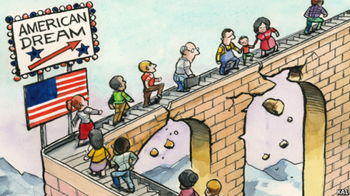
AMERICAN DREAM

Slide 29
A National ethos of the United States
The Epic of America by James Truslow (1931)
‘’Life, Liberty and the Pursuit of Happiness’’.
The set of ideals such as democracy, human rights, opportunity and equality.

Slide 30
Discussions on American Dream
Is American dream still alive or only an illusion?
Is American dream still working?
Is American dream still worth pursuing?
Do all US citizens have equal opportunities or are there still conflicts concerning the origin or believes of certain groups?
If we say that everyone can become rich if they work hard enough–does that mean that the poor are only too lazy? (Or do we have to take other factors into account, too?)

Slide 31
‘’You thought everbody in America had a car and a gun; your uncles and aunts and cousins thought so, too. Right after you won the American visa lottery, they told you: In a month, you will have a big car. Soon, a big house’’. (1)
‘’You could never afford enough perfumes and clothes and handbags and shoes to go around and still pay your rent on what you earned at the waitressing job, so you wrote nobody’’. (3)

Slide 32
The Title of the Story
The Thing Around Neck
Isolation:
Loneliness
Homesickness
Integration, Adaptation and cultural in-betwenness.

Slide 33
Sometimes you sat on the lumpy mattress of your twin bed and thought about home—your aunts who hawked dried fish and plantains,cajoling customers to buy and then shouting insults when they didn’t; your uncles who drank local gin and crammed their families and lives into single rooms; your friends who had come out to say goodbye before you left. (2)

Slide 34
‘’At night, something would wrap itself around your neck, something that nearly choked you before you fell asleep’’. (3)
‘’The thing that wrapped itself around your neck, that nearly choked you before you fell asleep, started to loosen, to let go’’. (7)

Slide 35
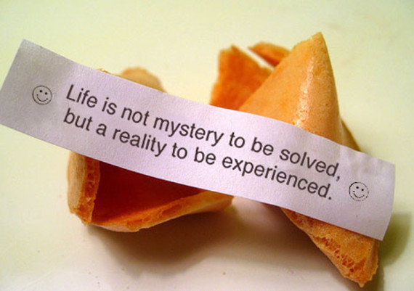
Fortune Cookie

Slide 36
Depiction of the Orient
Orientalism
The Orient as Mystic and exotic place reflecting long history of Orientalist fantasies.
Edward Said, Orientalism (1978)
Patronizing Western attitude towards Eastern societies.

Slide 37
Stereotype, Cultural Representation
Significant component in the othering process
Refering to inferiority marked by essentialism.
The subject reduced to a trait
Representation: Fundamental feature underlying the process of stereotyping.

Slide 38
‘’They asked where you learned to speak English and if you had real houses back in Africa and if you’d seen a car before you came to America’’. (1)
Then he told you how the neighbours said, a few months after he moved into his house, that the squirrels had started to disappear. They had heard that Africans ate all kinds of wild animals’’. (1)

Slide 39
‘’Many people at the restaurant asked when you had come from Jamaica, because they thought that every black person with a foreign accent was Jamaican. Or some who guessed that you were African told you that they loved elephants and wanted to go on a safari’’. (3)
‘’ After your shift that night, he was waiting outside, earphones stuck in his ears, asking you to go out with him because your name rhymed with hakuna matata and The Lion King was the only maudlin movie he’d ever liked’’. (4)

Slide 40
Assignment
If you were the author of the story, how would you conclude the narrative?

