Slide 1
BIO 206 PLANT MORPHOLOGY
LECTURE NOTES
14th WEEK
DR. AYDAN ACAR ŞAHİN

Slide 2
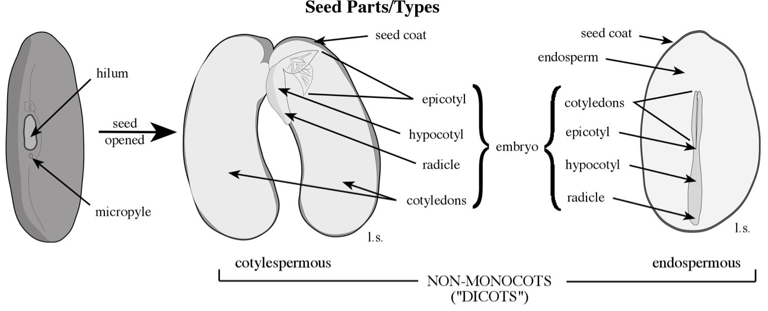
SEED
hilum- scar of attachment of funiculus
raphe – ridge on seed coat formed from adnate funiculus
cotylespermous – nutritive tissue in cotyledons (e.g., beans, peas)
endospermous – nutritive tissue in endosperm
exalbuminous – no endosperm deposited (e.g., orchid seeds)
perispermous – nutritive tissue in nucellus

Slide 3
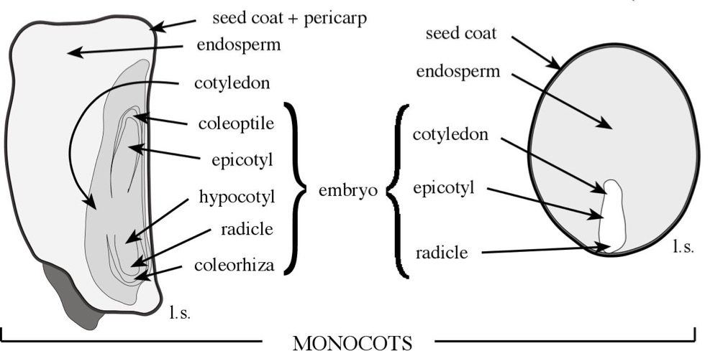
hilum- scar of attachment of funiculus
raphe – ridge on seed coat formed from adnate funiculus
cotylespermous – nutritive tissue in cotyledons (e.g., beans, peas)
endospermous – nutritive tissue in endosperm
exalbuminous – no endosperm deposited (e.g., orchid seeds)
perispermous – nutritive tissue in nucellus

Slide 4
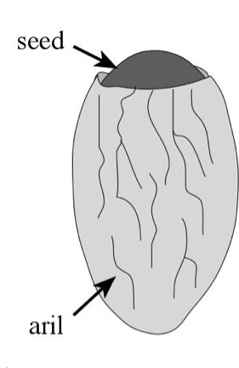
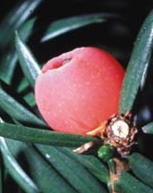
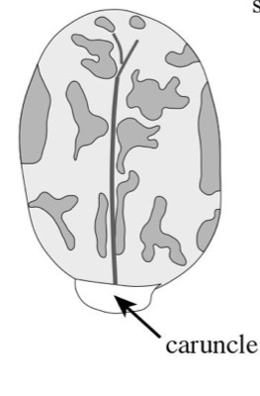
aril - a fleshy outgrowth of the funiculus, raphe, or integuments (but separate from the integuments) that generally functions in animal seed dispersal
Taxus, yew Taxaceae
caruncle/strophiole – a fleshy outgrowth at the base of the seed; function in animal seed dispersal
Ricinus communis, castor-bean Euphorbiaceae

Slide 5
Fruit and seed dispersal
Diaspore – dispersal unit (seeds and/or fruits)
anemochory – dispersal by wind (e.g., samaras, achene w/pappus)
autochory – self dispersal
explosively dehiscent fruits (e.g., Ceanothus)
hypogeous fruits –plant themselves (e.g., Arachis, peanut)
hydrochory – water dispersal (e.g., Cocos nucifera, coconut)
zoochory – dispersal by animals
myrmecochory – ant dispersal (e.g., Viola, violet; seeds w/caruncle)
exozoic – diaspore attached to animal (e.g., burs)
endozoic – diaspore eaten, passes through gut (fleshy fruits)
atelochory – absence of specialized dispersal

Slide 6
