Slide 1
BI & Analytics
* Business analytics def.
- Extensive use of data
- Quantitative analysis
- Supports decision making
* Aims
- Better understanding of processes
- Reveal new business patterns
- Explain the results
- Optimization
- Forecasting
Notes:
Business analytics
Extensive use of data and quantitative analysis
Supports fact-based decision making within organizations
AIMS:
better understanding of current business performance,
reveal new business patterns and relationships,
explain why certain results occurred,
optimize current operations,
and forecast future business results.

Slide 2
BI & Analytics
* BI def.
- Applications, practices, and technologies
- to extract, transform, integrate, viualize, analyse, interpret, and present data
- Supports decision making
- Data warehouses, marts, lakes
* Aims
- Get the most value out of information
- Present the results of analysis
Notes:
Business intelligence (BI) includes:
a wide range of applications, practices, and technologies
for the extraction, transformation, integration, visualization,
analysis, interpretation, and presentation of data
to support improved decision making.
large collections of data called data warehouses, data marts, and data lakes are used in BI applications.
Users may access the data and BI applications via the Web or through intranets and extranets
The goal of business intelligence
to get the most value out of information and present the results of analysis

Slide 3
BI & Analytics
* Benefits achieved from BI & Analytics
- Detecting frauds in an organisation
- Improving forecasting
- Increasing sales
- Optimizing operations
- Reducing costs
Notes:
* Benefits achieved from BI & Analytics
- Detecting frauds in an organisation
- Improving forecasting
- Increasing sales
- Optimizing operations
- Reducing costs

Slide 4
BI & Analytics
* Components required for BI & Analytics
- Data management
- Creative data scientists
- Commitment to data driven decision making
Notes:
Components required for effective BI & Analytics
data management program
integrated set of functions that defines the processes by which
data is obtained, used, stored, secured, and processed in such a way
to ensure accessibility, reliability, and timeliness of the data
Creative data scientists
An organization must have a strong commitment to datadriven decision making

Slide 5
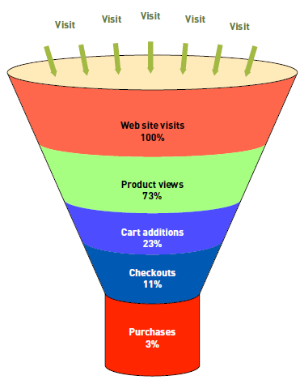
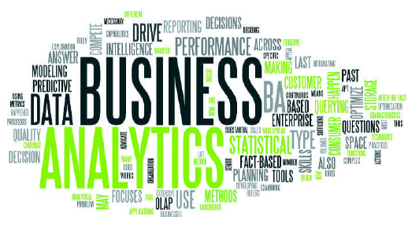
BI & Analytics
* BI & Analytics tools
- Spreadsheets
- Reporting and querying tools
- Data visualization tools
-- Word clouds
-- Conversion funnel
Notes:
BI & Analytics tools
Spreadsheets are used to perform operations on the data based on formulas, create reports, and graphs (e.g. MS Excel)
Reporting and querying tools can present that data in an easy-to-understand fashion
—via formatted data, graphs, and charts.
Data visualization is the presentation of data in a pictorial or graphical format
A word cloud is a visual depiction of a set of words, grouped together using the frequency of their occurrence
Generated from analyses of text documents or a Web page.
More frequent words than other words may be shown in a larger font size and/or a darker color
A conversion funnel is a graphical representation that summarizes the steps a consumer takes in making the decision to buy your product
Enables decision makers to see what steps are causing customers confusion or trouble

Slide 6
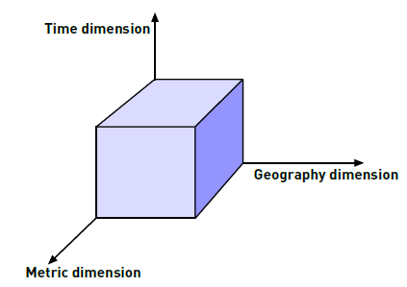
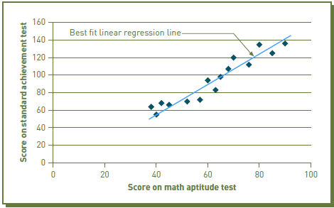
BI & Analytics
* BI & Analytics tools
- Online analytical processing
- Drill-down analysis
- Linear regression
Notes:
BI & Analytics tools
OLAP is a method to analyze multidimensional data from many different perspectives
Databases built to support OLAP processing consist of data cubes
Data cubes contain numeric facts called measures, which are categorized by dimensions, such as time and geography
A simple example would be a data cube that contains the unit sales of a specific product as a measure
The time dimension might be a specific day, whereas the geography dimension might define a specific store
Drill-down analysis involves the interactive examination of high-level summary data in increasing detail to gain insight into certain elements
—sort of like slowly peeling off the layers of an onion.
For example, in reviewing the worldwide sales for the past quarter, we might want to drill down to view the sales for each country
Linear regression is a mathematical technique for predicting the value of a dependent variable
based on a single independent variable and the linear relationship between the two
It consists of finding the best fitting straight line through a set of observations
The most commonly used measure for the best-fitting line is the line that minimizes the sum of the squared errors of prediction.
This best fitting line is called the regression line
Linear regression does not mean that one variable causes the other
it says that when one value goes up, the other variable also increases or decreases proportionally

Slide 7
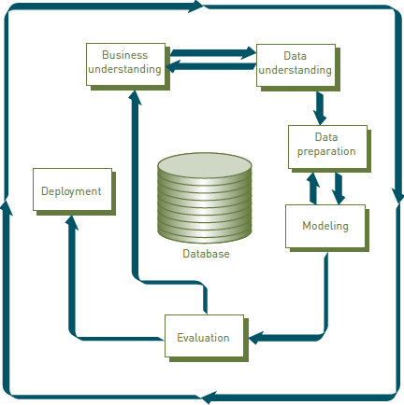
BI & Analytics
* BI & Analytics tools
- Data mining
Notes:
Data mining tools enable organizations to make predictions about what will happen
Three most commonly used data mining techniques are:
Association analysis (a specialized set of algorithms sorts through data and forms statistical rules about relationships among the items),
Neural computing (historical data is examined for patterns that are then used to make predictions),
Case-based reasoning (historical if-then-else cases are used to recognize patterns).
The Cross-Industry Process for Data Mining (CRISP-DM) is a six-phase structured approach for the planning and execution of a data mining project
An example showing how data mining can be used:
Based on past responses to promotional mailings, identify those consumers most likely to take advantage of future mailings.

Slide 8
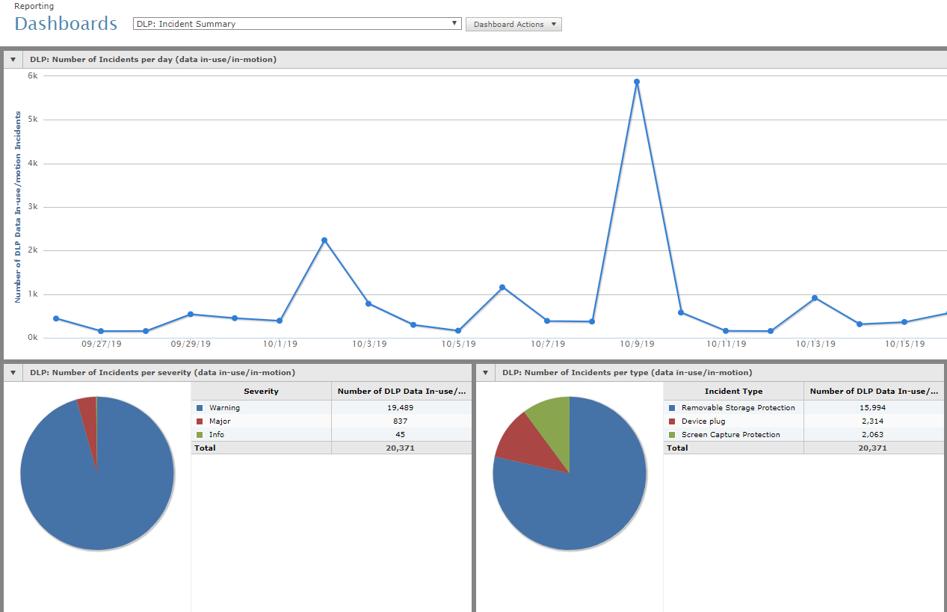
BI & Analytics
* BI & Analytics tools
- Dashboards
Notes:
A dashboard presents a set of KPIs about the state of a process at a specific point in time.
key performance indicator (KPI): a measurable value used to evaluate the organization’s success at reaching targets
As different organizations have different goals, various organizations will have different KPIs
If you work in the highway division of a transportation authority,
a KIP could be to track the average driver’s speed from July to November, as many accidents happened during this time the previous year
Here is a sample dashboard from DLP orchestrator.
Self-service analytics includes training, techniques, and processes that
empower end users to work independently to access data from approved sources
to perform their own analyses using a set of tools.
In the past, such data analysis could only be performed by data scientists.
Selfservice analytics encourages nontechnical end users to make decisions based on facts and analyses rather than intuition.

Slide 9
Knowledge Management
* KM def.
- Discovering
- Capturing
- Sharing
- Applying
* Aim
to enhance the impact of knowledge
Notes:
Knowledge management
performing the activities involved in discovering, capturing, sharing, and applying knowledge
to enhance the impact of knowledge on the organization’s goal achievement.

Slide 10
Knowledge Management
* KM solutions
- Processes
- Systems
- Mechanisms & technologies
- Infrastructure
Notes:
Knowledge management solutions
refer to the variety of ways in which KM can be facilitated
KM processes
KM systems
KM mechanisms and technologies
KM infrastructure

Slide 11
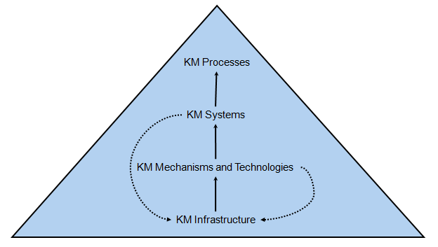
Knowledge Management
Notes:
Knowledge management systems
are the integration of technologies and mechanisms that are developed to support KM processes

Slide 12
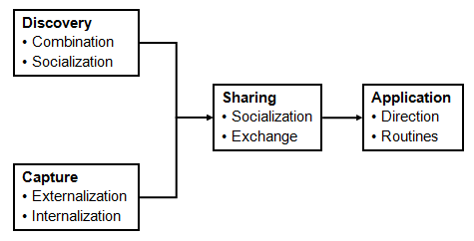
Knowledge Management
Notes:
Knowledge management processes
Here are the KM processes

Slide 13
Knowledge Management
* Knowledge discovery
- Tacit
- Explicit
* Knowledge capture
- Externalization
- Internalization
Notes:
Knowledge discovery
Development of new tacit or explicit knowledge from data and information or from the synthesis of prior knowledge.
Explicit knowledge is knowledge that is documented, stored, and codified.
Tacit knowledge is the know-how that someone has developed as a result of personal experience.
Knowledge capture
Retrieving either explicit or tacit knowledge that resides within people or organizational entities.
Externalization involves converting tacit knowledge into explicit forms
such as words, concepts or visuals.
Internalization is the conversion of explicit knowledge into tacit knowledge.
It represents the traditional notion of “learning”

Slide 14
Knowledge Management
* Knowledge sharing
* Knowledge applying
- Direction
- Explicit
Notes:
Knowledge sharing
the process through which explicit or tacit knowledge is communicated to other individuals
Knowledge applying
Direction: individuals possessing the knowledge direct the action of another individual without transferring to that person the knowledge
Routines: involve the utilization of knowledge embedded in procedures, rules, and norms that guide future behavior

Slide 15
Knowledge Management
* KM mechanisms
- learning by doing
- on-the-job training
- learning by observation
- face-to-face meetings
Notes:
Examples of KM mechanisms include
learning by doing,
on-the-job training,
learning by observation,
and face-to-face meetings

Slide 16
Knowledge Management
* KM technologies
- AI
- electronic discussion
- simulation
- DBs
- DSSs
- ERP systems
- Expert systems
- MISs
- Videoconferencing
- Repositories
Notes:
Technologies that support KM
artificial intelligence (AI) technologies,
electronic discussion groups,
computer-based simulations,
databases,
decision support systems,
enterprise resource planning systems,
expert systems,
management information systems,
videoconferencing,
and information repositories (encompassing best practices databases and lessons learned systems)

Slide 17
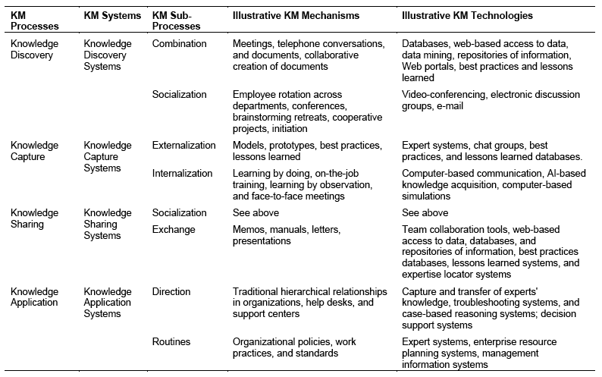
Knowledge Management
Notes:
Here we see KM processes, systems, mechanisms, and technologies

Slide 18
Knowledge Management
* KM infrastructure
- Organizational Culture
- Organizational Structure
- Information Technology Infrastructure
- Common Knowledge
- Physical Environment
Notes:
Organizational culture reflects the norms and beliefs that guide the behavior of the organization’s members
Organizational Structure: Hierarchical structure of the organization
The IT infrastructure includes data processing, storage, and communication technologies and systems
Common knowledge refers to the organization’s cumulative experiences,
helps enhance the value of an individual expert’s knowledge by integrating it with the knowledge of others
Physical environment includes the design of buildings and the separation between them.

Slide 19
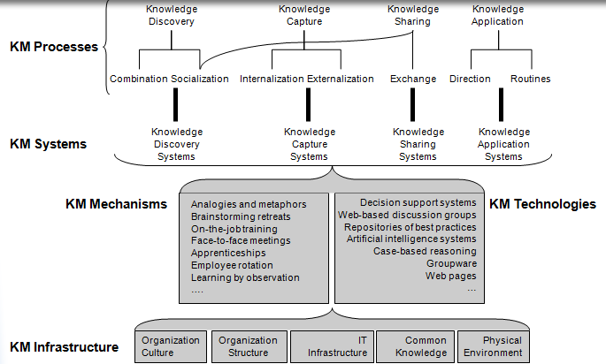
Knowledge Management
Notes:
Organizational culture reflects the norms and beliefs that guide the behavior of the organization’s members
Organizational Structure: Hierarchical structure of the organization
The IT infrastructure includes data processing, storage, and communication technologies and systems
Common knowledge refers to the organization’s cumulative experiences,
helps enhance the value of an individual expert’s knowledge by integrating it with the knowledge of others
Physical environment includes the design of buildings and the separation between them.

