Slide 1
The Revolutionary War
AKE 117 American History I
Dr. Gamze kati gumus

Slide 2
A City upon A Hill
“For we must Consider that we shall be as a City upon a Hill, the eyes of all people are upon us…” John Winthrop from A Model of Christian Charity, 1630
“You are the light of the world. A city on a hill cannot be hidden.” Matthew 5:14

Slide 3
Thirteen Colonies
New Hampshire
Massachusetts
Connecticut
Rhode Island
New York
New Jersey
Pennsylvania
Delaware
Maryland
Virginia
North Carolina
South Carolina
Georgia

Slide 4
The First Continental Congress (1774)
Twelve Colonies came together and formed the First Continental Congress.
Georgia did not send a delegate because they were attacked by the Creek and needed the support of British soldiers.

Slide 5
From Journals of the Continental Congress - The Articles of Association; October 20, 1774
“We, his majesty's most loyal subjects, the delegates of the several colonies of….
“To obtain redress of these grievances, which threaten destruction to the lives liberty, and property of his majesty's subjects, in North-America, we are of opinion, that a non-importation, non-consumption, and non-exportation agreement, faithfully adhered to, will prove the most speedy, effectual, and peaceable measure.”
https://avalon.law.yale.edu/18th_century/contcong_10-20-74.asp
Notes:
From https://avalon.law.yale.edu/18th_century/contcong_10-20-74.asp

Slide 6
The Second Continental Congress (May 1775)
Olive Branch Petition: Claimed loyalty to the King
Declaration of the Causes and Necessities: Denied the intention of separation from Great Britain

Slide 7
The Midnight Ride of Paul Revere (April 1775)
General Thomas Gage received orders to arrest Sam Adams and John Hancock, rumored to be near Lexington(Mass.). When Gage heard that the colonists had stockpiled guns and powder in Concord, he decided to act. * Upon learning the intention of Commander Gage to arrest rebels, Revere rode to Lexington to warn Adams and Hancock.
Notes:
From https://www.loc.gov/classroom-materials/united-states-history-primary-source-timeline/american-revolution-1763-1783/first-shorts-of-war-1775/
Image from https://allthingsliberty.com/2014/04/did-paul-reveres-ride-really-matter/

Slide 8
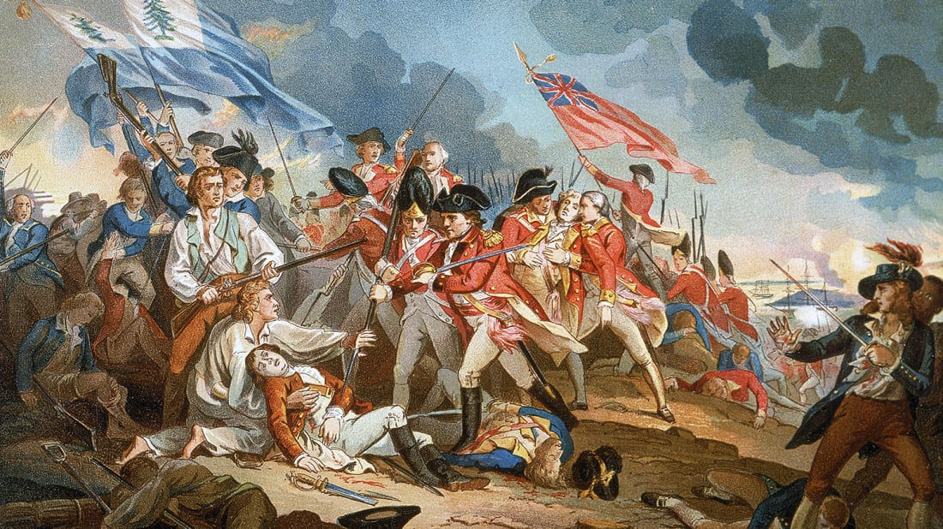
The Battle of Bunker Hill (June 1775)
The first formal battle of the Revolution.
The British took control of the Breed’s Hill and the Charlestown Peninsula, yet they lost many soldiers in the pursuit of this costly victory.
Notes:
Image from https://www.mentalfloss.com/article/503234/11-facts-about-battle-bunker-hill

Slide 9
What came up next…
The Second Continental Congress
Created a Continental army
Appointed George Washington of Virginia as commander
Issued paper money to support colonial troops
Formed a committee to negotiate with foreign countries

Slide 10
The Declaration of Independence
Notes:
Image from https://daretoventure.org/8-things-you-didnt-know-about-the-declaration-of-independence/

Slide 11
The Declaration of Independence (July 4, 1776)
When in the Course of human events, it becomes necessary for one People to dissolve the Political Bands which have connected them with another, and to assume among the Powers of the earth, the separate and equal Station to which the Laws of Nature and of Nature’s God entitle them, a decent Respect to the Opinions of Mankind requires that they should declare the causes which impel them to the Separation.
[…]
We, therefore, the Representatives of the united States of America, in General Congress, Assembled, appealing to the Supreme Judge of the World for the Rectitude of our Intentions, do, in the Name, and by Authority of the good People of these Colonies, solemnly Publish and Declare, That these United Colonies are, and of Right ought to be Free and Independent States; that they are absolved from all Allegiance to the British Crown, and that all political Connection between them and the State of Great-Britain, is and ought to be totally dissolved; and that as Free and Independent States, they have full Power to levy War, conclude Peace, contract Alliances, establish Commerce, and to do all other Acts and Things which Independent States may of right do. —And for the support of this Declaration, with a firm Reliance on the Protection of divine Providence, we mutually pledge to each other our Lives, our Fortunes, and our sacred honor.

Slide 12
Notes:
Recruitment poster

Slide 13
The War of Independence (1775-1783)
England was in an advantaged position with a powerful navy, a professional army, and 50,000 troops in America.
Americans, on the other hand, did only have an army of amateurs, comprised of 5,000 troops.
And yet, the untamed nature of America as well as the logistic and communicational difficulties became disadvantageous to the British army.

Slide 14
The War of Independence (1775-1783)
In the North, General Burgoyne surrendered to General Horatio Gates in October 1777.
The French secretly supplied money and arms to Americans in an effort to avenge its defeat by the British in the Seven Years’ War.
Franklin visited Paris as the unofficial American ambassador, and King Louis XVI signed two treaties with the United States in February 1778.
In 1778, the British offered Americans a return to the imperial status before 1763.
In 1769, Spain became allies with France to recover its losses from England.

Slide 15
The War of Independence (1775-1783)
After 1778, putting down rebellion became secondary to Britain’s global struggle with France and Spain.
The British thought they would gain support in the South, based on their assumption that the loyalist population was in fear of Indian raids and slave uprisings.
American army under two different generals (Lincoln and Gates) was defeated, but angry Southerners helped with guerilla attacks.
At Yorktown, the combined American and French army of nearly 17,000 men forced Cornwallis to surrender in October 1781.

Slide 16
Home Front
Many Native American tribes remained neutral. Some supported the British since the British had worked hard to protect native lands from colonials.
Some African American slaves in the South were recruited and freed by the British. Some escaped during the chaos. And some gained freedom by fighting in the Continental army.
Women, whose husbands or male relatives went to fight, assumed the responsibilities which previously belonged to men. Many did not have land or business, hence there were many impoverished women. Some of them joined their relatives in the army camps.
A great tension between the patriots and loyalists ensued.
$250 million were issued in Continental paper money. However, the inflation could not be controlled because there was too much money for too few goods. Therefore, the continental money was almost worthless.
Notes:
From https://www.loc.gov/classroom-materials/united-states-history-primary-source-timeline/american-revolution-1763-1783/revolutionary-war-home-front/

Slide 17
The Treaty of Peace (1783)
Although the war was won, the United States had to reconcile its objectives with France and Spain.
France and Spain wanted Britain to be humiliated, but neither monarchies wanted an independent American republic-especially the Spanish who had colonies in South America.
In September, the American negotiators in Europe discovered that the French foreign minister had sent his secretary on a secret trip to London. They were convinced of French duplicity.*
Franklin, Adams and Jay decided to negotiate with Britain alone despite the Continental Congress’ instruction not to do so.
Notes:
From https://www.loc.gov/classroom-materials/united-states-history-primary-source-timeline/american-revolution-1763-1783/revolutionary-war-groping-toward-peace-1781-1783/

Slide 18
The Treaty of Peace (1783)
Great Britain recognized American independence, and agreed to much more generous boundaries than France and Spain.
The negotiators later persuaded France, and thus Spain was compelled to compromise.
The treaty (also known as the Treaty of Paris) was signed in Paris on September 7, 1783.

Slide 19
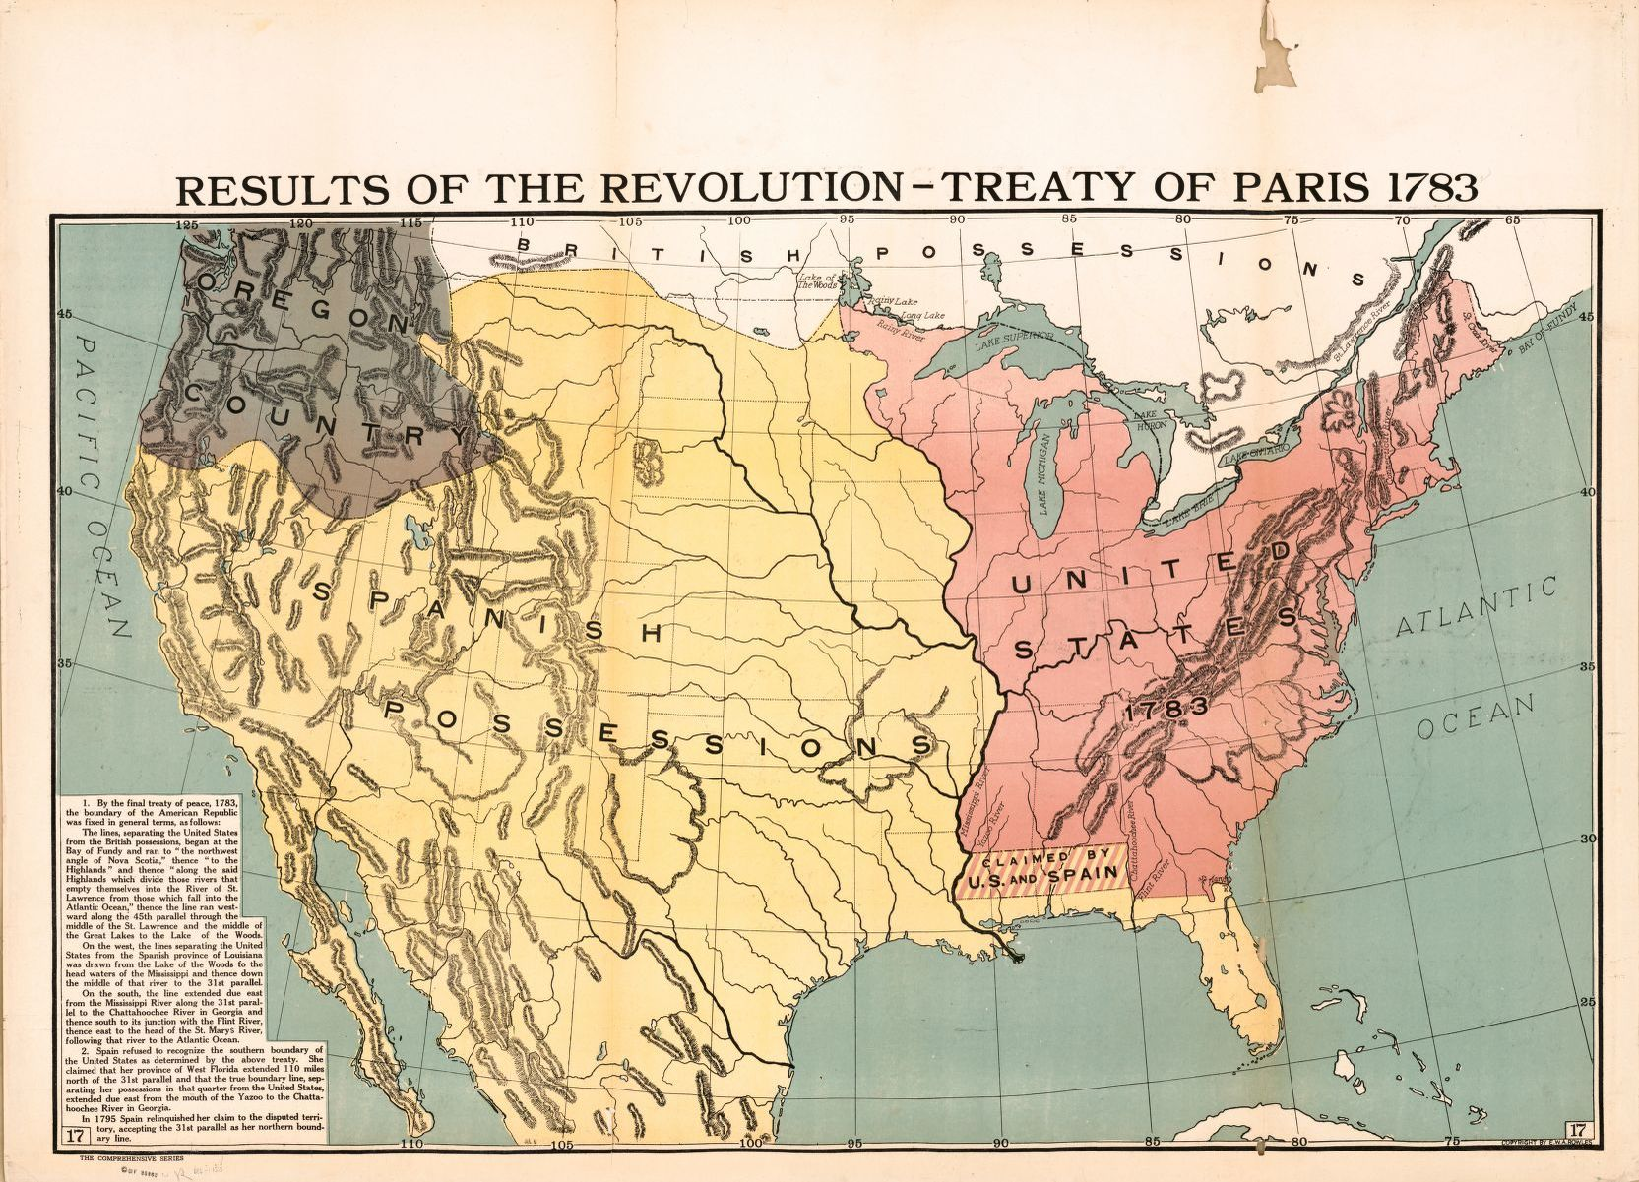

Slide 20
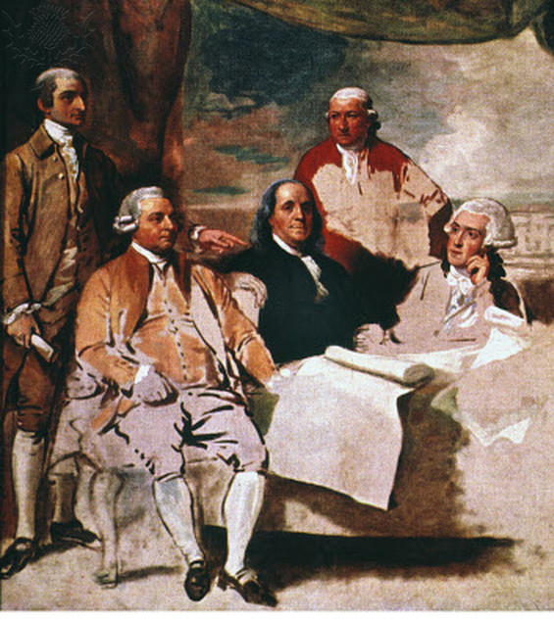
American Peace commissioners, left to right: John Jay, John Adams, Benjamin Franklin, Henry Laurens,, and William Temple Franklin (B. Franklin’s grandson and secretary). Unfinished painting (because the British commissioners refused to pose) by Benjamin West.
Notes:
From https://readitreadit.wordpress.com/2019/09/03/10173/

Slide 21
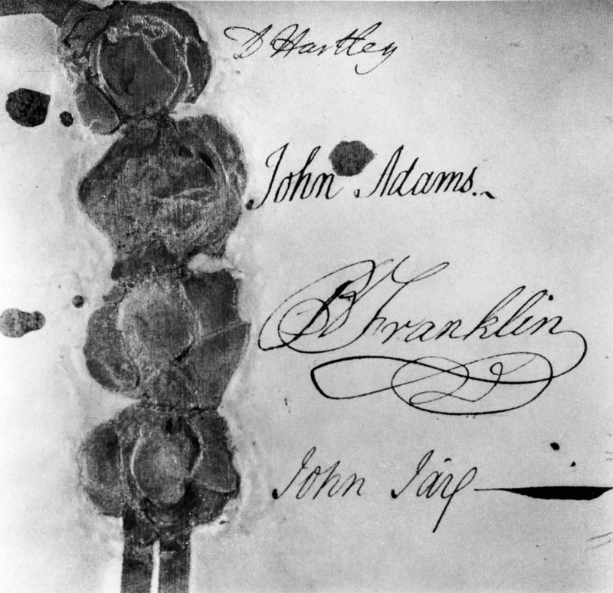
Photograph of the signatures and seals of the 1783 Treaty of Paris. The signatures are English politician David Hartley (1731-1813) (representative of Britain), American politicians John Adams (1735?-1826), Benjamin Franklin (1706 -1790), and John Jay (1745?-1829). (Photo by Archive Photos/Getty Images)
Notes:
From https://readitreadit.wordpress.com/2019/09/03/10173/

Slide 22
Chronology
1774
First Continental Congress meets in Philadelphia.
1775
Battle of Lexington and Concord
1775
Second Continental Congress meets in Philadelphia.
1775
Battle of Bunker Hill
1776
Declaration of Independence
1778
Military alliance with France
1789
Spain enters war against Britain
1781
Cornwallis surrenders
1783
Treaty of Peace signed with Britain

