Slide 1
PRION DISEASES
Transmissible Spongiform Encephalopathies

Slide 2
In animals,
Scrapie - In the Sheep
BSE – Bovidae
Feline transmissible spongiform Encephalopathy (FSE)-- Cats
Transmissible Mink Encephalopathy - MinkMule, Deer and Elk's TE
In humans,
Kuru
Creutzfeldt-Jakob Disease (CJD)
nvCJD
Gertsmann-Straussler-Scheinker Syndrome
Fatal Familial insomnia

Slide 3
Etiology
The transmissible spongiform encephalopathies (TSEs) are a group of neurodegenerative disorders caused by prions, infectious proteins that appear to replicate by converting a normal cellular protein into copies of the prion.
The cellular protein, which is called PrP^{c} , is found on the surface of neurons.
Pathogenic isoforms of PrP^{c} are designated PrP^{res} (The ‘res’ refers to the proteinase K-resistant nature of prions, compared to normal PrP^{c}).
PrP^{Sc} or PrP^{TSE} are other names for this protein.
Prions that cause different diseases (e.g. BSE or scrapie) are considered to be different strains of PrP^{res} .

Slide 4
Characteristics of Prions
PrP^{sc} is an isoform which has less alpha helix and more beta-pleated sheet than PrP^{c}, it is more proteinase-k-resistant than PrP^{c}.
PrP^{sc}, but not PrP^{c}, self-aggregates into fibrils which appear as rods of amyloid in infected brains.
The glycosylation sites are involved in the self aggregation of PrP^{sc}.
PrP^{sc} is antigenically distinct from PrP^{c} but does not induce an immune response in the host.

Slide 5
Different pathotypes induce clinical disease after different incubation times- the agent therefore has some inherited variability.
Infectivity is not destroyed by ultraviolet light or nucleases which destroy nucleic acid as if any nucleic acid is highly protected or absent.
The catalysis of PrP^{c} into PrP^{sc}, may depend on solely upon the interaction between the infective PrP^{sc} and host PrP^{c} without any nucleic acid replication.
The physical inactivation rate is 134-138 ºC, 18 minutes in the autoclave.
It is also very resistant to processes such as alcohol, formol, UV.

Slide 6
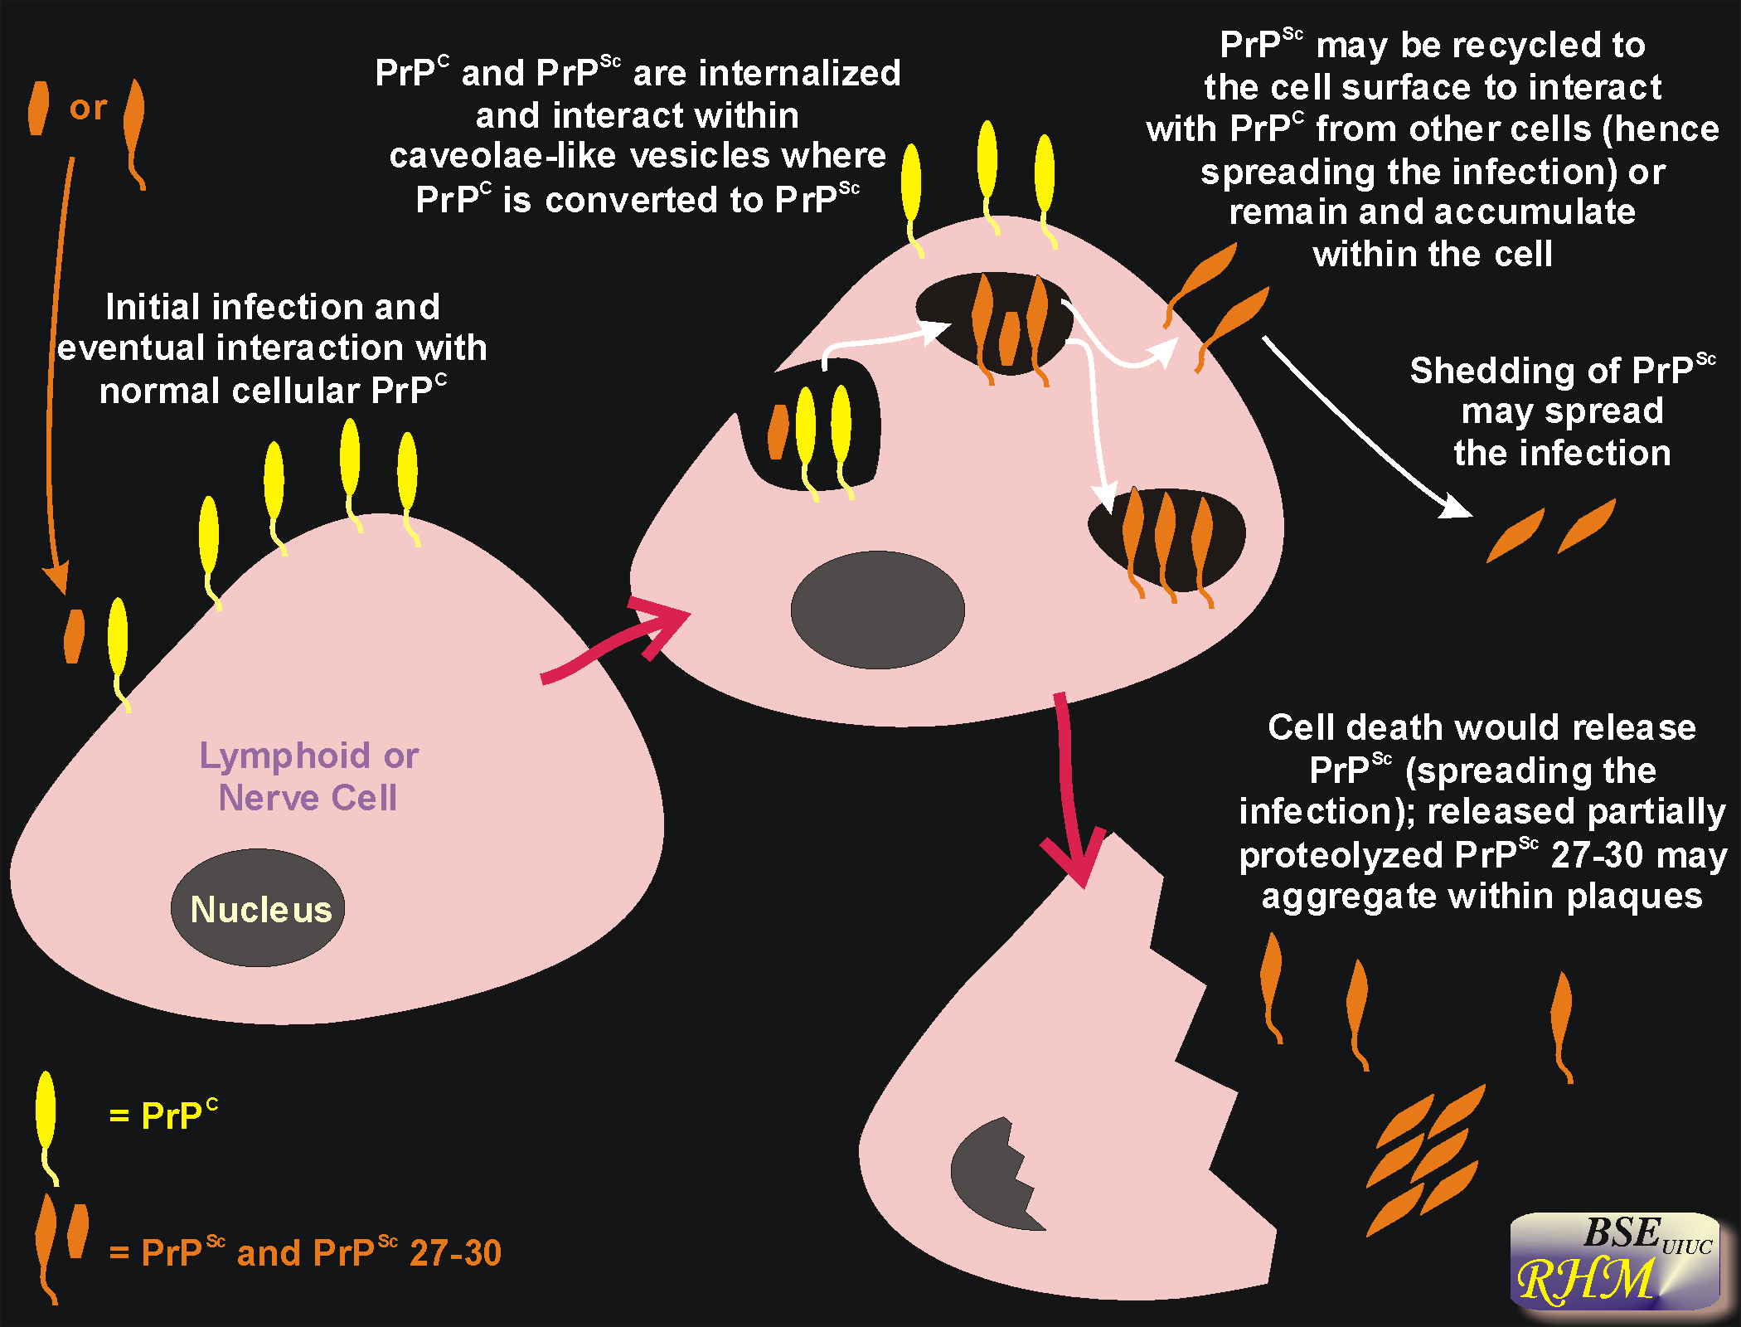

Slide 7
SCRAPIE

Slide 8
Scrapie is a neurodegenerative disease, caused by a prion, that affects sheep, and less frequently, goats.
Infected animals do not usually become ill for years; however, the clinical signs are progressive and invariably fatal once they develop.
The presence of classical scrapie can result in trade sanctions, and many countries are conducting control or eradication programs.
Notifable Disease

Slide 9
As a result of increased surveillance, atypical (Nor98) scrapie prions have been detected in both sheep and goats.
Atypical scrapie often occurs in sheep that are genetically resistant to classical scrapie.
It has been reported in countries that do not have classical scrapie.
Atypical/ Nor98 prions do not seem to be transmitted readily between animals in nature, and are rarely detected in more than one animal in a herd or flock.

Slide 10
Ethiology
Scrapie is a member of the TSEs, a group of neurodegenerative disorders caused by prions, infectious proteins that seem to replicate by converting a normal cellular protein into copies of the prion.
The pathogenic isoforms of PrP^{c} found in animals with scrapie are designated PrP^{res} (‘res’ refers to the proteinase K-resistant nature of prions, compared to normal PrPc ).
Other names used for this protein are PrP^{Sc} (‘Sc’ for scrapie), PrPTSE or PrP^{d} (‘d’ for disease-associated).

Slide 11
Classical scrapie is an infectious disease that can be caused by multiple strains of the classical scrapie prion.
Atypical (or Nor98) scrapie prions were first detected in Norway in 1998, although they have also been found in older archived samples from Europe.
Classical scrapie can affect domesticated sheep and goats and possibly other animals closely related to sheep and goats.
Atypical (Nor98) scrapie has been reported in sheep and goats.
There is no evidence that humans have ever been infected with scrapie. Epidemiological studies have found no links between scrapie and any human prion diseases.

Slide 12
Transmission
Infected animals carry the scrapie prion for life, and can transmit the agent even if they remain asymptomatic.
Infections are thought to occur primarily by ingestion,
but sheep can also be infected experimentally via
the conjunctiva or nasal cavity,
by injection into various body sites,
probably through abraded skin.
Most sheep are thought to become infected from their dam, either at or soon after birth.
Spread is usually from ewe to lamb : by drinking of amniotic fluid in utero,; by transfer of lymphocytes from colostrum/milk /nasal secretions/placental material into skin abrasions.

Slide 13
Clinical Signs
The incubation period for classical scrapie is estimated to be 2-7 years in most animals, with peak prevalence occurring at 2-5 years of age in sheep.
Signs of illness are rare in animals less than a year old.
The incubation period for atypical scrapie is uncertain, but it is usually seen in older animals than classical scrapie
Scrapie is always fatal once the clinical signs appear.
Classical scrapie is most common in 2 to 5 year-old sheep, and signs of illness are rare in animals less than a year of age.

Slide 14
Classical Scrapie
The signs of classical scrapie can be variable in sheep and the first clinical signs are usually behavioral.
Affected sheep tend to stand apart from the flock and may either trail or lead when the flock is driven.
Animals may also develop have an impaired menace response or carry their heads low.
Sheep first appear hyperexcitable with an erect head and high-stepping gait.
grind their teeth,
Sheep make lip movements when their back is scratched.
Later on muscle tremors (especially of the head and neck), bilateral intense pruritis or stupor and finally ataxia may develop with accompanying anorexia and emaciation.

Slide 15
A domestic sheep in the later stages of Scrapie. Image from http://academics.wellesley.edu/Chemistry/Chem101/aspirin/1mouton%20scrapie.jpg
Sheep, whole body. Alopecia due to trauma that is secondary to scrapie.

Slide 16
Drinking behavior and urination can also change, with some sheep drinking small quantities of water often.
Most animals die within a few weeks to several months after the onset of clinical signs.
Atypical Scrapie
Incoordination and ataxia seem to be the most prominent clinical signs in sheep with atypical/ Nor98 scrapie.
Pruritus appears to be minimal or uncommon, although it has been seen in some animals.
Loss of body condition, anxiety, tremors, abnormal menace responses or a subdued mental status have been reported in some cases, but not others.

Slide 17
Post Mortem Lesions
There are no characteristic gross lesions in classical or atypical scrapie, although there may be nonspecific changes such as wasting or emaciation, and skin or wool lesions resulting from pruritus.
The histopathological lesions of scrapie are usually (though not always) bilaterally symmetrical.
The characteristic lesions of classical scrapie are noninflammatory spongiform changes, with neuronal vacuolation, in the CNS.
Brain. The red box indicates the region of the obex, which is the portion of the brain that must be obtained for the diagnosis of TSE and other spongiform encephalopathies such as scrapie and chronic wasting disease

Slide 18
Vacuoles are seen throughout the brain parenchyma. Proliferating reactive astrocytes have been counter-stained and appear brown.
Higher Magnification. Single large empty vacuoles are seen in each of two neurons. These cytoplasmic vacuoles push the nucleus and other normal contents of cytoplasm to margins of the cell.
http://research.vet.upenn.edu/FieldInvestigations/SEImages/SCRAPIE/tabid/1609/Default.aspx

Slide 19
Diagnosis
Both classical and atypical scrapie can be diagnosed after death by detecting prions in the CNS.
Classical scrapie can be diagnosed in live sheep by detecting prions in biopsies from the nictitating membrane (third eyelid test), palatine tonsil or rectoanal mucosaassociated lymphoid tissue. They have also been found sometimes in superficial lymph nodes.

Slide 20
Immunoblotting (Western blotting) and immunohistochemistry are the most specific assays for detecting prions.
Immunoblotting can also distinguish atypical/Nor98 scrapie from classical scrapie.
Various rapid tests for classical scrapie, based on ELISAs, automated immunoblotting or other techniques, are available in some countries.
Highly sensitive assays, including protein misfolding cyclic amplification (PMCA) and quaking-induced conversion (QuIC) or real-time quaking-induced conversion (RT-QuIC), may be able to identify infected animals earlier than immunoblotting or immunohistochemistry.
Serology is not useful for diagnosis, as antibodies are not made against prions.

Slide 21
Control and Prevention
Complete decontamination of prion-contaminated tissues, surfaces and environments can be difficult.
These agents are very resistant to most disinfectants, including formalin and alcohol.
They are also resistant to
heat,
ultraviolet,
microwave and ionizing radiation,
particularly when they are protected in organic material or preserved with aldehyde fixatives, or when the prion titer is high.

Slide 22
A 1-2 N sodium hydroxide solution, or a sodium hypochlorite solution containing at least 2% (20,000 ppm) available chlorine, has traditionally been recommended for equipment and surfaces.
Surfaces should be treated for more than 1 hour at 20°C (68°F). Overnight disinfection is recommended for equipment.
Physical inactivation of prions can be carried out by porous load autoclaving at 134°C (273°F) for 18 minutes at 30 lb/in² .
A combination of chemical and physical decontamination can be more effective than either procedure alone, and effective combinations of chemical agents (e.g., NaOH) and autoclaving have been published.

Slide 23
Bovine Spongiform Encephalopathy
Mad Cow Disease, BSE

Slide 24
Bovine spongiform encephalopathy (BSE) is a fatal neurodegenerative disease, caused by a prion, that mainly affects cattle.
Other ruminants, cats, nonhuman primates and humans are occasionally affected;
feline spongiform encephalopathy (FSE) in cats,
and variant Creutzfeldt-Jakob disease (vCJD) in people.
BSE is primarily acquired by eating prion-containing tissues from an infected animal.
Cooking and standard disinfection procedures do not destroy this agent.
Infected animals or people do not become ill for years; however, the disease is always progressive and fatal once clinical signs develop.
Notifable Disease

Slide 25
BSE was first reported in the United Kingdom in the 1980s.
Its origins are unknown; however, the recycling of ruminant tissues into ruminant feed amplified BSE prions and caused an explosive epidemic in the U.K.
This epidemic peaked in 1992, with almost 1,000 new cases diagnosed each week.
John W. Willesmith, (1998). MANUAL ON BOVINE SPONGIFORM ENCEPHALOPATHY, Epidemiology Department, Central Veterinary Laboratory

Slide 26
Etiology
BSE is a member of the transmissible spongiform encephalopathies (TSEs), a group of neurodegenerative disorders caused by prions, infectious proteins that appear to replicate by converting a normal cellular protein into copies of the prion.
The cellular protein, which is called PrP^{c} , is found on the surface of neurons.
Pathogenic isoforms of PrP^{c} are designated PrP^{res} (The ‘res’ refers to the proteinase K-resistant nature of prions, compared to normal PrP^{c}). PrPS^{c} or PrP^{TSE} are other names for this protein.
Prions that cause different diseases (e.g. BSE or scrapie) are considered to be different strains of PrP^{res} .

Slide 27
BSE mainly occurs in cattle, but the host range of this prion is unusually broad compared to most prions.
Rare clinical cases have been reported from goats; exotic ruminants in zoos, kudu, gemsbok, eland, Arabian oryx, scimitar-horned oryx, ankole cattle and North American bison; various felids including housecats, cheetahs, pumas, ocelots, tigers.
Humans occasionally develop variant Creutzfeldt-Jakob disease after eating prion-containing tissues from an infected animal. To date, all known cases have been caused by the classical BSE prion.

Slide 28
Transmission
BSE is usually transmitted when an animal or human ingests tissues containing the BSE prion.
Young animals may be particularly susceptible: some studies suggest that most cattle become infected with BSE during the first six months of life.
Sheep are, likewise, most susceptible to experimental (oral) inoculation during the first few months of life, especially during the first few weeks.
In cattle, the prions are thought to replicate initially in the Peyer’s patches of the ileum, then are transported via the peripheral nerves to the central nervous system (CNS).

Slide 29
The highest prion concentrations occur in the CNS (both the brain and spinal cord) and in the ileum.
There is no evidence that BSE is transmitted horizontally between cattle; however, there is an unexplained increase in the risk of BSE among the offspring of infected animals.
https://biogeekery.wordpress.com/2013/01/29/prions-ii-the-diseases/

Slide 30
In humans, variant Creutzfeldt-Jakob disease usually results from eating BSE prions in contaminated animal tissues.
Several patients were infected via blood transfusions from asymptomatically infected individuals, and highly sensitive prion detection techniques have found BSE prions in the blood of some symptomatic patients.
There is also the potential for transmission by routes such as transplantation or the use of prion-contaminated equipment during surgeries.

Slide 31
Clinical Signs
The incubation period for classical BSE is estimated to be 2 to 8 years in cattle, and might be longer than a decade in a few instances.
Published incubation periods in sheep fed BSE prions have ranged from approximately 1.5 years to more than 6 years

Slide 32
Bovine spongiform encephalopathy is a neurological disease that usually has an insidious onset in cattle.
The clinical signs may include
gait abnormalities (particularly hindlimb ataxia) and difficulty negotiating obstacles,
low carriage of the head,
hyperresponsiveness to stimuli,
tremors
behavioral changes such as aggression, nervousness
apprehension,
changes in temperament,
even frenzy
Intense pruritus is not usually seen in cattle, but some animals may lick or rub persistently.
Nonspecific signs include loss of condition, weight loss, teeth grinding (possibly due to visceral pain or neurological disease) and decreased milk production.

Slide 33
Post Mortem
Gross lesions are not found in BSE, with the exception of nonspecific signs, such as emaciation or wasting.
The histopathologic lesions are confined to the CNS.
Neuronal vacuolation and non-inflammatory spongiform changes in the gray matter are characteristic of the disease in cattle.

Slide 34
Diagnosis
There is no live animal test for BSE.
This disease is usually diagnosed by detecting prions (PrP^{res}) in the CNS.
Sampling of the whole brain is mainly done at the level of the obex; however, the brainstem can be sampled through the foramen magnum for some purposes (e.g., for surveillance with rapid tests).
Immunoblotting or immunohistochemistry are the most specific assays.
A number of rapid diagnostic tests based on ELISAs, automated immunoblotting (Western blotting) and lateral flow assays are also available.
Rapid tests allow large numbers of samples to be screened, and are often used in surveillance and slaughter testing.
Positive samples in rapid tests are traditionally confirmed with immunohistochemistry or immunoblotting.

Slide 35
Control and Prevention
An effective strategy for preventing the introduction or dealing with occurrences of BSE includes:
targeted surveillance of occurrences of clinical neurological disease;
transparency in reporting findings of BSE;
safeguards on importation of live ruminant species and their products, in accordance with the OIE Terrestrial Code;
removal of specified risk material (SRM) (brain, spinal column) during slaughter and processing of carcasses;
prohibit the inclusion of SRM in animal feeds, thus removing potentially contaminated material from the food chain;
humane destruction of all suspected and susceptible animals exposed to contaminated feed (OIE Terrestrial Animal Health Code);
appropriate disposal of carcasses and all animal products (OIE Terrestrial Animal Health Code);
livestock identification to enable effective surveillance and tracing of suspected livestock.

Slide 36
Bakanlığımızca Alınan Önlemler
BSE hastalığının ortaya çıkışından itibaren konu Bakanlığımızca dikkatle izlenmektedir. Ülkemiz insan ve hayvan sağlığının korunması amacıyla hastalık görülen ülkelerden çift tırnaklı canlı hayvan, hayvan maddeleri, hayvansal orijinli yem katkı maddeleri ve bu maddeleri ihtiva eden yemlerin ithal edilmesi 25.05.1990 tarihinde yasaklanmıştır.
Ülkemizde Bakanlığımıza bağlı Veteriner Kontrol ve Araştırma Enstitüleri bünyesindeki laboratuvarlarda, sığırlarda sinirsel bulgularla seyreden çeşitli hastalıkların teşhisi maksadıyla incelenen merkezi sinir sistemi dokularında BSE’nin tanıtıcı bulguları tespit edilmemiştir. Mevcut diğer bilimsel kurumlarda da hastalığın tespit edildiğine dair bir kayıt bulunmamaktadır.
Bakanlığımız devam etmekte olan teşhis çalışmalarına ek olarak, mezbahalarda kesime alınan hayvanlarda hastalık taramasını başlatmak için hazırlıklarını sürdürmekte, yine konu ile ilgili eğitici çalışmalara ağırlık vermektedir.

Slide 37
References
http://www.cfsph.iastate.edu/Factsheets/pdfs/scrapie.pdf
http://www.cfsph.iastate.edu/Factsheets/pdfs/bovine_spongiform_encephalopathy.pdf
http://www.oie.int/doc/ged/D13944.PDF
http://www.oie.int/fileadmin/Home/eng/Animal_Health_in_the_World/docs/pdf/2.04.06_BSE.pdf

Slide 38
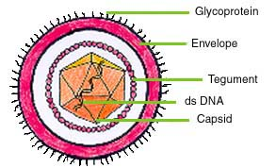
HERPESVIRIDAE

Slide 39
These large viruses cause many diseases which involve erosions/necrotic lesions of the the resp tract, brain, blood vessels, placenta and urinogenital tract
eg infectious bovine/feline rhinotrachietis, pseudorabies, equine abortion.
Structure
Herpesviruses have double stranded DNA enclosed in an icosahedral capsid to a diameter of 100‑150 nm.
The envelope glycoproteins are the most important vaccinal antigens.
Nucleus replication
Latency following primer infection
There are 3 subgroups.

Slide 40
Herpesviridae
Sub Family
Alphaherpesvirinae
Betaherpesvirinae
Gammaherpesvirinae

Slide 41
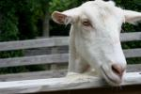
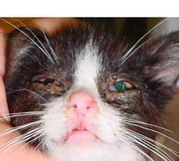
Alphaherpesvirinae
Bovine Herpes Virus
Type 1,2,5
Equine Herpes Virus Type 1,3,4
Caprine Herpes Virus
Type 1
Canine Herpes Virus
Type 1
Feline Herpes Virus Type 1
Porcine Herpes Virus
Type 1

Slide 42
Betaherpesvirinae
In this subgroup, there are viruses that cause infection in humans. Only SHV2, which affects rhinitis in pigs, is present in this group.

Slide 43
Gammaherpesvirinae
Cattle;
Bovine Herpes Virus Tip 4 ve Alcelaphine herpesvirus (BHV-3)
Horses;
Equine Herpes Virus Tip 2 ve Tip 5
Sheep;
Ovine Herpes Virus Tip 1 ve Tip 2
Goats;
Caprine Herpes Virus Tip 2

Slide 44
Herpesviruses are bad news for 4 reasons
1) Some infect crucial target tissues e.g. the brain and maternal placenta.
2) All become latent (as circular DNA in the nucleii of ganglia of lymphocytes) of recovered animals. Subsequent reactivation during stress causes disease or tumours.
3) All are cell-associated and can spread between cells by cell fusion. Inactivated vaccines which induce circulating antibody therefore do not work well and safe strong live vaccines which stimulate long term cytotoxic T cells are difficult to make. (DNA vaccines, with Th1 cytokine genes as adjuvants, are the answer if ever licensed)

Slide 45
4) Virulence is associated with presence of a thymidine kinase (tk) gene, so this is deleted from genetically engineered vaccines eg to Aujesky’s virus. Tk acclerates new DNA synthesis by salvaging thymidine from degraded DNA into TTP.

Slide 46
BOVINE MAMILLITIS BOVINE ULSERATIF MAMILLITIS PSEUDO LUMPYSKIN DISEASE

Slide 47
Bovine herpesvirus 2 (BHV-2) is the causative agent of two diseases.
I. The first is localized in the udder and called bovine herpes mammillitis.
II. The second is a generalized cutaneous form named Allerton disease or pseudo-lumpy skin disease, due to it’s similarity with the capripoxvirus infection causing lumpy skin disease.

Slide 48
Etiology
Alphaherpesvirinae
BHV-2
It is serologically one type
Antigenically close with human herpes viruses (herpes simplex 1 and 2).
Virus forms roundness, lysis, and intranuclear inclusions in bovine cells.

Slide 49
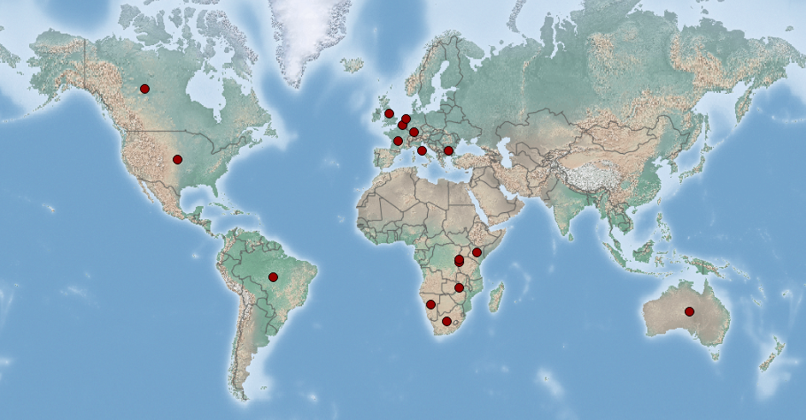
Cattle and buffalo are natural hosts of BHV-2. Sheep and goats can be experimentally infected and develop local lesions

Slide 50
BHV-II can occur sporadically or in outbreaks that often have a seasonal association with cold weather and may result in reduced milk production and increased susceptibility to bacterial mastitis.
The generalized form is often seen in South Africa, summer and autumn. Arthropods are thought to transmit the virus. However, vector identification was not performed.
Mamillitis form milking machines is the most important reason.
Arthropods have also been reported to be transmitted.
Outbreaks associated with the introducement of subclinical infected animals to the herd.

Slide 51
Clinical Signs
Bovine herpes mammillitis
This disease is usually observed in dairy cows during the second part of the year and usually heifers in 2 to 10 days after calving. It can also be observed in bulls.
The infection spreads within three weeks among the herd.
The virus is transmitted directly from animal to animal and indirectly by contaminated material.
Biting flies could also play a role in virus transmission.
The incubation period is 4 to 10 days.
The lesions are localized on the teats, and rarely on the udder and perinea.
The skin is swollen and translucent and some vesicles may be visible. The lesions appear blue or purple.
Teats are generally painful, and affected cows often resist milking, leading to development of mastitis.
They evolve as ulcers and resolve without complications within 4 weeks.
Suckling calves may become affected, showing the same lesions on the lips, the nose and in the mouth.

Slide 52
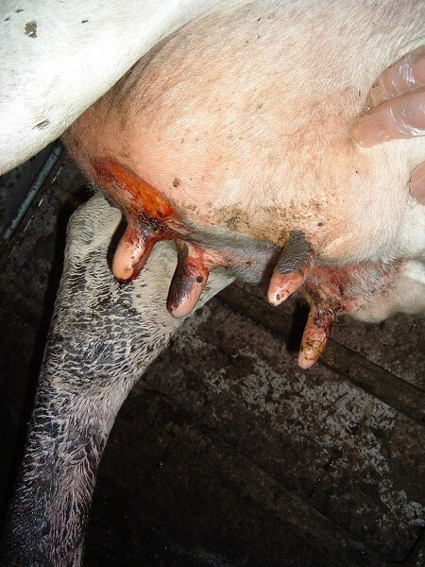
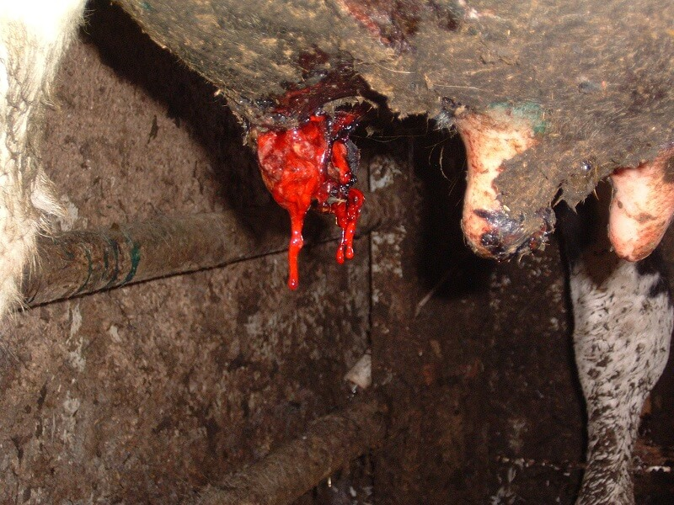
https://www.vetstream.com/treat/bovis/illustration/herpes-mammillitis-sloughing-teat-2

Slide 53
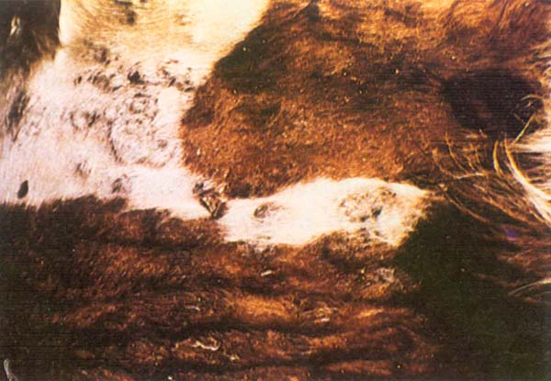
Pseudo-lumpy skin disease
Pseudo-lumpy skin disease is a generalized and febrile disease.
Circumscribed nodules suddenly appear on the skin of the whole body.
These nodules are hard, palpable and circular.
A slight depression is visible in their centre.
After a few days, necrosis follows, the nodules evolve as ulcers and are covered by scabs.
After 2 weeks, the lesions are resolved but leave areas provisionally devoid of hair.
http://www.fao.org/docrep/003/t0756e/T0756E03.htm

Slide 54
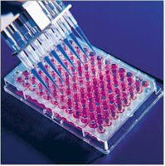
Diagnosis
Clinical diagnosis Bovine herpes mammillitis is suspected when the characteristic lesions appear on the teats, especially in late summer and early winter.
The disease must be differentiated from pseudo-cowpox.
Pseudo-lumpy skin disease produces lesions very close to these induced by lumpy skin disease. However, the slight depression observed in the centre of the nodules is characteristic of pseudo-lumpy skin disease. Laboratory
The virus can be isolated from the lesions, especially from vesicles when they are present.
The virus grows in most bovine cell lines, such as bovine embryonic kidney or testicle cells.
Serological diagnosis is achieved by seroneutralization.
Alternatively an ELISA can be performed for the detection of specific BHV-2 antibodies.

Slide 55
Prevention and Control
No commercial vaccine against BHV-2 is available.
Control is only performed during BHV-2 outbreaks, no preventative controls are used.
Affected cows should be isolated from the herd and milked separately.
The milking machine should be disinfected with iodophores, and insecticides should be used to eliminate biting flies.

Slide 56
References
https://www.cabi.org/isc/datasheet/91712
Gourreau JM; Moussa A; Dubois A; Hermitte P; Delmache P; Fedida M; Guerrin R, 1989. Epidemic of ulcerative thelitis due to mammillitis herpesvirus in Haute-Marne. Point Vétérinaire, 21(123):633-635.
Gourreau JM; Pauluzzi L, 1988. Bovine ulcerative mammillitis. Point Vétérinaire, 20(114):507-520; 143 ref.
Scott FMM, 1989. Bovine herpesvirus 2 infections. In: Wittmann G, ed. Herpesvirus Diseases of Cattle, Horse and Pigs. Massachusetts, USA:Kluwer Academic Publishers, 73-95.

Slide 57
Bovine Herpesvirus 4
Gamaherpesvirinae
dsDNA
Bovine herpesvirus 4 (BHV-4) has been called ‘passenger’ virus by some authors, because it causes mainly subclinical disease.
BHV-4 infection is associated with cattle diseases of the genital tract, such as vulvovaginitis, post-partum metritis and abortion.

Slide 58
The range of species susceptible to BHV-4 is quite broad. Among ruminants, American bison, African buffalo, sheep and goats support natural or experimental infection with BHV-4.
BHV-4 has also been isolated from lions and from cats.

Slide 59
Systems Affected
BHV-4 is transmitted directly and indirectly via infected materials containing mainly respiratory but also genital secretions from infected animals.
mammary gland diseases of large ruminants reproductive diseases of large ruminants reproductive diseases of small ruminants
BHV-4 infection is worldwide distributed, but the seroprevalence varies from 4 % in Switzerland to 50 % in northern Italy.

Slide 60
Pathology
Except for the defined role of BHV-4 in genital diseases, one may only speculate about its contribution to other pathologies. BHV-4 was designated as ‘passenger’ virus when it was isolated from ethmoidal tumours in Indian cattle.
The virus replicates within mucosal cells and then invades the mononuclear cells, causing generalised infection and crossing the placenta to infect the unborn foetus.
Indeed the virus infects mononuclear blood cells and this peculiarity allows it to be distributed in the whole body.
In primary infection and during reactivation phases of the latent state, BHV-4 can be re-isolated from virtually all bovine tissues and organs. It is therefore very hard to discriminate between a ‘by chance’ isolation and a direct role of the virus in the observed lesions.

Slide 61
Clinical Signs
BHV-4 can cause abortion and births of weak or dead lambs, calves and kids. It can also increase the incidence of retained foetal membranes.
In dairy cattle, BHV-4 can cause mastitis and associated udder lesions and milk changes.
The virus has also been isolated from cases of conjunctivitis and respiratory disease in calves but it is unclear and somewhat doubtful whether it was the responsible pathogen in these cases. The respiratory route is however the main route of transmission of the virus.
As with all herpesviruses, BHV-4 can undergo latency, often residing in the trigeminal ganglia similarly to BHV-1 (IBR) and recrudescing with stress and/or immunosuppression. Recovered cattle often become latent carriers. Both acute and latent infections are highly prevalent in endemic BHV-4 areas.

Slide 62
Diagnosis
BHV-4 can be isolated from nasal or vaginal secretions or from triturated organs harvested from cows at necropsy.
Viral DNA can be detected by PCR.
Antibodies to BHV-4 can be detected using ELISA and Indirect Immunofluorescence. Immunoperoxidase assays are also available.
It must always be considered that presence and positive identification of BHV-4 does not mean that it is responsible for the observed disease.

Slide 63
Control
Exclusive use of hygienic measures can gain control of BHV-4. Seropositive animals should be removed wherever possible due to the high likelihood that they are latent carriers of disease. Infected cows that calve should be isolated approaching and following parturition, as huge quantities of virus are shed in uterine exudates.
Vaccines were developed in the USA but are not widely used.

Slide 64
References
https://www.cabi.org/isc/datasheet/91709
https://en.wikivet.net/Bovine_Herpesvirus_4
Fabricant CG; Gillespie JH; Krook L, 1971. Intracellular and extracellular mineral crystal formation induced by viral infection of cell cultures. Infection and Immunity, 3:416-419.
Kruger JM; Osborne CA; Goyal SM; Pomeroy KA; O'Brien TD, 1990. Clinicopathologic and pathologic findings of herpesvirus- induced urinary tract infection in conventionally reared cats. American Journal of Veterinary Research, 51(10):1649-1655; 27 ref.
Thiry E; Bublot M; Dubuisson J; Pastoret PP, 1989. Bovine herpesvirus 4 (BHV-4) infections of cattle. In: G. Wittmann, ed. Herpesvirus diseases of cattle, horses, and pigs. Kluwer Academic Publishers, Norwell, 96-115.

Slide 65
Caprine Herpesvirus 1 (CpHV 1):
CpHV-1
Features of Herpesviridae
Alphaherpesvirinae
CpHV 1 is closely related to infectious bovine rhinotracheitis virus of cattle and causes sporadic outbreaks of late-term abortions often unassociated with other clinical signs.

Slide 66
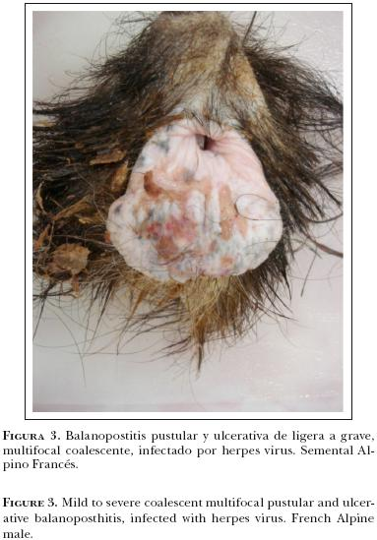
1) The virus also causes vulvovaginitis, balanoposthitis, and respiratory disease in adult goats
2) Enteric and systemic diseases in neonatal goats.
Fetuses can be fresh or autolyzed and do not contain diagnostic gross lesions. Presumptive diagnosis is by microscopic identification of necrosis with the presence of intranuclear inclusion bodies in the liver, lungs, and other organs

Slide 67
Transmission
All nasal, conjunctival, genital exudates, semen
Diagnosis
Definitive diagnosis is by identification of CpHV 1 by isolation, PCR, or immunologic staining methods.
Not all fetuses contain lesions or virus, so multiple fetuses should be submitted.
Infected goats can become latently infected and can shed the virus during times of stress.
Vaccines are not commercially available.

Slide 68
References
Candanosa Aranda, I. E., Sierra García, M., Sánchez Cervantes, A., Salas Garrido, G., Méndez Bernal, A., Cobos Marín, L., & Álvarez Ramírez, L. (2011). Vulvovaginitis y balanopostitis pustular sugerente a herpesvirus caprino-1 en cabras (Querétaro, México). Veterinaria México, 42(3), 233-243.
https://www.msdvetmanual.com/reproductive-system/abortion-in-large-animals/abortion-in-goats

Slide 69
CORYZA GANGRENOSA BOVUM
Malignant Catarrhal Fever

Slide 70
Malignant catarrhal fever (MCF) is an infectious systemic disease that presents as a variable complex of lesions affecting mainly ruminants and rarely swine.
It is principally a disease of domestic cattle, water buffalo, Bali cattle, American bison, and deer.
In some species, such as bison and some deer, MCF is acute and highly lethal, capable of affecting large numbers of animals.
With occasional exceptions, the disease in cattle normally is seen sporadically and affects single animals.

Slide 71
Etiology
MCF results from infection by one of several members of a group of closely related ruminant gammaherpesviruses of the Rhadinovirus genus.
Although the MCF group of ruminant rhadinoviruses currently comprises approximately 10 known members, only a few are known to be pathogenic under natural conditions.

Slide 72
Wildebeest-associated MCF: alcelaphine herpes virus 1 (AlHV-1). Endemic in wildebeest populations worldwide.
Sheep-associated MCF: ovine herpesvirus 2 (OvHV-2). Endemic in most sheep populations worldwide.
Caprine-associated MCF: caprine herpesvirus 2 (CpHV-2): Endemic in most domesticated goat populations worldwide, and causes MCF in cervids.
Unknown origin: causes MCF in white-tailed deer (MCFV-WTD).

Slide 73
The viruses are maintained within the sheep and wildebeest populations in similar but not identical patterns.
AlHV-1:
Transmission in wildebeest occurs perinatally; all calves become infected within the first few months of life and remain carriers for life
Transmission to susceptible hosts occurs only from wildebeest; there is no definitive evidence that MCF-affected animals transmit the disease horizontally to others
Most cases of wildebeest-associated MCF occur when susceptible animals are exposed to parturient wildebeest or young calves, or pasture contaminated by them.

Slide 74
OvHV-2:
A proportion of lambs are infected in utero with most lambs becoming infected perinatally
Transmission is only from sheep to susceptible hosts, not horizontally between infected hosts
Sources of virus
Nasal and ocular secretions mainly, but also reported in faeces and semen (OvHV-2 DNA detected in semen of domestic rams)

Slide 75
Transmission
AlHV-1
Transmission of AlHV-1 within free-living wildebeest populations is very efficient: all wildebeest calves are infected within the first few months of life by in utero, direct contact or aerosol routes
Most transmission by wildebeest calves occurs at 1–2 months of age – transmission after six months of age is rare
Virus is shed by wildebeest calves in nasal and ocular secretions, mainly in the cell-free form

Slide 76
OvHV-2
Transmitted mainly by the respiratory route, probably in aerosols
Shed intermittently in nasal secretions, particularly by 6 to 9 month old lambs
A proportion of lambs are infected in utero with most lambs becoming infected perinatally, though infection may not occur in some situations till after 3 months of age.
Close contact with sheep by susceptible species is usually required, but cases have been reported when sheep and cattle were separated by 70 metres, and in bison herds up to 5 km from a lamb feedlot

Slide 77
AlHV-1, OvHV-2 and CpHV-2 seem to be carried in many, most or all individuals of the reservoir species, and the virus spreads readily within infected herds.
Morbidity rates as high as 50-100% have been reported in bison, in outbreaks where there is close contact with sheep.
The case fatality rate from MCF viruses is 80-90% in symptomatic cattle, and approaches 100% in symptomatic bison, deer and water buffalo.
Residual corneal opacity is often seen in recovered cattle, but complete recovery is also possible.

Slide 78
Clinical Signs
The clinical signs of MCF are highly variable and range from peracute to chronic.
In general, the most obvious signs develop in the more protracted cases.
Peracute: either no clinical signs are detected, or depression followed by diarrhoea and dysentery may develop 12–24 hours prior to death
In general: high fever, increased serous lachrymation and nasal exudate progressing to profuse mucopurulent discharge, inappetance, and decreased milk yields
Progressive bilateral corneal opacity, starting at the periphery, is characteristic.
Skin ulceration and necrosis may be extensive or restricted to the udder and teats

Slide 79
Bovine, muzzle. Multiple shallow erosions are filled with dried nasal exudate.
Bovine, muzzle. The muzzle is hyperemic, multifocally covered by adherent mucopurulent exudate, and contains many shallow erosions.
Bovine, oral mucosa. There is a gingival hyperemia and focal erosion
Corneal opacity causes blindness
the surface of the muzzle has been sloughed in this animal
Affected cattle are profoundly depressed with a high fever
http://www.nadis.org.uk/bulletins/malignant-catarrhal-fever-(mcf).aspx

Slide 80
Case 1 had mucopurulent nasal secretion (A) corneal oedema of the right ocular globe (B), fibrinopurulent bronchopneumonia, petechial haemorrhages within the mesenteric, thoracic and pleural surfaces, ulcerative stomatitis and rhinitis, pulmonary oedema, lymphadenomegaly and bilateral multifocal haemorrhagic nephritis (C). The fetus carried by this cow had normal external appearance and measured 30 cm in crown–rump length. Case 2 had bilateral corneal oedema, ulcerative stomatitis (D) and abomasitis.
Headley, S. A., Pimentel, L. A., Oliveira, V. H. S., Toma, H. S., Alfieri, A. F., Carvalho, A. M., ... & Alfieri, A. A. (2015). Transplacental transmission of ovine herpesvirus 2 in cattle with sheep-associated malignant catarrhal fever. Journal of comparative pathology, 153(4), 206-211.

Slide 81
Salivation and oral hyperaemia may be an early sign, progressing to erosions of the tongue, hard palate, gums and, characteristically, the tips of the buccal papillae
Superficial lymph nodes may be enlarged and limb joints may be swollen
Nervous signs such as hyperaesthesia, incoordination, nystagmus and head pressing may occur alone or with signs described above
A few infected animals may recover following mild or even quite severe clinical reactions

Slide 82
Forms
Historically, MCF has been described as having several “forms”—mild, peracute, head and eye, intestinal.
Peracute: either no clinical signs are detected, or depression followed by diarrhoea and dysentery may develop 12–24 hours prior to death.
İntestinal: Fever, Diarrhea, hemorrhagic gastroenteritis or hematuria may also be seen, although these signs are less common than in bison and deer
Cutaneal (Skin) form: Skin lesions (erythema, exudation, cracking, crust formation) are common in animals that do not succumb quickly. Skin ulceration and necrosis may be extensive or restricted to the udder and teats
Neurologic form: Nervous signs such as hyperaesthesia, incoordination, nystagmus and head pressing may occur alone or with signs described above

Slide 83
head and eye: high fever, increased serous lachrymation and nasal exudate progressing to profuse mucopurulent discharge, inappetance, and decreased milk yields.
In cattle, swollen lymph nodes and severe eye lesions (panophthalmitis, hypopyon, corneal opacity) are more frequent, and hemorrhagic enteritis and cystitis less frequent, than in deer and bison.
Salivation and oral hyperaemia may be an early sign, progressing to erosions of the tongue, hard palate, gums and, characteristically, the tips of the buccal papillae
Superficial lymph nodes may be enlarged and limb joints may be swollen
Progressive bilateral corneal opacity, starting at the periphery, is characteristic.

Slide 84
Post Mortem
The principal lesions are
inflammation and necrosis of respiratory, alimentary, or urinary mucosal epithelium;
subepithelial lymphoid infiltration;
generalized lymphoid proliferation and necrosis;
widespread vasculitis.
Mucosal ulcerations and hemorrhage are common.
Hemorrhages may be present in many parenchymatous organs, particularly lymph nodes.
A classic but not pathognomonic histologic lesion is fibrinoid necrosis of small muscular arteries, but vessels of all types may be inflamed, including those in the brain.
Prominent white nodules representing intramural and perivascular proliferation may be apparent, particularly in the kidneys.

Slide 85
Bovine, hard palate. There are multiple coalescing mucosal erosions.
Bovine, skin. There are numerous raised plaques (multifocal dermatitis).
Bovine, head, sagittal section. Mucoid exudate multifocally covers the nasal and pharyngeal mucosa.
Bovine, nasal turbinate. There is a small amount of mucoid exudate.
Bovine, prescapular lymph nodes: Moderately (left) to markedly enlarged (right) due to MCF.
Bovine, prescapular lymph node. There are foci of hemorrhage (and necrosis) in the cortex, and the medulla is edematous.

Slide 86
Bovine, omasum. Omasal leaves contain multiple pale foci of necrosis; on the right there are several ulcers.
Bovine, cecum and ileum. There are scattered small foci of mucosal hemorrhage and erosion.
Bovine, spiral colon. There are multiple mucosal hemorrhages.
Bovine, kidney. Multiple pale foci in the cortex are foci of institial nephritis.
Bovine, colon. There is severe longitudinal linear congestion of the mucosa.

Slide 87
Diagnosis
AIHV-1 may be recovered from clinically affected animals using peripheral blood leukocytes or lymphoid cell suspensions. Virus can also be recovered from wildebeest, either from peripheral blood leukocytes or from cell suspensions of other organs.
OvHV-2 has never been identified formally, although lymphoblastoid cell lines propagated from affected animals contain OvHV-2-specific DNA and virus particles have been observed in these cells.
Both AlHV-1 and OvHV-2 have been transmitted experimentally to cattle, rabbits and hamsters, which develop lesions characteristic of MCF.

Slide 88
Viral DNA has been detected in clinical material from cases of MCF caused by both AIHV-1 and OvHV-2 using the PCR. PCR is becoming the method of choice for diagnosing both forms of the disease.
Serological tests
Virus neutralisation
Immunoblotting
Enzyme-linked immunosorbent assay (ELISA)
Immunofluorescence
Paired serum samples (5 ml) taken 3–4 weeks apart
Virus isolation from peripheral blood leukocytes (AlHV-1) or lymphoid cells

Slide 89
Differential diagnosis
Rinderpest
Bovine viral diarrhoea mucosal disease
Infectious bovine rhinotracheitis
Bluetongue
Epizootic haemorrhagic disease
Foot and mouth disease
Vesicular stomatitis
Ingestion of caustic materials or some toxic plants

Slide 90
Control and Prevention
The prognosis is grave.
No treatment has been found to provide any consistent benefit. Stress reduction of subclinical or mildly affected animals is indicated.
No vaccine is currently available.
Sheep can be produced that are free of virus by early weaning and isolation.
The only other effective control strategy is separation of carriers from susceptible species.
When large numbers of potent shedders are present, such as in lamb feedlots, distances >1 km may be necessary to protect highly susceptible species such as bison.

Slide 91
References
http://www.cfsph.iastate.edu/Factsheets/pdfs/malignant_catarrhal_fever.pdf
http://www.msdvetmanual.com/generalized-conditions/malignant-catarrhal-fever/overview-of-malignant-catarrhal-fever
http://www.oie.int/fileadmin/Home/eng/Animal_Health_in_the_World/docs/pdf/Disease_cards/MALIGNANT_CATHARRAL_FEVER.pdf

