Slide 1
COM258
Chapter 5: More SQL: Complex Queries

Slide 2
Outline
More Complex SQL Retrieval Queries
Views (Virtual Tables) in SQL
Schema Change Statements in SQL

Slide 3
More Complex SQL Retrieval Queries
Additional Features
Nested queries
Joined tables
Outer joins
Aggregate functions
Grouping

Slide 4
More Complex SQL Retrieval Queries
Comparisons Involving NULL
SELECT Fname, Lname
FROM EMPLOYEE
WHERE Super_ssn IS NULL;

Slide 5
More Complex SQL Retrieval Queries
Nested queries
Placing select-from-where blocks within WHERE clause of another query
Outer query
IN operator

Slide 6
More Complex SQL Retrieval Queries
Nested queries
= ANY(or =SOME) operator
ALL
>, >=, <, <= and <> can be combined with ANY or SOME

Slide 7
More Complex SQL Retrieval Queries
Correlated nested query
Evaluated in nested query once for each tuple in the outer query
EXISTS function check whether the result of a correlated nested query is empty or not
EXISTS and NOT EXISTS usually used with correlated nested queries.

Slide 8
More Complex SQL Retrieval Queries
Renaming Attributes in SQL
Keyword AS followed by new name

Slide 9
More Complex SQL Retrieval Queries
Joined Tables in SQL

Slide 10
More Complex SQL Retrieval Queries
Joined Tables in SQL
NATURAL JOIN
INNER JOIN
LEFT OUTER JOIN
RIGHT OUTER JOIN
FULL OUTER JOIN

Slide 11
More Complex SQL Retrieval Queries
Aggregate Functions in SQL
Grouping
Create subgroups of tuples before summarizing
COUNT
SUM
MAX
MIN
AVG
These functions can be used in SELECT clause or in HAVING clause

Slide 12
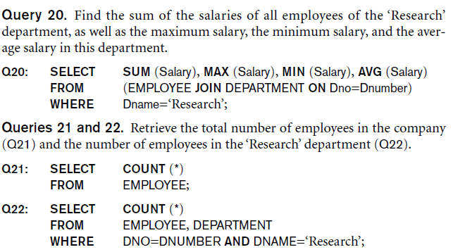
More Complex SQL Retrieval Queries
Aggregate Functions in SQL

Slide 13
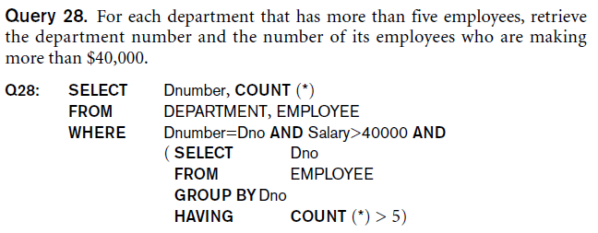
More Complex SQL Retrieval Queries
Grouping: The GROUP BY and HAVING Clauses
GROUP BY
HAVING

Slide 14
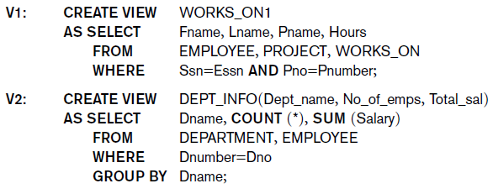
More Complex SQL Retrieval Queries
Views (Virtual Tables) in SQL
Single table derived from other tables
CREATE VIEW

Slide 15
More Complex SQL Retrieval Queries
The ALTER Command
Alter table actions:
Adding or dropping column
Changing a column definition
Addinf or dropping table constraints
ALTER TABLE COMPANY.EMPLOYEE ADD COLUMN Job VARCHAR(12);

