Slide 1
Artificial insemination in Cats
Koray tekin
Ankara Üniversitesi, Veteriner Fakültesi
Reprodüksiyon ve Suni Tohumlama Anabilim Dalı
Notes:
değerli dinleyiciler, sizlere köpeklerde suni tohumlama ile ilgili bir seminer sunacağım.
Sunum sırasın

Slide 2
Hormonal Changes in the Queen
Queen in Estrus (no mating)
Mating
Estrus
(9 days)
Parturition
E₂
E₂
Pregnancy
Lactation
P₄
Proestrus
P₄
4
8
12
16
4
8
12
16
20
Weeks

Slide 3
Hormonal Changes in the Queen
Proestrus
Estrogen increases due to follicular development
Estrus
Estrogen high until ovulation
Ovulation 27 hr after mating (vaginal stimulation)
Diestrus
No Cl if mating does not occur, so no diestrus
Cl produces progesterone (63 days, peak day 20)
If pregnancy does not occur or fails, CL life only 1/2 that seen in pregnancy.

Slide 4
Mating
Queens call or vocalize (low moaning sound)
Owners may think a sign of illness
During mating
Tom bites neck female
With erection penis faces forward

Slide 5
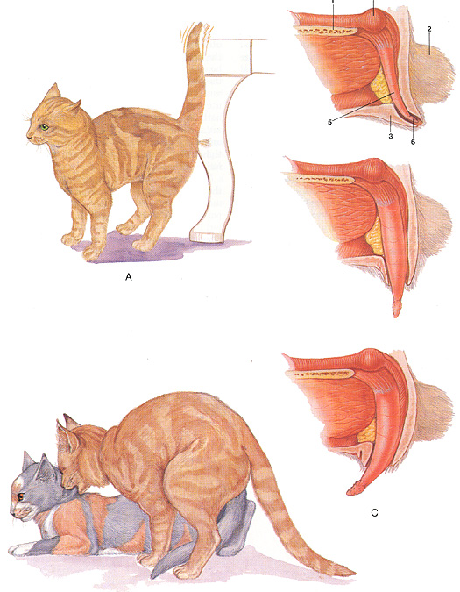
Erection and Mating

Slide 6
Queens call or vocalize (low moaning sound)
Owners may think a sign of illness
During mating
Tom bites neck female
With erection penis faces forward
Only lasts 30 seconds to 5 minutes
As male dismounts female gives a loud copulatory call and Tom retreats
Mating occurs 6 - 7 times until queen declines
May occur for up to 4 days

Slide 7
