Slide 1
Sub-Departamento de Língua Portuguesa | Faculdade de Línguas, História e Geografia |
UNIVERSIDADE DE ANKARA
ISP 420 – Portekiz Kültürü | Cultura Portuguesa

Slide 2
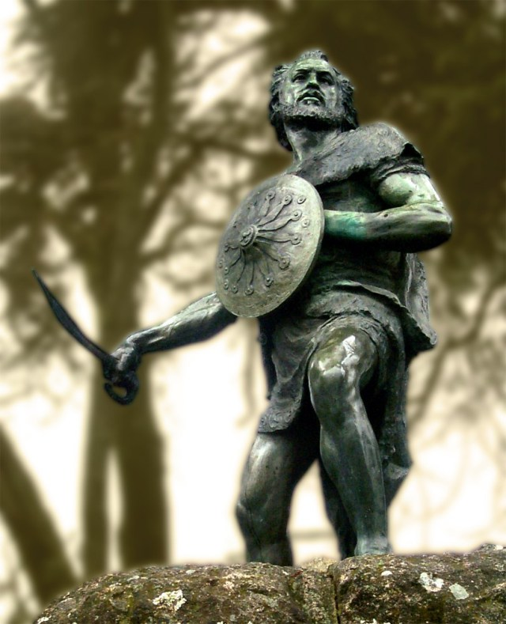
Quatro constantes culturais
Origem Exemplar:
The moral foundation of the country.
The rise of the country and independent nation;
A reconquista;
The complex of Viriato (complexo Viriatino) – ‘guerreiro nobre’ lusitano contra o ocupante estrangeiro.
O Portugal de Camões destinado a Descobrir

Slide 3
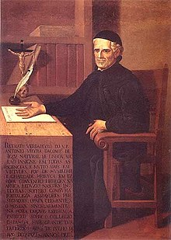
Quatro constantes culturais
2. Nação Superior:
Sebastianismo – failure of Alcácer-Quibir;
Lost of Independence;
O Nevoeiro / Encoberto;
Padre António Vieira e Quinto Império
“É a hora!” de Pessoa
Complex of Vieira – ‘Complexo Vieirino’ – to wish more than the possible – País suspenso no tempo.

Slide 4
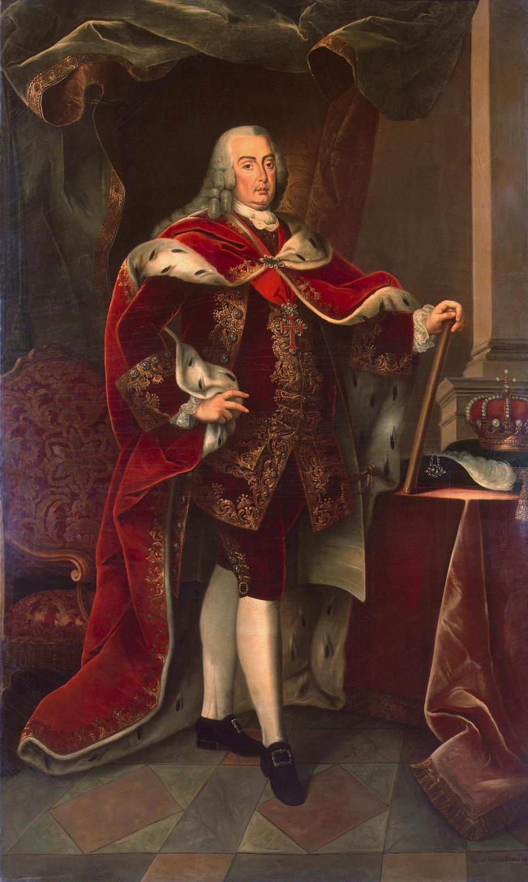
Quatro constantes culturais
3. Nação Inferior:
Domination of the Church of the portuguese colective mentality;
Dependency of the gold of Brazil;
Causes of Decadence (Antero de Quental)
Decay of Lisboa (earthquake 1755)
Marquês de Pombal – believe that the people were in civilizational inferiority and needed the influences from Europe – Enlightenment – creation of modern Bureaucracy – Liberal Revolution and modernism born here – ‘Complexo Pombalino’

Slide 5
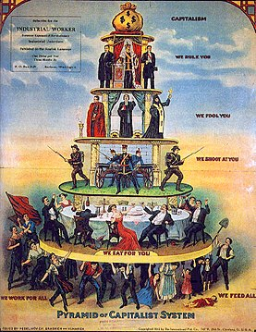
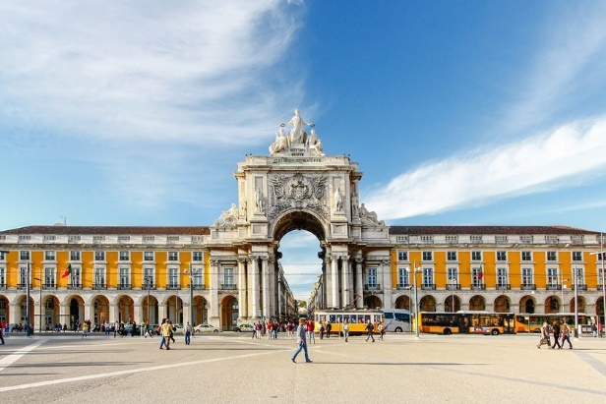
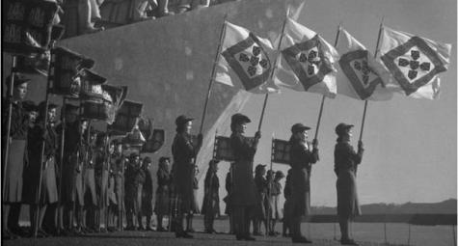
Quatro constantes culturais
4. Canibalismo Cultural:
To define 400 years from 1580 (lost of independence) and 1980 (before accession to EEC – now EU): To define the modern and contemporary portuguese culture as each new doctrine is ‘devouring’ and destroying the ones before;
Each new current condemning the olds as heretical and destroying them in favour of their own ideas: Inquisition; Pombal; Republicans; Estado Novo de Salazar; Socialists; Anarquists; Evangelists; Communists before 1974 revolution. ‘Complexo Canibalista’.

Slide 6
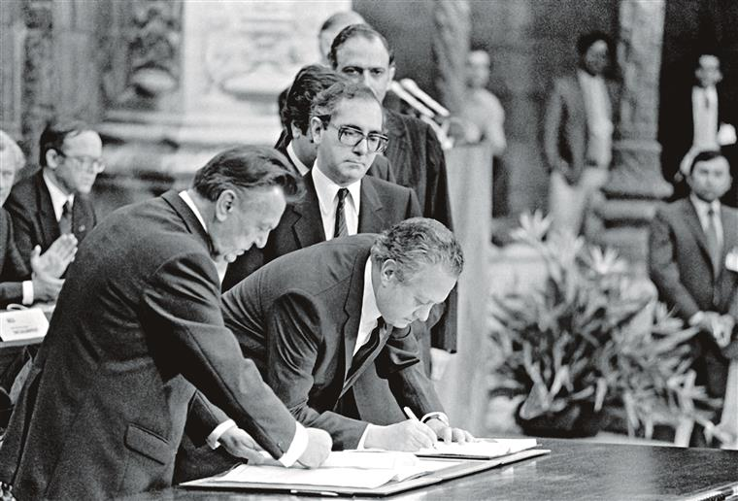
Current cultural situation: ‘um intervalo civilizacional’
The european modernization after the 1980s marked profound changes in the fundamental institutions of Portugal.
At the political, economical, geopolitical, cultural and social levels:
The changes at this 5 levels updated historically the country and socially the country was europeanized (to be developed further classes.)

Slide 7
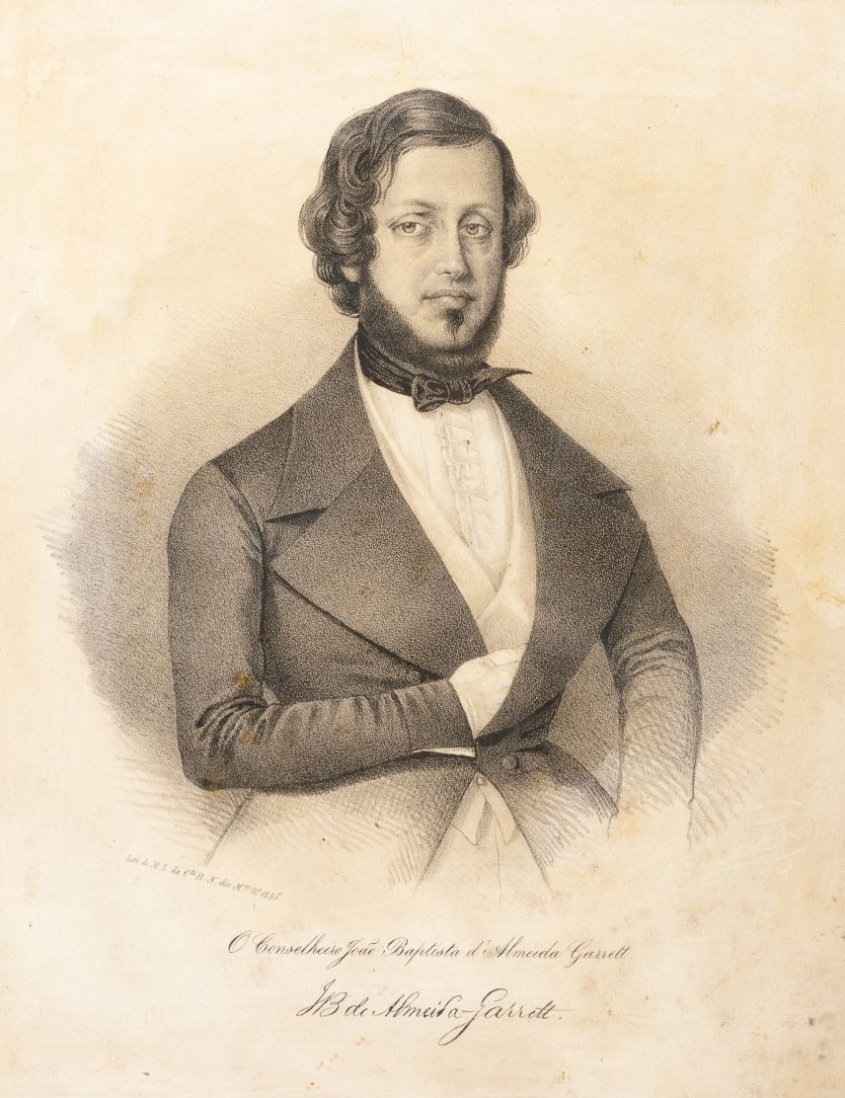
The founder of Modern Literature: Almeida Garret
The same ideological and civic struggle to ‘question Portugal’;
Founder of modernism and transition to realism;
A writer who attempts a synthesis between the two conflictual visions of portuguese culture and thought;
In one side inspired by the romantism of european (especially English) literature but also na extense knowledge of the classics;
In another side gathering the portuguese oral tradition, the folklore and popular literature ‘O Romanceiro’, to express it as portuguese heritage.
A man of letters, politics and civic intervention for a ‘new country’ out of the decadent look bakwards.

Slide 8
The founder of Modern Literature: Almeida Garret

Slide 9
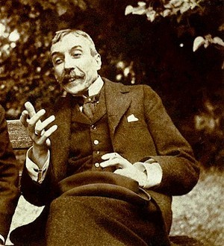
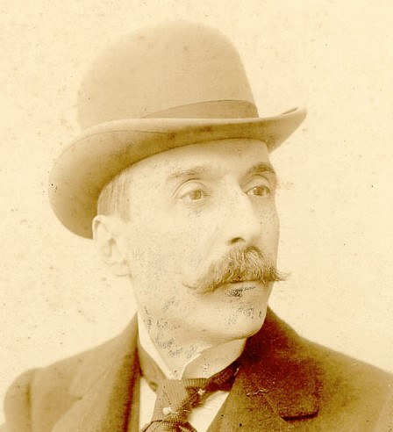
The Europeism/ Cosmopolitism and Realism: Eça de Queiroz
Deeply influenced by the European culture (lived in France and Englad) – portraits portuguese bourgeois and aristocratic society;
Concerned with the cultural and political role of Portugal in Europe (context of fin-de-siècle – cultural and racial decline – imperial questions);
Themes: so-called aristocratic but Bourgeois petty Lisbon; Portugal History – imperial decline – towards end of Monarchy;
Ironical/satyrical/critical aproach to the dialectics between the two conflictual visions:
«– Lisboa é Portugal – gritou o outro. – Fora de Lisboa não há nada. O país está todo entre a Arcada e S. Bento!...» Não tenho ideia de ver tal «paisagem» (Os Maias, cap. VI)

Slide 10
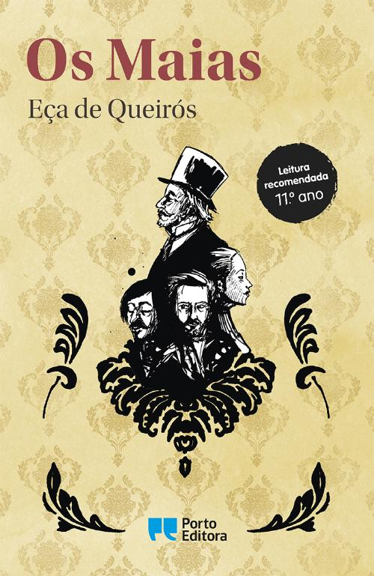
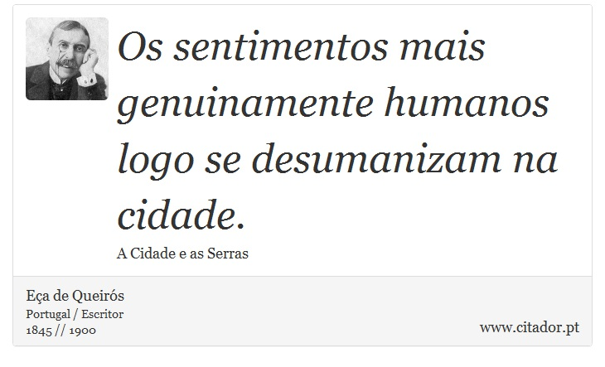
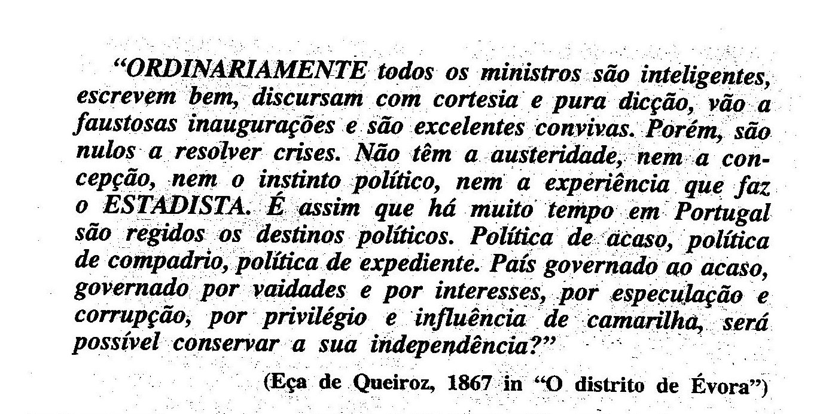
The Social Critique of Eça de Queiroz

Slide 11
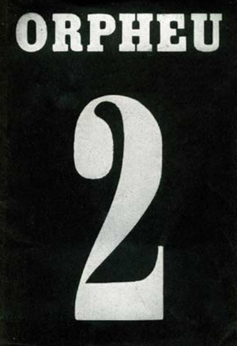
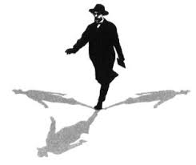
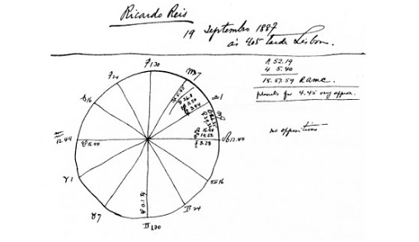
Orpheu and Pessoa: Modernism

