Slide 1
Metal Complexes for Diagnosing Disease

Slide 8
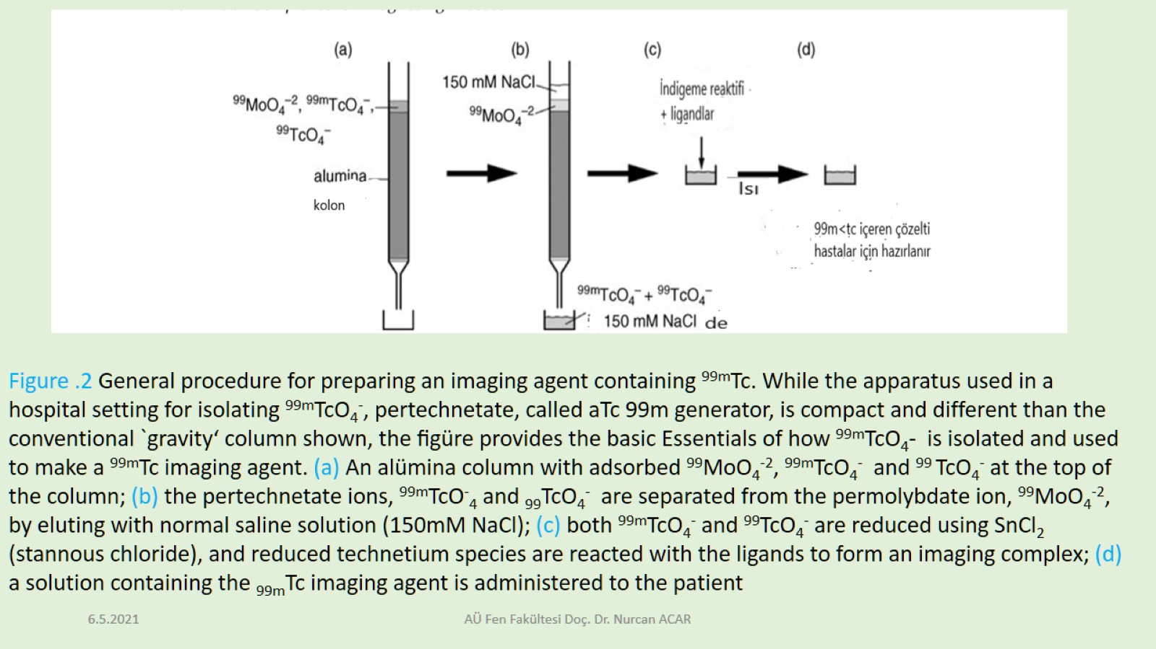

Slide 12
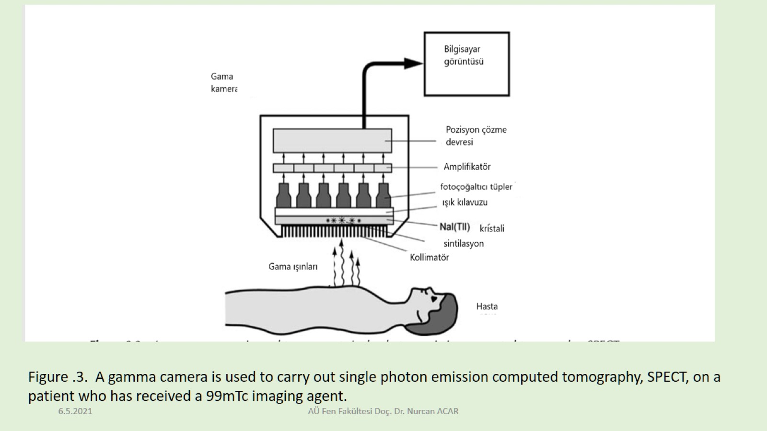

Slide 14
