Slide 1
NEW COMEDY
Dr. Funda Hay
fhay@ankara.edu.tr

Slide 2
New Comedy begins with the Greek playwright Menander’s plays after 320s BC.
The chorus becomes increasingly separate the action
the five-act structure is established.
The extravagant and grotesque costumes disappeared.
All the plays have a contemporary, domestic setting.

Slide 3
All the plays have similar plot elements.
There are also deceptions, recognitions and reversals of fortune.
There are fairly long narrative speeches and divine prologues

Slide 4
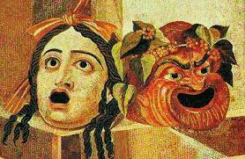
ROMAN COMEDY

Slide 5
The essence of what is ridiculous is based on flaw and being lack of nobility.
Roman comedy deals with everyday domestic affairs.
The plots turn on misunderstandings or mistaken identity, misunderstood motives, or deliberate deception.

Slide 6
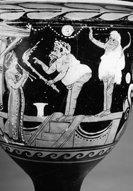
They show the well-to-do middle class, those around them.
Of all the characters, the most famous is perhaps the “clever slave”.

Slide 7
“Let no worn out prostitutes sit in the front part of the auditorium, nor the ushers move about in front of spectators or show anyone to seats while the actors are onstage… Don’t let slaves take up seats meant for free men…, let nursemaids keep little children at home… Let matrons… refrain from gossiping.”

Slide 8
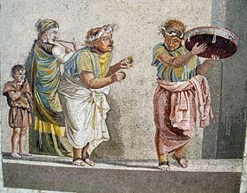
musical element;
Two-thirds of the lines were accompanied by the flute.

Slide 9
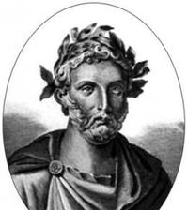
PLAUTUS

Slide 10
Maccius Plautus, born in 254 BC, was a writer, an actor, and an artist who put plays on stage
it is believed that he started writing plays in 207.
Impressed by New Comedy, Plautus adapted people, topics and speeches from the lives of the Romans.

Slide 11
The most important one among Plautus’ characters are slaves.
who learned all kinds of intrigues and tricks
smart

Slide 12
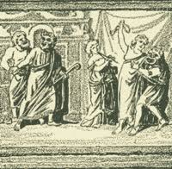
Most of the actors also must be skilled singers, because the main characters perform “entering songs”.

Slide 13
The Menaechmi

Slide 14
The play depends on mistaken identity.
His characters merely contribute to the overall tone of good-humoured cynicism- with a considerable touch of misogyny.
A company of six actors could easily perform the ten speaking roles in the Menaechmi.

Slide 15
the characters in the Menaechmi are types rather than individuals.
Peniculus (“Brush”) suggests the parasites’ ability to sweep the table clean;
the cook is called Cylindrus (“Roller”);
the courtesan is named Erotium (“Lovely”).

Slide 16
BIBLIOGRAPHY
Brockett, O. G., Ball, R. J. The Essential Theatre. Thomson Wadsworth, 2004.
Croally, Neil and Roy Hyde. Classical Literature: An Introduction. Routledge, 2011.

