Slide 1
Business Information Systems I
How does IS transform business?
Dr. Sevgi Eda Tuzcu

Slide 2
How does IS transform business? – WB Report, 2016
Notes:
One of the most important changes in the business environment has been made by ICTs.
This graph shows the spread of these technologies globally to business, people and government.

Slide 3
How does IS transform business? – WB Report, 2016
Notes:
It spread faster to developing countries than the other technologies like steamship or electricity.
Countries believe that these investments will provide them competitive advantage.
However, if their choices are not correct, it means that they waste their valuable capital.

Slide 4
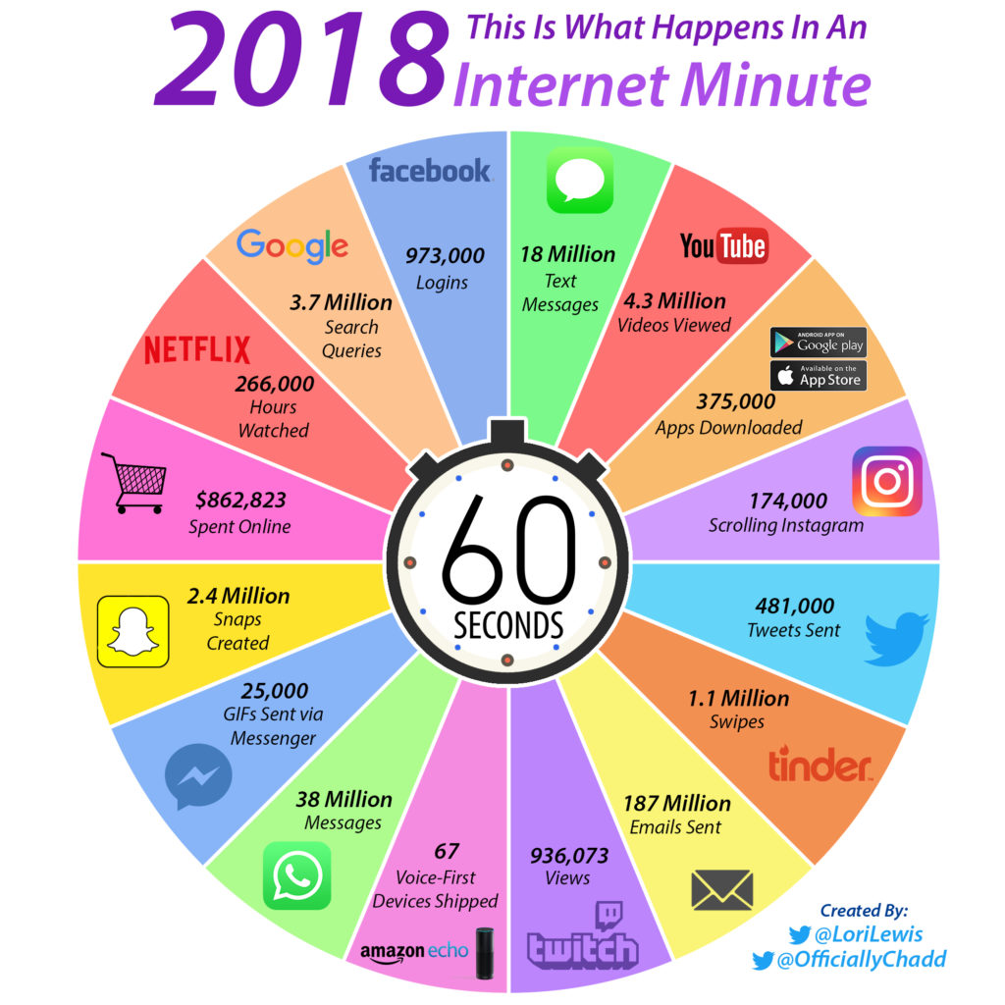
Internet in a Minute -2018 vs 2019 https://www.beingguru.com/2019/06/what-happens-on-internet-in-60-seconds-one-minute-in-2019/

Slide 5
How does IS transform business?
One of the biggest changes in business environment: Information Systems
What is the effect of IS on business, economies and societies?

Slide 6
On Economies:
Online trading and increased labor productivity: ICT creates total value added.
Manufacturing has changed: M2M, big data, 3D printing, AI, robots etc
Changes in work life: New ICT skills, changes in work tasks, higher collaboration, close monitoring, working irregular hours.
Notes:
TVA is the enhancement a company gives its product or service before offering it to customers. By e-commerce and increased labor productivity, companies are able to have competitive advantage.
ICT transforms the manufacturing. Robots, machines, M2M communication, artificial intelligence, advances in big data, 3D printing are transforming production.
Demand for new skills: to develop new applications, to use them for professional purposes, and complementary skills to perform new tasks related to the use of ICT like analyzing big data.
The majority of the workers are experiencing more autonomy in their jobs. There is a decrease in repetitive tasks.
Collaboration is much easier, but workers feel that their performance is more closely monitored.
They need more time to acquire and improve new skills. Working irregular hours and more is common.
A high need for security.
(Value added is the difference between the price of product or service and the cost of producing it. The price is determined by what customers are willing to pay based on their perceived value. Value is added or created in different ways.)

Slide 7
On Societies
The number of Internet users in OECD countries: from 60 % to 95 % (2005 to 2013).
Large differences across countries and inside countries.
Broadband access is not the same.
New skills are required from the workers - New ways to work and communicate.
Notes:
ICT demands new skills, but obtaining them is not that easy.
Digital divide is a major, economic, social and ethical problem.

Slide 8
On Societies
Easier communication, free digital products
New ways to spend free time
The world becomes flat?
Notes:
information technology has also speeded up globalization, the integration of economies, goods , services and cultures.
Friedman argues that the world has become flat due to technological advances connecting people in China, India, and the United States as if we were all next-door neighbors. The world has become tiny. This connection through internet and global communications reduced the economic and cultural advantages of developed countries. Hence, this “globalization” presents both challenges and opportunities for business firms.

Slide 9
On Firms
Higher competition in the market
New markets are opening, destroying old ones.
New platforms like clouds
More outsourcing, more collaboration
Firms will be smaller in size.
Notes:
Many organizations not only compete nationally, but also internationally. By using ICT, we can reach new markets.
Firms have begun to use new technologies like cloud computing, and other mobile digital platforms. These changes allow organizations to rely more on telework, remote work, and distributed decision making.
This same platform means firms can outsource more work.
firms can collaborate with suppliers and customers to create new products, or make existing products more efficiently.
More outsourcing and using more new technologies cause firms to shrink in size. IT will replace the middle management.

Slide 10
On Firms:
Too much information –information overload
Making decisions is harder.
The ability to collect, collate, filter and disseminate information and making sure it is relevant is crucial.
No time and location restrictions.
The basic roles that IS plays for a business:
Support of business processes and operations.
Support of decision making by employees and managers.
Support of strategies for competitive advantage.
Notes:
the quantity and the speed of the information available to managers increases. In this environment, managers must be selective about the information.
there is more information but it is hard to find reliable ones. This is called information overload. One of the tasks of an efficient IS it to produce relevant info, so IS becomes more important.

Slide 11
References
World Bank, World Development Report, 2016
https://www.beingguru.com/2019/06/what-happens-on-internet-in-60-seconds-one-minute-in-2019/
Laudon K. and J. Laudon, Management Information Systems Managing the Digital Firm, Pearson, 13th ed.

