Slide 1
Nanomedicine

Slide 7
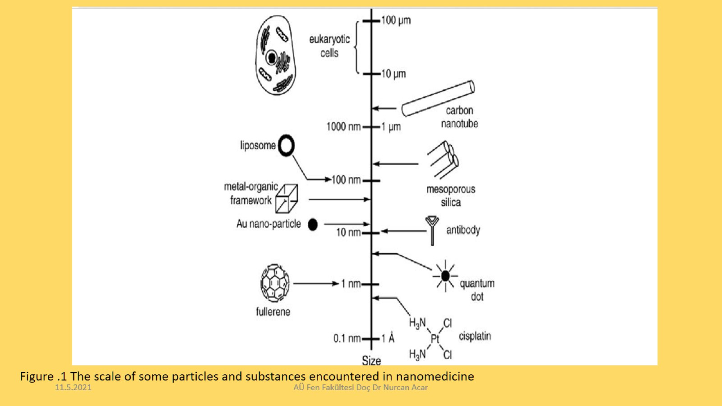

Slide 12
