Slide 1
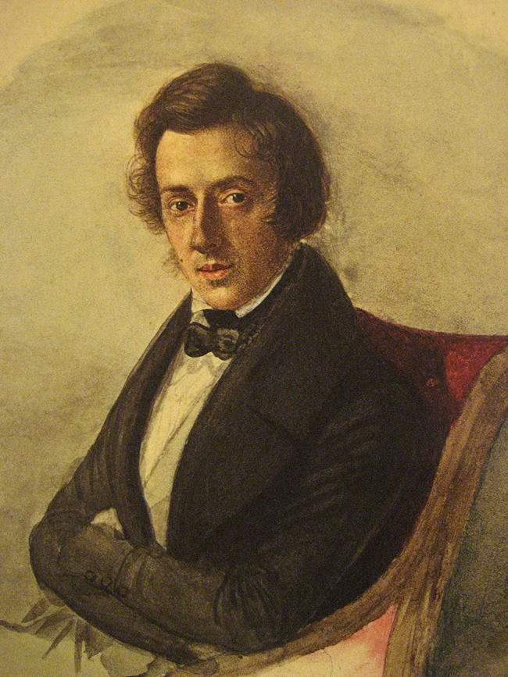
Chopin

Slide 2
Wszystko, co powinieneś wiedzieć o Fryderyku Chopinie!
https://www.youtube.com/watch?v=myD-LXvDJ6I&t=215s

Slide 3
20 faktów o CHOPINIE
https://www.youtube.com/watch?v=wFj4_vXmyj4&t=1s

Slide 4
Etiuda C-moll op. 10 nr. 12 (Rewolucyjna)
https://www.youtube.com/watch?v=S-KMmBBDhXI

Slide 5
Polonaise, Op. 53 (Kissin)
https://www.youtube.com/watch?v=8QT7ITv9Ecs

Slide 6
preludium deszczowe des-dur op.28 nr 15
https://www.youtube.com/watch?v=0LWoLykSSaQ

Slide 7
Sonata No.2 in B-flat minor, Op.35 (Pogorelich, Fialkowska)
https://www.youtube.com/watch?v=dw4aGcmircA

Slide 8
Kaynaklar
https://youtu.be/myD-LXvDJ6I
https://www.youtube.com/watch?v=wFj4_vXmyj4&t=1s
https://www.youtube.com/watch?v=S-KMmBBDhXI
https://www.youtube.com/watch?v=8QT7ITv9Ecs
https://www.youtube.com/watch?v=0LWoLykSSaQ
https://www.youtube.com/watch?v=dw4aGcmircA

