Slide 13
RESPIRATORY SYNCYTIAL VIRUS INFECTION

Slide 14
It is a viral infection of cattle and sheep, often resulting in mild or severe respiratory tract infections in the lower respiratory tract.

Slide 15
Ethiology
Paramyxoviridae Pneumovirus
RNA
Helical symmetry
Enveloped
Sensitive to Ether and Chloroform
BRSV was named for its characteristic cytopathic effect, the formation in infected tissue of syncytial cells, giant multinuclear cells formed by the fusion of several cells.
Virus inoculates to Human and Bovine primer and fetal cell cultures.
Monkeys, Mouse and Hamsters could be used as experimental animals.

Slide 16
Transmission
Transmission is via respiratory aerosols or from direct contact with infected cattle.
In the winter, sheep and cattle are taken to closed places so that transmission of the infection increases.

Slide 17
Pathogenesis and Pathology
RSV is a major pathogenic infection.
Subclinical infections could observed.
The bovine virus and the human virus do not cross inect.
Primary replication in the nasal epithelium then replication throughout the epithelium of the upper respiratory tract and bronchial tree.
Respiratory epithelial cilia of calves are lost within 8-10 days.
Syncytia formation occurs and these can be seen shed into the bronchioles.
Some cases are complicated by oedema and emphysema.
The disease affected the lungs have pink and solid adenomatous structure (consolidation).

Slide 18
Clinical Signs
There are 2 forms:
Acute Form
a- First term: 40-42 C fever, increase in respiratory rate, dry continuous cough, nose and eye discharge and conjunctivitis.
b- Second term: Pulmonary Emphysema occurs with the introduction of secondary effects.
As acute form develops rapidly, there is no chance of treatment and it results in death.

Slide 19
Subclinical Form;
Increase in respiratory rate
Loss of appetite and constipation
Cough
High fever
Nasal Discharge
20% Mortality

Slide 20
Diagnosis and Differantial Diagnosis
Direct and indirect methods could be used.
Direct;
It is diagnosed from organ and nasal discharge.
Isolation of the agent is strong because the virus can be extremely labile.
It is important to get the insulation material at the appropriate time.
The diagnosis could be delayed because of late onset of the CPE.
Viral antigens are detected by Direct Fluorescence and ELISA.
Indirect;
Serum Neutralization, IH, CFT, IF and ELISA tests are used.

Slide 21
Immunology
Antibodies formed against infection protect the lungs.
Mucosal antibodies occur in RSV infections. (IgA)
Unlike humans maternal antibodies are transferred only via colostrum in calves

Slide 22
Prevention and Control
Formalin-inactivated vaccines, though constituting a high level of neutralizing antibodies in seronegative animals, can not protect against infection all animals.
Immunity to natural infections is insufficient.
Atenue Live and inactive virus vaccines are used.

Slide 23
https://www.zoetisus.com/conditions/beef/bovine-respiratory-syncytial-virus-_brsv_.aspx
Virology textbook.

Slide 24
Equine Influenza

Slide 25
Equine Infl uenza (EI) is a highly contagious though rarely fatal respiratory disease of horses, donkeys and mules and other equidae.
The disease has been recorded throughout history, and when horses were the main draft animals, outbreaks of EI crippled the economy.
Nowadays outbreaks still have a severe impact on the horse industry.

Slide 26
Orthomyxoviridae
Humans
Influenzavirus A
Equide
Swine
Avian
Marine Mammals
Influenzavirus B
Humans
Influenzavirus C
Swine
Humans

Slide 27
Nomenclature
A/equine/Saskatoon/1/90(H3N8)
HA and N
Serotype
group
year
species
Isolation no
location
A/equine/Prague/1/56(H7N7)
A/fowl/Hong Kong/1/98(H5N1)
A/swine/Lincoln/1/86(H1N1)

Slide 28
Distribution of HA serotypes in nature
HA serotype
Avian
Horse
Swine
Human
HA1
yes
yes
yes
HA2
yes
yes
HA3
yes
yes
yes
yes
HA4
yes
HA5
yes
yes
HA6
yes
HA7
yes
yes
HA8-16
yes
HA16 was detected in the most recent seagull.

Slide 29
Distribution of N serotypes in nature
N serotype
Avian
Horse
Swine
Human
N1
yes
yes
yes
N2
yes
yes
yes
N3
yes
N4
yes
N5
yes
N6
yes
N7
yes
yes
N8
yes
yes
N9
yes

Slide 30
Significant A-type influenza epidemics
H1N1, which caused Spanish Flu in 1918, and Swine Flu in 2009
H2N2, which caused Asian Flu in 1957
H3N2, which caused Hong Kong Flu in 1968
H5N1, which caused Bird Flu in 2004
H7N7, which has unusual zoonotic potential^{[24]}
H1N2, endemic in humans, pigs and birds
H9N2
H7N2
H7N3
H10N7

Slide 31
Ethiology
Orthomyxoviridae Influenzavirus
Segmented, single stranded RNA
The single stranded RNA is negative sense, It has a different gene on each segment. The 8 segments are held together by the helical capsid comprised of nucleoprotein.
enveloped
Sensitive to Ether and Chloroform
HA and N
Each gene codes for one protein: haemagglutinin (H) spike, neuraminidase (N) spike, matrix (which lines the inside of the envelope and is like scaffolding), nucleoprotein, 3 viral polymerases and a large non‑structural protein.
H enables the virus to attach to respiratory epithelial cells within seconds via sialic acid on the host cell. H also attaches to red blood cells in-vitro, hence its name. Such haemagglutination is blocked when virus is pretreated with antibody (Haemagglutination inhibition (HI) test).
N is a sialidase enzyme which which prevents new virus simply reattaching to the same host cell and allows it to move to new cells
Two types are available, Type 1 (H7N7) and Type 2 (H3N8)

Slide 32
Ethiology
Inoculates in the amniotic cavity of ECE.
Cultivation and cytopathic effect:
Influenza viruses are routinely grown to high titre in the allantoic cavity of 10-day-old fertile hens eggs or more rarely in kidney cells for vaccines and diagnosis. Virus is detected by its ability to haemmagglutinate red blood cells.
virus cause cpe in cell culture
Under natural conditions it is only seen on equids.
They are related to but distinct from the viruses that cause human and avian infl uenza.

Slide 33
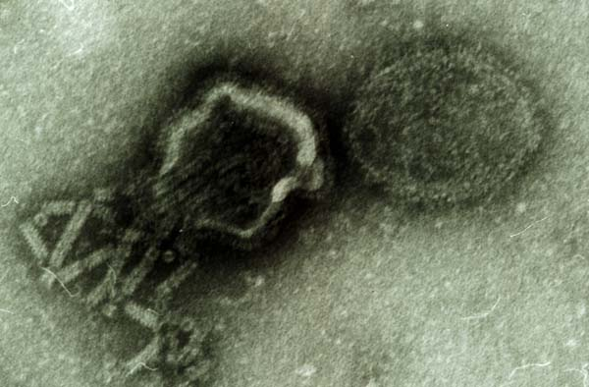
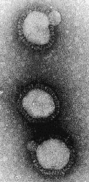
Ethiology
Nucleocapsid
(RNA surrounded with
protein)
envelope
haemagglutinin and
neuraminidase “spikes”
on envelope
100 nm

Slide 34
Antigens
1. Type specific.
A, contains the veterinary isolates. B and C are human. The A antigens are on the nucleoprotein and can be identified by ELISA in certain diagnostic tests eg on nasal swabs.
2. Subtype specific antigens on H and N.
detected by HI and NI tests.
The external H and N envelope glycoproteins carry the subtype antigens H1 to H15 and N1 to N9. Vaccinal immunity involves neutralisation of the subtype specific antigens on H.
H1 to H15 viruses are in ducks which are the source of new mammalian subtypes.
Equine influenza type 1 and type 2 carry H7 N7 and H3 N8 respectively ie their vaccines do not cross protect.
3. Antigenic drift ‑ variation of H within a subtype within a host species
4. Antigenic shift ‑ change of subtype of H within a host species

Slide 35
Transmission
Virus is highly contagious.
EI is spread by contact with infected animals, which in coughing excrete the virus.
In fact animals can begin to excrete the virus as they develop a fever before showing clinical signs.
It can also be spread by mechanical transmission of the virus on clothing, equipment, brushes etc carried by people working with horses.

Slide 36
Once introduced into an area with a susceptible population, the disease, with an incubation period of only one to three days, spreads quickly and is capable of causing explosive outbreaks. Crowding and transportation are factors that favour the spread of EI.

Slide 37
Factors Strengthening Epizootics / Epidemics
Antigenic drift
Reassortment and antigenic shift
Short-term immunity
Transfer between species
It is known to pass through dogs.

Slide 38
Antigenic drift
evolution of a variant within a subtype, meaning imperfect protection by old vaccines
Why? Each H molecule carries 5 antigenic regions via which antibodies can HI, neutralize and block attachment to host cells. A change in any region results in antigenic drift. The RNA genes of influenza are constantly mutating, during error-prone replication. If the mutation involves escape from neutralisation the variant is selected in infected animals.
Drift is detected by 2-4-fold alterations in HI titres between one isolate and another isolate recovered several years later. Drift is now best assessed by panels of mAb in HI tests and nucleotide sequencing of the neutralisation sites on H.
These mutations accumulate with time. The human viruses appear to accumulate more mutations than the equine, which may relate to the presence of more people than horses in the world.

Slide 39
Reassortment and antigenic shift
Complete change of H molecule meaning no protection by old vaccines. Shift occurs by a) gene reassortment, b) change of species specificity
a) Gene reassortment Pigs become infected with duck virus and human virus at the same time, eg on a chinese commune where all 3 species live close together. Some virus reassorts its RNA segments in the pig respiratory epithelial cells to produce a new virus with a duck H gene for attachment and a 7 human genes for virus growth. This new virus will infect vaccinated humans because it has a brand new subtype of H.

Slide 40
Reassortment

Slide 41
b) Change of species specificity. A 1997 virus which killed at least 8 Hong Kong children was related in all 8 gene segments to an H5 chicken fowl plague virus. This HK virus could have originated from migratory ducks, spread to chickens, undergone mutations to become more virulent in chickens and thereby become infectious to man. For this reason a million chickens were slaughtered in HK in 1998 although the human cases had already stopped.

Slide 42
Pathogenesis
Once the virus enters the organism, Aerosol virus infects the ciliated epithelium of the nasal mucosa and then may extend to the bronchioles with resulting epithelial cell necrosis, which manifests as bronchiolitis and serous exudation
The virus spreads to the respiratory tract in 2-4 days. Rhinitis occurs.
Histopathologically, cell infiltration in bronchial regions and thickening in alveolar walls are seen.

Slide 43
Clinical Signs
A harsh dry cough follows an incubation period of 1‑3 days when the horse also develops pyrexia, depression, loss of appetite, enlarged submandibular lymph nodes, muscle pain and weakness.
Secondary bacterial infection follows defective muco-ciliary transport.
While most animals recover in two weeks, the cough may continue longer and it may take as much as six months for some horses to regain their full ability. If animals are not rested adequately, the clinical course is prolonged.
A fatal bronchopneumonia is more likely if horses continue to be exercised.

Slide 44
Type 2 cause more severe infections.
In some cases, there is a cough that does not heal (due to the viral presistence) (two-year-old-caugh).

Slide 45
Diagnosis
Virus isolation:
Samples are taken from several horses because only a low proportion may be excreting virus. Deep nasal swabs are collected by inserting a long swab 12 inches into each nostril ‑
THE SWAB IS deposited INTO 10 ML TRANSPORT MEDIUM (sterile basic salts solution containing antibiotics), transported at 4 C and frozen at -70 C.
Antigen detection:
Directigen Flu A is a commercial antibody capture ELISA for type A antigens of nucleoprotein in swabs. It does not tell the lab which subtype is involved
Serology:
Following clinical disease a 4 fold increase in serum antibody to H7 of equine 1 or H3 of equine 2 will occur between bleeds taken during the acute and convalescent phase (2 weeks later). This antibody can be detected by haemagglutination inhibition (HI) and will say whether virus is equine 1 or 2.

Slide 46
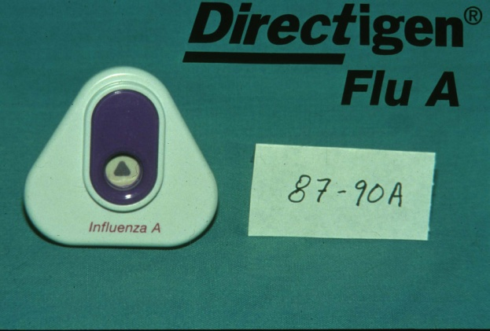
Directigen Flu-A

Slide 47
Immunity and epidemiology:
As with most viruses the period of virus excretion from nasal secretions is during the first 10 days following infection before spec-immunity kicks in.
Secreted IgA antibodies in horses are important for protection.
Vaccinated animals can excrete virus without disease and have carried the virus between countries eg to South Africa from USA.
As with other resp viruses spread is by personnel and instruments (which most vets do not realise) as well as by aerosol eg at race meetings.
No zoonotic risk.

Slide 48
Chemotherapy
Those who block the membrane fusion
Amantidine (Symmetrel)
Remantidine (Flumadine)
Neuraminidase inhibitors
Zanamivir (Relenza)
Oseltamivir (Tamiflu)

Slide 49
Prevention and Control
Isolate coughing horses to minimise spread and use disposable syringes when treating them.
Prophylaxis is by vaccination.
Vaccines combination of A/Equine 1 (H7N7) ve A/Equine 2 (H3N8)
Vaccination is practiced in most countries. However, due to the variability of the strains of virus in circulation, and the difficulty in matching the vaccine strain to the strains of virus in circulation, vaccination does not always prevent infection although it can reduce the severity of the disease and speed recovery times.
Single vaccination provides protection for 2-3 months. The second vaccination should be done again after 6-9 monts.

Slide 50
When the disease appears, efforts are placed on movement control and isolation of infected horses. The virus is easily killed by common disinfectants, so thorough cleaning and disinfection is part of biosecurity measures in responding to the disease. Since the disease is most often introduced by an infected animal, isolation of new entries to a farm or stable is paramount to preventing the introduction of disease to a premise.

Slide 51
http://www.oie.int/doc/ged/D14001.PDF
PETER H. RUSSELL, BVSc, PhD, FRCPath, MRCVS, Department of Pathology and Infectious Diseases, The Royal Veterinary College, http://www.pitt.edu/~super1/Virology/virology.htm

