Slide 1
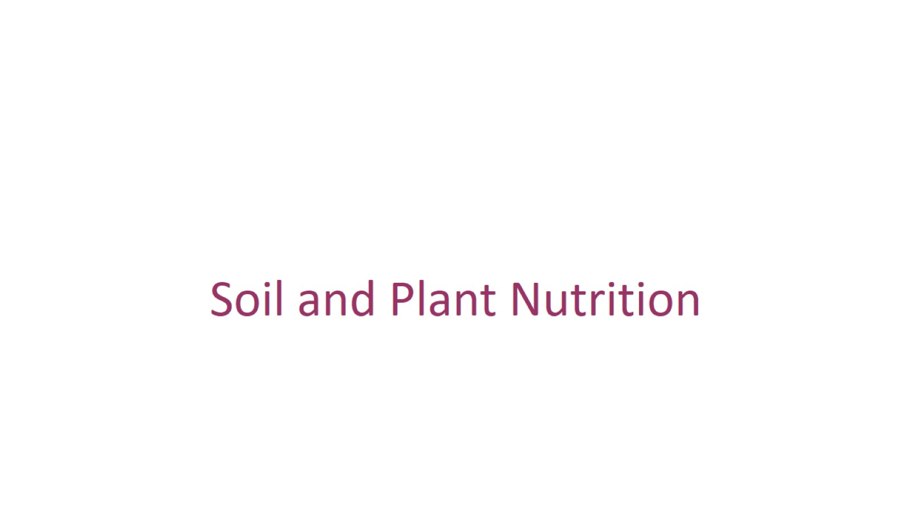

Slide 2
Overview: “The Nation that Destroys Its Soil Destroys Itself”

Slide 3
Soil is a living, finite resource

Slide 4
Soil Texture

Slide 6
Topsoil Composition

Slide 7
Inorganic Components

Slide 9
Organic Components

Slide 10
Soil Conservation and Sustainable Agriculture

Slide 11
Irrigation

Slide 13
Fertilization

Slide 14
Adjusting Soil pH

Slide 15
Controlling Erosion

Slide 17
Preventing Soil Compaction

Slide 18
Phytoremediation

Slide 19
Concept 37.2: Plants require essential elements to complete their life cycle

Slide 20
Macronutrients and Micronutrients

Slide 21
Symptoms of Mineral Deficiency

Slide 22
Improving Plant Nutrition by Genetic Modification: Some Examples

Slide 23
Resistance to Aluminum Toxicity

Slide 24
Flood Tolerance

Slide 25
Smart Plants

Slide 26
Plant nutrition often involves relationships with other organisms

Slide 27
Soil Bacteria and Plant Nutrition

Slide 28
Rhizobacteria

Slide 29
Bacteria in the Nitrogen Cycle

Slide 30
Nitrogen-Fixing Bacteria: A Closer Look

Slide 33
Nitrogen Fixation and Agriculture

Slide 34
Fungi and Plant Nutrition

Slide 35
The Two Main Types of Mycorrhizae

Slide 36
Agricultural and Ecological Importance of Mycorrhizae

Slide 37
Epiphytes, Parasitic Plants, and Carnivorous Plants

