Slide 1
Ash analysis
Assoc Prof. ÖZGE ŞAKIYAN DEMİRKOL
15.03.2021

Slide 2
The definition of ash
Ashing is an important first step in proximate or specific mineral analysis.
Ash refers to the inorganic (mineral) residue remaining after the combustion or complete acid-facilitated oxidation of organic matter in food.

Slide 3
Two major types of ashing are used: dry ashing and wet ashing.
Dry ashing is primarily used for proximate composition and for some types of specific mineral analyses. Dry ashing requires very high (500–600 °C) temperatures, which may be achieved by conventional or microwave heating.
Wet ashing (acid-facilitated oxidation) is used as a preparation for the analysis of minerals that might be volatilized and lost during dry ashing. Wet ashing uses lower temperatures than dry ashing and relies on strong acids and chemical oxidizers to rid samples of organic material.

Slide 4
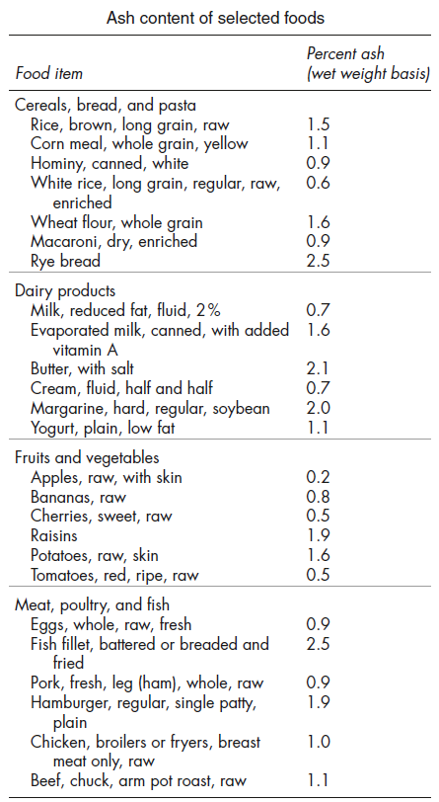
Ash contents of selected foods
Ash analysis gives info about the
Mineral content of the food material

Slide 5
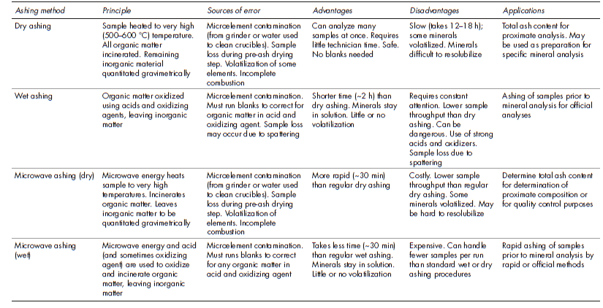

Slide 6
The important points to be considered during ash analysis
The food materials with high moisture content should first dried than burned.
The combustion process continues till a whitish color observed.
If there are unburned points in the sample the crucibles should be taken out from the oven and cooled down. A certain amount of distilled water, alcohol, sulphuric acid, nitric acid and hydrogen peroxide is added and it is continued to be burned.

Slide 7
For each food material, there is a different appropriate time-temperature relation for ash drying.
For certain types of minerals burning at alkali or acidic environment is required.
Since wet ashing is conducted either at lower temperatures than dry ashing or in sealed vessels, minerals are not lost due to volatility.

Slide 8
Water soluble and water insoluble ash analysis
This analysis is preferred for sugary and fruit products to be tested whether there is extra minerals or preservatives used in it.
For the analysis certain amount of water is added to the sample which is analyzed with respect to ash content. The water added ash is heated up to boiling and filtered. The sample on the filter paper is burned further and by this procedure the water insoluble ash content is determined.

Slide 9
Thanks!!!!
osakiyan@ankara.edu.tr

