Slide 1
COM 412
Information Technology and Security Governance
Week 11
Protection of Information
Protection of People
Protection of Premises

Slide 2
Protection of Information
* What is Information Classification?
* Information confidentiality
- Confidential
- Restricted
- Internal
- Public
* More levels maybe needed

Slide 3
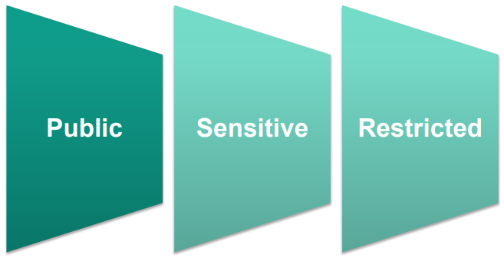
Protection of Information
Sample set of classifications

Slide 4
Protection of Information
* Where does ISO 27001 fit in?
* Annex A 8.2: ‘Information Classification’
- Enter your assets into an inventory
- Classification
- Labelling
- Handling

Slide 5
Protection of Information
1. Enter your assets into an inventory:
Asset register, who is responsible for it (who owns it), and what format it’s in
2. Classification
Asset owners are responsible
3. Labelling
Different processes for information that’s stored digitally and physically

Slide 6
Protection of Information
4. Handling:
Establish rules for how to protect each information based on its classification and format

Slide 7
Protection of Information
4. Handling:
• View
• Update
• Delete
• Transfer (digital and paper)
• Mail
• Store
• Destroy

Slide 8
Protection of Information
Data handling examples:
• Creation and Access
• Disclosure
• Storage
• Copying and Transmitting
• Printing
• Backup
Notes:
Here are some data handling examples:
• Creation and Access
• Disclosure
• Storage
• Copying and Transmitting
• Printing
• Backup

Slide 9
Protection of Information
* Creation and Access:
- Use of Privately Owned Equipment:
• a secure form of remote access (e.g. Secured VPN)
• ensure these items:
• not a public computer;
• user ID and password is not observed;
• sensitive information cannot be viewed by others;
• restricted data are not downloaded;
• restricted data are not printed out;
• open sessions are not left unattended;
• sessions are properly terminated.

Slide 10
Protection of Information
* Creation and Access:
- Use of University Owned Equipment:
• Information is safer if it is encrypted.
• If University equipment is classified as Restricted which is not encrypted, you must:
• Make sure that the equipment is not a public computer
• The equipment is physically secured from unauthorised access
• Using of the equipment requires adequate user authentication (e.g. login password)
• You must delete any residual unencrypted data from any University equipment.

Slide 11
Protection of Information
* Disclosure:
• You may reveal Restricted information only to those who need it to carry out their official University work.
• Data users should be aware of the classification and the controls needed to protect it. (e.g. use of classification label if appropriate)
• Classified data is not to be provided to any third party.
• Disclosure of Sensitive or Restricted information should be made via secure channels such as VPN or network storage with proper access control.

Slide 12
Protection of Information
* Storage:
• Unless the data is encrypted, you must save it :
• on the Storage Area Network (SAN);
• in private storage areas on the LAN;
• in shared storage areas on LANs.
• You must not store this sort of data on unencrypted local hard disks.
• The storage device must be physically secured
• You may make back-up copies of Restricted data for disaster recovery provided that the backup media are physical secured.

Slide 13
Protection of Information
* Storage:
• Where you use removable media to transport or present Sensitive or Restricted data:
• You must keep the removable media with you at all times or secure it under lock and key where this is not practical.
• For media containing data classified as Restricted, you must:
• Return it during normal working hours;
• destroy the data after use; or
• store it outside normal working hours in encrypted format

Slide 14
Protection of Information
* Copying and Transmitting:
• You may only copy Sensitive or Restricted data to removable media for approved special use such as:
• Transporting the data to a research sponsor or another University;
• presentation of the data
• Only copy the minimum amount of Restricted data
• Securely delete or destroy the copy.
• file erase tools should be used to completely delete the file.
• Keep the number of copies of Restricted data few.
• All copies are to be tracked by the data owner/custodian.

Slide 15
Protection of Information
* Copying and Transmitting / E-mail:
• Sensitive or Restricted information may be sent as a encrypted/ password protected attachment to an e-mail
• The recipient is informed of the password by a different method such as over the telephone.
• Do not send the password in the same e-mail that contains the password protected attachment.
• Recipients should be aware of the classification.

Slide 16
Protection of Information
* Printing:
• Restricted documents may only be printed with the permission of the document‟s author.
• When making copies of Restricted documents:
• Use secure print function;
• keep the number of copies as low as possible;
• treat all copies in the same way as the original.

Slide 17
Protection of Information
* Backup:
• Should be made in encrypted format.
• If encryption for backup is not feasible, data owner should be informed of the risk of unencrypted backup.

Slide 18
Protection of Information
Responsibilities in Information Classification:
* Management
* IT
* Data owner

Slide 19
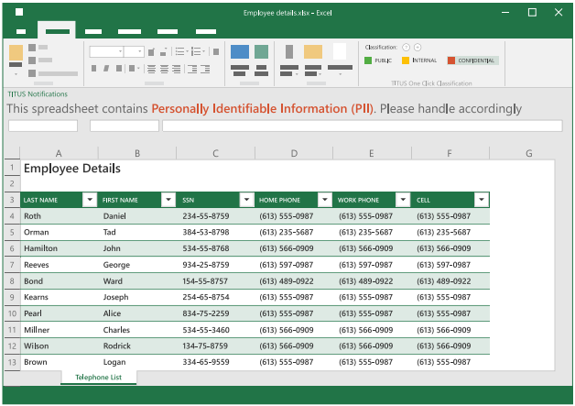
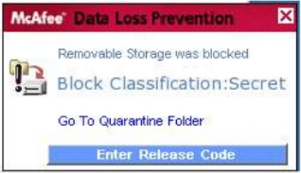
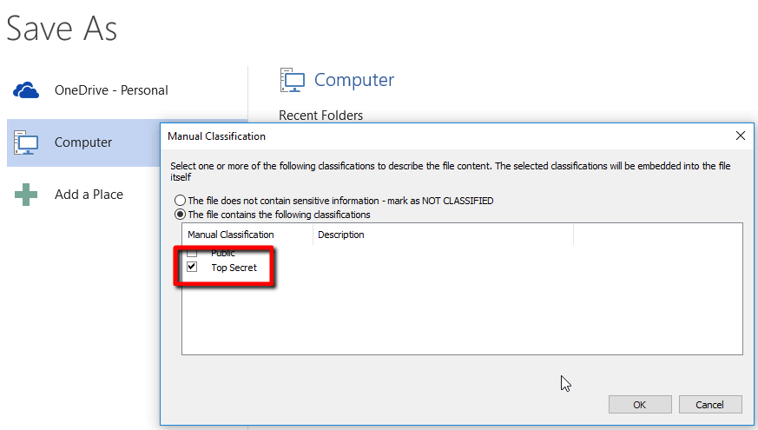
Protection of Information

Slide 20
Protection of Information
Identity and Access Management:
• Object: A passive entity that contains information or functionality
• Subject: A user, program or process that requests access to an object or the data within an object
• Access: The flow of information between a subject and an object
• Access control: Security features that control how user and systems communicate with each other and the resources

Slide 21
Protection of Information
Identity and Access Management:
• Identification: Describes a method by which a subject claims to have a specific identity
• Authentication: Describes a method to validate a subject claims of who it claims it to be

Slide 22
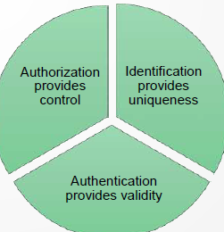
Protection of Information
Identity and Access Management:
• Authorization: Providing access to an authenticated resource based on its rights
• Accountability: Keeping a track of actions performed by the subject on an object

Slide 23
Protection of Information
Identity and Access Management:
• Permissions: Access granted to subject for an object and determines what you can do with it
• Rights: Ability to take an action on an object
• Privileges: It is a combination of permissions and rights

Slide 24
Protection of Information
* Creating and issuing identity should involve 3 aspects:
- Uniqueness
- Non-descriptive
- Issuance
* IdM
* Directories
- X.500
- LDAP

Slide 25
Protection of Information
* Three general factors for authentication are:
• Something a person knows (knowledge)
• Something a person has (ownership)
• Something a person is (characteristic)
* Multi-factor authentication
* 1:1 Verification (e.g. Access card)
* 1:N verification (e.g. Fingerprint database)
* Mutual Authentication

Slide 26
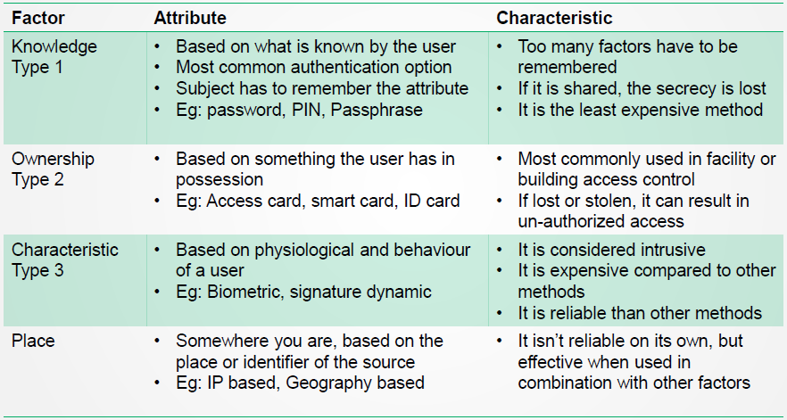
Protection of Information

Slide 27
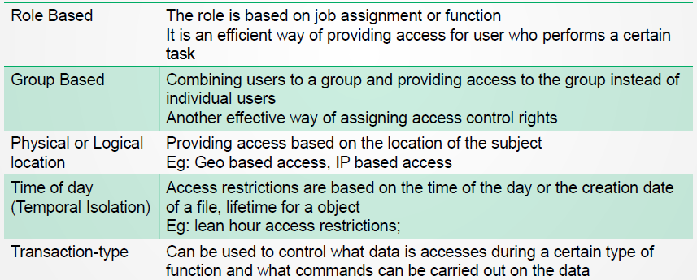
Protection of Information
* Authorization:
- Granting access to subject should be based on the level of trust and the need-to-know

Slide 28
Protection of Information
* Authorization:
- Default to No Access
- Need to Know
- Excessive Privileges
- Authorization Creep (creeping privileges)

Slide 29
Protection of Information
* Access Control categories:
- Administrative Access Control
focus on people and business practices
- Logical Access Control
Technical Access control
- Physical Access Control
Items that we can physically touch

Slide 30
Protection of Information
* Access Control Models:
• Discretionary access control
• Mandatory access control
• Role based access control
* Model decision is based on:
• Business and security goals
• Culture
• Habits of conducting business
Notes:
Access control model is:
A framework that dictates how a subject access an object
Three main types of access control models are
• Discretionary access control
• Mandatory access control
• Role based access control
Access control model decision is based on
• Business and security goals
• Culture
• Habits of conducting business

Slide 31
Protection of Information
* Discretionary Access Control (DAC):
• identity based access control type
• can be applied to both directory tree structure and the files in it
• based on the discretion of the owner
• Access control lists (ACL)
Notes:
• A system using DAC enables the owner to specify which subjects can access specific resources
• Control of access is based on the discretion of the owner
• Access is restricted based on the authorization granted to the users
• The most common implementation of DAC is through Access control lists (ACL) on objects
• DAC can be applied to both directory tree structure and the files in it
• DAC is considered identity based access control type

Slide 32
Protection of Information
* Mandatory Access Control (MAC):
• users do not have the rights to decide who can access objects
• more structured and stricter than DAC model
• rules are defined via the security policy
• user cannot install software, change permissions, add new users
• not flexible nor scalable
• very few systems technically capable of implementing this mode
Notes:
• In MAC model, users do not have the rights to decide who can access objects
• MAC model is much more structured and stricter than DAC model and is based on a security label system
• The rules of how subjects access objects are defined via the organization’s security policy
• In MAC model, user cannot install software, change permissions, add new users etc.
• This type of model is used in environments that places information classification and confidentiality of
utmost importance,
• This is mainly seen in a military or national security context, with very few systems
technically capable of implementing this model.
• It is more secure than DAC but it isn’t flexible nor scalable

Slide 33
Protection of Information
* Role-Based Access Control (RBAC):
• access to resources is based on the role/task the user holds
• Task Based access control
• centrally administered set of controls
• rights and permissions are assigned implicitly to the user via the role or group the user inherits
• the best system for companies with high employee turnover

Slide 34
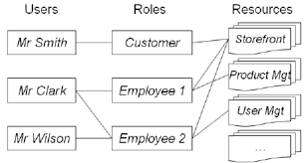
Protection of Information
Notes:
This is an example of role based access control.
In Windows infrastructures , for example, role based access control implementation involves creation of active directory groups for every single role in the organization, and then users are placed in those groups to give them the permissions to do their job.
It’s also possible that users can have more than one role.

Slide 35
Protection of Information
* Accountability:
- Auditing capabilities ensure users are accountable for their actions
- Accountability is tracked by recording user, system and application activities
- event-oriented audit review
- Integrity of logs with digital signature, hashing and strong access control

Slide 36
Protection of People
* Human vulnerabilities:
- weaknesses introduced by staff
- unawareness, complacence
- Social Engineering

Slide 37
Protection of People
* Common social engineering attacks:
- Baiting
-- use a false promise to pique a victim’s greed or curiosity
-- mostly physical media is used
-- don’t necessarily have to be carried out in the physical world

Slide 38
Protection of People
* Common social engineering attacks:
- Scareware
-- involves victims being bombarded with false alarms and fictitious threats
- Pretexting
-- attacker obtains information through a series of cleverly crafted lies

Slide 39
Protection of People
* Common social engineering attacks:
- Phishing
-- Spear phishing
-- Whaling
-- Vishing

Slide 40
Protection of People
* Security Culture:
- Employing leadership-driven cyber governance
- Clearly documenting security policies
- Training employees
- Encouraging people to report incidents

Slide 41
Protection of People
* Personnel Security:
- Recruit the right person
- Set the right expectations
- Ensure their ongoing suitability
- Manage their departure

Slide 42
Protection of Premises
* Physical Security:
- deny access to unauthorized personnel physically accessing a building, facility, resources, or stored information
- guidance on how to design structures

Slide 43
Protection of Premises
* Types of Threats to Physical Environment:
- Natural / Environmental
- Man made / Political Events
Notes:
Types of Threats to Physical Environment:
• Natural / Environmental
– Earthquakes, floods, storms, hurricanes, fires, snow/ice
• Man made / Political Events
– disgruntled employees, unauthorized access,
employee errors, espionage, malicious
code, chemical contamination, Explosives, sabotage, vandalism and theft

Slide 44
Protection of Premises
* Types of Controls Related to Physical Environment:
- Administrative controls
- Technical controls
- Physical controls
Notes:
Types of Controls Related to Physical Environment:
• Administrative controls are policies & procedures
– Facility location, construction, and management.
– Physical security risks, threats, and countermeasures.
• Technical controls
– Authenticating individuals and intrusion detection.
– Electrical issues and countermeasures.
– Fire prevention, detection, and suppression.
• Physical controls
– Perimeter & Building Grounds.
– Building Entry Point.
– Data Centers or Server Room Security.

Slide 45
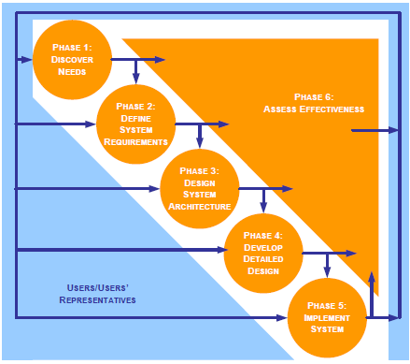
Protection of Premises
Notes:
Similar to information system, physical security
system also uses System Development Life Cycle process…

Slide 46
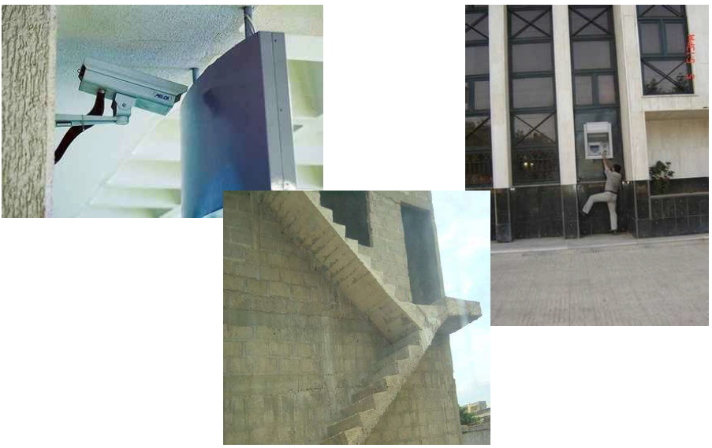
Protection of Premises
Notes:
Here are a few examples of design failures.

Slide 47
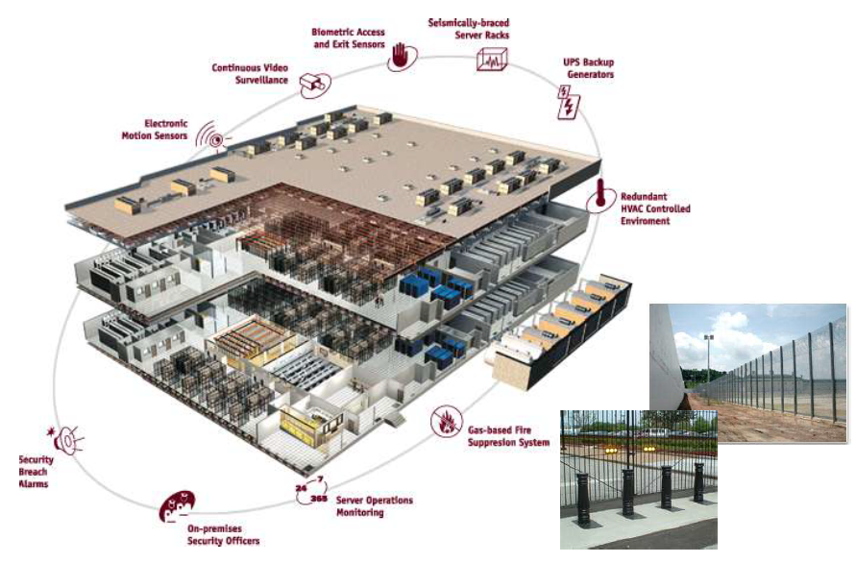
Protection of Premises
Notes:
This is an example of perfect design and implementation of physical security.

