Slide 1
EME 201 Materials Science
The Structure of Crystalline Solids

Slide 2
UNIT CELLS
The atomic order in the crystalline solid material shows that small organizations of atoms form a repetitive pattern.
For this reason, when defining crystal systems, the structure is divided into small re-entities known as unit cells.
A unit cellular is chosen to symbolize the symmetry of the crystal structure wherein all the atomic positions within the crystal can be produced by using the translation of the unit cell indispensable distances of each of its edges.
A unit cell is the primary structural unit or constructing block of a crystal shape and defines its crystal shape based on its geometry and atomic positions.
The atomic bonds in this type of materials is metallic and thus nondirectional in nature.

Slide 3
The Face-Centered Cubic Crystal Structure
The crystal shape present for plenty metals has a unit cell of cubic geometry, with atoms positioned at each of the corners and the centers of all the cube faces.
This type of cubic structure is known as the face-centered cubic (FCC) crystal structure.
A number of the familiar metals having this crystal structure are copper, aluminum, silver, and gold.
The spheres or ion cores contact one another across a face diagonal; the cube edge length a and the atomic radius R are related via
a = 2R(2)^{0.5}
Sometimes, we want to decide the number of atoms associated with every unit cell.

Slide 4
The Face-Centered Cubic Crystal Structure
Depending on an atom’s position, it is able to be taken into consideration to be shared with adjoining unit cells—this is, only some fraction of the atom is assigned to a particular cell.
The number of atoms in keeping with unit cellular, N, may be computed the usage of the following components:
N = Ni + Nf/2 + Nc/8
- Ni = the number of interior atoms
- Nf = the number of face atoms
- Nc = the number of corner atoms

Slide 5
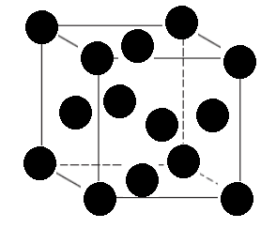
The Face-Centered Cubic Crystal Structure
For the Face centered cubic crystal structure, there are eight corner atoms, six face atoms, and no interior atoms.
The number of atoms in keeping with unit cellular, N, is equal to:
N = Ni + Nf/2 + Nc/8
N = 0 + 6/2 + 8/8 = 4
A total of four whole atoms may be assigned to a given unit cell.
A total of four whole atoms may be assigned to a given unit cell.
Figure 1. The face-centered cubic crystal structure

Slide 6
The Face-Centered Cubic Crystal Structure
Different vital characteristics of a crystal structure are the coordination number and the atomic packing element (APF).
Coordination number:
The coordination number is the number of atoms touching a selected atom, or the range of nearest acquaintances for that particular atom.
This is one indication of the way tightly and successfully atoms are packed collectively.
For ionic solids, the coordination number of anions is defined as the range of nearest cations and the coordination number of cations is defined as the range of nearest anions.
For metals, every atom has the identical number of nearest-neighbor or touching atoms.

Slide 7
The Face-Centered Cubic Crystal Structure
The coordination number is equal to 12 for face-centered cubic crystal structure.
Atomic packing factor (APF):
The packing component is the fraction of the area of the atoms, assuming hard spheres are sized to touch the nearest buddies of the atoms.
The general expression for the atomic packing factor is given below:
APF = (Volume of atoms in a unit cell)
Unit cell volume
For the Face-Centered cubic crystal structure, the atomic packing factor is equal to 0.74.
Figure 1. The face-centered cubic crystal structure

Slide 8
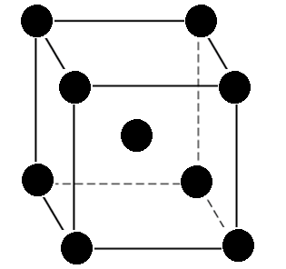
The Body-Centered Cubic Crystal Structure
Any other common metallic crystal shape additionally has a cubic unit cell with atoms placed at all eight corners and a single atom on the cube center.
That is called a body centered cubic (BCC) crystal shape.
Corner and center atoms contact one another alongside cube diagonals, and unit cell dimension a and atomic radius R are associated through the equation given below:
a = 4R/(3)^{0.5}
Chromium, iron, tungsten displays a body centered cubic (BCC) crystal structure.
Figure 2. The body centered cubic crystal structure

Slide 9
The Body-Centered Cubic Crystal Structure
Each body centered cubic crystal unit cell has a single center atom and eight corner atoms.
The center atom is totally contained within the unit cell; therefore, the number of atoms per body centered cubic crystal unit cell is equal to:
N = Ni + Nf/2 + Nc/8
N = 1 + 0 + 8/8 = 2
A total of two whole atoms may be assigned to a given unit cell.
The coordination number for the body centered cubic crystal structure is equal to 8.
Figure 2. The body centered cubic crystal structure

Slide 10
REFERENCES
William D. Callister, ‘Materials Science and Engineering: An Introduction’, Seventh edition, John Wiley & Sons, Inc., U.S.A.
Brian S. Mitchell, ‘AN INTRODUCTION TO MATERIALS ENGINEERING AND SCIENCE FOR CHEMICAL AND MATERIALS ENGINEERS’, John Wiley & Sons, Inc., U.S.A, 2004.
J. W. Martin, ‘Materials for Engineering’, Third Edition, WOODHEAD PUBLISHING LIMITED, Cambridge, England.
Donald R. Askeland & Pradeep P. Fulay, ‘Essentials of Materials Science and Engineering’, Second Edition, Cengage Learning, Toronto, Canada.
G. S. Brady, H. R. Clauser, J. A. Vaccari, ‘Materials Handbook’, Fifteenth Edition, McGraw-Hill Handbooks.

