Slide 1
Ecology and Environmental Biology
Dr. Nüket BİLGEN

Slide 2
Food chains & food webs
Producers, or autotrophs, make their own organic molecules. Consumers, or heterotrophs, get organic molecules by eating other organisms.
A food chain is a linear sequence of organisms through which nutrients and energy pass as one organism eats another.

Slide 3
In a food chain, each organism occupies a different trophic level, defined by how many energy transfers separate it from the basic input of the chain.
Food webs consist of many interconnected food chains and are more realistic representation of consumption relationships in ecosystems.
Energy transfer between trophic levels is inefficient—with a typical efficiency around 10%. This inefficiency limits the length of food chains.

Slide 4
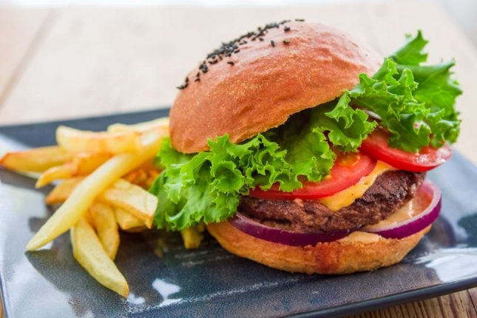
Food chain
In ecology, a food chain is a series of organisms that eat one another so that energy and nutrients flow from one to the next.
grass →cow → human.
lettuce→ human.
Fries → human
Onion → human

Slide 5
For situations like the one above, we may want to use a food web that consists of many intersecting food chains and represents the different things an organism can eat and be eaten by.

Slide 6
Living things in an ecosystem are divided into 2 nutrition types:
1- Autotrophic (Producers): make their own food. Using light energy and inorganic materials, they form complex organic molecules.
2- Heterotrophic (Consumers): fed from others.
Some are fed only by the producers. These are called herbivores.
For example; cow and rabbit.
Some are fed by eating other consumers. These are called carnivores.
For example; fox and hawk.
Some are fed by eating both producers and other consumers.
For example; bear, human

Slide 7
Photoautotrophs, such as plants, use energy from sunlight to make organic compounds—sugars—out of carbon dioxide in photosynthesis. algae
Chemoautotrophs use energy from chemicals to build organic compounds out of carbon dioxide or similar molecules. This is called chemosynthesis. For instance, there are hydrogen sulfide-oxidizing chemoautotrophic bacteria found in undersea vent communities where no light can reach.

Slide 8
Autotrophs form the base of food chains and food webs, and the energy they capture from light or chemicals sustains all the other organisms in the community. When we're talking about their role in food chains, we can call autotrophs producers.

Slide 9
Food chains
who-eats-who ?
At the base of the food chain lie the primary producers..
The organisms that eat the primary producers are called primary consumers.

Slide 10
The organisms that eat the primary consumers are called secondary consumers. Secondary consumers are generally meat-eaters—carnivores.
The organisms that eat the secondary consumers are called tertiary consumers. These are carnivore-eating carnivores, like eagles or big fish.
Some food chains have additional levels, such as quaternary consumers—carnivores that eat tertiary consumers. Organisms at the very top of a food chain are called apex consumers.

Slide 11
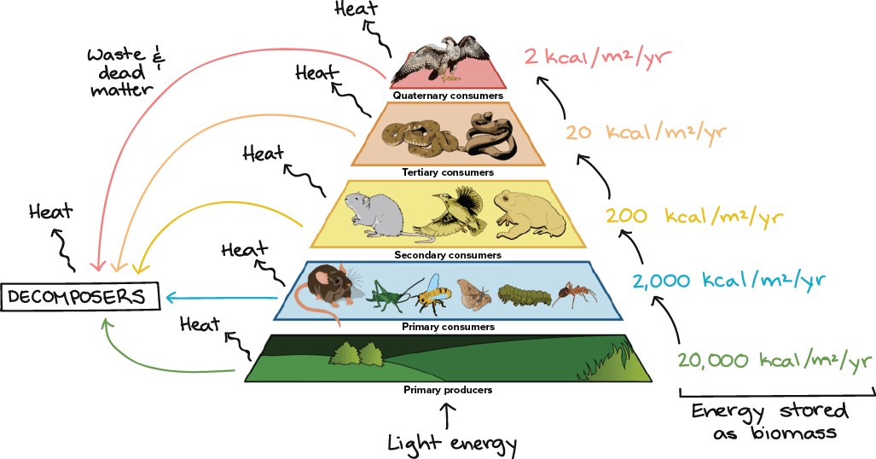
Decomposers
organisms that break down dead organic material and wastes.
the decomposer level runs parallel to the standard hierarchy of primary, secondary, and tertiary consumers.

Slide 12
detritivores
multicellular animals such as earthworms, crabs, slugs…
They not only feed on dead organic matter but often fragment it as well, making it more available for bacterial or fungal decomposers.

Slide 13
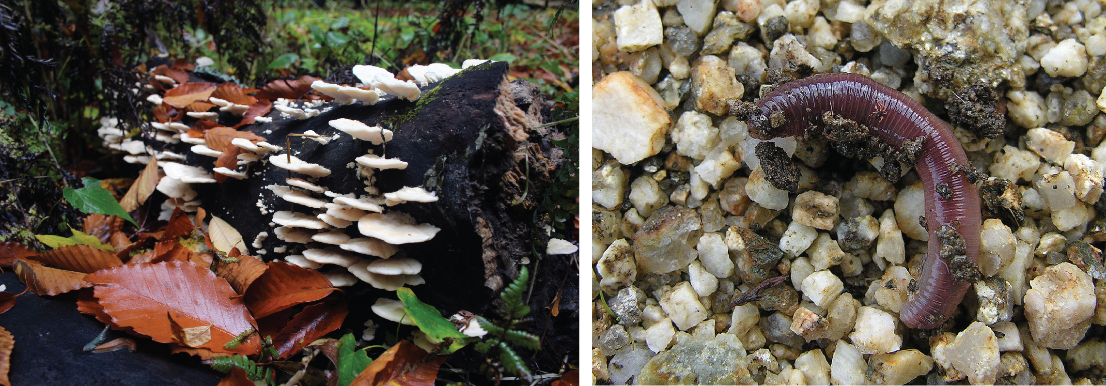
Decomposers as a group play a critical role in keeping ecosystems healthy. When they break down dead material and wastes, they release nutrients that can be recycled and used as building blocks by primary producers.
Examples of decomposers: left, fungi growing on a log; right, an earthworm.

Slide 14
Food webs
Think of hamburger example.
To represent who eats who relationships more accurately, we use a food web,
a graph that shows all the trophic—eating-related—interactions between various species in an ecosystem.

Slide 15
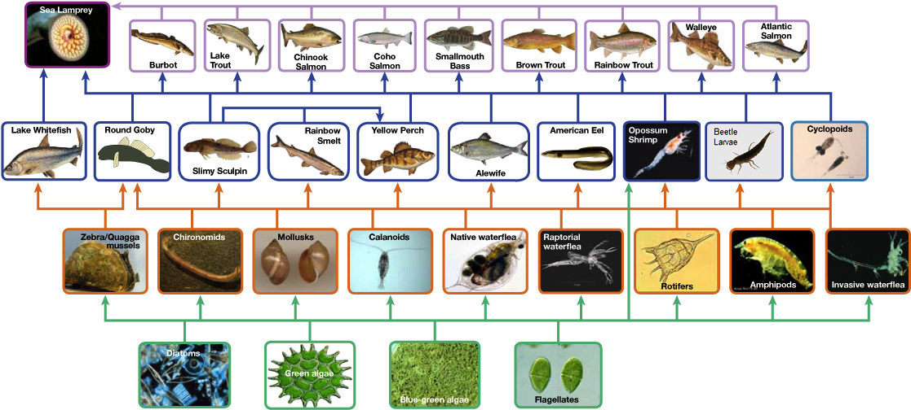

Slide 16
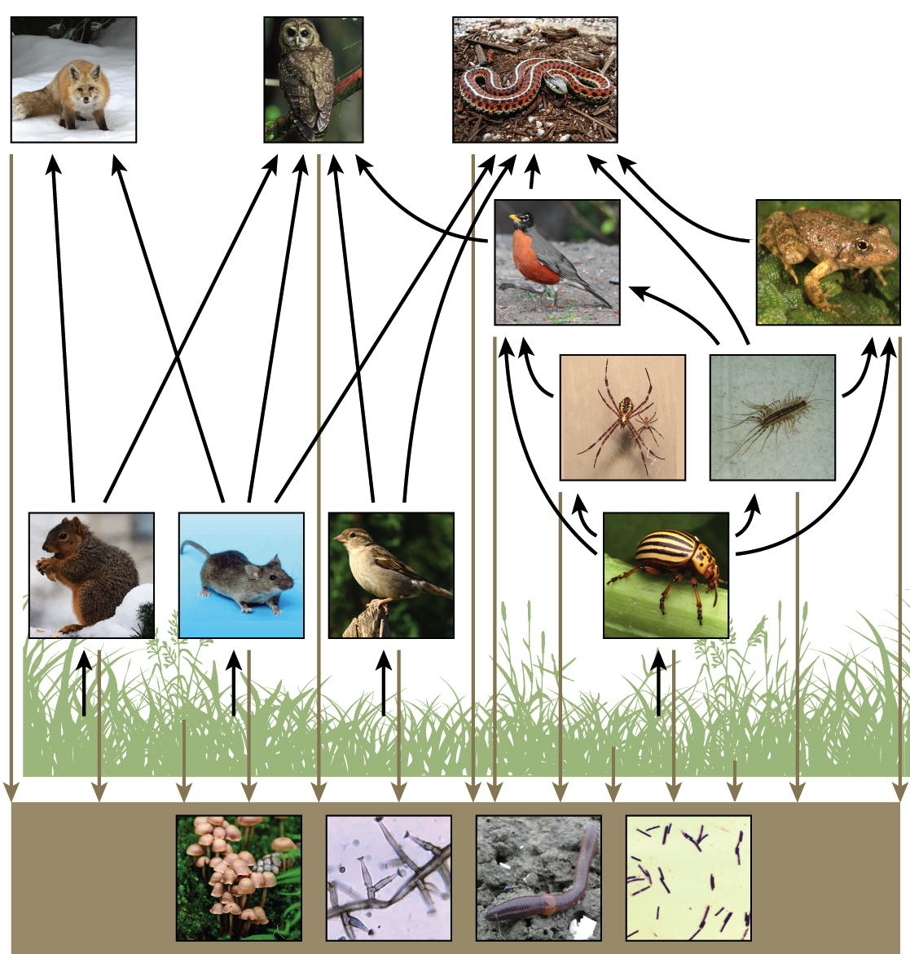

Slide 17
Dynamics of the Ecosystem…
The dynamic of the ecosystem is formed matter transition and energy cycles.
Boundaries of the ecosystem are not fixed.
For example rivers flow through many ecosystems, and thus affected, shows that ecosystems are not closed.
Ecosystems are linked to each other.

Slide 18
only about 10% of the energy that's stored as biomass in one trophic level
Trophic pyramid illustrating the 10% energy transfer rule.

Slide 19
Light energy is captured by primary producers.
Amount of energy stored as biomass:
At each level, energy is lost directly as heat or in the form of waste and dead matter that go to the decomposers. Eventually, the decomposers metabolize the waste and dead matter, releasing their energy as heat also.

Slide 20
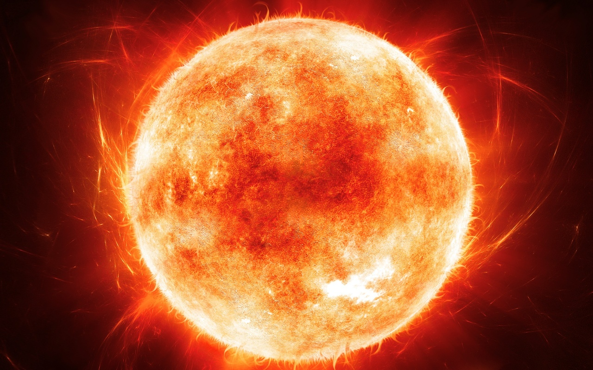
The primary source of energy in the ecosystem is the sun.
Notes:
in ecology, the sequence of transfers of matter and energy in the form of food from organism to organism. Food chains intertwine locally into a food web because most organisms consume more than one type of animal or plant. Plants, which convert solar energy to food by photosynthesis, are the primary food source. In a predator chain, a plant-eating animal is eaten by a flesh-eating animal. In a parasite chain, a smaller organism consumes part of a larger host and may itself be parasitized by even smaller organisms. In a saprophytic chain, microorganisms live on dead organic matter.

Slide 21
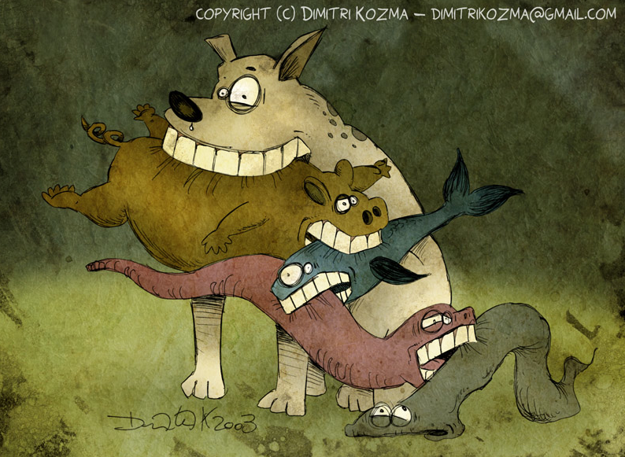

Slide 22
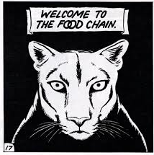
Any step change will disturb the balance between animal populations, and any step change will cause step effects, changes or even starvation on or with it.

Slide 23
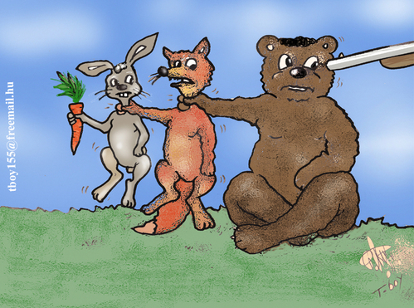

Slide 26
The Aquatic Environment
Environment? → first week’ class,
Everything that surrounds and influences an organism. Oceans, poddle, forest…
Environmental factors? →first week’ class,
Biotics and abiotics
Water…
What is WATER to us?

Slide 27
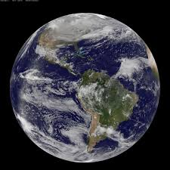
The Aquatic Environment
Water is the essential substance of life,
Dominant component of all living organisms
Dominant environment on earth

Slide 28
Major feature influencing the adaptations of organisms that inhibit aquatic environment is salinity.

Slide 29
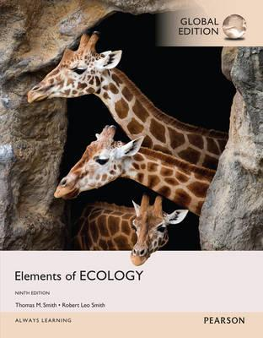
References
1- https://www.youtube.com/watch?v=ZouWWVyz9v8
2- http://www.climatedata.info/forcing/albedo/
3- http://astrocampschool.org/greenhouse-effect/
4- https://sites.google.com/a/gsbi.org/gvc1506/environment/greenhouse-effect
5- https://spaceplace.nasa.gov/seasons/en/
← Source material of this lecture
Further reading
McCarty, J. P., Wolfenbarger, L. L. and Wilson, J. A. 2017. Biological Impacts of Climate Change. eLS. 1–13.

