Slide 1
Realism: Neo-positivism & Critical Realism
Dr. Boran A. Mercan

Slide 2
What is “realism”?
Epistemological considerations
Naive (empirical) realism
Critical realism
Right realist criminology
Left realist criminology
British
a critique of elements of radical
Marxist approaches
Against neo-liberal economic policies
criminology: no practical value
ignored the very real impact of crime on the most vulnerable members of society

Slide 3
What is realism?
Realism resembles positivism at two points:
first of all, realism uses the natural science approach to the collection of data and to the explanation of social facts,
Secondly, the assumption that there is something ‘out-there’, something external reality awaiting to be discovered; what is called as reality is independent of our descriptions
There are two strands of realism: empirical (naive) and critical

Slide 4
Empirical realism posits that. reality can be comprehended by the use of relevant method and techniques.
Naive (empirical) realism assumes that there is a perfect match between reality and the terms we use to describe it.
Such an assumption ‘fails to recognise that there are enduring structures and generative mechanisms underlying and producing observable phenomena an events’ and is therefore ‘superficial’ (Bhaskar 1989: 2).
That’s why critical realism has emerged

Slide 5
Critical realism recognizes the external reality of the social world but takes an active position in the transformation of the world as we know.
This depends on our knowledge of the social world and the means to change & transform it
As Bhaskar (1989: 2) argues , ‘we will only be able to understand—and so change—the social world if we identify the structures at work that generate those events and discourses. . . . These structures are not spontaneously apparent in the observable pattern of events; they can only be identified through the practical and theoretical work of the social sciences’
That is to say, things are not like as they seem to us, so there are structures beneath what is seen.
Even natural science methods and others become the means to explore and identify what is given to us

Slide 6
Right realism
Thinking about Crime
Distinguishing left and right realism
Wilson and Herrnstein
Murray and the ‘underclass

Slide 7
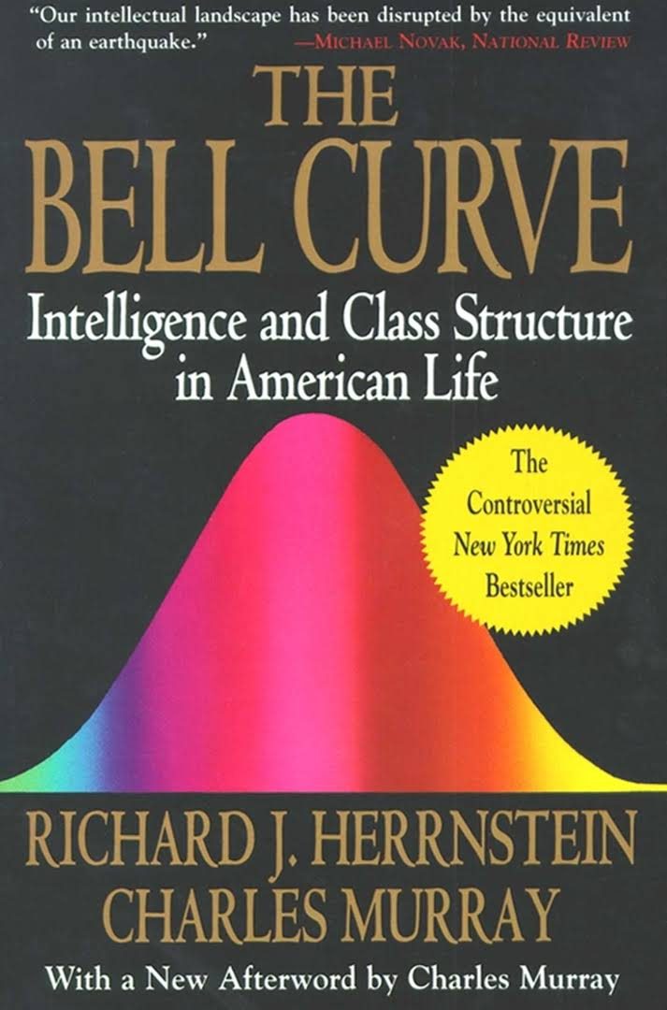
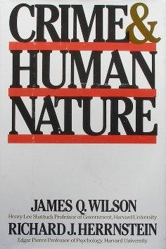
The Rise of Right Realism
Source: Basic Books
Source: Simon and Schuster

Slide 8
The Keynesian welfare state, full-employment, social insurance, standard-mass production & consumption and the post-war prosperity did not bring about the declining rates of crime in the US and UK
Arab-Israeli War, Oil crisis in 1973
The demise of the welfare programmes
The rise of neo-liberalism (flexibility and insecurity in labour markets)
Neo-liberal and neoconservative economy policies gained a momentum at the both sides of Atlantic, becoming quite effective tools to squeeze public sector and wider society

Slide 9
Right realism in criminology was a response of neo-conservative governments
James Q. Wilson Thinking about Crime (1975)
Wilson established a relationship between rising crime rates and welfare dependency
For Wilson, rising crime rates were the sign of social disgrace and dilapidation during the 1960s.
This was accompanied by the rising number of welfare recipients, drug addicts and youth unemployment. D
The American society was split into two parts: the wealthy and affluent vs. the pathological and predatory

Slide 10
Crime can be prevented through the use of situational crime prevention strategies
“If objective conditions are used to explain crime, spokesmen who use poverty as an explanation of crime should, by the force of their own logic, be prepared to consider the capacity of society to deter crime by raising the risks of crime. But they rarely do. Indeed, those who use poverty as an explanation are largely among the ranks of those who vehemently deny that crime can be deterred” (Wilson, 1975: xiv).

Slide 11
For rising crime rates, Wilson and Herrnstein (1985) held responsible of young children in one-parent families and saw this was the reason of the failure to develop a decent morality.
they also indicated the biological deficiency that causes amoral behaviour and offending to occur.
Return back to the biological positivism in the 18th and 19th centuries

Slide 12
“The existence of biological predispositions means that circumstances that activate behaviour in one person will not do so in another, that social forces cannot deter criminal behaviour in 100% of the population, and that the distribution of crime within and across societies may, to some extent, reflect underlying distributions of constitutional factors. Crime cannot be understood without taking into account predispositions and their biological roots.” (Wilson and Herrnstein, 1985: 103)

Slide 13
Their position can be interpreted the combination of social genetic approach with the principles of operant psychology
Physiological terms are limited, instead the point they made basically refers to the conditions that bring out biological factors come to merge with social elements in a way as to generate moral degradation and crime in society.

Slide 14
“The larger the ratio of the rewards (material and nonmaterial) of noncrime to the rewards (material and nonmaterial) of crime, the weaker the tendency to commit crimes. The bite of conscience, the approval of peers and any sense of inequity will increase or decrease the total value of crime; the opinions of family, friends, and employers are important benefits of noncrime, as is the desire to avoid the penalties that can be imposed by the criminal justice system. The strength of any reward declines with time, but people differ in the rate[s] at which they discount the future. The strength of a given reward is also affected by the total supply of reinforcers.” (Wilson and Herrnstein, 1985: 261)

Slide 15
Herrnstein and Murray (1994) even further took the argument to the point that personal intelligence influences the offending behaviour
Special emphasis on ‘cognitively disadvantaged’
‘many people tend to think of criminals as coming from the wrong side of the tracks. They are correct insofar as that is where people of low cognitive ability disproportionately live.’ (Herrnstein and Murray, 1994: 251)
For Herrnstein and Murray, people whose IQ scores are more likely to commit crime
Social class position and status is not a parameter in their analysis
They have received a substantial amount of criticism....

Slide 16
Charles Murray (1990) brought back a two-century-old debate in.
As if in the Victorian epoch, for Murray, the poor should be classified as deserving and undeserving
Traditional youth socialisation process broke down
Role modes for the youth drastically changed
The youth no longer want to work
Tolerance to idleness and comfort undermines the social cohesion and solidarity in the both sides of Atlantic

Slide 17
“One class of people was never even called ‘poor’. I came to understand that they simply lived on low incomes, as my own parents had done when they were young. There was another set of people, just a handful of them. These poor people didn’t just lack money. They were defined by their behaviour. Their homes were littered and unkempt. The men in the family were unable to hold a job for more than a few weeks at a time Drunkenness was common. The children grew up ill-schooled and ill-behaved and contributed a disproportionate share of the local juvenile delinquents.” (Murray, 1990: 1)

Slide 18
For Murray, underclass is the big problem and how the community will respond to it is directly to do with the nature of problem
The existence of underclass has devastating effects on community life
Welfare relief leads people to behave irresponsibly and has got direct impact in swelling the number of single-parent families
The rates of decline in marriages is associated with the rise of crime and deviancy.
The traditional male roles also declined depending on the single-parenting.

Slide 19
Left Realism
Left realist criminology (Critical in theory & method)
Jock Young and Roger Matthews
The critique of ‘left idealism’
The nature of left realism
What Is To Be Done about Law & Order?

Slide 20
Radical criminology tended to be socialist
However, left realist criminology tends to be social democratic:
“It is unrealistic to suggest that the problem of crime like mugging is merely the problem of mis-categorization and concomitant moral panics. If we choose to embrace this liberal position, we leave the political arena open to conservative campaigns for law and order – for, however exaggerated and distorted the arguments conservatives may marshal, the reality of crime in the streets can be the reality of human suffering and personal disaster. (Young, 1975)” (Newburn, 2007: 282)

Slide 21
Left idealism, they argued, assumed that crime occurred within the working class because of poverty, and that crime was an attempt to redress their balance in our inequitable society. To blame the poor for their criminality is to blame the victim and it is the crimes of the powerful, rather than the powerless, that should preoccupy us. The crimes of the powerless are, in fact, generally petty and the fact that it is such crimes that are the predominant focus of the criminal justice system illustrates the way in which the criminal law functions to protect the interests of the wealthy. The core of the critique focused on left idealism’s:

Slide 22
Crime is something real ‘out-there’
Crime affects human life and makes people suffer from its physical, social and psychological consequences
There needs to be something done to prevent or compensate its consequences
It can be taken as the revolt or outrage against the affluent side of society
It affects everyone in the community
Thus, we need a ‘realistic’ approach
Left realism sets in to respond to the problem of crime

Slide 23
Left realism starts out with the critique of radical criminology and left idealism that claims:
Crime is the means of correcting socio-economic inequalities on the side of the working-class
The poor should be conceived as the weak in comparison to the upper classes’ wealth and power in securing themselves from the hands of criminal justice
The crimes of the poor and working class are majorly in the category of petty crime
Petty crimes draws so much attention of the criminal justice system that crimes of the powerful disappear before the eyes of public
Left realism is opposed to these arguments of Left idealists...

Slide 24
“The core of the critique focused on left idealism’s:
Utopianism – It has continued to adhere to the view that some form of crime-free future is possible if only social structural conditions could be changed. One consequence of this is that left idealism is accused of focusing on unrealistic and unachievable political change, and of failing to focus on more practical policy changes which would improve people’s lives.
Romanticism – Left idealism has continuedto view much crime as a form of primitive rebellion, has excused it and failed to understand and appreciate the harm caused. As David Matza (1969: 44) put it, ‘Romance, as always, obscures the seamier and more mundane aspects of the world.’” (Newburn, 2007, 283)

Slide 25
“Naive anti-empiricism – Left realists accuse their idealist colleagues of ignoring evidence not only about the impact of criminal victimisation, but also about its extent. Whereas idealists are scornful of data suggesting that crime had been increasing during the 1970s and 1980s, realists, not least via local crime surveys, adopted a position that, whilst retaining a scepticism about offi cial measures, nonetheless accepted that crime had been increasing.
Naive abolitionism – It has clung to the view that the closure of institutions and the limiting of the criminal justice system would be an uncritical good.” (Newburn, 2007: 283)

Slide 26
“The central tenet of left realism is to reflect the reality of crime, that is in its origins, its nature and its impact. This involves a rejection of tendencies to romanticize crime or to pathologize it, to analyse solely from the point of view of the administration of crime or the criminal actor, to underestimate crime or to exaggerate it . . . Most importantly, it is realism which informs our notion of practice: in answering what can be done about the problems of crime and social control.” (Young, 1986: 21)

Slide 27
Jock Young (1992) sheds light on the processes that gave birth to the left realism
a) The aetiological crisis: the problem of identifying the right cause-effect relationship; apparently the rise of crime lays somewhere else not in the behavioural deficiency of people; need to identify socio-economic problems and the role of agents
b) No matter how the size of the law enforcement agencies and criminal justice capacity has expanded, the rise of crime could not be reduced. Administrative criminology was responsible of this, which induces an amalgamation of neo-classicism and social positivism

Slide 28
d) Victimization is totally out of question; victims and the damage given to them are invisible
e) There was a rising public attention to the need of criticism of law enforcement agencies in steering criminal justice procedure and need for the democratic service accountability.

Slide 29
Source: AbeBooks

Slide 30
John Lea and Jock Young What is to be Done about Law & Order? (1984) set the terms for realistic criminology
Crime is a real problem
One must look at behind what is known as crime and order and understand social structures
Control and punishment is something that needs to be considered seriously
One must take into account the conditions of offender and victim, and look for the conditions of protecting victims
There apparently needs a democratic policing and the cooperation between police and wider public
The rise of poverty and deprivation should also be considered in making new policies

Slide 31
Left realism:
rejects utopianism in favour of democratic socialism
accepts legal definitions of crime
focuses on crime as perceived by victims
stresses fear of crime as rational
reworks subcultural, anomie and structural conflict theories
assumes crime caused by relative deprivation, social injustice and marginalisation
prioritise social justice via programmes of crime prevention. (Source: Newburn, 2007: 290)

