Slide 1
B-310 BİYOKİMYA II DERSİ
XIV. Hafta

Slide 2
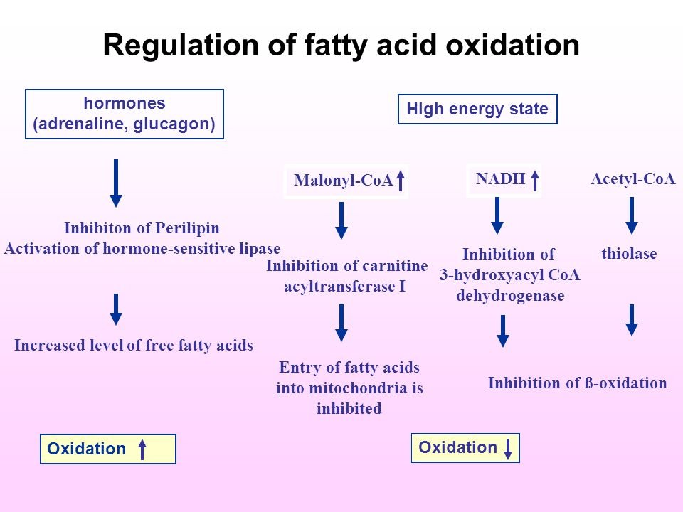
https://www.google.com/url?sa=i&url=https%3A%2F%2Fslideplayer.com%2Fslide%2F6899180%2F&psig=AOvVaw2dnOGkEEaeG5NYwcCFK1v3&ust=1589143576987000&source=images&cd=vfe&ved=0CAIQjRxqFwoTCKi0iMXTp-kCFQAAAAAdAAAAABAZ

Slide 3
Sentazlar, sentetazlar, liyazlar, ligazlar, kinazlar, fosforilazlar, dehidrogenazlar, fosfataz enzimlerinin birçoğu sitrik asit döngüsünde yer alan enzimlerdir.
Bu yol indirgen ajanların (elektron taşıyıcılarında tutulan) üretimini

Slide 4
karbohidratlarda, yağlarda ve proteinlerde saklı olan enerjinin ATP oluşumuna aktarılmasını sağlamaktadır,
Sitrik asit döngüsü geri dönüşümsüz reaksiyonlarda yer alan enzimlerin düzenlenmeleri ile

Slide 5
https://www.youtube.com/watch?v=LQmTKxI4Wn4
https://www.youtube.com/watch?v=kXpzp4RDGJI

Slide 6
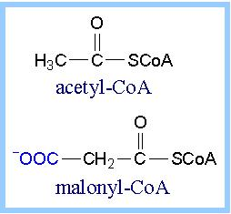

Slide 7
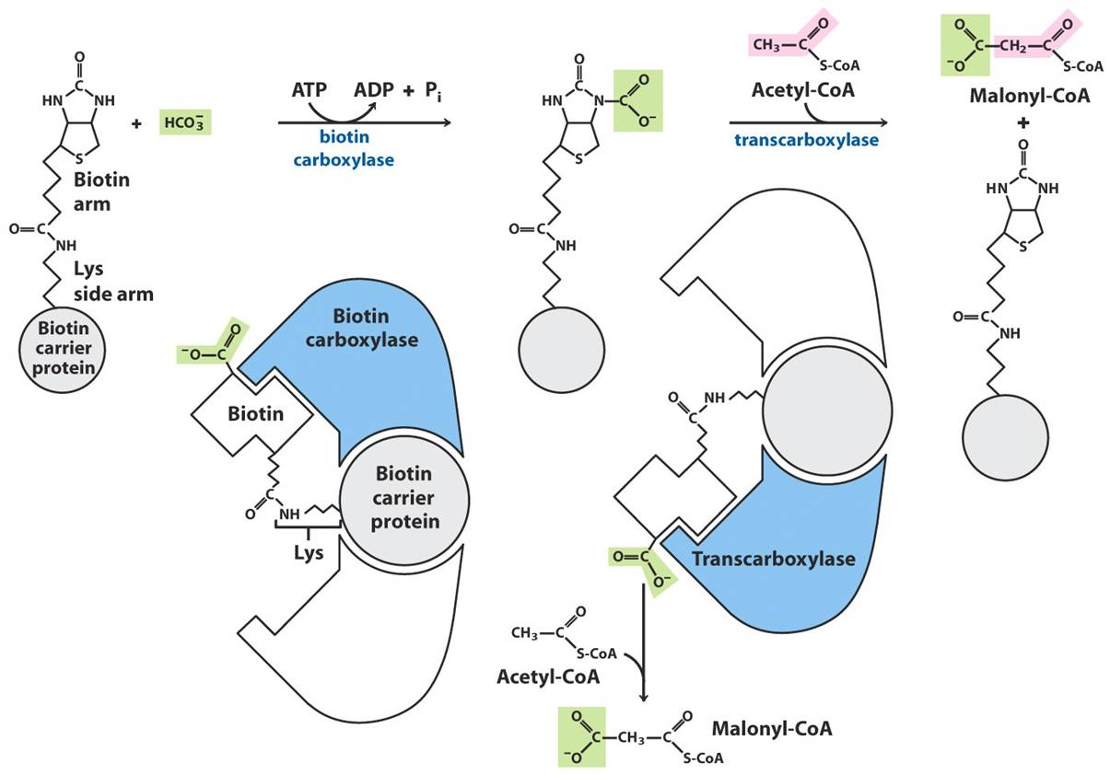

Slide 8
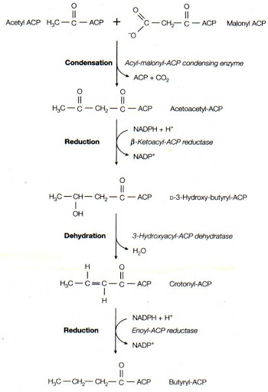
https://www.google.com/url?sa=i&url=http%3A%2F%2F80.251.40.59%2Fveterinary.ankara.edu.tr%2Ffidanci%2FDers_Notlari%2FLM-Yag_Asitlerinin_Biyosentezi.html&psig=AOvVaw0fr5yvJuvDMjmGjSsPRkz3&ust=1588790671652000&source=images&cd=vfe&ved=0CAIQjRxqFwoTCNiHn8-wnekCFQAAAAAdAAAAABAx

Slide 9
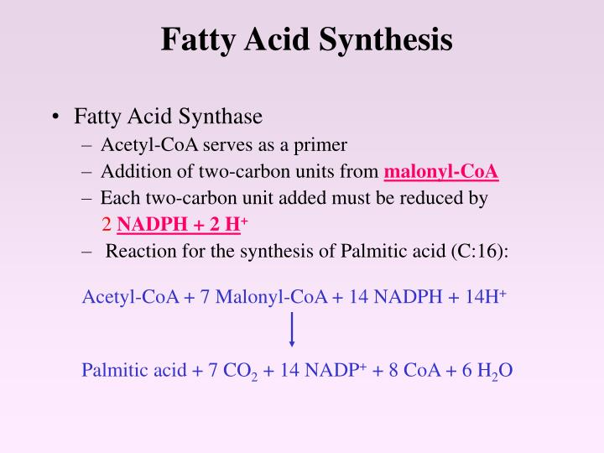
https://www.google.com/url?sa=i&url=https%3A%2F%2Fwww.slideserve.com%2Fdeanna%2Ffatty-acid-synthesis-1323760&psig=AOvVaw2PUXdURo9vmicrlAq3Wap8&ust=1589148598721000&source=images&cd=vfe&ved=0CAIQjRxqFwoTCJCjipzmp-kCFQAAAAAdAAAAABBi

Slide 10
https://www.google.com/url?sa=i&url=https%3A%2F%2Fslideplayer.com%2Fslide%2F13507659%2F&psig=AOvVaw2PUXdURo9vmicrlAq3Wap8&ust=1589148598721000&source=images&cd=vfe&ved=0CAIQjRxqFwoTCJCjipzmp-kCFQAAAAAdAAAAABBz

Slide 11
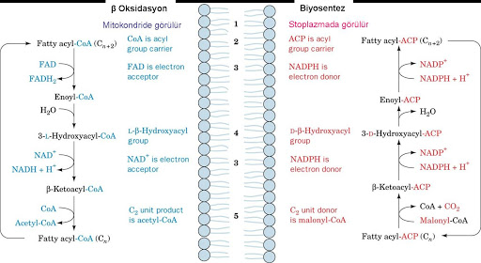
https://www.google.com/url?sa=i&url=http%3A%2F%2F80.251.40.59%2Fveterinary.ankara.edu.tr%2Ffidanci%2FDers_Notlari%2FLM-Yag_Asitlerinin_Biyosentezi.html&psig=AOvVaw0fr5yvJuvDMjmGjSsPRkz3&ust=1588790671652000&source=images&cd=vfe&ved=0CAIQjRxqFwoTCNiHn8-wnekCFQAAAAAdAAAAABA2

Slide 12
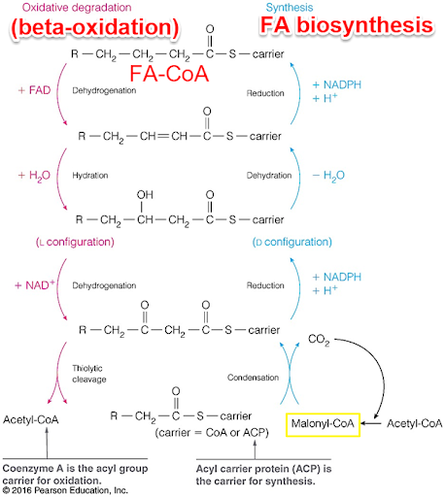
https://www.google.com/url?sa=i&url=http%3A%2F%2Fanitapopescu.me%2Fprojects%2FNotes%2F10-FA-Synthesis.html&psig=AOvVaw2PUXdURo9vmicrlAq3Wap8&ust=1589148598721000&source=images&cd=vfe&ved=0CAIQjRxqFwoTCJCjipzmp-kCFQAAAAAdAAAAABAa

Slide 13
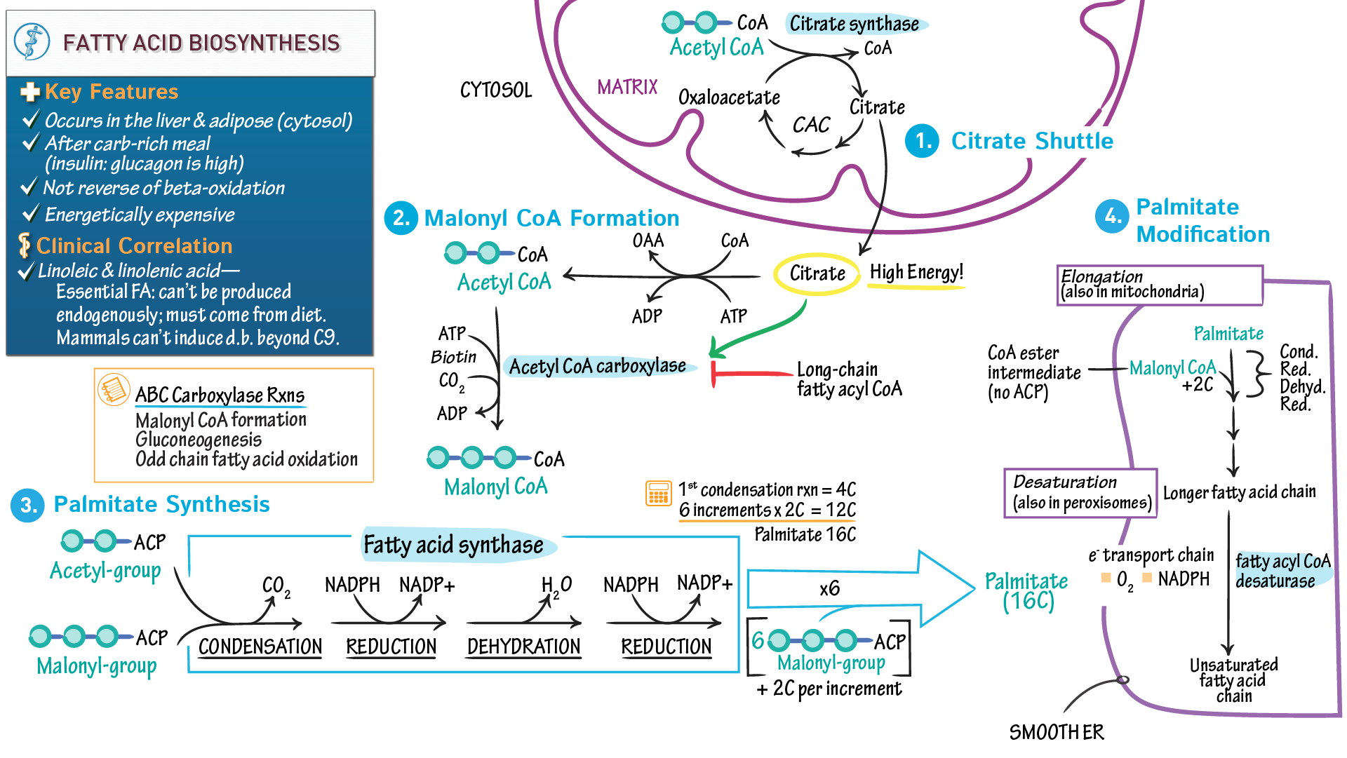

Slide 14
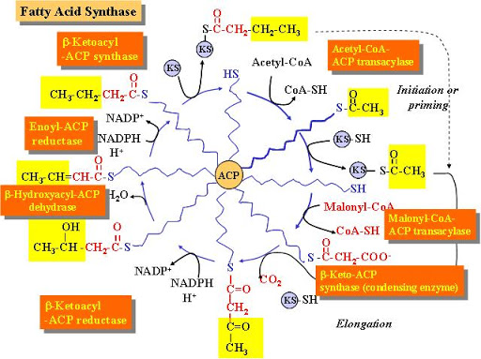
https://www.google.com/url?sa=i&url=http%3A%2F%2F80.251.40.59%2Fveterinary.ankara.edu.tr%2Ffidanci%2FDers_Notlari%2FLM-Yag_Asitlerinin_Biyosentezi.html&psig=AOvVaw0fr5yvJuvDMjmGjSsPRkz3&ust=1588790671652000&source=images&cd=vfe&ved=0CAIQjRxqFwoTCNiHn8-wnekCFQAAAAAdAAAAABA8

Slide 15
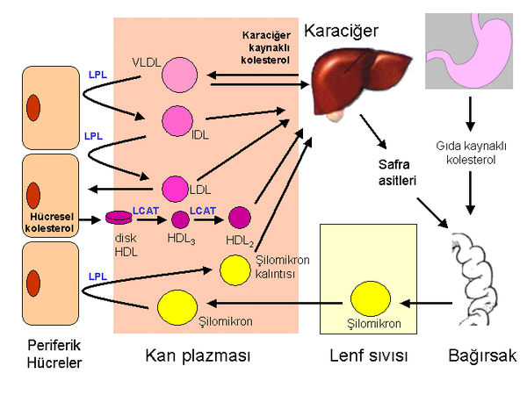
https://www.google.com/url?sa=i&url=https%3A%2F%2Ftr.wikipedia.org%2Fwiki%2FLipoproteinler&psig=AOvVaw0bxrXk6UtqP0FbLDKouBRE&ust=1589325085258000&source=images&cd=vfe&ved=0CAIQjRxqFwoTCKCS9Lz3rOkCFQAAAAAdAAAAABAD

Slide 16
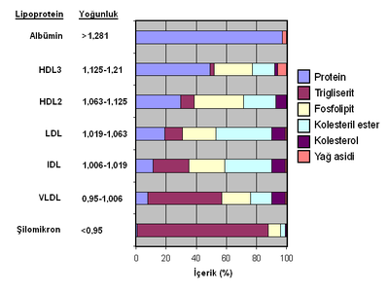
https://www.google.com/url?sa=i&url=https%3A%2F%2Ftr.wikipedia.org%2Fwiki%2FLipoproteinler&psig=AOvVaw0bxrXk6UtqP0FbLDKouBRE&ust=1589325085258000&source=images&cd=vfe&ved=0CAIQjRxqFwoTCKCS9Lz3rOkCFQAAAAAdAAAAABAh

Slide 17
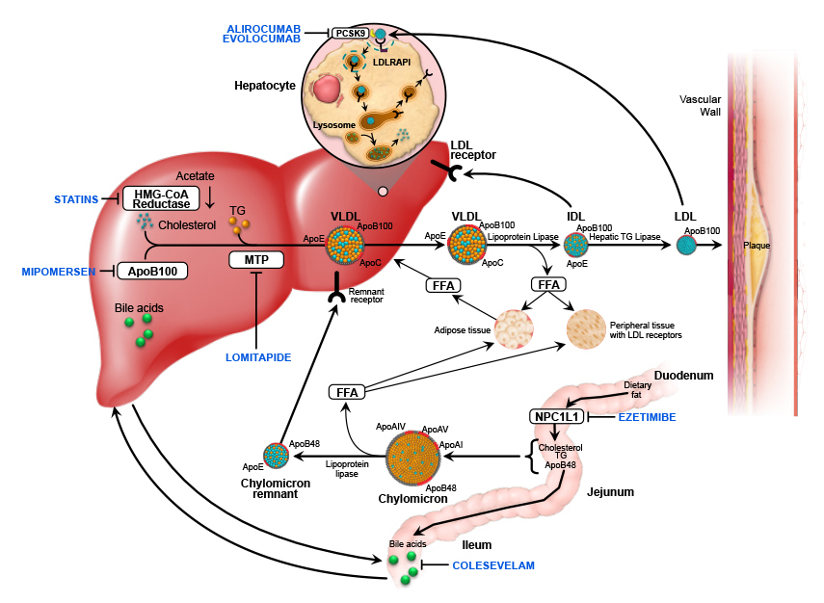
https://www.google.com/url?sa=i&url=https%3A%2F%2Fwww.mayo.edu%2Fresearch%2Flabs%2Fatherosclerosis-lipid-genomics%2Fresearch%2Ffamilial-hypercholesterolemia&psig=AOvVaw3sFQiJ3mlJL0rFvW3hMhya&ust=1589325361350000&source=images&cd=vfe&ved=0CAIQjRxqFwoTCNiGvsH4rOkCFQAAAAAdAAAAABAD

Slide 18
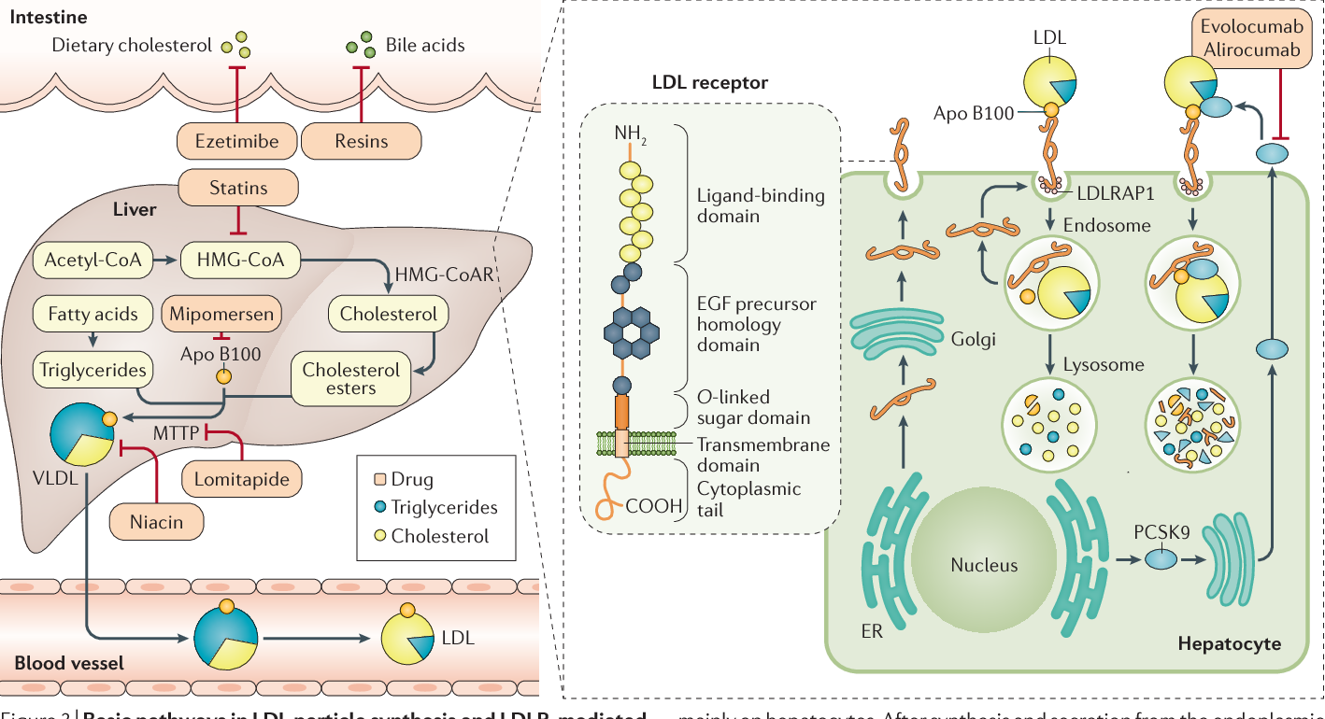
https://www.google.com/url?sa=i&url=https%3A%2F%2Fwww.semanticscholar.org%2Fpaper%2FFamilial-hypercholesterolaemia-Defesche-Gidding%2F10e49bb4199fade6ebb6149bd8471d1d2857ba2d%2Ffigure%2F3&psig=AOvVaw3sFQiJ3mlJL0rFvW3hMhya&ust=1589325361350000&source=images&cd=vfe&ved=0CAIQjRxqFwoTCNiGvsH4rOkCFQAAAAAdAAAAABBL

Slide 19
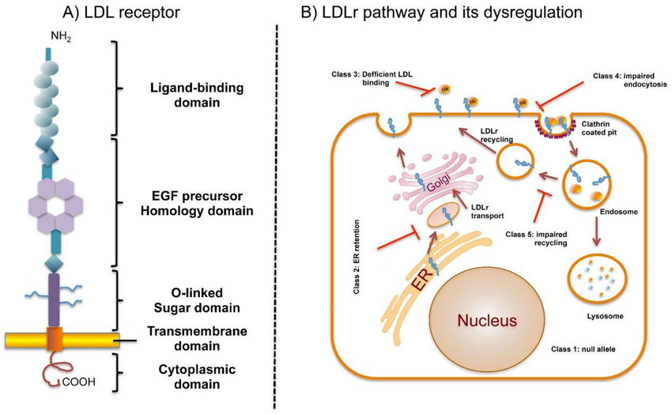
https://www.google.com/url?sa=i&url=https%3A%2F%2Fwww.researchgate.net%2Ffigure%2FDomain-organization-of-LDLr-and-LDLr-pathway-and-its-dysregulation-by-defective_fig1_325584732&psig=AOvVaw3sFQiJ3mlJL0rFvW3hMhya&ust=1589325361350000&source=images&cd=vfe&ved=0CAIQjRxqFwoTCNiGvsH4rOkCFQAAAAAdAAAAABBQ

Slide 20
KAYNAKÇA
Başlıca Kaynak: Lehninger Biyokimyanın İlkeleri, David L.Nelson, Michael M. Cox, Beşinci Baskıdan Çeviri, Çeviri Editörü; Y. Murat Elçin, Palme Yayıncılık, 2013.

Slide 21
Principles of Biochemistry, H. R. Horton, L. A. Moran, K. G. Scrimgeour, M. D. Perry, J. D. Rawn, Pearson Prentis Hall, 2006.
Color Atlas of Biochemistry, J. Koolman, K. H. Roehm, Georg Thieme Verlag, 2005.

Slide 22
Harper’s Illustrated Biochemistry, R. K. Murray, D. K. Granner, P. A. Mayes, V. W. Rodwell, Lange Medical Books/McGraw-Hill Medical Publishing Division, 2003.
Basic Concepts in Biochemistry, A Student’s Survival Guide, H. F. Gilbert, McGraw-Hill Health Proffesions Division, 2000.

