Slide 1
INSECT ECOLOGY
Dr. Jamba Gyeltshen
30/8/2011

Slide 2
Definition of Ecology
Ecology ≠ Environmental Science
The study of the distribution and abundance of organisms
Andrewartha 1961
The study of the interactions between organisms and their environment
Ecology is the scientific study of the interactions that determine the distribution and abundance of organisms.

Slide 3
Foundations of Ecology
Genetics = "currency" of life
Evolution = process by which the existing life originated
Behavior (Ethology) = the response of organisms to stimuli.
Physiology = study of the functions and activities of life – and the physical and chemical phenomena involved.
Ecology = context of life (and evolution)
Physiology
Genetics
Ecology
Behavior
Evolution

Slide 4
Levels of Integration
Issues with lack of understanding
Much of biology is reductionistic.
Lack of experiments
Time constraints
Logistical/Spatial constraints
Research Support
Landscapes*
Ecosystems*
Communities*
Species*
Populations*
Individual Organisms
Organ systems
Organs
Tissue
Cells
Subcellular organelles
Molecules
Decreasing Scientific Understanding

Slide 5
INSECT ECOLOGY
Insect ecology is the branch of entomology that focuses on the interrelationships between insects and their environment.

Slide 6
COMMUNITY
Communities are groups of organisms (populations) that maintain persistent associations with each other.
The members of a typical community include plants, animals, and other organisms that are biologically interdependent through predation, parasitism, and symbiosis.

Slide 7
The structure of a biotic community is largely characterized by the trophic (feeding) relationships among its member species. These relationships are often represented simplistically as a food chain.

Slide 8
Food Chains, Food Webs, and the Transfer of Energy

Slide 9
Autotrophs
A groups of organisms that can use the energy in sunlight to convert water and carbon dioxide into Glucose (food)
Autotrophs are also called Producers because they produce all of the food that heterotrophs use
Without autotrophs, there would be no life on this planet
Ex. Plants and Algae

Slide 10
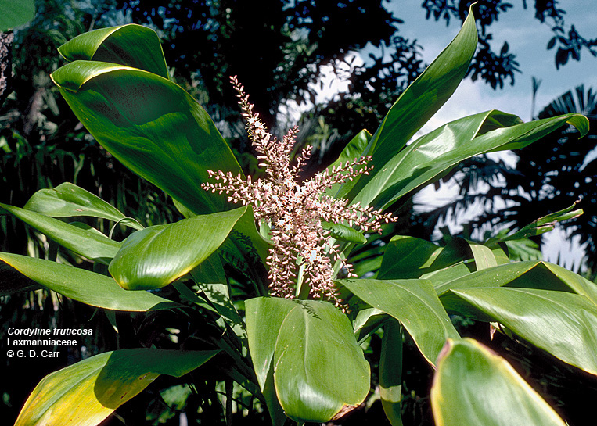
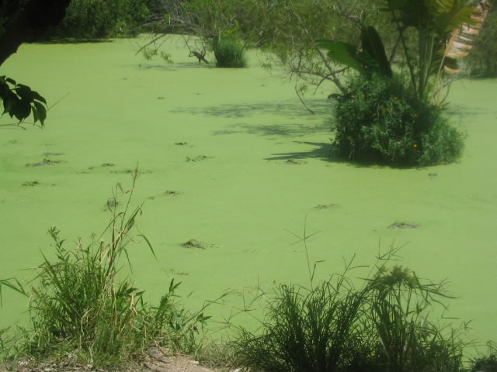
Autotrophs

Slide 11
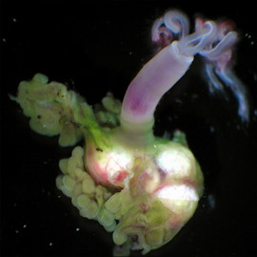
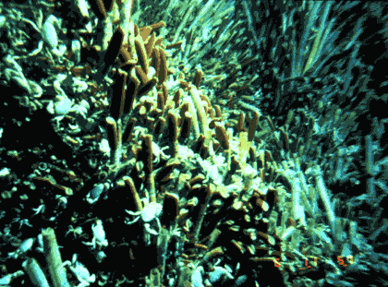
Autotrophs
Chemotrophs
Autotrophs that get their energy from inorganic substances, such as salt
Live deep down in the ocean where there is no sunlight
Ex. Bacteria and Deep Sea Worms

Slide 12
Heterotrophs
Organisms that do not make their own food
Another term for Heterotroph is consumer because they consume other organisms in order to live
Ex. Rabbits, Deer, Mushrooms

Slide 13
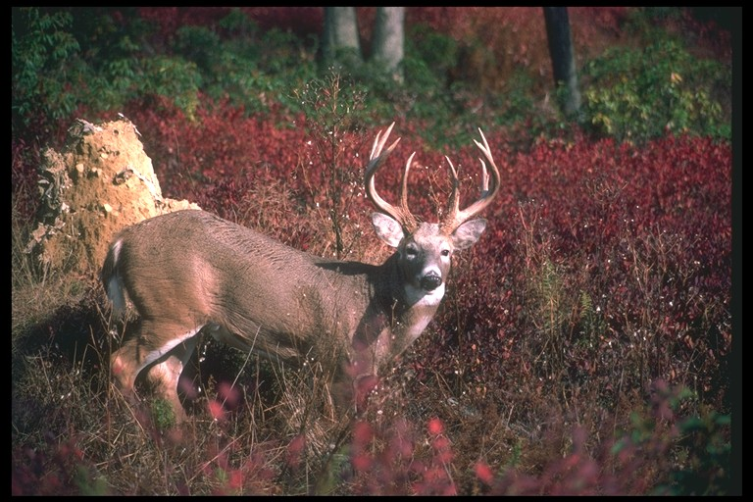
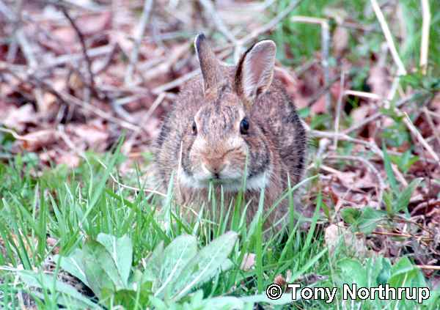
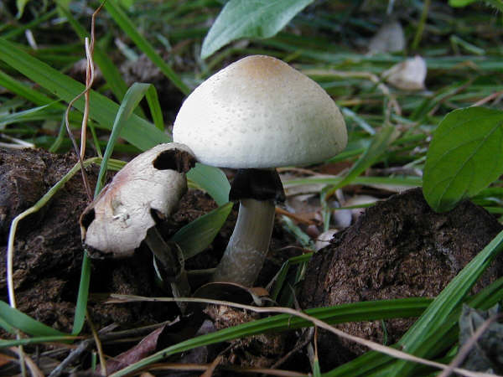
Heterotrophs

Slide 14
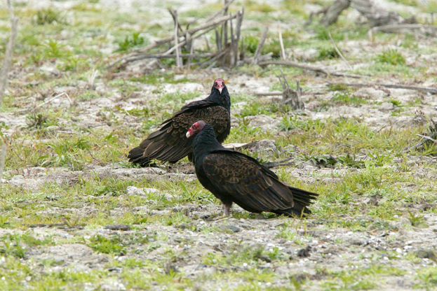
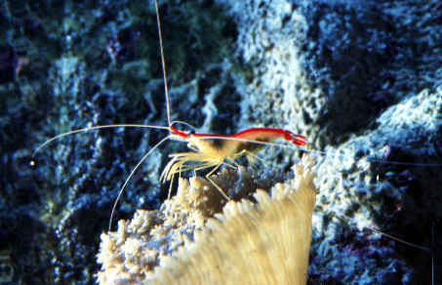
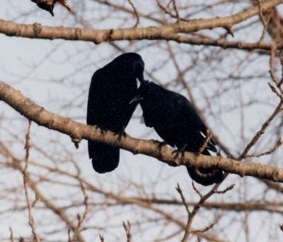
Heterotrophs
Consumers
1. Scavengers/Detritivores – feed on the tissue of dead organisms (both plans and animals)
Ex. – Vultures, Crows, and Shrimp

Slide 15
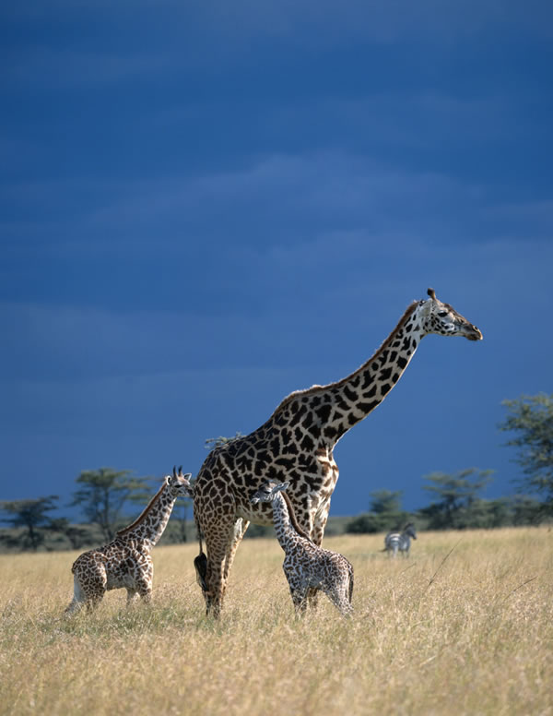
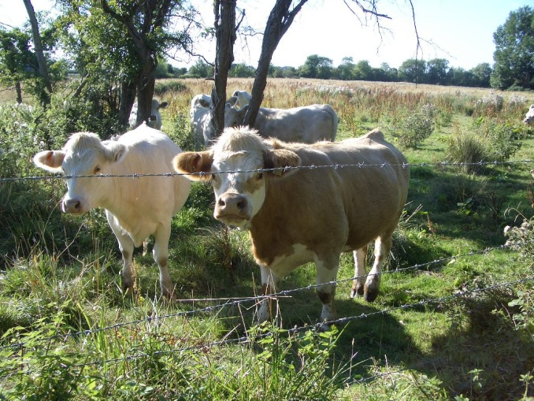
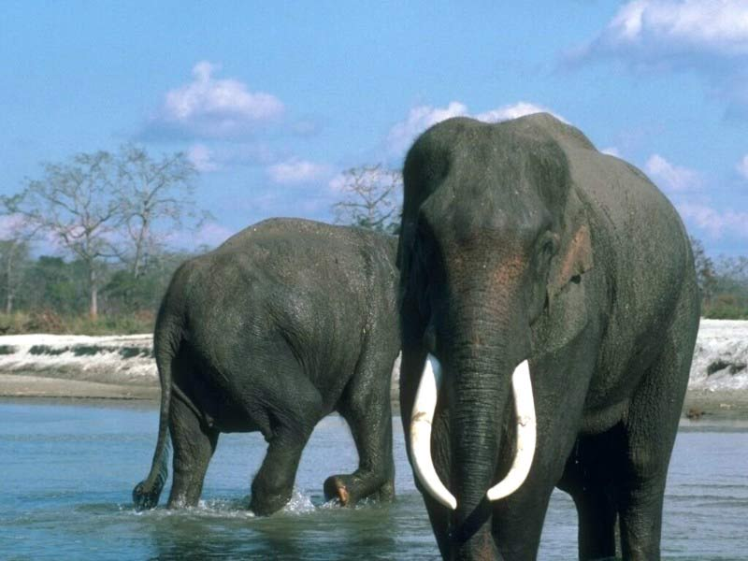
Heterotrophs
Consumers
2. Herbivores – eat ONLY plants
Ex. – Cows, Elephants, Giraffes

Slide 16
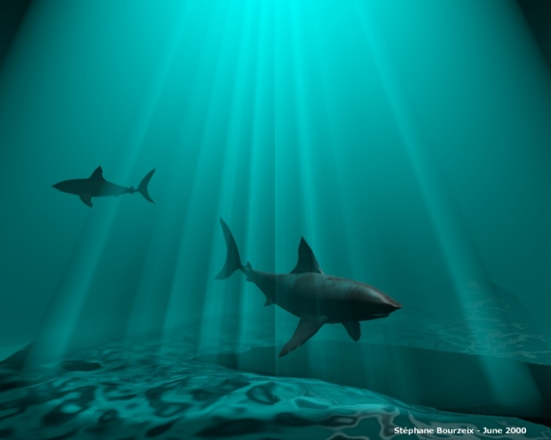
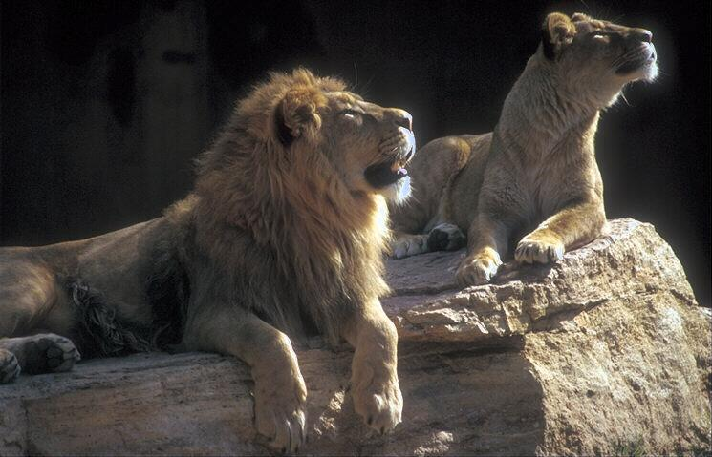
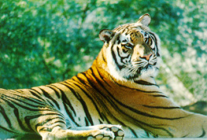
Heterotrophs
Consumers
3. Carnivores – eat ONLY meat
Ex. – Lions, Tigers, Sharks

Slide 17
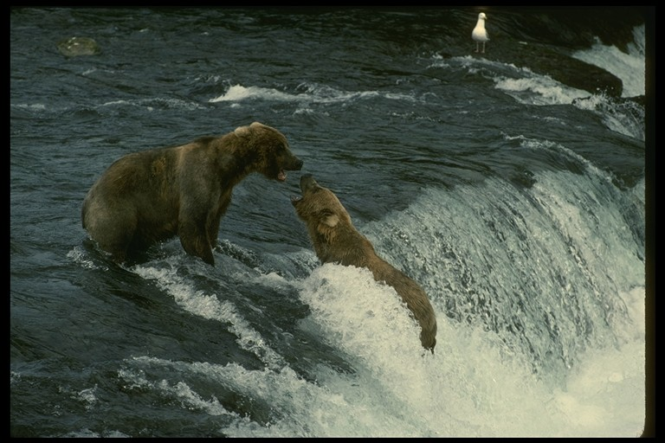
Heterotrophs
Consumers
4. Omnivores – eat BOTH plants and animals
Ex. – Bears and Humans

Slide 18
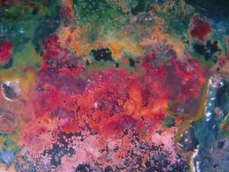
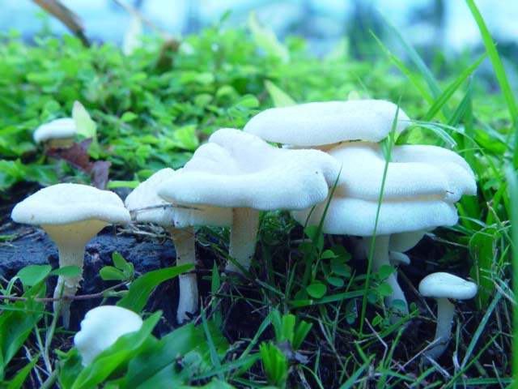
Heterotrophs
Consumers
5. Decomposers – absorb any dead material and break it down into simple nutrients or fertilizers
Ex. – Bacteria and Mushrooms

Slide 19
Transfer of Energy
When a zebra eats the grass, it does not obtain all of the energy the grass has (much of it is not eaten)
When a lion eats a zebra, it does not get all of the energy from the zebra (much of it is lost as heat)

Slide 20
Transfer of Energy
The two (2) previous examples of energy transfer show that no organism EVER receives all of the energy from the organism they just ate
Only 10% of the energy from one trophic level is transferred to the next – this is called the 10% law

Slide 21
Insects and the Food Chain
Insects as Prey
Fish & birds eat insects to survive
Fishers use lures to look like “flies”
Some chicks may eat up to 200,000 before leaving the nest
Insects as Decomposers
Flies and dung beetles break down droppings
Help to enrich the soil
Insects as Food for Humans
Important source of nutrition for early humans
Some still eat grasshoppers, crickets, ants, cicadas.
Other insects have major daily life uses (pg. 353)

Slide 22
Food Web
Most organisms eat more the JUST one organism
When more organism are involved it is know as a FOOD WEB
Food webs are more complex and involve lots of organisms

Slide 24
Food Web

Slide 25
Food Web

Slide 26
Biomass
The total mass of the organic matter at each trophic level is called biomass
Biomass is just another term for potential energy – energy that is to be eaten and used.
The transfer of energy from one level to another is very inefficient (10% Law)

Slide 27
Biomass

Slide 28
Ecological Pyramid
An ecological pyramid shows the relationship between consumers and producers at different trophic levels in an ecosystem
Shows the relative amounts of energy or matter contained at each trophic level
The Pyramid shows which level has the most energy and the highest number of organisms

Slide 29
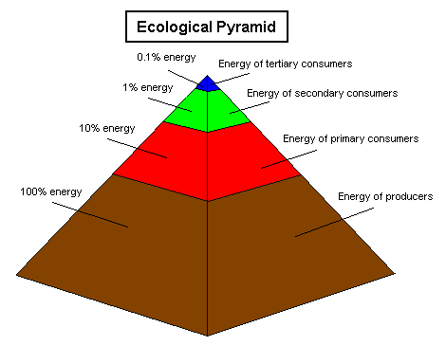
Ecological Pyramid

Slide 30
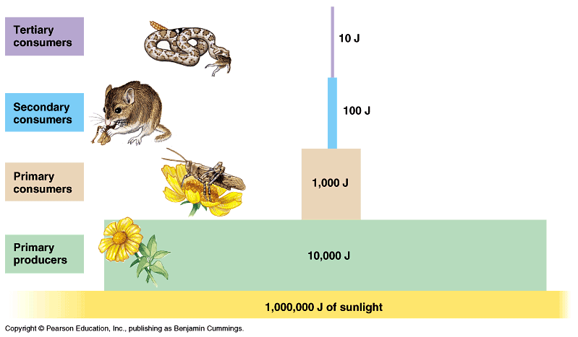
Ecological Pyramid

Slide 31
Symbiosis
A close and permanent association between organisms of different species
Commensalism – a relationship in which one organism benefits and the other is not affected
Mutualism – a relationship in which both organisms benefit from each other
Example: Birds eating pest off a rhino’s back
Parasitism – A relationship in which one organism benefits and the other is harmed
Example: Ticks on a dog

Slide 32
Ecological Succession
A change in the community in which new populations of organisms gradually replace existing ones
1. Primary Succession – occurs in an area where there is no existing communities and for some reason (s) a new community of organisms move into the area

Slide 33
Ecological Succession
A change in the community in which new populations of organisms gradually replace existing ones
2. Secondary Succession – occurs in an area where an existing community is partially damaged

Slide 34
Ecological Succession
A change in the community in which new populations of organisms gradually replace existing ones
3. Climax Community – a community that is stable and has a great diversity of organisms

Slide 35
Insect Herbivores
Animals that feed on plant tissues or plant products are often called herbivores.
Entomologists frequently use the noun "phytophagous" when referring to any of these nutritional strategies. Both words are derived from Greek roots: "phyton" meaning plant and "phagein" the verb to eat or devour.

Slide 36
How insects locate food?
Phytophagous insects generally use
1) Visual cues
2) Olfactory (odour) cues
to locate a host plant .
Visual cues may be as simple as the vertical silhouette of a tree or the contrast of white flowers against a dark background of foliage.

Slide 37
How insects locate food?
Visual cues can be the certain shapes or colors which they evidently associate with "food".
Example: Red spheres attract adult apple maggots, white pans of water attract aphids, and bright yellow sticky traps attract leafhoppers.

Slide 38
2) Olfactory (Odor) Cues
Odor cues are plant volatiles such as the saponins in alfalfa, the mustard oils in crucifers, or the terpenes in conifers.
Sometimes these attractants are primary plant compounds such as sugars (e.g. glucose), nucleotides (e.g. adenine), or amino acids (e.g. alanine) that a plant needs for its own survival and growth

Slide 39
But in other cases, the attractants are secondary plant compounds that have no nutritional value to either the plant or the insect.
These substances may be manufactured by the plant as a chemical defense against herbivores but they unwittingly serve as token feeding stimulants to a select group of specially adapted species.

Slide 40
Milkweed plants, for example, produce cardenolides that deter feeding by most phytophagous insects.
These chemicals, however, attract monarch butterflies, oleander aphids, milkweed beetles, and a few other species that have the ability to digest or detoxify the compounds.

Slide 41
Cyclical pattern of feeding
Insect herbivores often have a cyclical pattern of feeding behavior.
After an initial phase of attraction to the host plant, appropriate tactile (touch) and olfactory (odor) cues trigger the impulse to take a first bite.
Additional gustatory (taste) stimuli must be present in order for continued feeding to occur.
After a bout of feeding is complete, the insect may leave the host plant to engage in other activites.

Slide 42
Cyclical pattern of feeding

Slide 43
Chemical warfare
Since many plants conduct chemical warfare against insect herbivores by manufacturing repellents or deterrents, it is common for insects to be rather narrow and specialized in their choice of host plant.

Slide 44
Some of the more polyphagous insects (like grasshoppers and armyworms) will consume every part of their host plant.
But most insect herbivores are more selective: they specialize as leaf chewers, sap suckers, stem borers, root pruners, gall makers, leaf miners, collectors of pollen or nectar, etc.

Slide 45
Monophagous
A monophagous insect restricts itself to a single host species -- it is a consummate specialist, adapting its behavior and physiology to a single nutritional resource.

Slide 46
Oligophagous
Oligophagous insects have a slightly broader host range -- often adopting any plant within a close circle of related genera or the members of a single taxonomic family. These insects are less likely to starve if a preferred host plant is unavailable.

Slide 47
Polyphagous
A few insects are polyphagous. These species are equipped with "broad-spectrum" detoxification enzymes that can overcome a wide range of plant defenses.

Slide 48
Each of these feeding strategies represents a separate ecological niche and all of the species that feed on the same plant in the same way are known as members of a feeding guild.

Slide 49
Within a feeding guild, all species compete directly with each other for exactly the same resource. Between members of different guilds, competition is usually less direct and less severe. As a result, there is strong selective pressure limiting the number of species within each guild.

Slide 50
NATURAL SELECTION
Natural selection tends to favor adaptations that minimize competition between species within a feeding guild.

