Slide 1
HISTOLOGY
Epithelium I

Slide 2
What is Histology ?
Histology is the scientific study of the fine detail of biological cells and tissues that have been carefully prepared using "histological techniques” by microscopes
It is a discipline that is essential for the understanding and advancement of biology, medicine, veterinary medicine and many sub-disciplines within those scientific subjects.

Slide 3
The word "histology" comes from the combination of the Greek words , meaning "tissue", and which is sometimes translated as "-logia" and is a suffix generally used to denote the study of a subject or the branch of knowledge of a discipline

Slide 4
Tissue
Human’s body consists of billions of cells.
In biology, tissue is a cellular organizational level between cells and a complete organ.
A tissue is a collection of cells and noncellular structures, which have the similar origin, structure and carry out a specific function
Organs are formed by groups of tissues
Most organs are complex groups of different tissue types.
An organism is composed of organs that are grouped together and functionally integrated.

Slide 6
Cells are bound together with varying amounts of intercellular substance to form tissues and organs
Single-celled livings do not have tissue.
Simple multi-cells, such as sponges, do not have tissue, they have cells which are slightly differentiated

Slide 7
Tissues differs from the
ectoderm,
endoderm and
mesoderm layers of embryo
Differentiation of the tissues from these embryo layers is called histogenesis.
The transformation of an undifferentiated cell population into an organ during development is called organogenesis

Slide 8
The cells that make up the tissues are surrounded by the extracellular matrix secreted by these cells.
The composition of ECM material differs from one tissue to another.
The ECM can be liquid, semi-solid or solid.
Each tissue has its own unique cells.

Slide 9
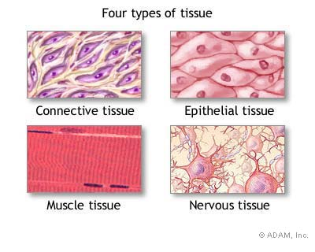
Three primitive germ layers give rise to 4 primary tissues
There are 4 types of tissue:
1. Epithelial
2. Connective
3. Muscle
4. Nervous
Similarities between tissue types:
1. All contain cells
2. Cells that make up tissues have similar functions

Slide 10
Connective tissue
Connective tissues are fibrous tissues.
They are made up of cells separated by non-living material, which is called an extracellular matrix.
liquid or rigid
For example, blood contains plasma as its matrix and bone's matrix is rigid.
Connective tissue gives shape to organs and holds them in place.

Slide 11
Blood, bone, cartilage, adipose tissues are examples of connective tissues.
One method of classifying connective tissues is to divide them into three types:
fibrous connective tissue
skeletal connective tissue
fluid connective tissue

Slide 12
Muscle tissue
Muscle cells form the active contractile tissue of the body known as muscle tissue.
Muscle tissue functions to produce force and cause motion, either locomotion or movement within internal organs.
Muscle tissue is separated into three distinct categories:
smooth muscle, found in the inner linings of organs
skeletal muscle, typically attached to bones, which generate gross movement
cardiac muscle, found in the heart where it contracts to pump blood throughout an organism.

Slide 13
Nervous tissue
Cells comprising the central nervous system and peripheral nervous system are classified as nervous (or neural) tissue.
In the central nervous system, neural tissues form the brain and spinal cord.
In the peripheral nervous system, neural tissues forms the cranial nerves and spinal nerves, inclusive of the motor neurons.

Slide 14
Epithelial tissue
The epithelial tissues are formed by cells that cover the organ surfaces such as
the surface of skin,
the airways,
the reproductive tract, and the
inner lining of the digestive tract.
The cells comprising an epithelial layer are linked via semi-permeable, tight junctions, this tissue provides a barrier between the external environment and the organ it covers.

Slide 15
Epithelial tissue helps to protect organs from microorganisms, injury, and fluid loss.
In addition to this protective function, epithelial tissue may also be specialized to function in
secretion,
excretion and
absorption.

Slide 16
Origin and Distribution of Epithelium
Consists of all layers of the embryo
Ectoderm - epidermis of skin and epithelium of cornea together covers the entire surface of the body; sebaceous and mammary glands
Endoderm - alimentary tract,
liver, pancreas, gastric
glands, intestinal glands
Endocrine glands - lose
connection with surface
Mesoderm
male and female reproductive tracts
Endothelium - lining of blood vessels
Mesothelium - lining serous cavities
ECTODERM
MESODERM
ENDODERM

Slide 17
General Properties of Epithelial Tissue
It is common in organism,
Covers all surfaces of the body from inside to outside and lines organs/cavity walls
It forms secretory glands,
The cells are abundant and tightly together, ECM is very limited

Slide 18
Exhibits polarity
Apical (superior) and basal (inferior) surfaces
Cells have special crossovers for special connections and communication
Supported by connective tissue
Cells are attached to a ‘basement’ membrane
The dead cells are replaced by new ones. *Ability to regenerate

Slide 19
Functions of epithelial tissue
Absorption,
Secretion
Transport,
Excretion
Protection,
Contraction,
Sensory intake etc

Slide 20
Types
Covering Epithelium
Glandular Epithelium
Neuroepithelium cells
Myoepiphelium cells

Slide 21
Classifications & Naming of Epithelia
First name of tissue indicates number of layers
Simple – one layer of cells
Stratified – more than one layer of cells

Slide 22
Classification & Naming of Epithelia
Last name of tissue describes shape of cells
Squamous – cells wider than tall (plate or “scale” like)
Cuboidal – cells are as wide as tall, as in cubes
Columnar – cells are taller than they are wide, like columns

Slide 23
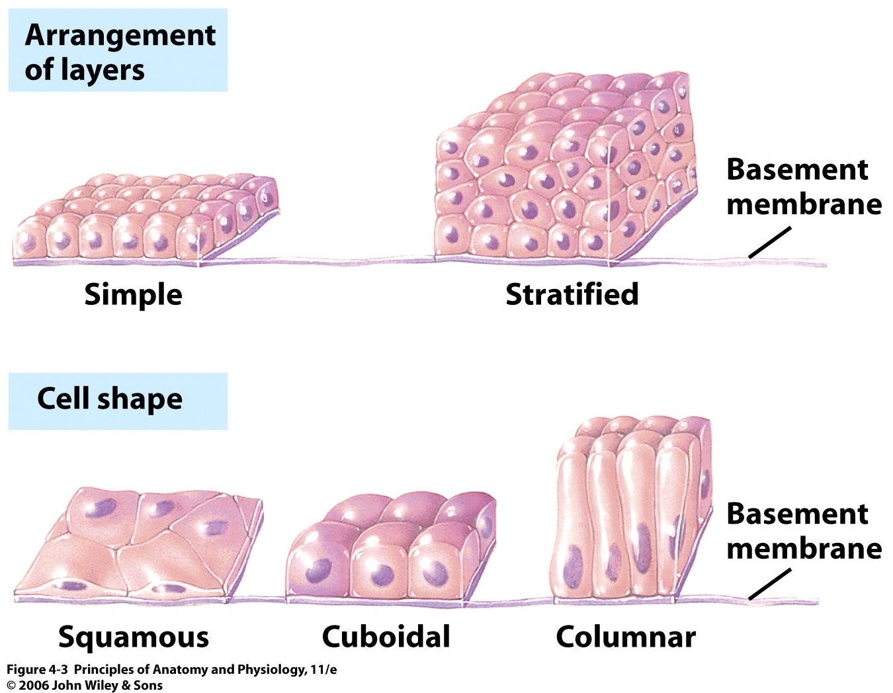

Slide 24
CLASSIFICATION OF EPITHELIA
NUMBER OF LAYERS
SIMPLE - ONE LAYER
STRATIFIED - MORE THAN ONE LAYER
SHAPE OF SUPERFICIAL CELLS
SQUAMOUS - FLAT
CUBOIDAL - CUBE
COLUMNAR – COLUMN
OTHER
PSEUDOSTRATIFIED - NOT TRULY STRATIFIED
TRANSITIONAL - URINARY TRACT

Slide 25
Simple Squamous Epithelium
Description
single layer of flat cells with disc-shaped nuclei
are very thin and sensitive, easily damaged
Special types
Endothelium (inner covering)
slick lining of hollow organs
Mesothelium (middle covering)
Lines peritoneal, pleural, and pericardial cavities
Covers visceral organs of those cavities

Slide 26
Simple Squamous Epithelium
Function
Passage of materials by passive diffusion and filtration
Secretes lubricating substances in serosae
Location
Renal corpuscles
Alveoli of lungs
Lining of heart, blood and lymphatic vessels
Lining of ventral body cavity (serosae)

Slide 27
Simple squamous epithelium from the surface (Mesothelium) (Silver painting)

Slide 28
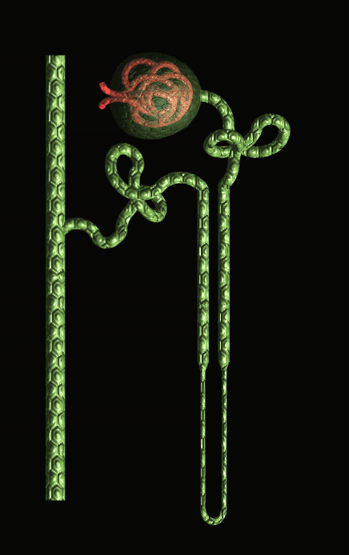
Bowman
kapsülü
Tek tabakalı
yassı epitel
Tek tabakalı
kübik epitel
Çıkan dalgalı kanal
(Distal tüpçük)
İnen dalgalı kanal
(Proksimal tüpçük)
Toplayıcı
kanal
Tek tabakalı
yassı epitel
Böbrek
Nefron şeması
Henle ilmeği

Slide 29
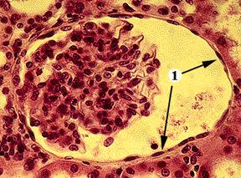
Glomerulus yumağı
Tek tabakalı yassı epitel (Ok ucunda) (Böbrek Bowman kapsülü)

Slide 30
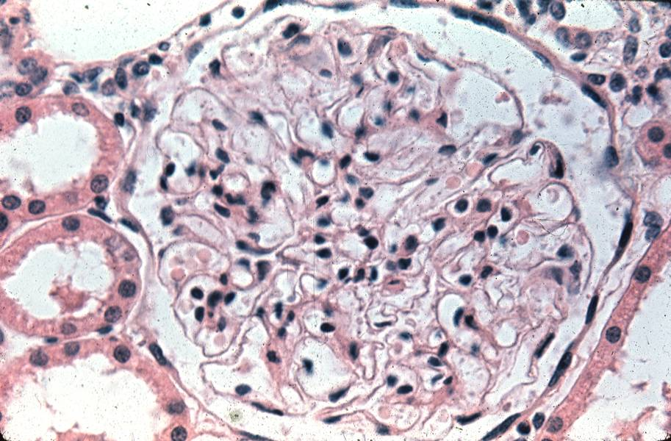
Tek tabakalı yassı epitel (Böbrek Bowman kapsülü)

Slide 31
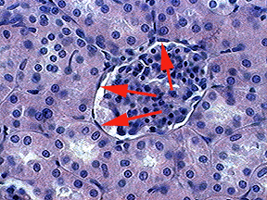
Tek tabakalı yassı epitel (Böbrek Bowman kapsülü)

Slide 32
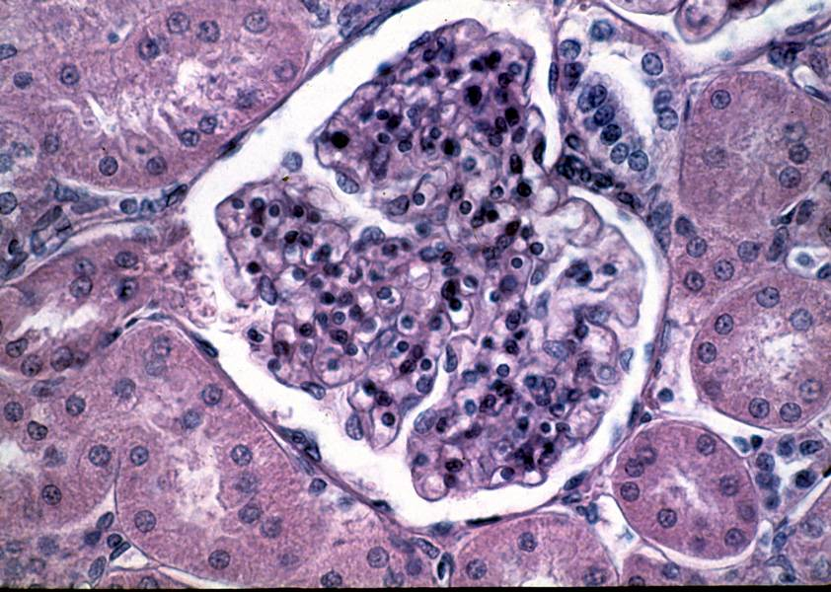
Tek tabakalı yassı epitel (Böbrek Bowman kapsülü)

Slide 33
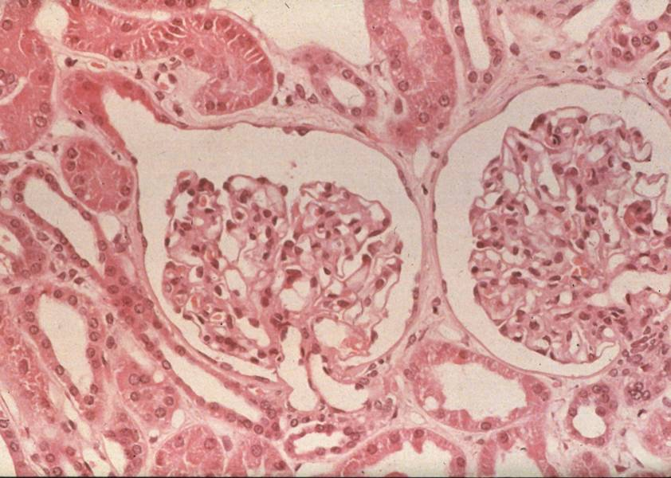
Glomerulus
yumağı
Tek tabakalı yassı epitel (Böbrek Bowman kapsülü)

Slide 34
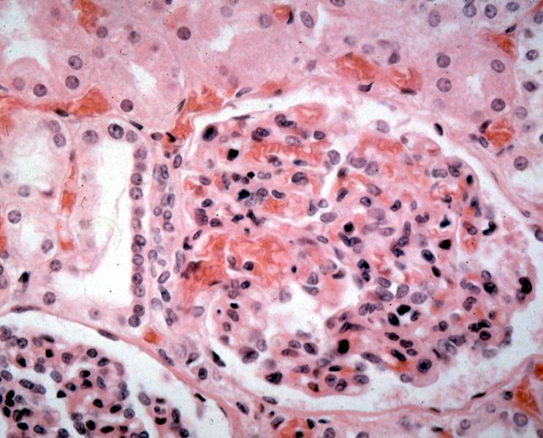
Tek tabakalı yassı epitel (Böbrek Bowman kapsülü’nde)

Slide 35
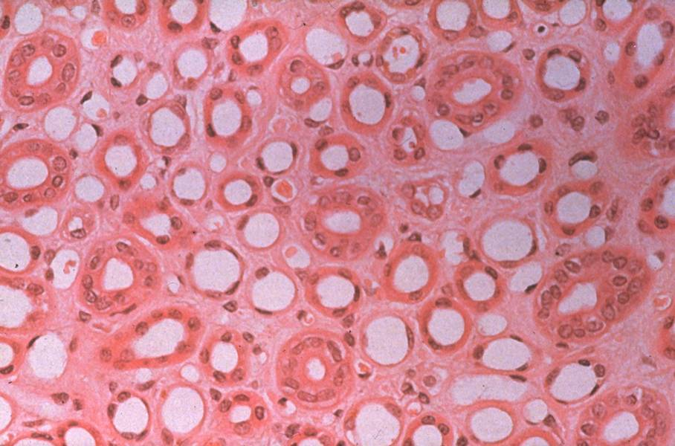
Tek tabakalı yassı epitel
Tek tabakalı yassı epitel (Böbrek, Henle ilmeğinin ince kısmı)

Slide 36
Ç
Bağ dokusu
Kollagen teller
Mezotelyumdaki tek tabakalı yassı epitelin (Ok) TEM’de görünüşü.

Slide 37
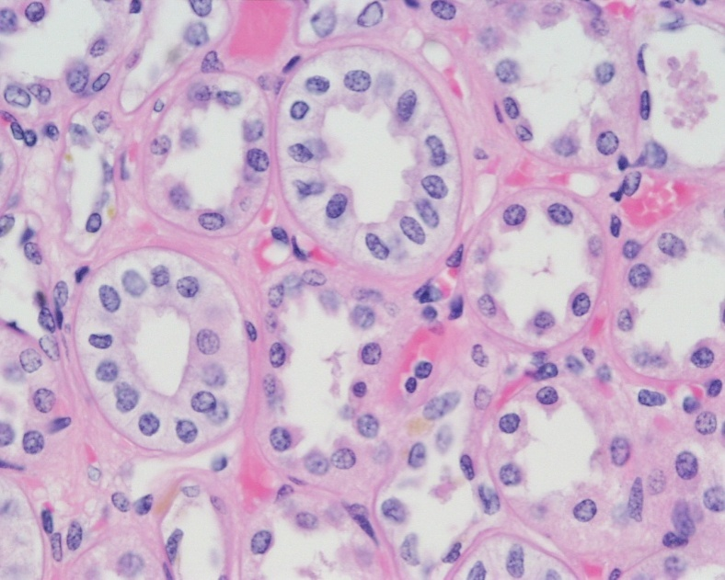
Simple Cuboidal Epithelium
Description
single layer of cube-like cells with large, spherical central nuclei
Function
secretion and absorption
Location
kidney tubules, secretory portions of small glands, ovary & thyroid follicles

Slide 38
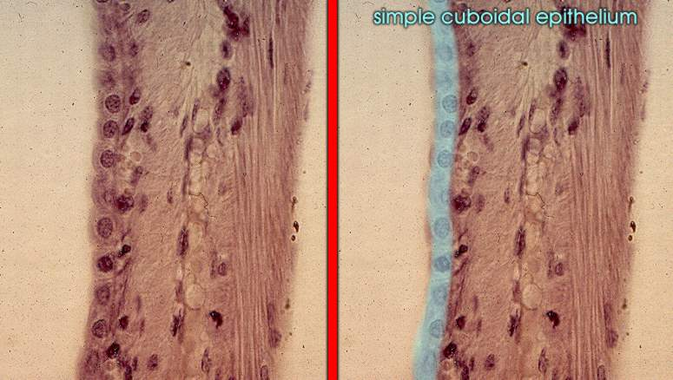
Tek tabakalı kübik epitel

Slide 39
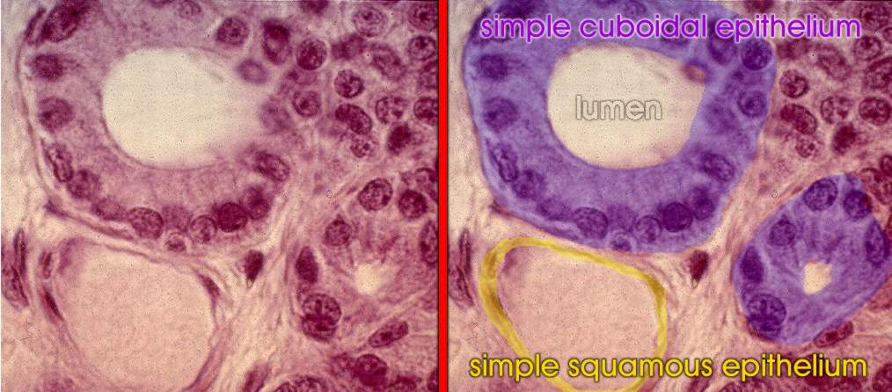
Tek tabakalı yassı epitel ve tek tabakalı kübik epitel,
Böbrek enine kesit.

Slide 40
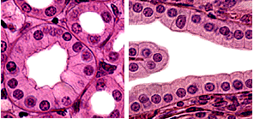
Tek tabakalı kübik epitel (Enine ve boyuna kesit)

Slide 41
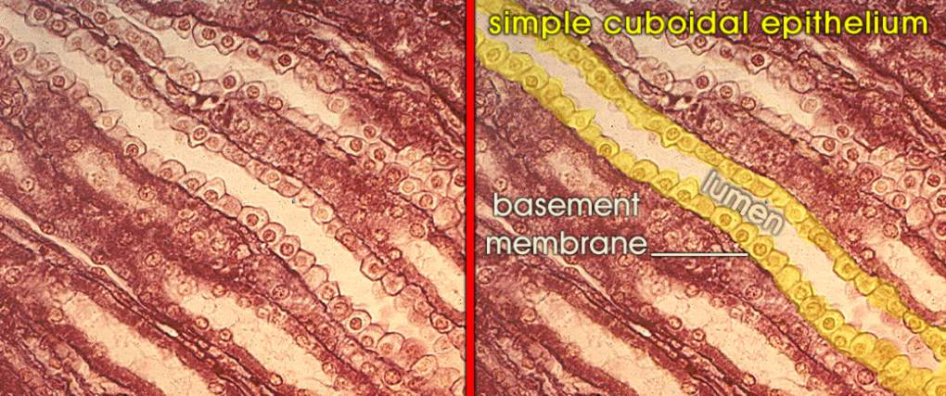
Bazal
lamina
Tek tabakalı kübik epitel, boyuna kesit (Böbrek).

Slide 42
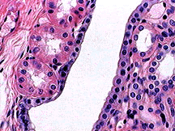
Tek tabakalı kübik epitel (İnsan böbreği)

Slide 43
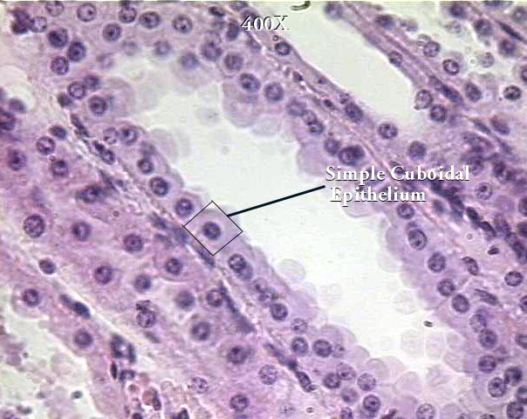
Tek tabakalı
kübik epitel
Tek tabakalı kübik epitel (x 400)

Slide 44
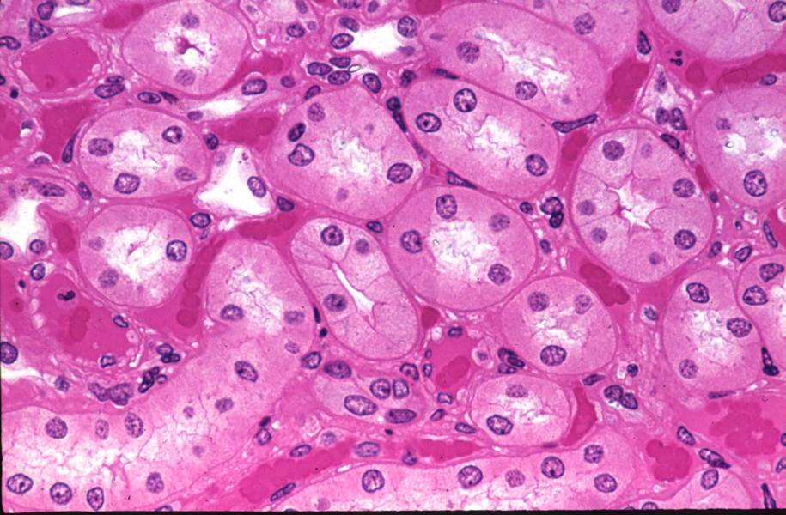
Tek tabakalı kübik epitel (Böbrek kanallarında)

Slide 45
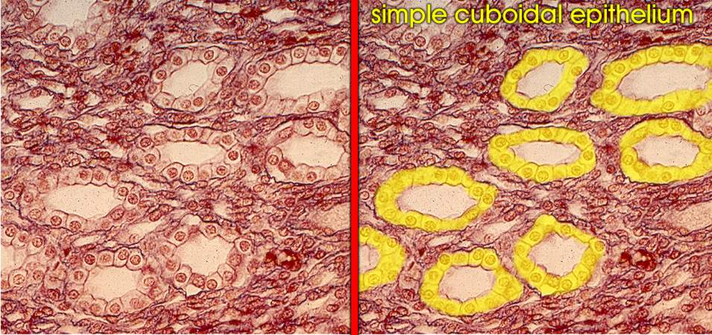
Tek tabakalı kübik epitel, enine kesit.

Slide 46
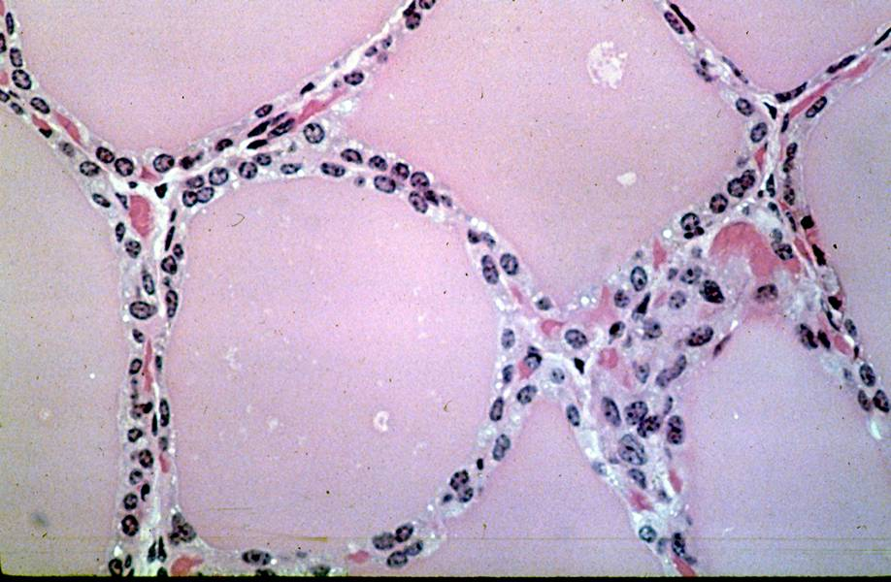
Tek tabakalı kübik epitel (Tiroit Bezi)

Slide 47
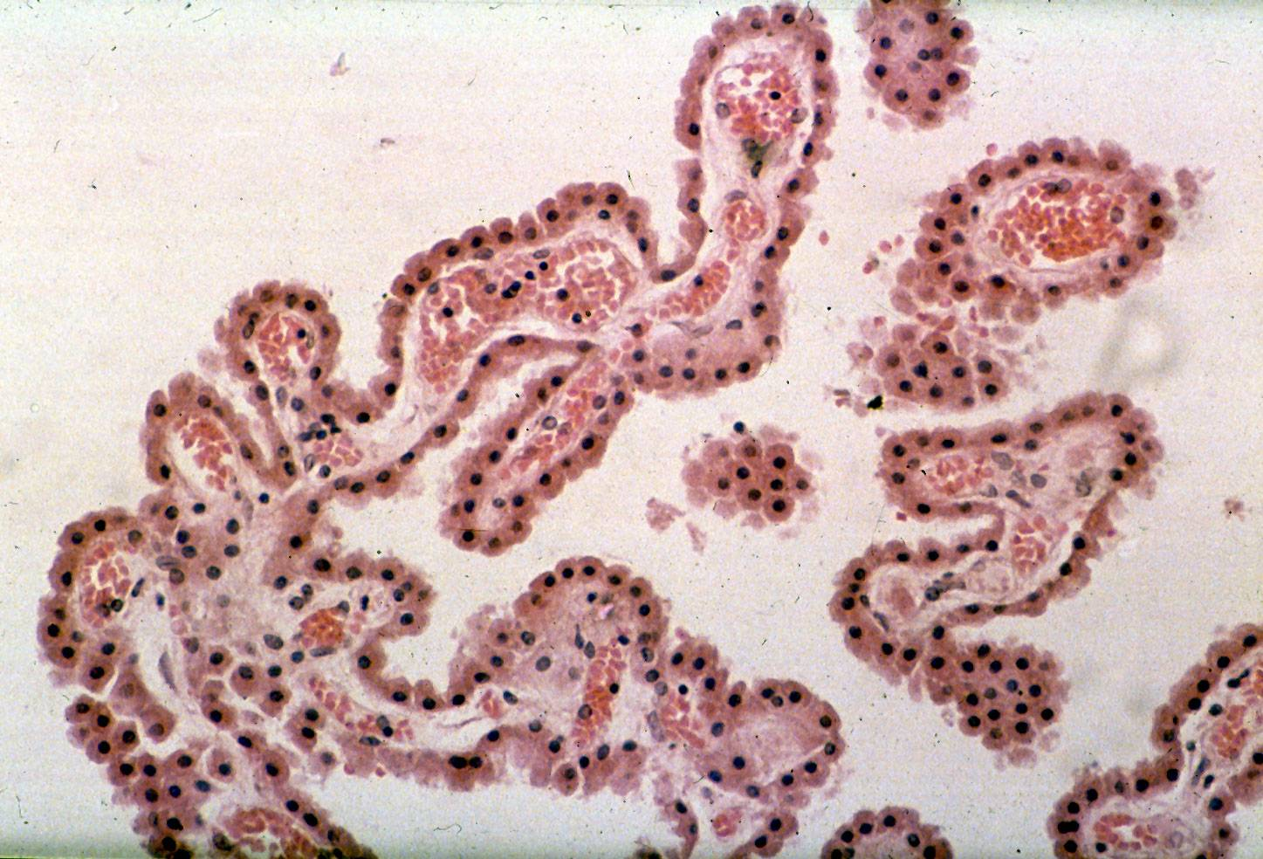
Tek tabakalı kübik epitel (Koroid pleksus)

Slide 48
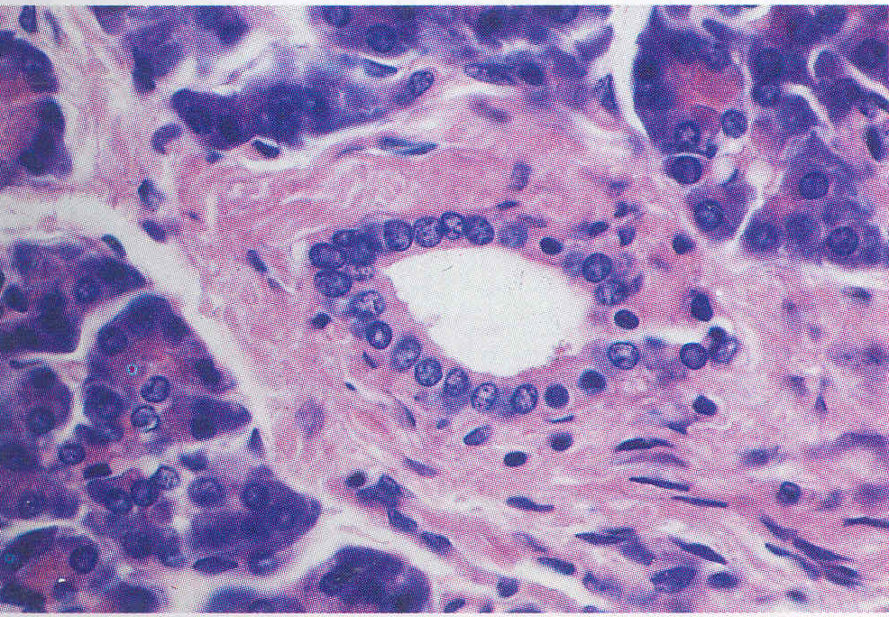
Kübik
Epitel
Bağ dokusu
Asinar bez
Tek tabakalı kübik epitel (Pankreas kanalı) (H&E) (x 350)

Slide 49
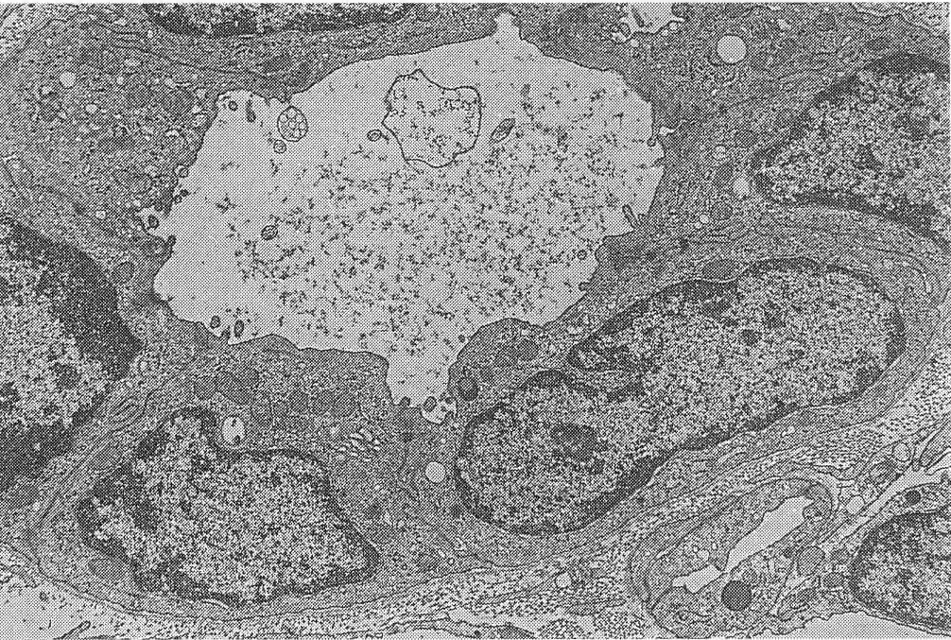
Pankreatik kanalı çevreleyen kübik epitelin enine kesiti (TEM, x 3400

Slide 50
Tek tabakalı kübik epitel, Ovaryum ( x132, H & E )
http://pathology.mc.duke.edu/ research/

Slide 51
Simple Columnar Epithelium
Description
single layer of column-shaped (rectangular) cells with oval nuclei
Some bear cilia at their apical surface
May contain goblet cells
Function
Absorption; secretion of mucus, enzymes, and other substances
Ciliated type propels mucus or reproductive cells by ciliary action

Slide 52
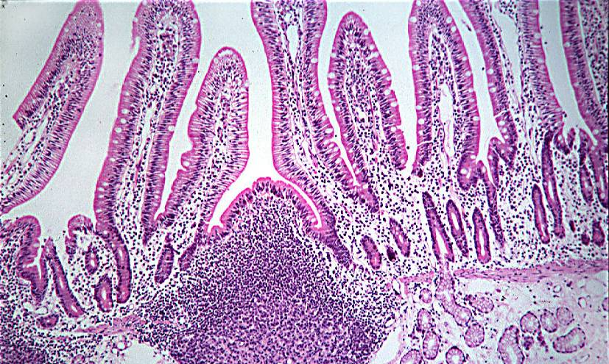
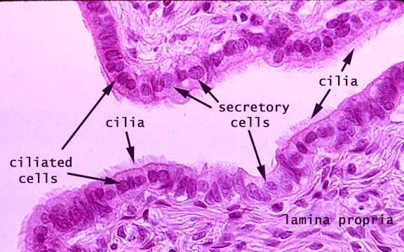
Simple Columnar Epithelium
Location
Non-ciliated form
Lines digestive tract, gallbladder, ducts of some glands
Ciliated form
Lines small bronchi, uterine tubes, uterus

Slide 53
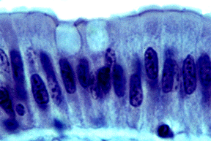
Goblet h..
Goblet h..
Tek tabakalı silindirik epitel ve Goblet hücreleri

Slide 54
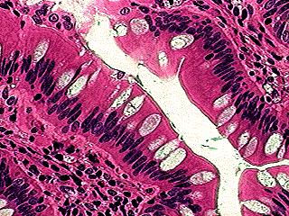
Tek tabakalı silindirik epitel ve Goblet hücreleri (İnce bağırsak)

Slide 55
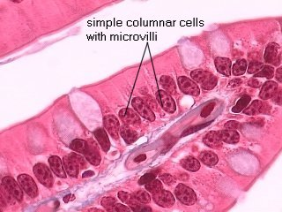
Mikrovillüslü
Silindirik epitel hücreleri
G
İnce bağırsak

Slide 56
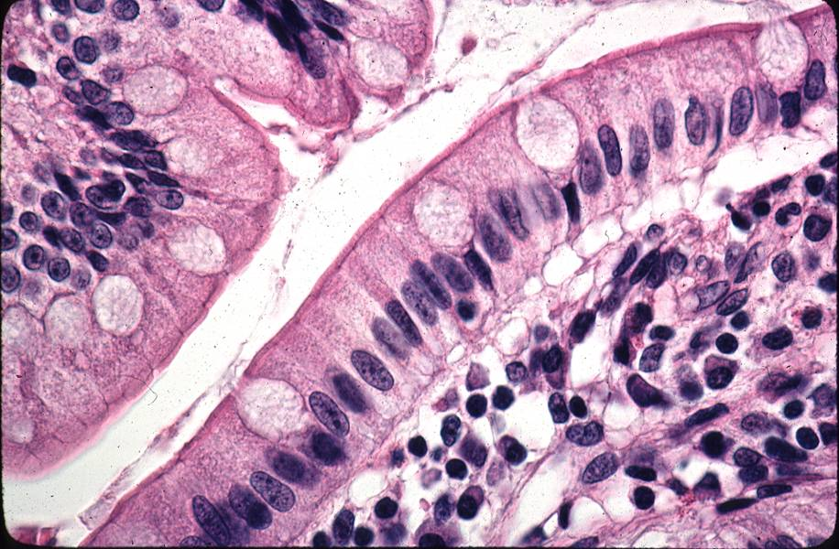
Tek tabakalı silindirik epitel ve Goblet hücreleri (Jejenum)

Slide 57
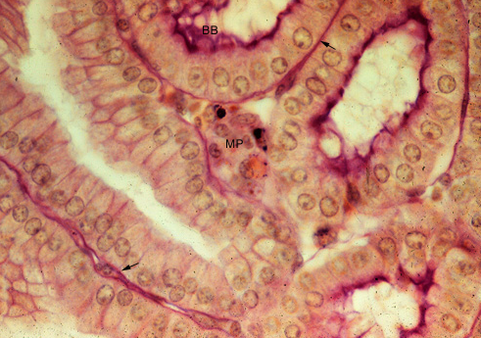
Tek tabakalı silindirik epitel (Böbrek tüpçükleri) (Periyodik asit-Schiff, PAS, boyaması). Epitelin bazal laminası (Ok) ve fırça kenar (BB) yapısı.

Slide 58
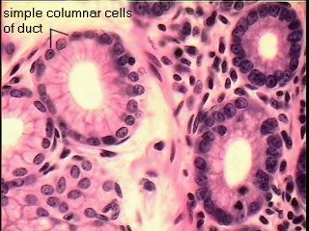
Tek tabakalı silindirik epitel
(Bez kanalında)
Ekzokrin bez

Slide 59
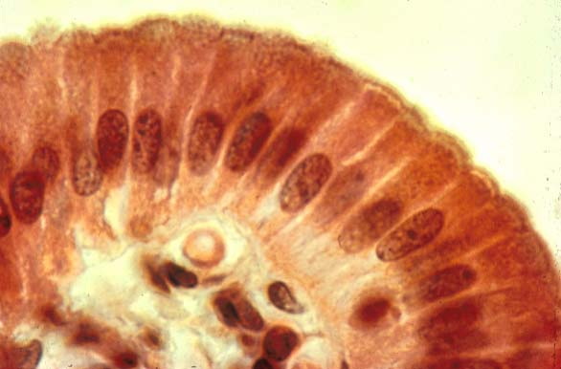
Tek tabakalı silindirik epitel, safra kesesi. http://www.city.ac.uk/optometry/Biolabs/Tissue

Slide 60
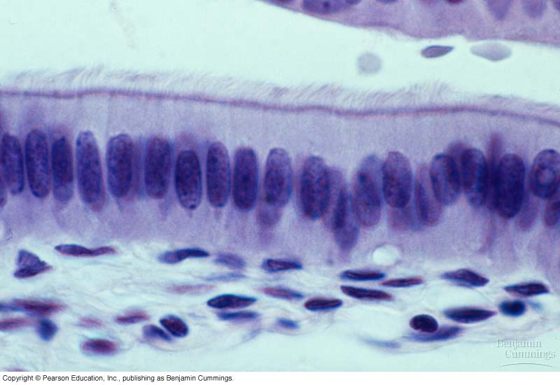
Tek tabakalı silli silindirik epitel

Slide 61
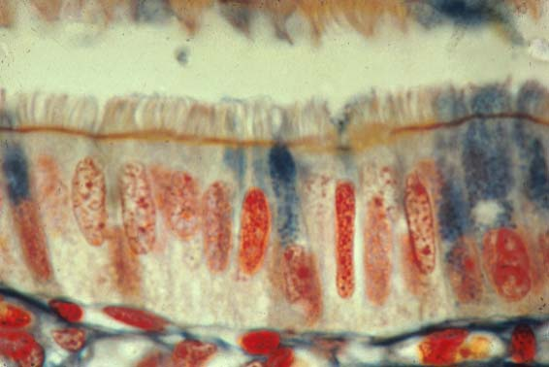
Siller
Tek tabakalı silli silindirik epitel (Ovidukt kesit)
http://www.city.ac.uk/optometry/Biolabs/Tissue/

Slide 62
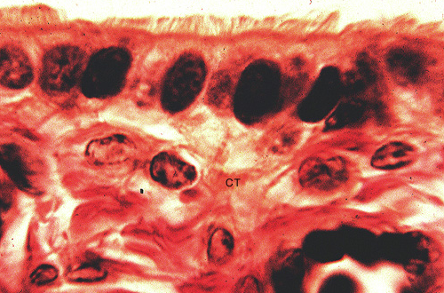
Tek tabakalı silli silindirik epitel ve bağ dokusu (İnsan ovidukt ampullası)

Slide 63
Pseudostratified Columnar Epithelium
Description
All cells originate at basement membrane
Only tall cells reach the apical surface
May contain goblet cells and bear cilia
Nuclei lie at varying heights within cells
Gives false impression of stratification
Function
secretion of mucus; propulsion of mucus by cilia

Slide 64
Pseudostratified Columnar Epithelium
Locations
Non-ciliated type
Ducts of male reproductive tubes
Ducts of large glands
Ciliated variety
Lines trachea and most of upper respiratory tract

Slide 65
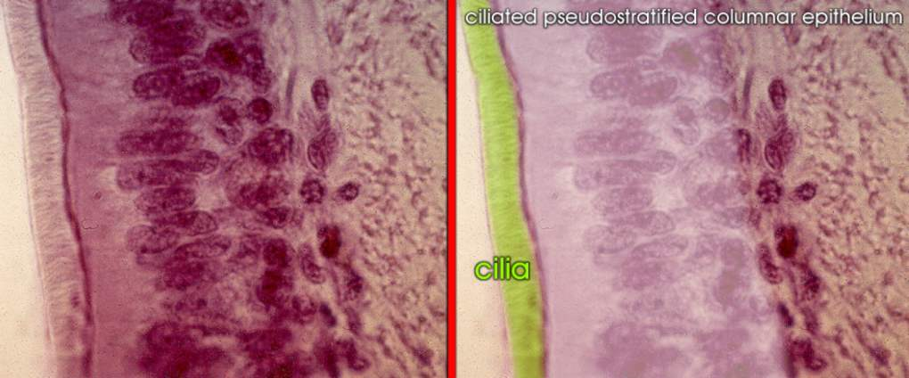
Siller
Epitel
Yalancı tabakalı silli silindirik epitel, Trake.

Slide 66
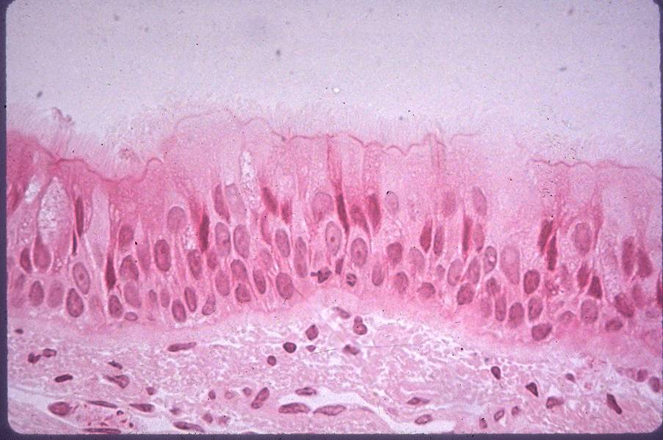
Siller
Yalancı tabakalı silli silindirik epitel (Trake)

Slide 67
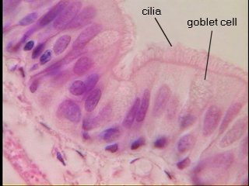
Siller
Goblet hücreleri
Yalancı tabakalı silli silindirik epitel hücreleri ve Goblet hücreleri

Slide 68
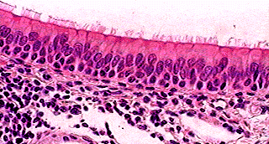
Lamina propria
Yalancı tabakalı silli silindirik epitel (Maymun, gırtlak)

Slide 69
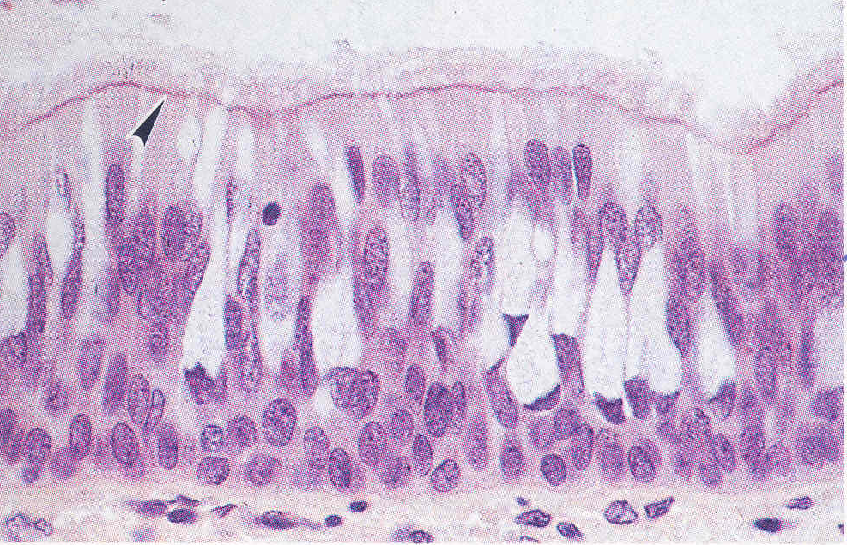
Yalancı tabakalı silli silindirik epitel ve goblet hücreleri. Sillerin bazal cisimcik kısımlarının hücrenin üst yüzeyinde oluşturduğu eozinofilik bir çizgi (Ok ucu) ve siller (H&E; x 460)

Slide 70
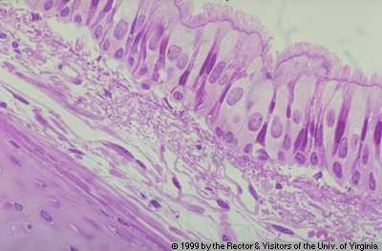
Yalancı tabakalı silli silindirik epitel (Trake)

Slide 71
Sil
Trakede yalancı tabakalı silli silindirik epitelin TEM’de görünüşü. Hücrelerin apikal yüzeyinde sil ve mikrovillüsler
(x 1.600)

Slide 72
Mikrovillüsler
Siller
Hücrelerin sınırı
Trakenin lümene bakan yüzünde yalancı tabakalı silli silindirik epitelin silleri ve mikrovillüsleri. Mikrovillüslerin 1 mikronluk boyuna karşı sillerin 8-10 mikron boyu kolaylıkla fark edilir. x1.450

Slide 73
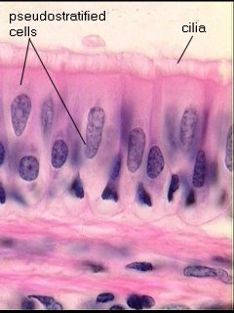
Yalancı tabakalı
silli silindirik epitel
Siller

Slide 74
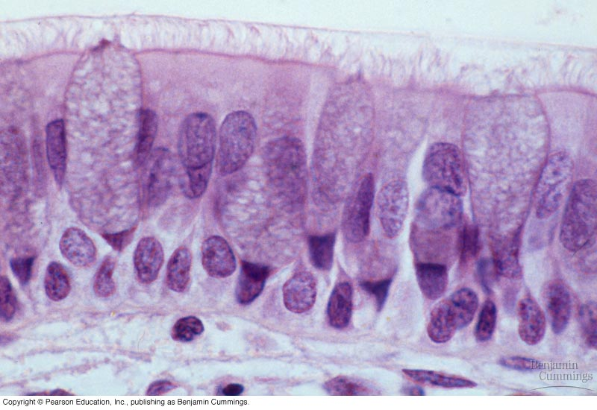
Siller
G
Yalancı tabakalı silli silindirik epitel ve Goblet hücreleri

Slide 75
Stratified Epithelia
Contain two or more layers of cells
Regenerate from below
Major role is protection
Are named according to the shape of cells at apical layer

Slide 76
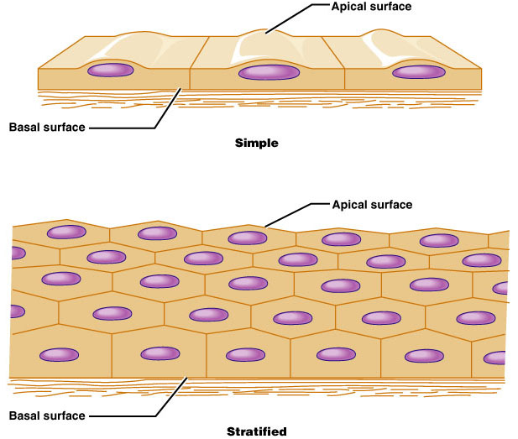
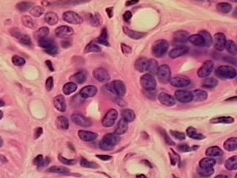
Stratified Epithelium
Characteristics
2+ layers
Stratified Squamous
Skin – outer layer hardened by ‘keratin’
4 to 5 layers thick
3. Stratified Cuboidal
Ducts of sweat glands
This type + stratified columnar are rare!

Slide 77
Stratified Squamous Epithelium
Description
Many layers of cells – squamous in shape
Deeper layers of cells appear cuboidal or columnar
Thickest epithelial tissue – adapted for protection

Slide 78
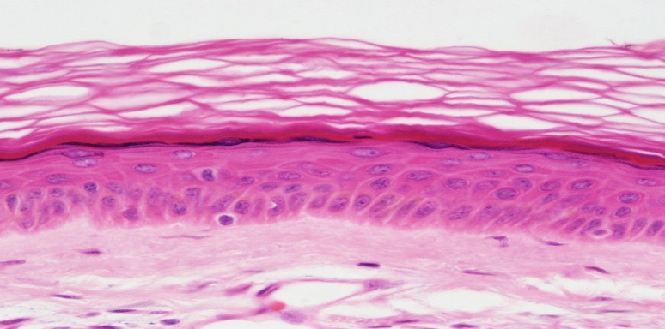
Stratified Squamous Epithelium
Specific types
Keratinized – contain the protective protein keratin
Surface cells are dead and full of keratin
Non-keratinized – forms moist lining of body openings
Function
Protects underlying tissues in areas subject to abrasion
Location
Keratinized – forms epidermis
Non-keratinized – forms lining of esophagus, mouth, and vagina

Slide 79
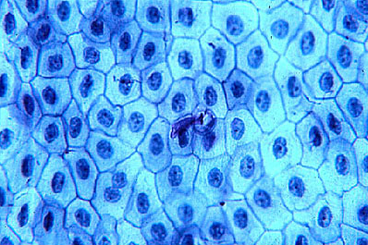
Çok tabakalı yassı epitelin yüzeyden görünüşü (Kurbağa derisi)

Slide 80
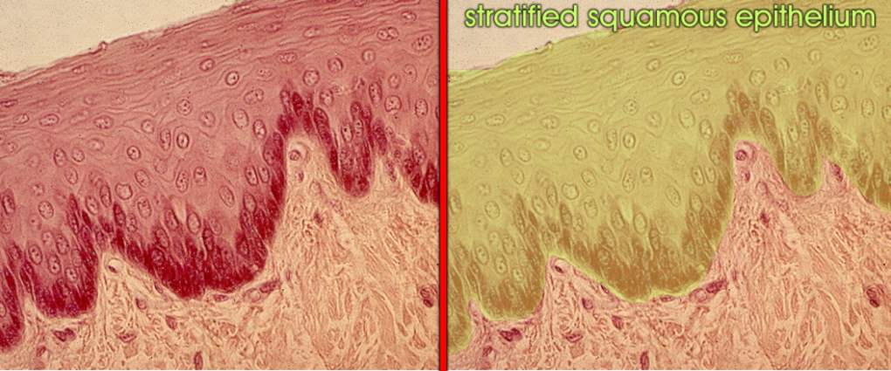
Çok tabakalı keratinleşmiş yassı epitel

Slide 81
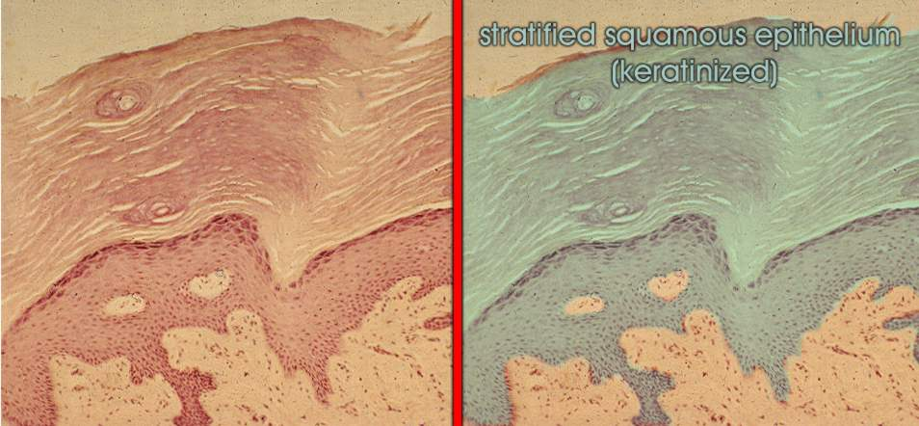
Keratin
Epitel
Bağ
dokusu
Çok tabakalı keratinleşmiş yassı epitel, Deri.

Slide 82
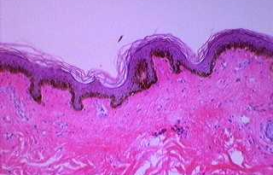
Keratin tabakası
Epitel
Bağ dokusu
Çok tabakalı keratinleşmiş yassı epitel

Slide 84
Epitel
Keratin
Bağ dokusu
Çok tabakalı keratinleşmiş yassı epitel (Deri)

Slide 86
Çok tabakalı keratinleşmiş yassı epitel (Deri)

Slide 87
Çok tabakalı keratinleşmemiş yassı epitel (İnsan özofagus)

Slide 88
Yassı epitel hücreleri
Çok tabakalı
yassı epitel
Bağ dokusu
Bazal hücreler
Bazal lamina (Resimde seçilmiyor)
Çok tabakalı keratinleşmemiş yassı epitel

Slide 89
Çok tabakalı keratinleşmemiş yassı epitel (Dil)

Slide 90
Çok tabakalı keratinleşmemiş yassı epitel (İnsan özofagus)

Slide 91
Çok tabakalı keratinleşmemiş yassı epitel (H&E) (x 350)

Slide 92
Çok tabakalı keratinleşmemiş yassı epitel (Vajina) (H & E)

Slide 93
Çok tabakalı keratinleşmemiş yassı epitel , Vajina duvarı (H&E)
http://www.city.ac.uk/optometry/Biolabs/Tissue/

Slide 94
Stratified Cuboidal
Features
Rare
Several sequential cubic cells
Location
In the fetus epithelium, the male seminiferous tubules
Some sweat and salivary glands drain
The mammary gland's wide channel
Ovarian follicle

Slide 95
Çok tabakalı kübik epitel (Ovaryum folikülü)

Slide 96
Çok tabakalı kübik epitel, meme süt bezi kanalı kesidi (H&E)
http://www.city.ac.uk/optometry/Biolabs/Tissue/

Slide 97
Çok tabakalı kübik epitel , tükürük bezi enine kesit (H&E)
http://www.city.ac.uk/optometry/Biolabs/Tissue/

Slide 98
Stratified Columnar
Features
Not common,
The underlying layered cells on the basal lamina are irregularly shaped and multifaced
The cells on the surface are cylindrical

Slide 99
Stratified Columnar
Location
The arch-shaped bottom zone (Fornix conjunctiva) of the conjunctiva covering the eyelids,
Part of the male urethra,
Some areas of the anal mucous membranes
Farinks, epiglottis (part of the larynx)
Large drains of some cloths
Nose part of soft ear, larynx
Temporary fetal esophagus

Slide 100
Kanal lümeni
Çok tabakalı silindirik epitel
Çok tabakalı silindirik epitel, Parotid Bezi
( H & E )
Bağ dokusu

Slide 101
Transitional Epithelium
Description
Basal cells usually cuboidal or columnar
Superficial cells dome-shaped or squamous
Function
stretches and permits distension of urinary bladder
Location
Lines ureters, urinary bladder and part of urethra

Slide 102
Değişken epitel
Üreter (H&E)

Slide 103
Değişken Epitel

Slide 104
Değişken epitel (İdrar kesesi)

Slide 105
Değişken epitel (İnsan, üreter ve renal pelvis)

Slide 106
Değişken Epitel

