Slide 1
Diversity And Classification of Flowering Plants: Commelinid Monocots

Slide 2
Commelinid Monocots

Slide 3
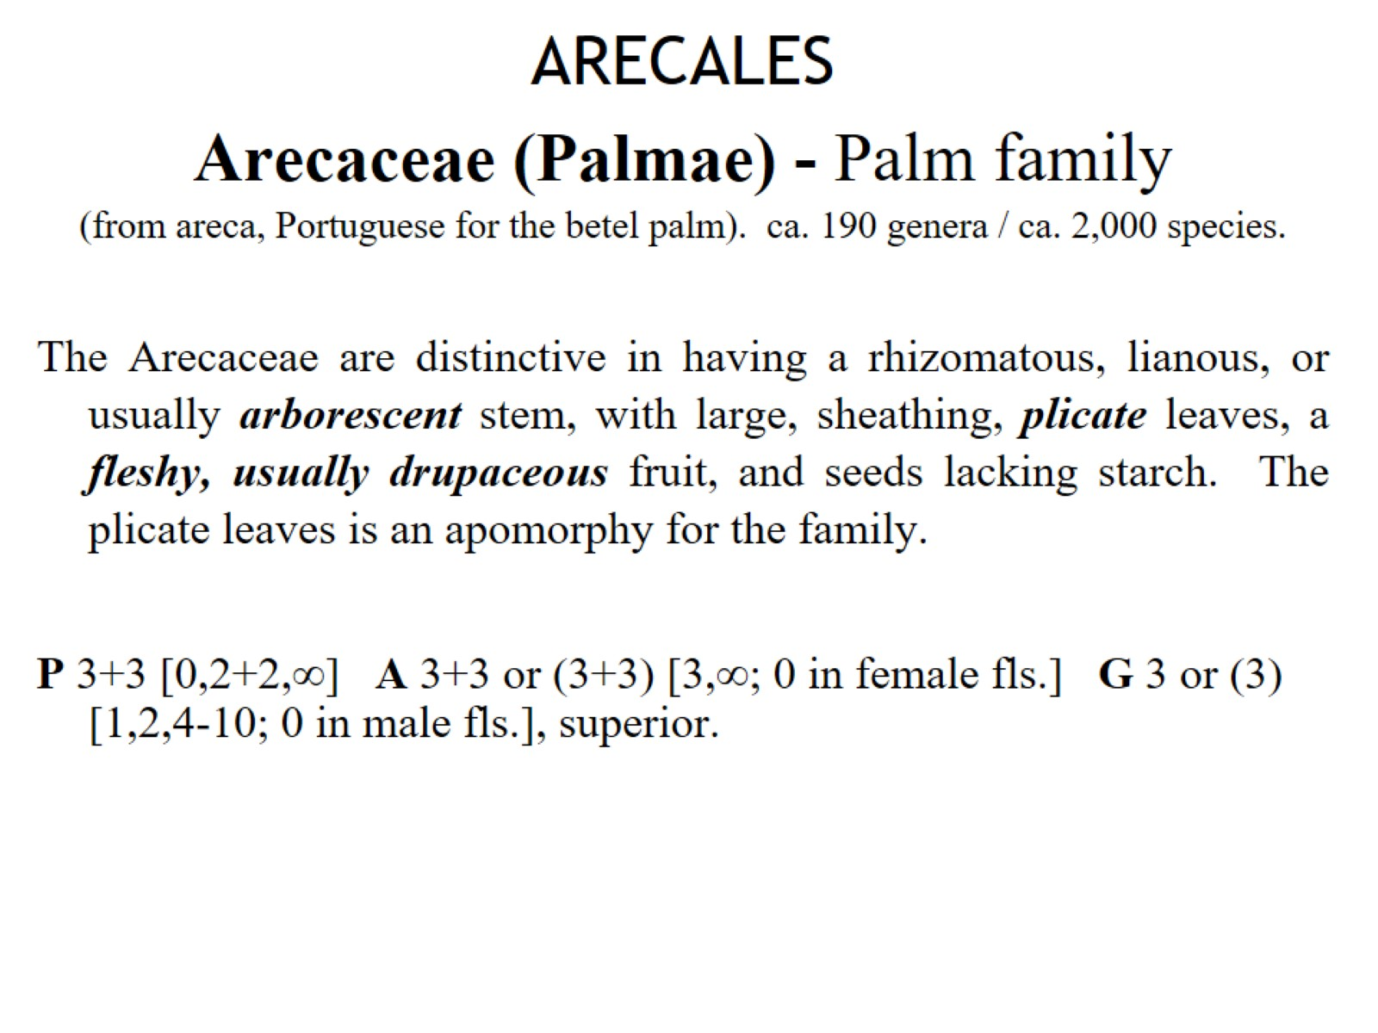
ARECALES Arecaceae (Palmae) - Palm family (from areca, Portuguese for the betel palm). ca. 190 genera / ca. 2,000 species.

Slide 4
ZINGIBERALES - Ginger Group

Slide 5
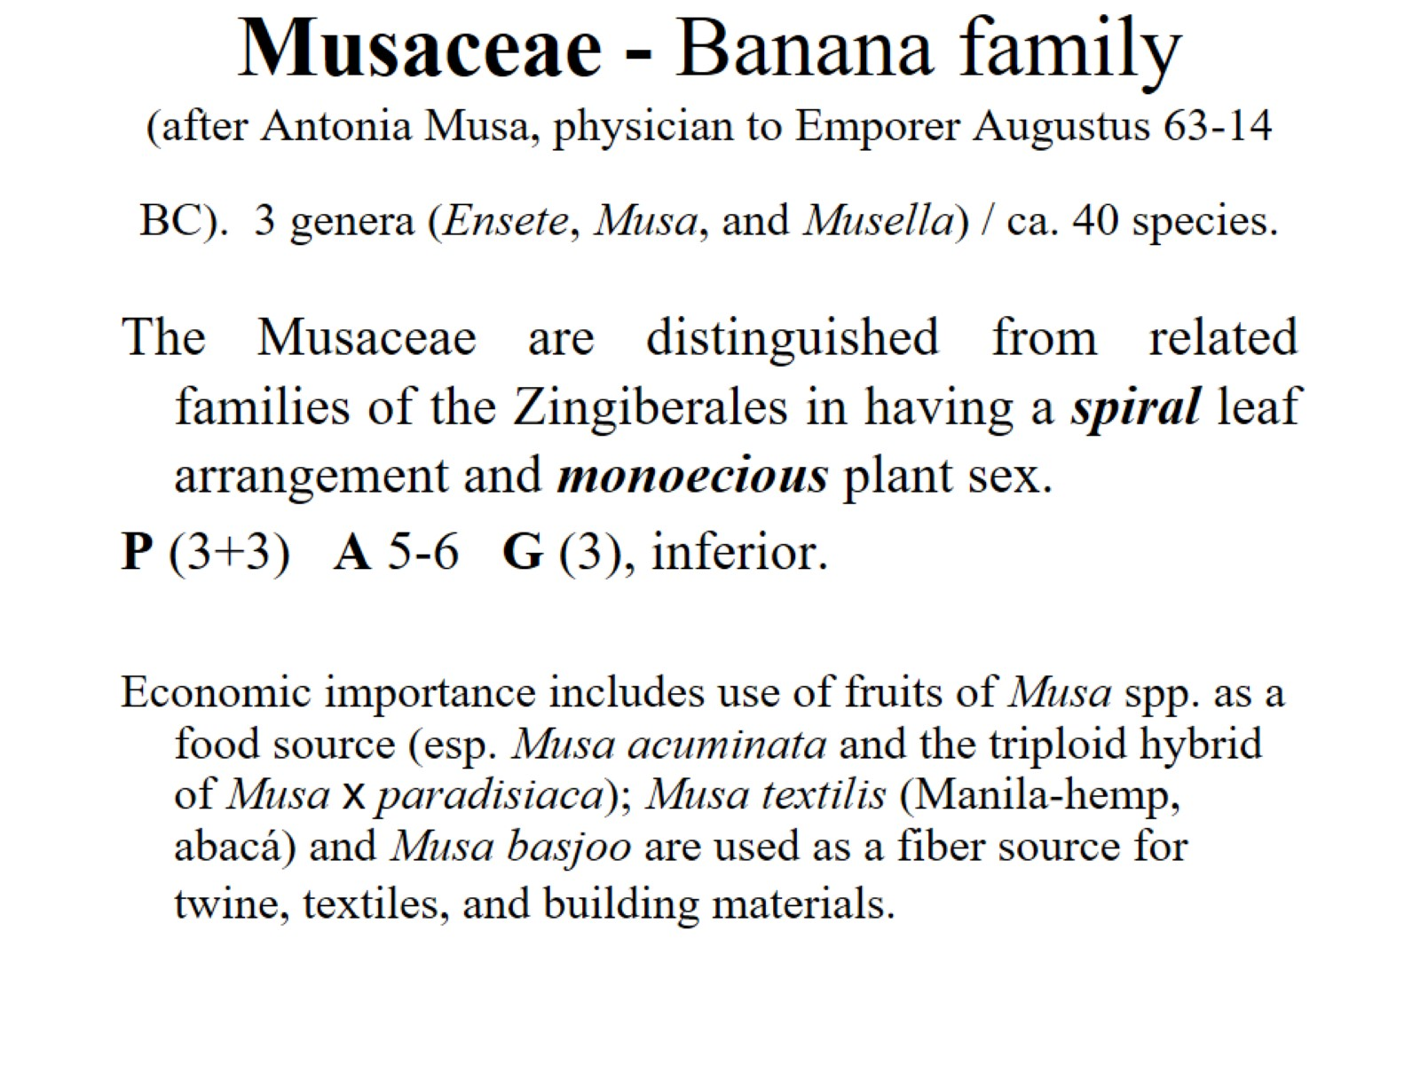
Musaceae - Banana family (after Antonia Musa, physician to Emporer Augustus 63-14 BC). 3 genera (Ensete, Musa, and Musella) / ca. 40 species.

Slide 6
Zingiberaceae - Ginger family (from a pre-Gr. name, possibly from India). 50 genera / 1,200 species

Slide 7
Zingiberaceae - Ginger family (from a pre-Gr. name, possibly from India). 50 genera / 1,200 species

Slide 8
Commelinaceae—Spiderwort family (after Caspar Commelijn, Dutch botanist, 1667–1731) 39 genera/640 species.

Slide 9
Cyperaceae - Sedge family (Gr. for several species of Cyperus). 98 genera / 4,350 species

Slide 10
Cyperaceae - Sedge family (Gr. for several species of Cyperus). 98 genera / 4,350 species

Slide 11
Juncaceae - Rush family (L. for binder, in reference to use in weaving and basketry). 7 genera / 430 species

Slide 12
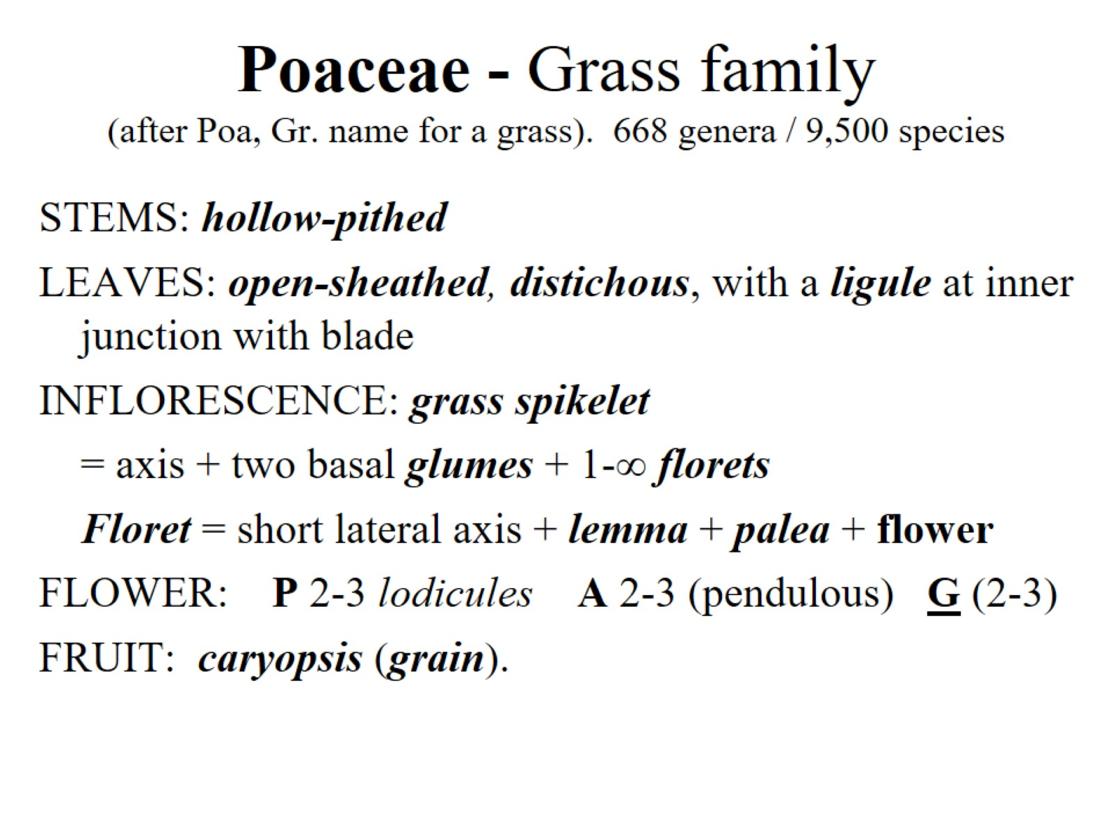
Poaceae - Grass family (after Poa, Gr. name for a grass). 668 genera / 9,500 species

Slide 13
