Slide 1
ARBs
As efective as ACE inhibitors in hypertension and HF
Don’t have any effect on the metabolism of bradykinin, more selective compared to ACE inhibitors
Useful in patients with HF and kidney disease
Advers effect profile is similar to ACE inhibitors
Dry cough and angioedema are not common (prefered to ACE inhibitors)

Slide 2
ARBs
AT1 receptors:
Heart
Vascular smooth muscle
Renal glomerules and tubulus
Adrenal cortex
Thrombocytes
Adipocytes
Placenta

Slide 3
ARBs
The effects of Ang II by binding AT1 receptors:
Vasoconstriction
Cardiac and vascular hypertrophy
Increased cardiac contractility
Direct renal sodium retention
Aldosteron secretion
ADH release
Sympathetic nervous system activation
Myocardial remodelling (collagen deposition, hypertrophy)
Endothelin activation
Platelet activation
Thrombosis due to increased plasminogen activator inhibitor (PAI-1)

Slide 4
ARBs
Losartan
Valsartan
Kandesartan
Eprosartan
Irbesartan
Telmisartan
Olmesartan

Slide 5
ARBs
Should not be given to the patients with renal artery stenosis (acute renal failure risk !)

Slide 6
Renin inhibitors
Aliskiren
Used in hypertension as monotherapy or in combination therapy
Adverse effects; diarrhea, rash, anemia, hyperkalemia
Contraindicated in pregnancy and lactation

Slide 7
Ca++ channel blockers
Inhibit Ca++ influx in vascular smooth muscle, vasodilatation
Inhibit Ca++ influx in cardiac muscle, impairs excitation-contraction coupling, cardiac contractility is decreased
Do not depress skeletal muscle (which uses intracellular Ca++ pool)
Nimodipine has high affinity to cerebral blood vessels (used after subarachnoidal hemorrhage)

Slide 8
Ca++ channel blockers
Their vasodilator effect is significant at arterioles, less at venules
Used as monotherapy in mild and moderate hypertension
More effective in in hypertensive patients with low renin, low plasma Ca++ levels and salt sensitive patients
More efective in old patients and afro-american race

Slide 9
Ca++ channel blockers
Dihydropyridines:
amlodipine, felodipine, isradipine, nikardipine, nifedipine, nizoldipine, nimodipine
Benzothiazepines:
Diltiazem
Phenylalkilamines:
verapamil

Slide 10
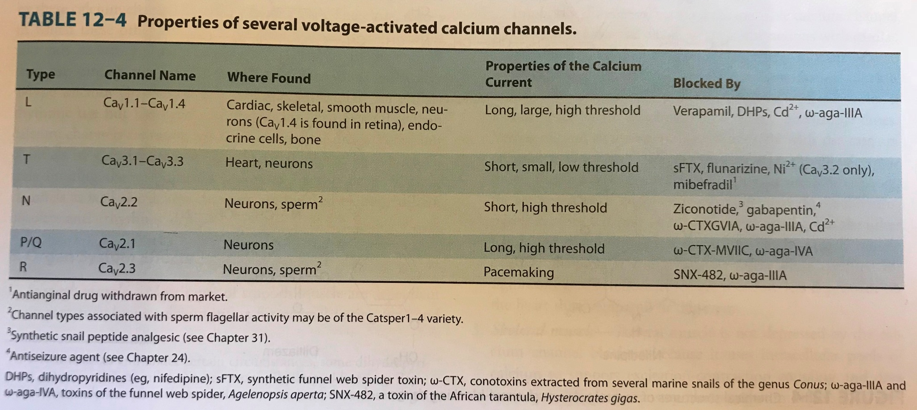
Basic and Clinical Pharmacology, Katzung & Trevor, 13th edition

Slide 11
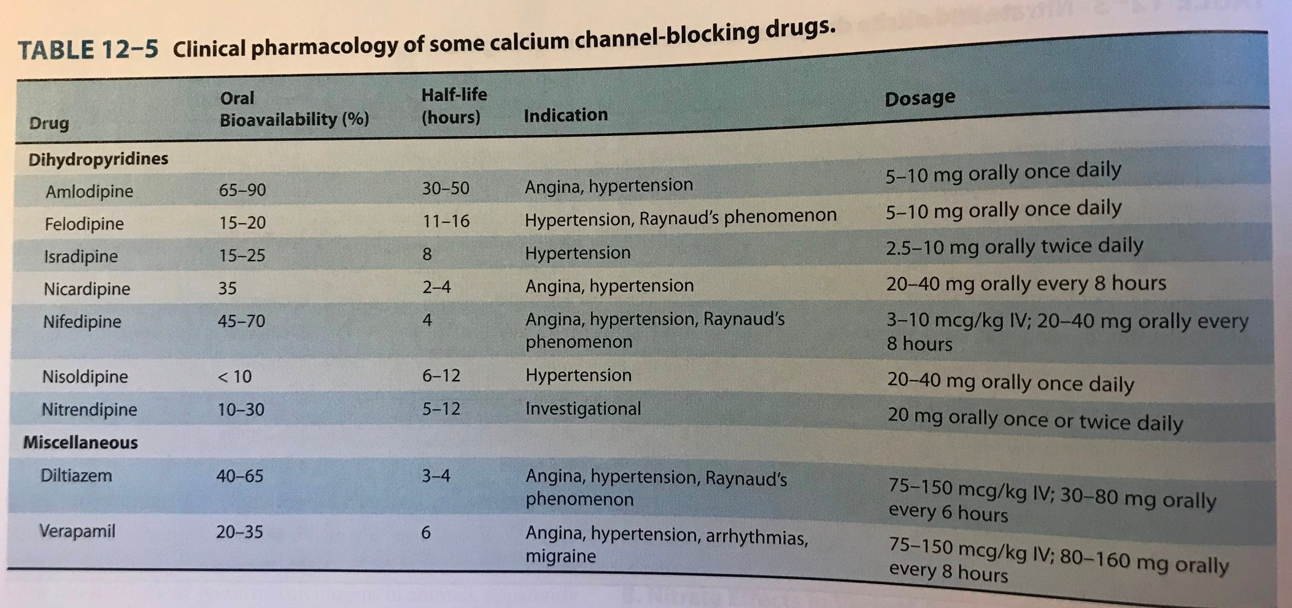
Basic and Clinical Pharmacology, Katzung & Trevor, 13th edition

Slide 12
Ca++ channel blockers
Dihydropyridines have less cardiodepressant effect, either maintains or mildly increases CO
Verapamil has cardiodepressant effect, decreases CO and HR
Oral-short acting nifedipine for hypertension emergency

Slide 13
Lippincott Illustrated reviews Pharmacology, 6th edition, 2015

Slide 14
Lippincott Illustrated reviews Pharmacology, 6th edition, 2015

Slide 15
Ca++ channel blockers
Toxic effects:
Cardiac depression, bradycardia, AV block, cardiac arrest, HF
Edema at ankle (with hydropyridines)
The patients using beta blockers are more sensitive to cardiodepressant effect of Ca++ channel blockers (concomitant use of verapamil with beta blockers is contrindicated!)

Slide 16
Beta blockers
BP is decreased due to reduced CO
More efficient in patients with high renin activity

Slide 17
Beta blockers
Propranolol
Metoprolol
Atenolol
Nadolol
Carteolol
Betaxolol
Bisoprolol
Acebutolol
Pindolol
Carvedilol
Labetalol
Nebivolol

Slide 18
Lippincott Illustrated reviews Pharmacology, 6th edition, 2015

Slide 19
Beta blockers
Metoprolol ve atenolol, cardioselective
The most used beta blockers
Advantageous in patients with asthma, diabetes or peripheral vascular disease
Betaxolol and bisoprolol are also selective beta 1 AR blocker

Slide 20
Beta blockers
Pindolol, acebutolol ve penbutolol: partial agonist (intrinsic sympathomimetic activity)
Decrease vascular resistance, the decrease in CO and HR is less than others
Could be particularly useful in patients with bradyaritmia or peripheral artery disease

Slide 21
Beta blockers
Labetalol, carvedilol and nebivolol; both beta blocker and vasodilatory effect
Labetalol; decreases PVR, no effect on CO or HR. Used in hypertensive emergency and pheochromacytoma as it has both alpha and beta blocker effect

Slide 22
Beta blockers
Carvedilol, nonselective beta blocker and vasodilator. Useful in HF and hypertension
Nebivolol, beta 1 AR selective blocker and vasodilator. Decreases PVR (NO mediated?)
Esmolol, very short half life (9-10 min), iv infusion. Intraoperative-postoperative hypertension treatment, hypertension emergency

Slide 23
Lippincott Illustrated reviews Pharmacology, 6th edition, 2015

Slide 24
Basic and Clinical Pharmacology, Katzung & Trevor, 13th edition

Slide 25
Basic and Clinical Pharmacology, Katzung & Trevor, 13th edition

Slide 26
Alpha 1 blockers
Vasodilatation
Reflex tachycardia is uncommon
More efective when combined with beta blocker and diuretics
Advers effects; first dose phenomenon, headache, dizziness, palpitations, lassitude
Used also in benign prostatic hyperplasia

Slide 27
Alpha 1 blockers
Prazosin
Terazosine
Doxazosine

Slide 28
Drugs that alter SNS function
Centrally acting sympathoplegic drugs:
Methyldopa
Clonidine
Adrenergic neuron blockers:
Guanethidine
Reserpine

Slide 29
Methyldopa;
First choice for hypertension in pregnancy
Has role in NE synthesis pathway. Coverted to alpha-methyl norepinephrine. This molecule is agonist of presynaptic alpha 2 ARs.
Decreases PVR, HR and CO
At the beginning of the treatment, sedation
In the chronic stage, mental lassitude, mental concentration difficulties (infrequently depression, nightmares, vertigo)
Could cause lactation (because of increased prolactin secretion)

Slide 30
Clonidine;
stimulates presinaptic alpha 2 ARs, decerases NE release, decreased HR and CO
Adverse effects, dry mouth and sedation
Should not be given to patients with mental depression
Concomitant use with TCAs inhibits the effect of clonidine
Sudden withdrawn of the drug could cause hypertensive crisis

Slide 31
Guanethidine;
Inhibits NE release from sympathomimetic nerve endings
Transported across the nerve membrane, concentrated in vesicles, replaces NE, causes depletion of NE
Adverse effects; postural hypotension and hypotension after exercise (particularly at the high doses)
Could cause hypertensive crisis in patients with pheochromacytoma
Its antihypertensive effect is decreased if used with TCAs

Slide 32
Reserpine;
Blocks the ability of aminergic transmitter vesicles to take up and store biogenic amines
Results in depletion of NE, dopamine and serotonin in central and peripheral neurons
Decreases PVR and CO
Used at low doses in mild hypertension
Adverse effects; sedation, mental depression and extrapyramidal effects resembling Parkinson’s disease

Slide 33
Vazodilators
Hydralazine
Minoxidil
Sodium Nitroprusside
Diazoxide

Slide 34
Basic and Clinical Pharmacology, Katzung & Trevor, 13th edition

Slide 35
Vasodilators
Relaxes smooth muscle of arterioles, decreases PVR
Nitrates and sodium nitroprusside relax both arteries and veins

Slide 36
Vasodilators
Hydralazine relaxes only arteries
Not efective (tachycardia occurs)
Used in severe hypertension
Adverse effects; headache, nausea, anorexia, palpitation, sweating and flushing
Angina or ischemic arythmia may be provoked in patients with ischemic heart disease

Slide 37
Vasodilators
Minoxidil, opens the K+ channels on the membrane of smooth muscle
Relaxes only arterioles
Tachycardia, palipitation, angina, edema
Headache, sweating, hypertrichosis
Also used in baldness

Slide 38
Vasodilators
Sodium nitroprusside, parenteral use (iv infusion
Hypertensive emergency
Vasodilatation both on arteries and veins
Activates GC, increased cGMP, relaxation on vascular smooth muscle

Slide 39
Vasodilators
Diazoxide, parenteral use
Effective and long acting
Opens K+ channels, relaxes arterioles
Used in hypertensive emergency
Could cause hypotension (MI and stroke risk!)
Inhibits insulin secretion from pancreas, used in the treatment of hypoglycemia secondary to insulinoma

Slide 40
Hypertensive emergency
Sodium nitroprusside (i.v. infusion) , first choice
Nifedipine, labetolol ve captopril

Slide 41
Preeclampsia:
BP increase in pregnacy (30/15 mmHg compared to values before pregnancy)
Or
Diasolic pressure> 110 mmHg and proteinuria

Slide 42
Methyldopa, first choice
Ca++ Ch bl., labetolol or hydralazine

