Slide 1
ANTIMYCOBACTERIAL DRUGS
Prof.Dr.A.Tanju ÖZÇELİKAY

Slide 2
Tuberculosis (TB) is a communicable infectious disease caused by Mycobacterium tuberculoris.
Globally, 2 billion people are infected and roughly 2 million people die from TB each year.

Slide 3
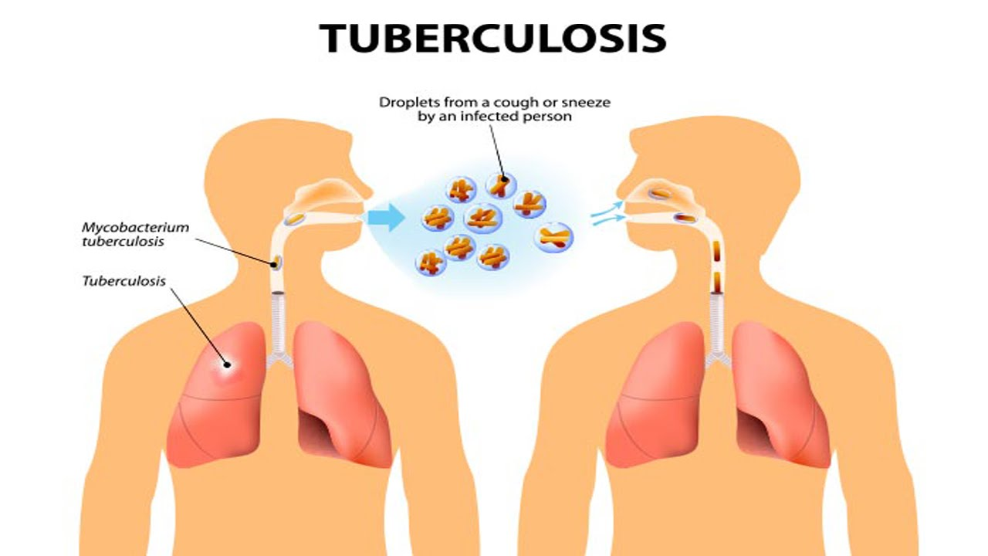
HIV is the most important risk factor for active tuberculosis.
An HIV-infected individual with TB infection is over 100-fold more likely to develop active disease than an HIV negative

Slide 4
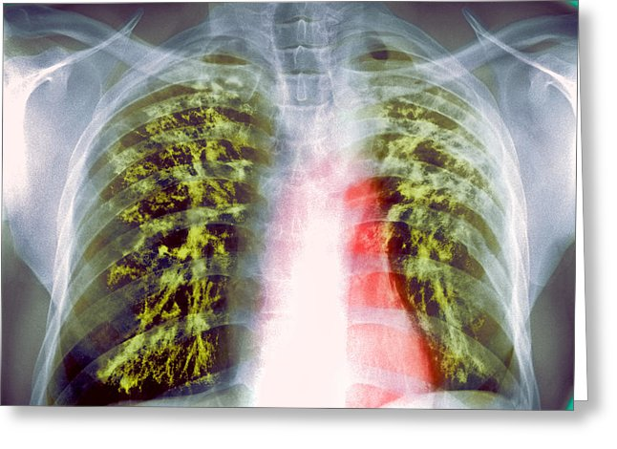
Signs and symptoms of TB are:
weight loss,
fatigue,
cough,
fever,
night sweat
phlegm with blood

Slide 5
The mycobacteria are slow-growing microbes.
The infections they cause require a prolonged treatment.
Drug toxicity and poor patient adherence are significant clinical concerns.
Prolonged treatment promotes the emergence of drug-resistance mycobacteria.

Slide 6
Drug resistance is a major impediment to successful therapy.
Drug resistance develops through spontaneous mutations in the chromosomal DNA.
The main cause underlying the emergence of resistance is inadequate drug therapy.
Treatment may be too short;
dosage may be too low;
patients are nonadherent with prescribed therapy.
The most importantly, the regimen may contain too few drugs

Slide 7
Exposing mycobacteria to monotherapy selects out these resistant strains.
Combination of two or more drugs is essential to kill heterogeneous populations of bacterial cells and to prevent drug resistance.
Because the response of mycobacterial infections to chemotherapy is slow, treatment must be administered for prolonged periods, usually from 6 months to years, depending on which drugs are used.

Slide 8
DRUGS USED IN TUBERCULOSIS
Based on their clinical utility, the antituberculosis drugs can be divided into two groups:
First-line drugs and
Second-line drugs

Slide 9
Firs-line drugs:
Isoniazid (INH), rifampin (or rifamycin), pyrazinamide and ethambutol
At least two (or more in certain cases) active agents should always be used to treat active tuberculosis and to prevent emergence of resistance during therapy.
Isoniazid and rifampin are the most active drugs against tuberculosis caused by susceptible strains.

Slide 10
ISONIAZID
Isoniazid is the most active drug for the treatment of tuberculosis.
Mechanism of Action
Isoniazid inhibits synthesis of mycolic acids, which are essential components of mycobacterial cell walls.

Slide 11
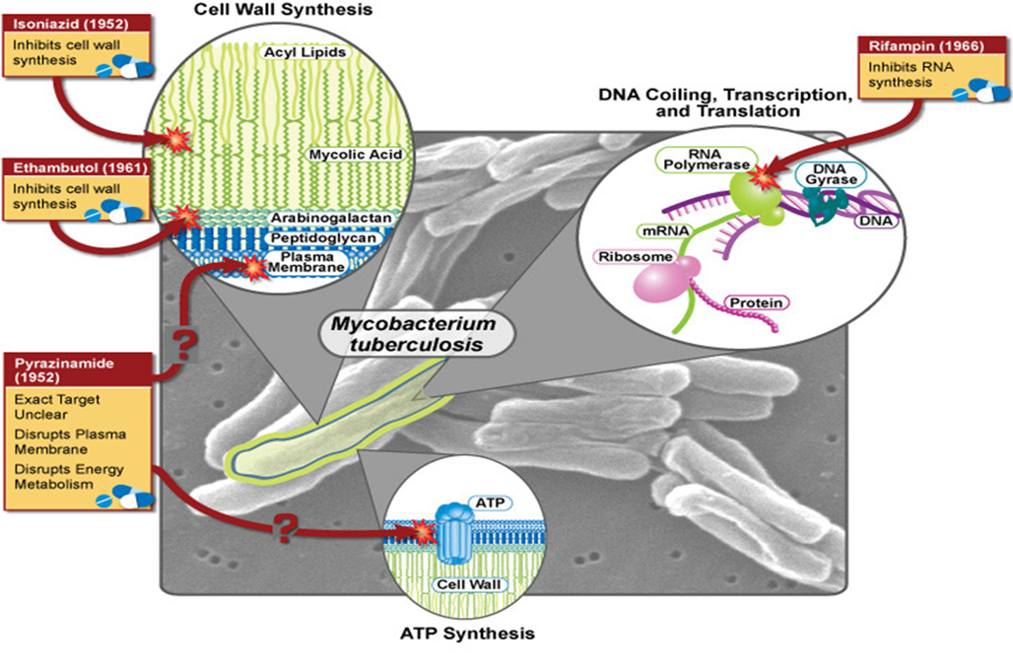

Slide 12
IZONIAZID
Pharmacokinetics:
Isoniazid is usually given by mouth but can be given parenterally in the same dosage.
Metabolism of isoniazid, especially acetylation by liver N-acetyltransferase, is genetically determined
Therefore, metabolism of isoniazid depends on genetic factors.

Slide 13
Adverse Reactions
The incidence and severity of untoward reactions to isoniazid are related to dosage and duration of administration.
A. Immunologic Reactions
Fever and skin rashes are occasionally seen. Drug-induced systemic lupus erythematosus has been reported.
B. Direct Toxicity
Isoniazid-induced hepatitis is the most common major toxic effect, and can be fatal,
The risk of hepatitis is greater in individuals with alcohol dependence.

Slide 14
Peripheral neuropathy is more likely to occur in slow acetylators and patients with predisposing conditions such as malnutrition, alcoholism, diabetes, AIDS, and uremia.
Neuropathy is due to a relative pyridoxine deficiency. Isoniazid promotes excretion of pyridoxine, and this toxicity is readily reversed by administration of pyridoxine.

Slide 15
RIFAMPIN
Mechanism of Action
Rifampin binds to the β subunit of bacterial DNA-dependent RNA polymerase and thereby inhibits RNA synthesis.
It should be used in combination with isoniazid and other antituberculosis drugs.

Slide 17
Adverse Reactions
Rifampin imparts a harmless orange color to urine, sweat, and tears.
Occasional adverse effects include rashes, thrombocytopenia, hepatitis
rifampin may cause a flu-like syndrome characterized by fever, chills, myalgias, anemia, and thrombocytopenia.

Slide 18
Adverse Reactions
Rifampin strongly induces most cytochrome P450 isoforms (1A2, 2C9, 2C19, 2D6, and 3A4),
Rifampin increases the elimination of numerous other drugs including methadone, anticoagulants, cyclosporine, some anticonvulsants, protease inhibitors, and contraceptives.

Slide 19
PYRAZINAMIDE
Pyrazinamide is an important first-line drug used in conjunction with isoniazid and rifampin in short-course regimens
Mechanism of Action
Pyrazinamide is converted to pyrazinoic acid, the active form of the drug, by mycobacterial pyrazinamidase.
The specific drug target is unknown, but pyrazinoic acid disrupts mycobacterial cell membrane metabolism and transport functions.

Slide 21
PYRAZINAMIDE
Adverse Reactions
Hepatotoxicity (in 1–5% of patients),
Nausea, vomiting, drug fever,
Hyperuricemia. The latter occurs uniformly and is not a reason to halt therapy. Hyperuricemia may provoke acute gouty arthritis.

Slide 22
ETHAMBUTOL
Mechanism of Action & Clinical Uses
Ethambutol inhibits mycobacterial arabinosyl transferases involved in the polymerization reaction of arabinoglycan, an essential component of the mycobacterial cell wall.
Ethambutol is always given in combination with other antituberculous drugs.
Adverse Reactions
The most common serious adverse event is visual disturbances

Slide 24
SECOND-LINE DRUGS FOR TUBERCULOSIS
Second-line agents are generally less effective and more toxic than the first-line drugs.
The alternative drugs are used in combination with the first-line drugs.
They are usually considered only :
- in case of resistance to first-line agents;
-in case of failure of clinical response to conventional therapy; and
-in case of serious treatment-limiting adverse drug reactions.

Slide 25
Streptomycin
Streptomycin is ototoxic and nephrotoxic. Vertigo and hearing loss are the most common adverse effects and may be permanent.
Toxicity is dose-related, and the risk is increased in the elderly.
As with all aminoglycosides, the dose must be adjusted according to renal function .

Slide 26
Etionamid
Ethionamide is chemically related to isoniazid and similarly blocks the synthesis of mycolic acids.
Ethionamide is also hepatotoxic.
Capreomycin
is a peptide protein synthesis inhibitor,.
Capreomycin is nephrotoxic and ototoxic. Tinnitus, deafness, and vestibular disturbances occur.
The injection causes significant local pain.

Slide 27
Cycloserine
Cycloserine is an inhibitor of cell wall synthesis.
The most serious toxic effects:
are peripheral neuropathy and central nervous system dysfunction, including depression and psychotic reactions.
Pyridoxine, should be given with cycloserine because this ameliorates neurologic toxicity.

Slide 28
Aminosalicylic Acid (PAS)
Aminosalicylic acid is a folate synthesis antagonist that is active almost exclusively against M tuberculosis
Very high concentrations of aminosalicylic acid are reached in the urine, which can result in crystalluria.
Aminosalicylic acid is used infrequently because other oral drugs are better tolerated

Slide 29
Kanamycin & Amikacin
the availability of less toxic alternatives (eg, capreomycin and amikacin) has made kanamycin obsolete.
Ototoxicity and nephrotoxicity are the main side effects of drugs..
Fluoroquinolones
Fluoroquinolones are an important addition to the drugs available for tuberculosis, especially for strains that are resistant to first-line agents.

