Slide 1
Insemination Techniques
Ankara Üniversitesi, Veteriner Fakültesi
Reprodüksiyon ve Suni Tohumlama Anabilim Dalı

Slide 2
Sperm type and Life span
Sperm | Dose | Expected life span | Schedule | % Fertility
Fresh | 150-200 x 10⁶ | 4-6 d | 4-18 ng/ml pg x 3 | Vaginal/80-90
Chilled | 150-200 x 10⁶ | 24-72 h | 8-18 ng/ml pg x 4 | Transcervikal/vaginal %70
Frozen | 50-300 x 10⁶ | 12-24 h | 10-18 ng/ml x 2 | %45 Transservikal/intrauterin

Slide 3
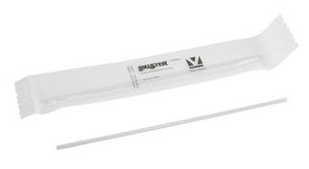
AI in bitches include vaginal deposition of the semen,

Slide 4
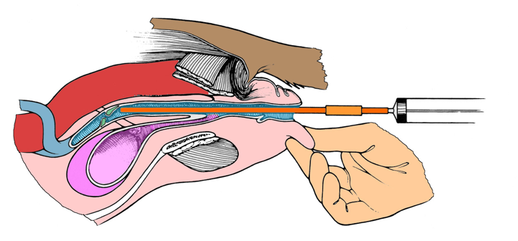
Insemination Techniques
Vaginal

Slide 5
Learning the techniques for TCI
Non-surgical TCI using the Norwegian/Scandinavian catheter
Rigid endoscope
Ref: Catharina Linde Forsberg DVM, PhD, Dipl ECAR

Slide 6
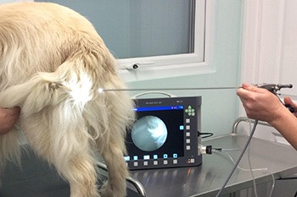
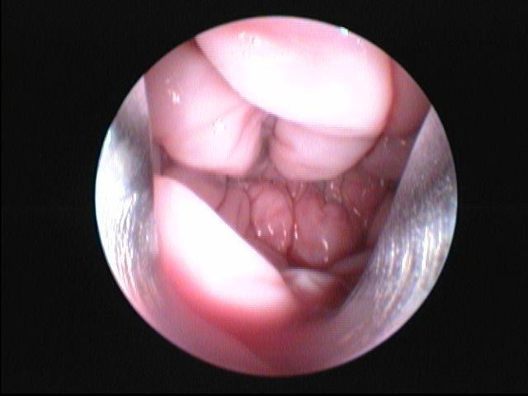
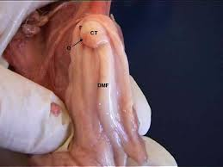
Insemination Techniques
Trans-Cervical

Slide 7
Methods for AI in bitches include;
Vaginal deposition of the semen,
Transcervical intrauterine deposition (TCI) using Norwegian/Scandinavian catheter or with the aid of a rigid endoscope,
Intrauterine (IU) insemination by laparoscopy
Or Full abdominal surgery

Slide 8
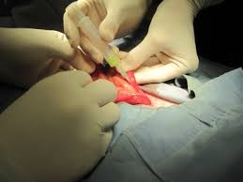
Insemination Techniques
Laparatomic

