Slide 1
REPRODUCTIVE HERD HEALTH
Prof.Dr. Şükrü Küplülü

Slide 2
CLINICAL-PRACTICAL APPROACH TO UTERUS INFECTIONS IN COWS

Slide 3
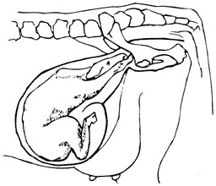
Hypothetical Approach to Fertility
1 year
365 days
P
R E G
280 day
Doğum
involution
Endometrial regeneration
Start of cyclic activity
Purification of infections
P
O
S
T
P
A
R
T
U
M
43
86
Insemination
(3 seeding chance)
43
0
Conception

Slide 4
Postpartum uterine infections
(Hansen, 2013)

Slide 5
Postpartum uterine contamination
(Sheldon ve Dobson, 2004)

Slide 6
The most common bacterial species and density in P.P uterus
□ Trueperella pyogenes, ■ E.coli (Williams, 2013).

Slide 7
P. P. Factors Associated with the Development of Uterine Infections
(Noakes, 2009)

Slide 8
The face of metritis (the importance of the Puerperal period)
Lochia
(Küplülü Ş, Vural R, Polat M ,2012)

Slide 9
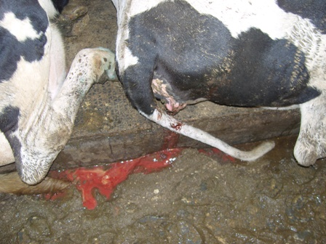
The face of metritis (the importance of the Puerperal period)
(Küplülü Ş, Vural R, Polat M ,2012)

Slide 10
Puerperal physiology-pathology
(Küplülü Ş, Vural R, Polat M ,2012)

Slide 11
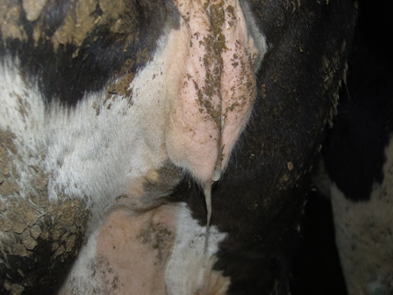
Puerperal physiology-pathology
(Küplülü Ş, Vural R, Polat M ,2012)

Slide 12
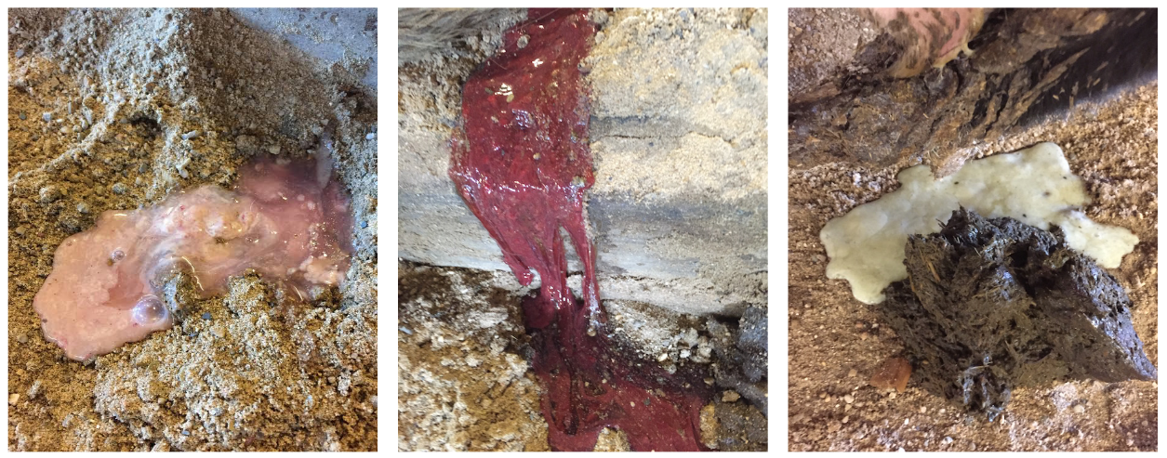
Puerperal physiology-pathology
(Stella ve ark., 2016)

Slide 13
Economic importance of metritis
NEGATIVE RESULTS OF METRITIS
Death
Treatment costs
Labor
Milk loss
Meat-milk antibiotic residual problem
Infertility
Sterility - Cutting
Metritis are,
* Seen on every cow and farm
ECONOMIC LOSS

Slide 14
Incidence of Metritis - Factors affecting incidence
Metritis incidence rates
Postpartum metritis: 36-50% (40%)
Systemic symptoms: 15-20% (3 weeks postpartum)
Subclinical endometritis: 30%
Sheldon, 2009
Variable - increases or multiplies depending on factors. Every farm
Herd management and management | Vaccination program
Feeding in transition period | Negative energy balance
Management of birth process | Mat, birth aid, etc.
Immunological competence of flock and individual | Stres
Intensity of the causative agents of infection | Environmental hygiene

Slide 15
Metritis is sometimes a CONCLUSION and sometimes a CAUSES [Infertility] Metritis is an immunological problem
Sudden increase in metabolic requirement
Fry growth and milk synthesis
Risk factors
Transition period dry matter intake
(Risk factors are effective)
NEB
(IGF-I,insulin)
Affects cellular immunity PMN weakness
METRİTİS
Mikroorganism

Slide 16
Transition immunology and uterine infections
NEGATIVE ENERGY CURVE BEFORE AND AFTER BIRTH
Parturition
Increased Energy Demand
Increased Energy Demand
Rapid growth of the calf
Kolostrogenezis
High lactation
Insulin independent energy use of the udder
Disadvantage
KM uptake reduction
High steroid
cortisol
Disadvantage
Ruminal adaptation
Metritis low
Metritis more
Energy curve and balance
NEB = NEFA = IGF-I = PMN reduction = Ig production reduction = Immune deficiency

Slide 17
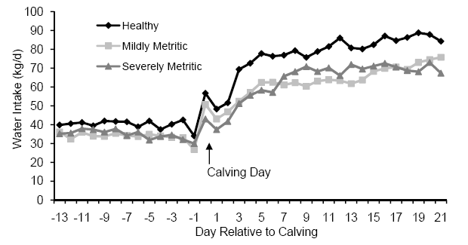
Water intake-Metritis relationship in periparturient period
J. M. Huzzey and T. R. Overton, Cornell University

Slide 18
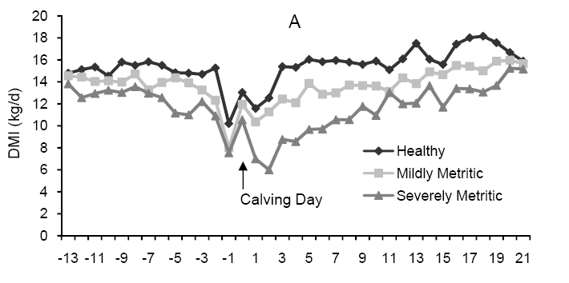
The relationship between dry matter intake and metritis in the periparturient period
J. M. Huzzey and T. R. Overton, Cornell University

Slide 19
Metritis, factor-predisposition factors and the role of immunity
FACTORS
bacteria
E.Coli
a.pyogenes
I f.necroph
Streptococcus spp.
Staphylococcus spp.
viruses
IBR (Herpes 1 and 4)
BVD-MD
Mushrooms
Aspergillus fumigatus
Mucor spp.
Mortierella wolfii
parasites
Neospora species.
Tritrichomonas
Sarcocystis neuroni
FACTOR / RISK LEVEL
Retentio sec.
Power birth
Abortions
Stillbirth
twins
hypocalcemia
Metabolic diseases
Season
IMMUNOLOGICAL FACTORS
1. Cellular immunity
(Leukocytes)
2. Humoral immunity
3. Complement proteins
4.Mechanical defense
(involution, mucosal health, mucus)
IMPROVEMENT
or
metritis
IMMUNOLOGICAL AND RISK FACTORS
INTERACTION
Parazitler
TARGET
Less active agent to the uterus / Predisposition factors should be monitored / Active immune system

Slide 20
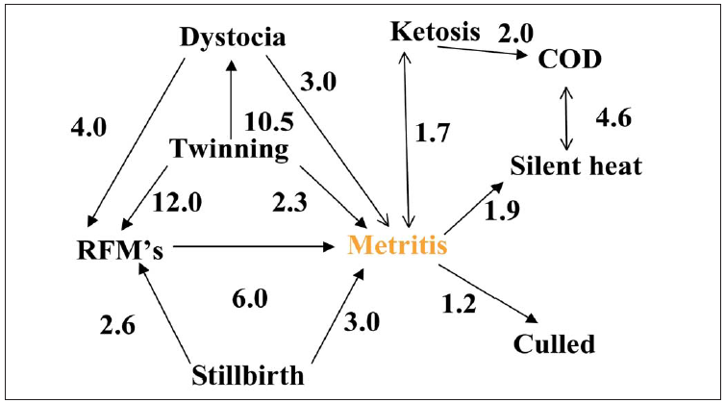
How important are the risk factors in metritis? (How do they impact)
A.pyogenes
G. Opsomer, A. de Kruif, 2009

Slide 21
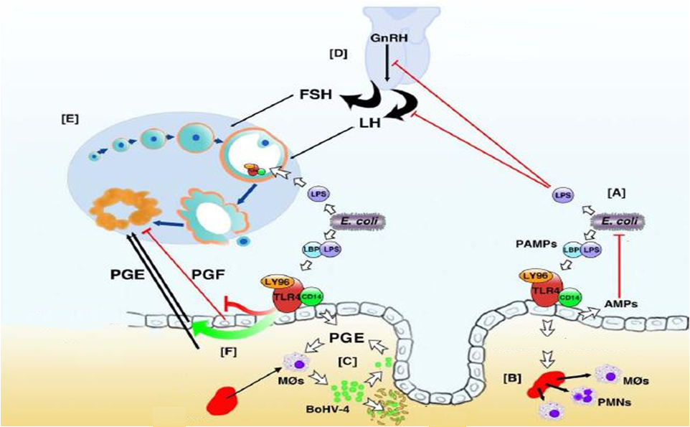
Uterine Infections-Ovarium Function Interactions
E.coli
şemotaksis
Sheldon et al.,2009

Slide 22
Metritis-Fertility: Prognosis
Type of infection
The duration of infection in the uterus
Endometrial gland degeneration
Depends on the effectiveness of treatment?
Cervisitis
Oophoritis
Salphingitis
IBR, BVD
Neospora
Heat stress
Mineral
Trace element
Vitamin
Sperm factor
Seeding factor
Insemination at the right time

