Slide 1
Biomimicry Design Thinking
Dr. Arzu GÜRSOY ERGEN
Fen Fakültesi Biyoloji Bölümü

Slide 2
WHY MIMIC NATURE??
There is a simple answer to this question:
Life has sustained on earth for 3.85 billion years.
Life adapts and evolves
Life creates conditions conducive to life
Notes:
http://www.mnn.com/earth-matters/wilderness-resources/photos/7-amazing-examples-of-biomimicry/copying-mother-nature

Slide 3
Strategies for Nature-Inspired Innovation
Biology-to-Design approach
Understanding a biological phenomenon and then applying it to a human design challenge.
Design-to-Biology approach
Identifying the core function of design challenge and then looking to nature to see how various organisms or ecosystems have achieved that function.

Slide 5
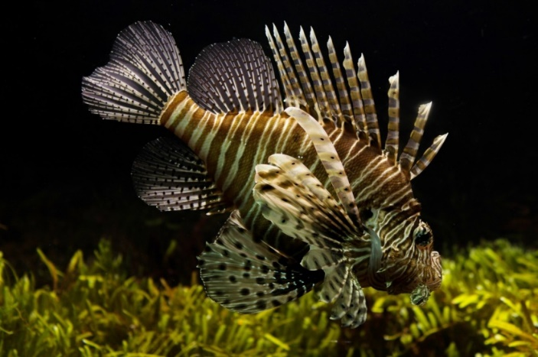
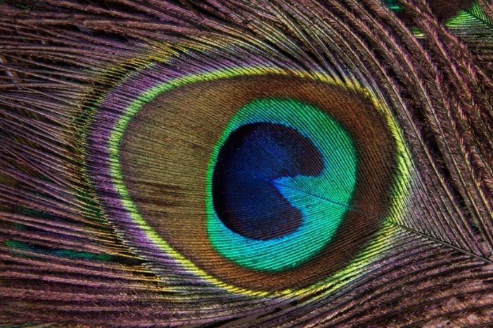
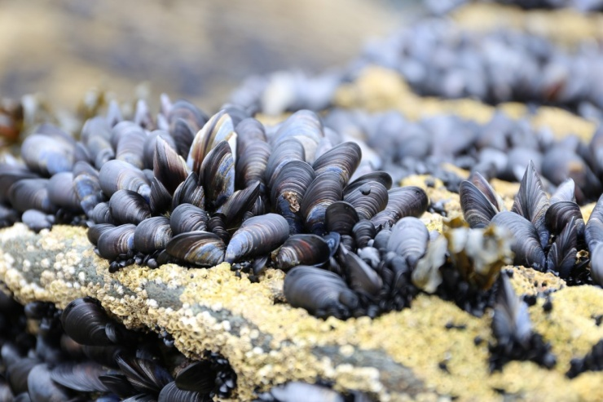
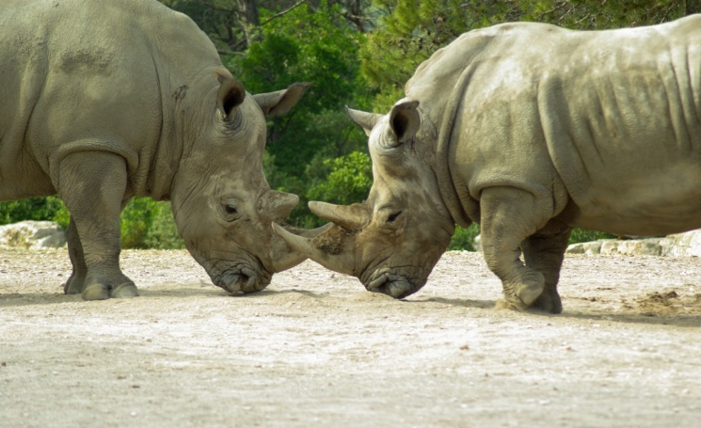
Why should we emulate nature?
Organisms in nature face the same challenges as we do, but they meet them sustainably.
How does nature
move in water?
How does nature
create color?
How does nature
handle force?
How does nature
glue things together?

Slide 6
What is sustainable design?
A process that leads to better design decisions by holistically considering long-term environmental impact, cost, and human well being.
Environmental,
Social,
Economic value.

