Slide 1
Analytical Chemistry I Practice

Slide 2
Course objectives
This course provides a one semester study of basic analytical laboratory techniques, used in qualitative and quantative analyses.
At the end of the semester students should;
Use analytical glasswares and associated lab equipments properly,
Discover the chemical principles of systematic analysis of cations-anions,
Operate basic qualitative and quantitative analytical techniques such as precipitation, filtration, flame tests, color observation etc.,
Apply laboratory safety rules strictly.

Slide 3
Course Topics
Week | Topics | Dates
1 | First Meeting, Introduction to Qualitative Analysis, Laboratory Safety | 19th September
2 | Anions | 26th September
3 | Group 5 Cations | 3rd October
4 | Group 5 and 4 Cations | 10th October
5 | Group 3 Cations | 17th October
6 | Group 2 Cations | 24th October
7 | Group 2 Cations | 31st October
8 | Mid-Term
9 | Group 1 Cations | 14th November
10 | Introduction to Quantitative Analysis, Preparation of NaOH-HCl | 21th November
11 | Standardization of NaOH-HCl, Determination of Aspirin Purity | 28th November
12 | Determination of Calcium carbonate, Determination of Boric acid in antiseptic solution | 5th December
13 | Determination of phosphoric acid, Preparation of potassium permanganate | 12th December
14 | Standardization of potassium permanganate and Fe analyses | 19th December
14 | Final

Slide 4
Grading
Midterm exam: 20%
Lab performance + quizzes: 20%
Final exam: 60%
Attendances
In case of 30% or more absences you will be graded F
Medical excuse is not valid for the course as it is a practical course

Slide 5
Analytical Chemistry
What is Analytical Chemistry?
"Analytical chemistry is the science of obtaining, processing, and communicating information about the composition and structure of matter. In other words, it is the art and science of determining what matter is and how much of it exists. "
What Do Analytical Chemist Do?
"Analytical chemists use their knowledge of chemistry, instrumentation, computers, and statistics to solve problems in almost all areas of chemistry and for all kinds of industries. For example, their measurements are used to assure the safety and quality of food, pharmaceuticals, and water; to assure compliance with environmental and other regulations; to support the legal process; to help physicians diagnose diseases; and to provide measurements and documentation essential to trade and commerce."
American Chemical Society, Analytical Chemistry Definition

Slide 6
Analytical Chemistry
Qualitative analytical chemistry identifies substances (determines presence or absence of a substance) while quantitative analytical chemistry measures amount of a particular substance or substances.

Slide 7
Qualitative Analysis
In qualitative analysis, an analytical reaction has to be:
1. Observable: Precipation, dissolution of a precipitate, color change, gas evolution or heat exchange.
Sensitive: Low amount of samples need to be detected.
Specific: Only intended analyte should be reacted. Other substances that possibly exist in the sample should not be reacted.

Slide 8
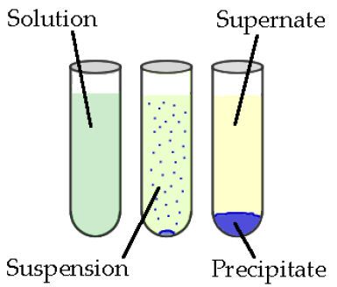
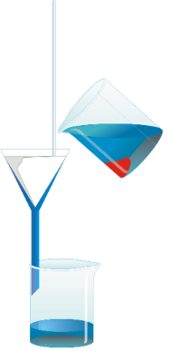
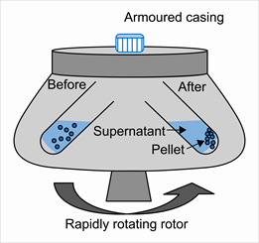
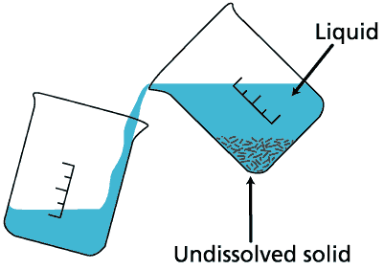
General Terms
Solution: a homogeneous mixture of two or more substances.
Solvent: a substance that is in excess amount comparing other substances and dissolves them in a solution.
Solute: a substance dissolved in solvent.
Precipitation: formation of a solid in a solution.
Separation of a precipitate
Filtration: precipiate can be separated from supernatant using a filter paper and a funnel .
Decantation: heavy, large-grained particles can be separated from supernatant by transferring liquid part to another tube.
Centrifugation: is a process which involves the application of the centripetal force for the sedimentation of heterogeneous mixtures with a centrifuge instrument
Filtration
Decantation
Centrifugation

Slide 9
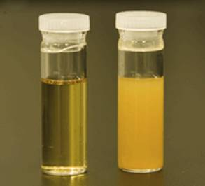
Best conditions for high-yield precipitation
Reagents need to be added slowly and mixture should be mixed well.
Heating yields better precipitates.
Reactant should not be added in excess amount as it may result complex formation and increased solubility.
Some substances can form colloids which is dispersion of solid particles in solvent. Colloids do not precipitate because of electrical charge that they carry on their surfaces. They can be precipitated by electrolyte addition.
At the end of precipitation, add one drop of reactant to supernatant to check whether precipitation is completed.
Precipitates need to be washed after separation from supernatant:
After filtration wash precipitate on the filter paper with distilled water
After decantation or centrifugation add some distilled water to test tube, mix the tube and wait for precipitation, discard water.
Solution (left) and colloid (right)

Slide 10
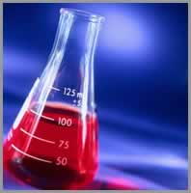
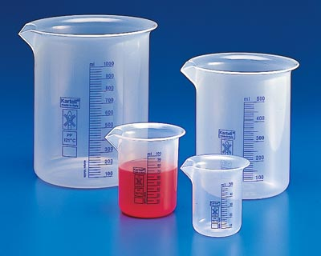
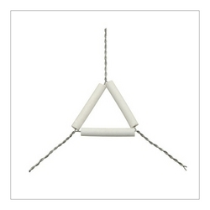
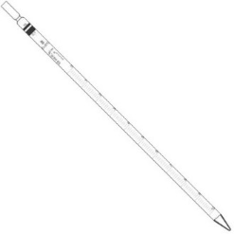
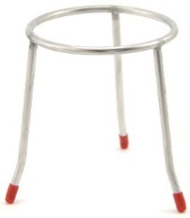
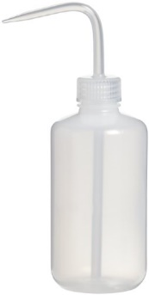
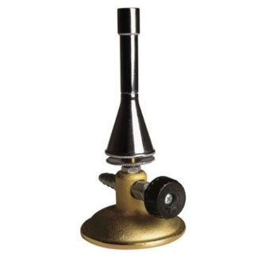
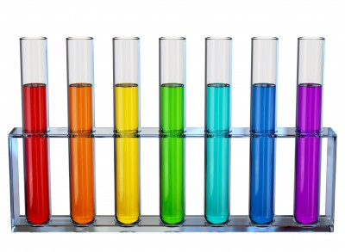
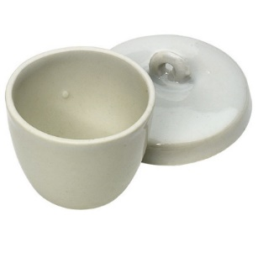
Labwares in Analytical Chemistry I Practice
Pipette Erlenmeyer flask Beaker Tripod support Triangle
Bunsen Burner Test tubes Crucibles Washing Bottle

Slide 11
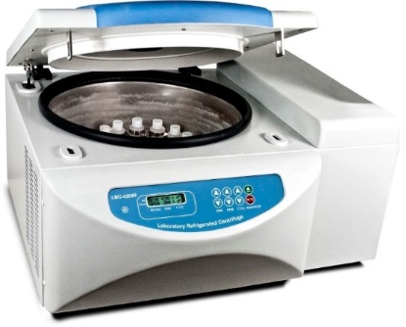
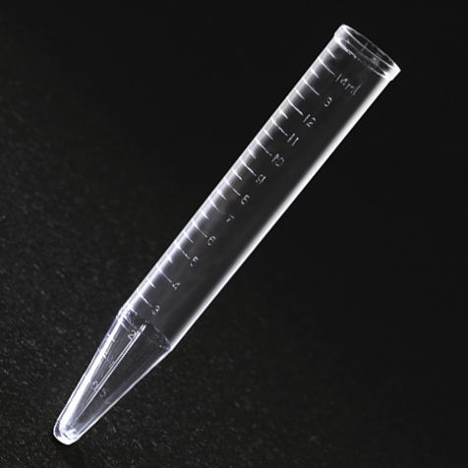
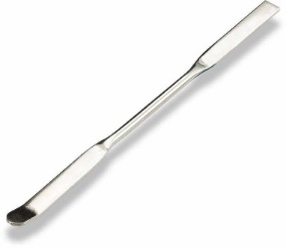
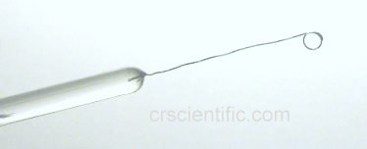
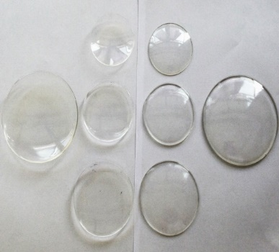
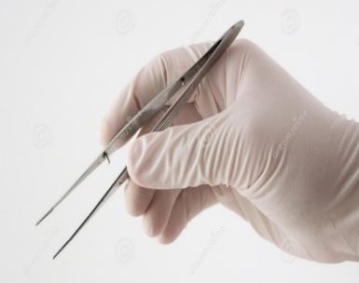
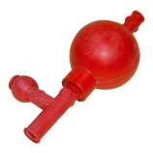
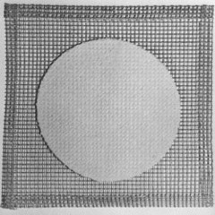
Labwares in Analytical Chemistry I Practice
Centrifuge tube
Platinum wire Spatula Centrifuge
Watch glass
Forcept
Wooden tongs
Rubber Bulb
Wire Gauze

Slide 12
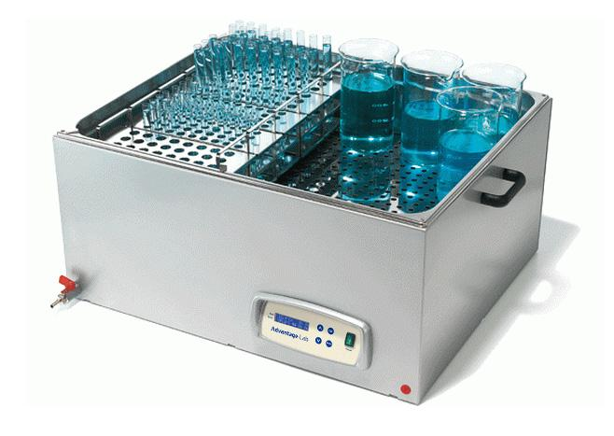
Tips
Transferring precipitate: use spatula
Mixing solution: use stirring rod
Heating solution: use water bath for safe and homogeneous heating
Solvent evaporation: apply flame to directly cruicible containing solution and turn the flame off when very little liquid left in the cruicible.
Distilled water: obtained by distillation of water. Always use distilled water in your experiments.
Cleaning glasswares: Wash with tap water a few times and then use a little amount distilled water.

Slide 13
Rules
Be punctual! Never come late.
Lab coats, googles and gloves must be worn at all times whilst working in the lab.
Cellphone usage is forbidden in the lab.
Do not shout in the laboratory.
Eating and drinking is forbidden in the laboratory (including chewing gum).
If you have an urgent issue, you may go outside with the permission of the teaching assistants (T.A.) Work slowly and carefully. Don’t try to rush things in the laboratory.
Absolutely no fooling around or horse play will be tolerated in the laboratory
Shoes must be worn in the laboratory at all times. These must be covered-top. NO sandals or spaghetti-strap high-heels are permitted.

Slide 14
Rules
Do not mouth-pipet; use a rubber bulb.
The wearing of shorts is forbidden in all Analytical Chemistry labs
In case of chemical burns, Immediately run copious amounts of cool water to the affected area. Never apply an acid (base) to neutralize any base (acid) you may have gotten on you. Always wash with large amounts of cold water.
Never point the top of a test tube, beaker, flask etc., at yourself or anyone else.
Loose long hair can be a danger as open flame is used in Analytical Chemistry Lab. Please try to keep your hair bound in some manner.
For wastes, ask your T.A. for disposal (container or sink)
Clean up all spills immediately.

