Slide 1
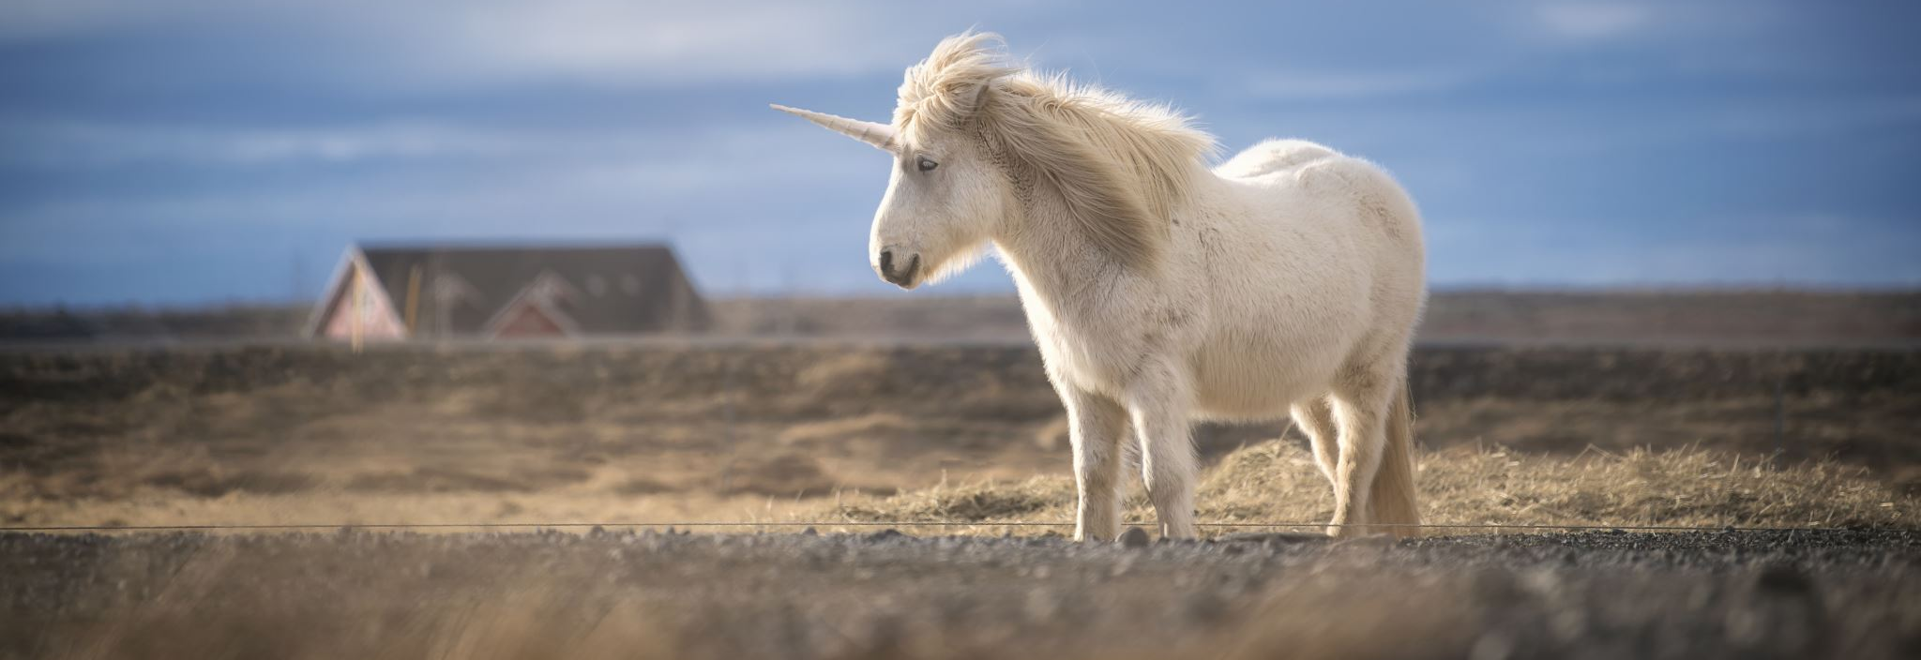
Fantasy Fiction

Slide 2
Sources
Andrew Rayment, “The Problem of Defining Fantasy Literature” in Fantasy, Politics, Postmodernity, 2014.
Brian Stableford, The A to Z of Fantasy Literature, 2009.
Mendlesohn, Farah. “Towards a Taxonomy of Fantasy.” Journal of the Fantastic in the Arts 13/2, 2002.
John Clute & John Grant, The Encyclopedia of Fantasy, 1996.

Slide 3
Definitions
the literature of subversion
an approach to reality
any text with fantastic elements
the liberation of the imagination
the literature of the ever-extending horizon
a lot of disagreement

Slide 4
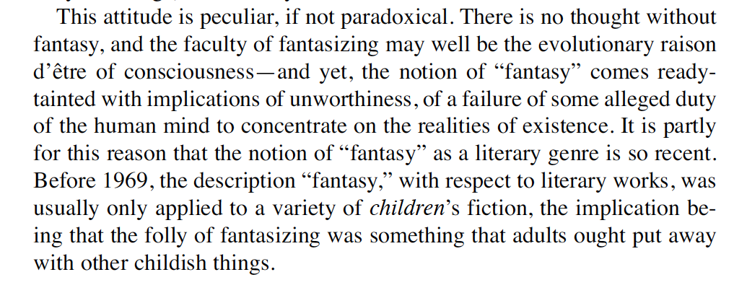
Brian Stableford

Slide 5
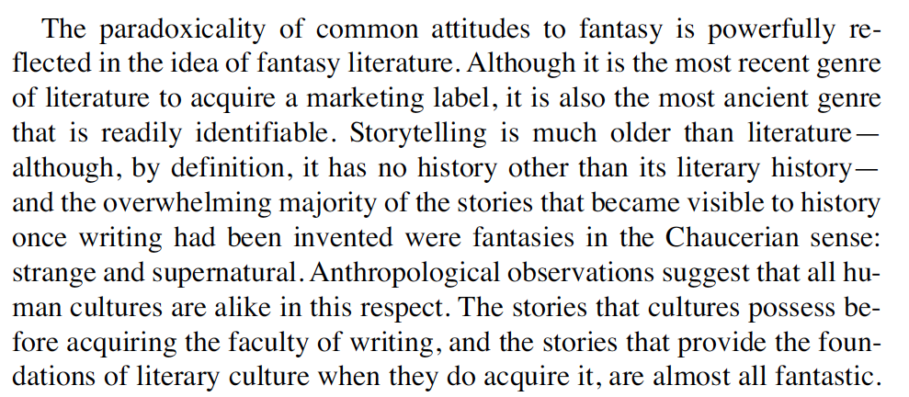

Slide 6
History
myth, legend, folklore
fairy tales
Homer’s Iliad and Odyssey
fantastic elements in literature
the fantastic and the naturalistic mingled until the 18th century
“fantasy literature is as old as literature itself and its elements of fantasy are much older.”
Brian Stableford

Slide 7
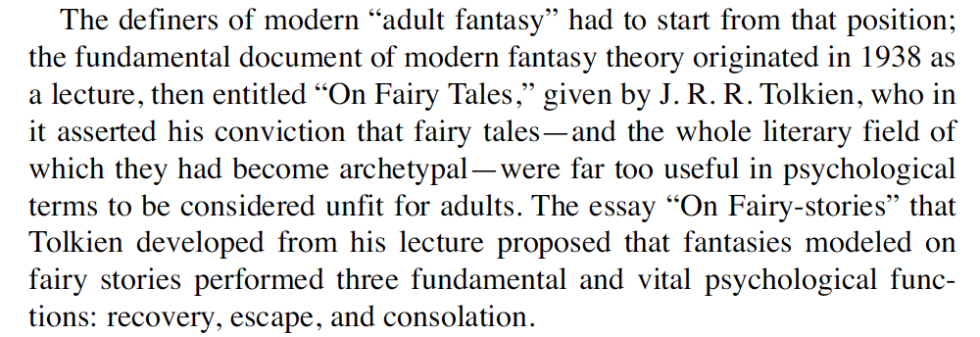

Slide 8
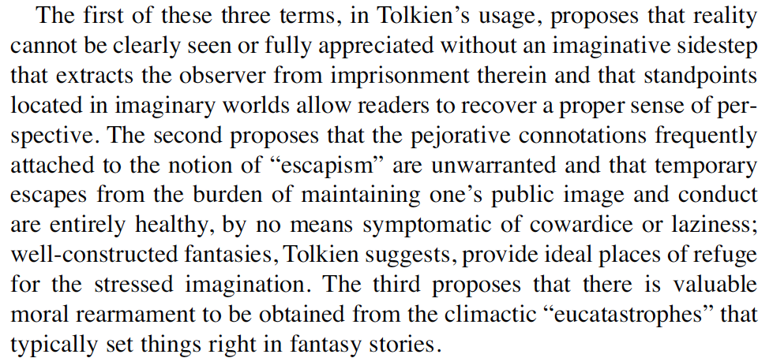

Slide 9
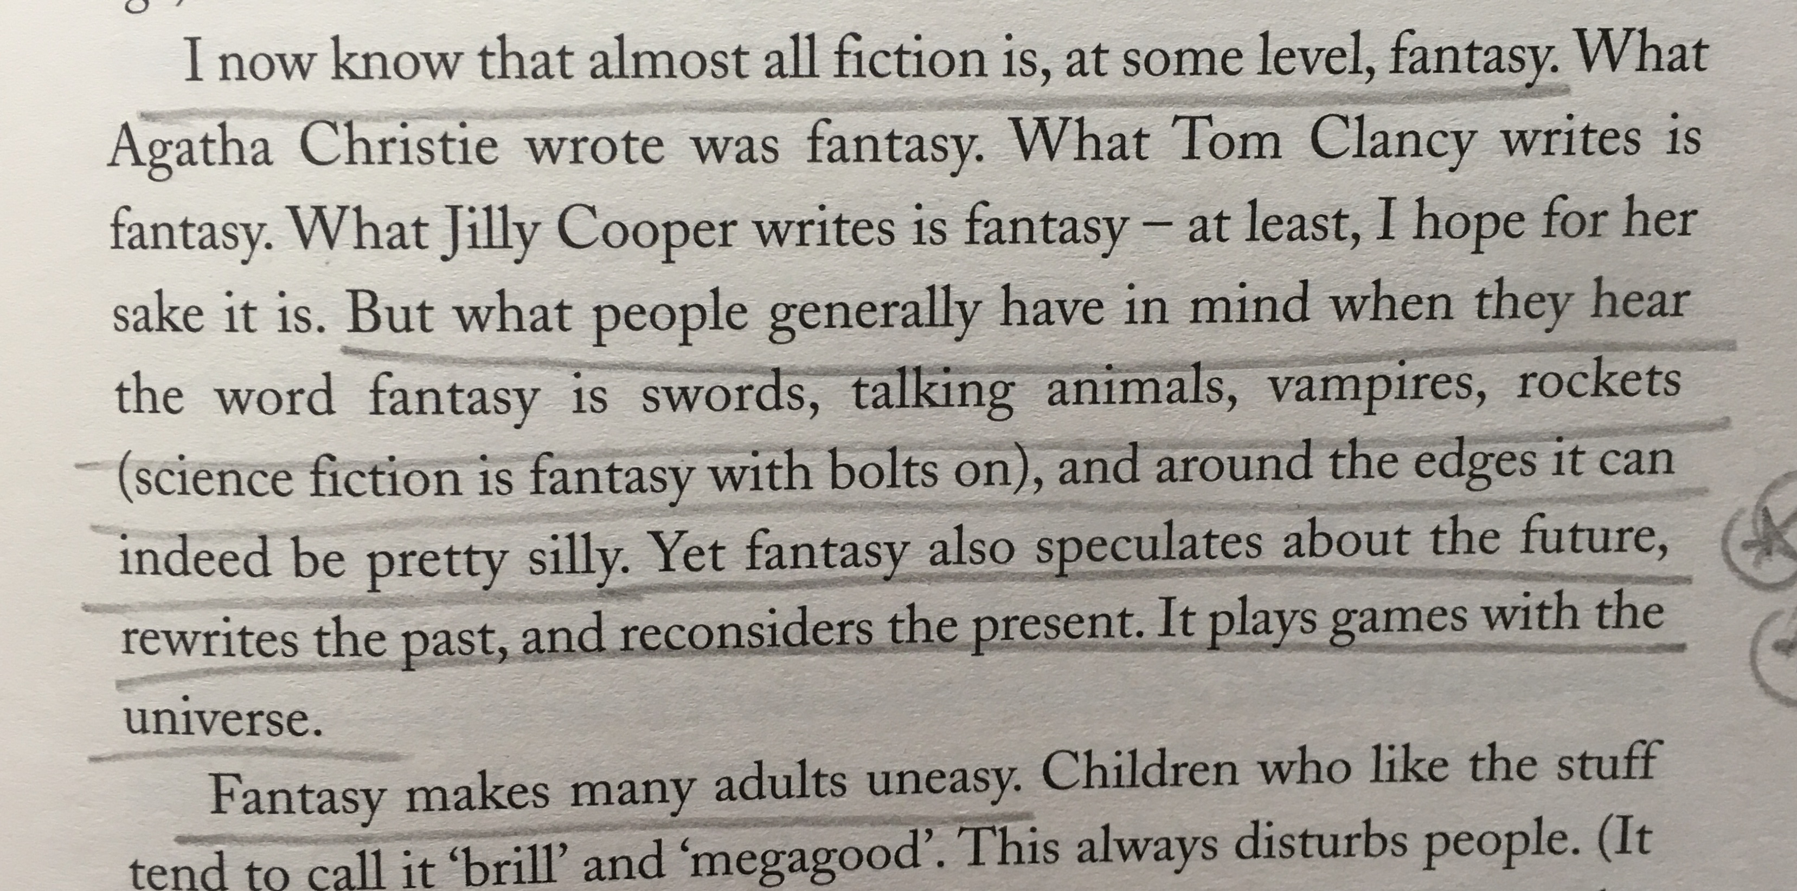
Terry Pratchett

Slide 10
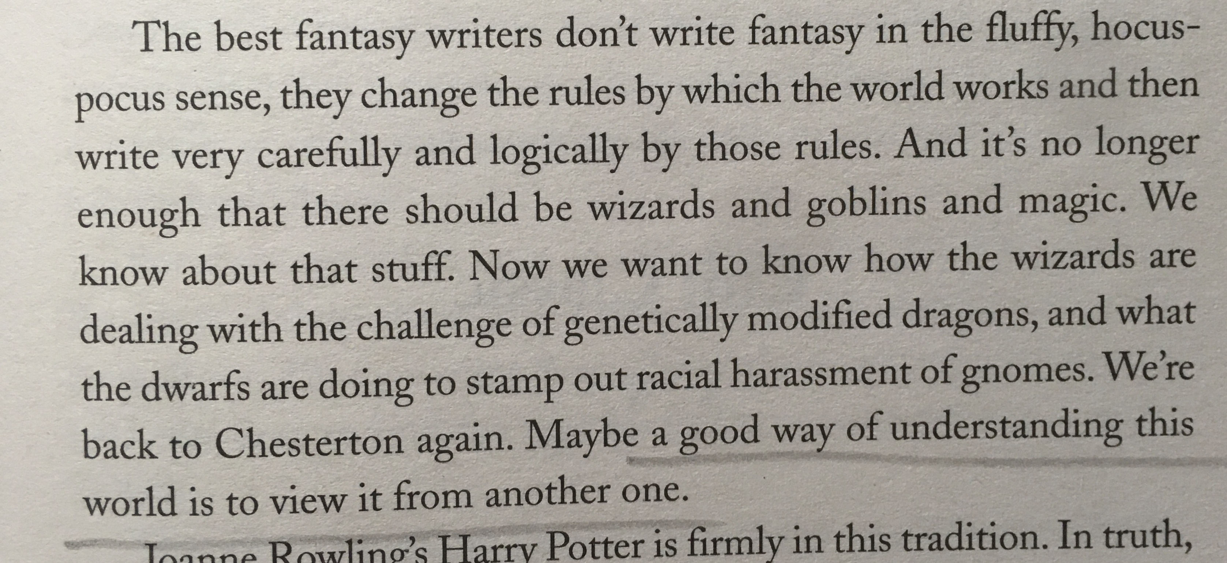
Terry Pratchett

