Slide 1
Determination of boric acid (H₃BO₃)
Aquoeus boric acid solution with a concentration of 2 % (w/v) has antibacterial and antifungal effects and is used topically.
In this experiment, the students will determine the concentration of their boric acid samples as g/L and % (w/v).
Then, the students will calculate and explain how to prepare 100 mL 2 % (w/v) boric acid solution using their original sample in their reports .

Slide 2
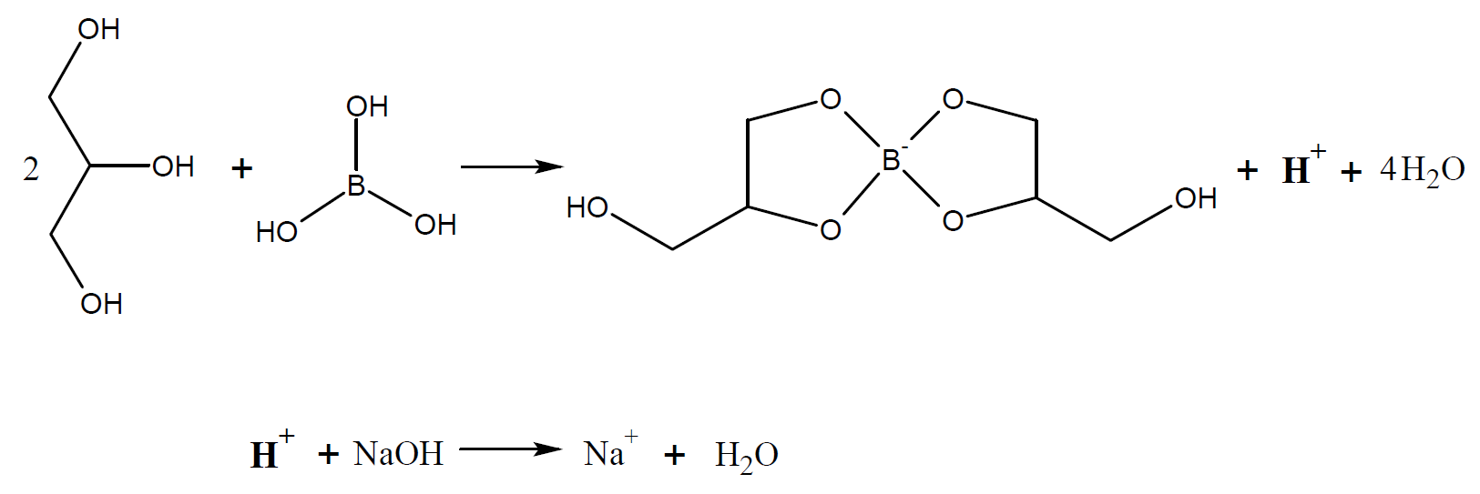
Principle:
Since boric acid is a very weak acid(K_{a}=5x10⁻¹⁰) it cannot be titrated directly with strong alkali solutions.
The complex formed by boric acid with a compound that have several alcohol groups (glycerol, mannitol, sorbitol e.g.) behaves like a mild acid.
That is why, boric acid is titrated with NaOH after adding glycerol to the erlenmayer.
The proton that is occurred after the formation of complex can be titrated with standardized NaOH.

Slide 3
Experimental Procedure:
Each student will receive 5 mL of boric acid solution with an unknown concentration in a 100 mL volumetric flask.
Complete the sample in the flask to 100 mL with distilled water. Take a portion of it into an erlenmeyer flask with your single volume pipette.
Add 10 mL glycerol solution (1:1 diluted and neutralized) to the erlenmeyer flask. (The glycerol solution prepared by the lab personnel will be ready to use.)
Add 2 drops of phenolphthalein to the erlenmeyer flask and titrate with standardized NaOH solution until the pink color is observed.

Slide 4
Calculation:
Boric acid concentration of the original sample will be calculated as g/L and w/v %. (${MW}_{H_{3}{BO}_{3} }=61.82 g/mol$)
First, the moles of NaOH consumed during titration is calculated:
$$n_{NaOH = }M_{NaOH}×V_{NaOH}$$
According to reaction equation:
If 1 mol NaOH reacts with 1 mol H₃BO₃
$n_{NaOH}$ mol NaOH reacts with x mol H₃BO₃
From this ratio, the moles of H₃BO₃ in the diluted sample ($x=n_{H_{3}{BO}_{3}}$) is calculated. Then the molarity of the diluted sample is calculated from x.
$$M_{H_{3}{BO}_{3}}=\frac{x}{V_{H_{3}{BO}_{3}}}$$
The molarity of the original sample ($M_{sample})$ is calculated by multiplying the molarity of the diluted sample by the dilution factor:
$$M_{sample}= M_{H_{3}{BO}_{3}}×DF$$
The molarity is multiplied by the molecular weight to convert the concentration of the original sample to g/L:
$$C\left(g/L\right)=M_{sample}×61.82$$
Concentration of the original sample is calculated as w/v %.
(w/v) % $=\frac{g}{100 mL}$
In your report, explain how to prepare 100 mL of 2 % (w/v) boric acid solution by using the original sample you have received with dilution calculations.
(w/v) %$=C(g/L) × 10$
$$C(g/L)=\frac{g}{1000 mL }$$
Reference: Analitik Kimya Pratikleri – Kantitatif Analiz (Ed. Feyyaz ONUR), 2014

