Slide 1
Jan Matejko 1838-1893

Slide 2
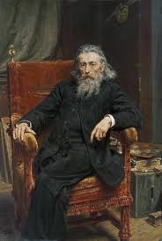
Jan Matejko, Polonya’nın önemli tarihi, siyasi ve askeri olaylarını betimlediği resimleriyle tanınan en meşhur Polonyalı ressamdır.
https://www.youtube.com/watch?v=lNr4sV1-kqk

Slide 3
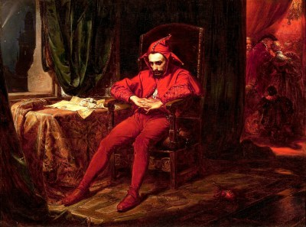
Stańczyk
https://www.youtube.com/watch?v=7Omj_4Ri9O0

Slide 4
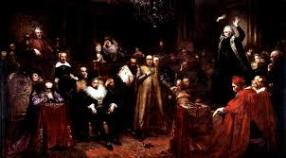
Kazania skargi
https://www.skarga.edu.pl/gim/index.php/9-inne/115-jan-matejko-kazanie-ks-piotra-skargi

Slide 5
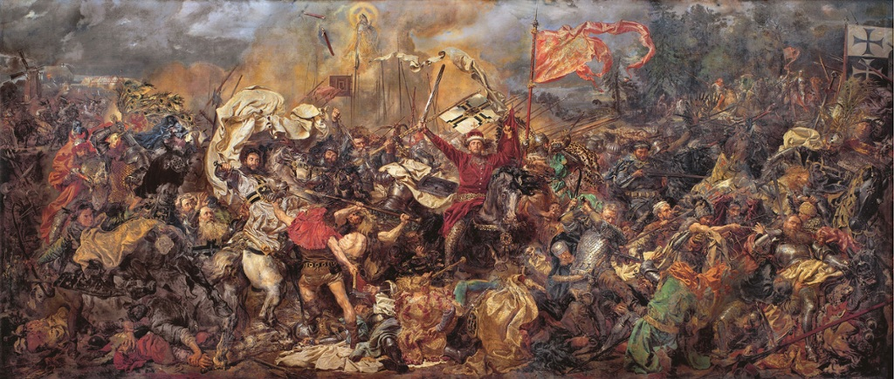
Bitwa pod grunwaldem
https://www.youtube.com/watch?v=4Yi2170hPSs

Slide 6
Kaynaklar
https://www.youtube.com/watch?v=lNr4sV1-kqk
https://www.youtube.com/watch?v=7Omj_4Ri9O0
https://www.skarga.edu.pl/gim/index.php/9-inne/115-jan-matejko-kazanie-ks-piotra-skargi
https://www.youtube.com/watch?v=4Yi2170hPSs

