Slide 1
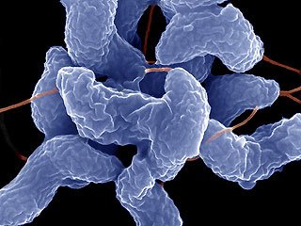
CAMPYLOBACTER INFECTIONS

Slide 2
Classification
Kingdom : Bacteria
Phylum : Proteobacteria
Class : Epsilonproteobacteria
Order : Campylobacteriales
Family : Campylobacteriaceae
Genus : Campylobacter, Arcobacter

Slide 3
General Features I
Gram negative, "S", helical, spiral, oblique spikes
Microaerophilic (3-5% O2, 7-10% CO₂), without spore, without capsules
Can pass through 0.45 μm diameter filters
Active with polar flagella
Dont have fimbria and pilus
Optimal temperature is 37 ° C
They do not form pigments
Oxidase positives

Slide 4
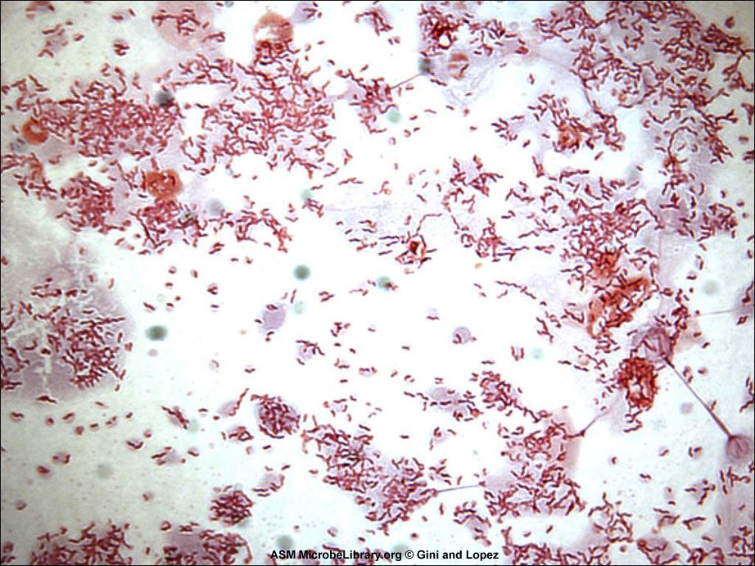

Slide 5
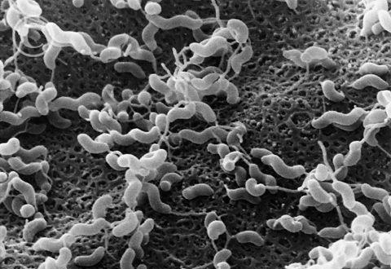
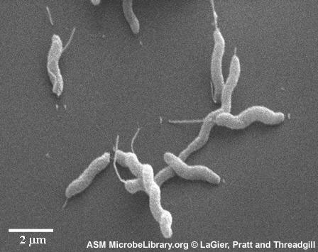
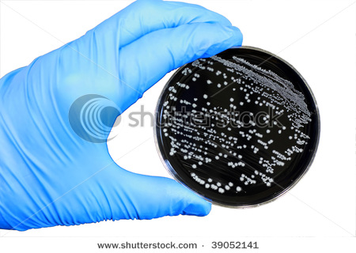
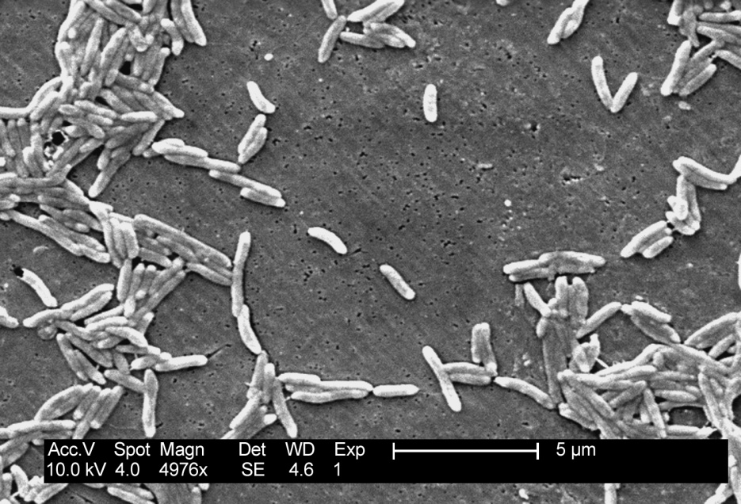

Slide 6
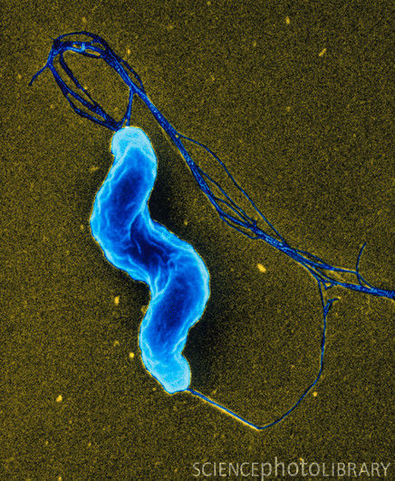
General Features II
Gelatin, urea, MR and VP negative
Catalase, nitrate, hippurate, H₂S reactions differ between species
Species that can culture at 42 ° C form the group "thermophilic Campylobacter"

Slide 7
Important Species
C. fetus subsp. fetus
C. fetus subsp. venerealis
C. jejuni
C. coli Thermophilic Campylobacters
C. lari
C. upsaliensis
C. helveticus
C. sputorum
C. faecalis
C. hyointestinalis subsp. hyointestinalis

Slide 8
C. fetus subsp. Fetus Infections
Epidemic abortus in sheep, sporadic abortus in cattle
Carries general characteristics of Campylobacter genus
Corkscrew-like active movement with monotric flagella
Do not have capsule but have microcapsule
Resistant to 1% glycine-tolerant, streptomycin, nalidixic acid, polymyxin-B and vancomycin
Culture on Thiol, Thioglycolate, Brusella, brain-heart infusion and Columbia medium
Blood and serum enhance the reproduction
Under microaerobic condition, it grows at 25-37 ° C, doesn’t grow at 42 ° C

Slide 9
It is highly sensitive, dies with O2 and at + 4 , -20 ° C
In 3-5 days it forms round and smooth, convex colony
Greyish-cream colored
Form "S" type non-hemolytic colonies
Light homogeneous turbidity in liquid medium
Oxidase, catalase, nitrate and selenite positive
Hippurate, indoxyl acetate negatifir
Does not form H₂S in TSI medium

Slide 10
Epidemiology
the primary hosts of C. fetus subsp. fetus are sheep and cattle
Epidemic in sheep, sporadic in cattle
It rarely infects other animal species
It can be found in bowel and instine in ahealthy animal
It spreads through Infected animal feces, fetal and genital excretions
After the infection, the flock immunity develops, even if the agent is found, no abort occurs
Contagion is only through the mouth (!!!)
Coaches do not carry effect and are not infested by insemination
It is zoonotic. It causes sporadic infections in humans

Slide 11
Patogenesis I
C. fetus subsp. fetus is placed in the intestine and bile with oral transmission
If the animal is not immune, it passes from the digestive system to the blood from the 4th month of pregnancy.
After a short blood bacterium, pass into placenta
C. fetus subsp. fetus has affinity to placental and chorionic tissues
It reaches the fetus through the placenta
Abortion is caused by lesions that occur in fetal bacterium or placenta

Slide 12
Patogenesis II
C. fetus subsp. fetus pathogenicity factors are; flagella, musinase enzyme, endotoxin and layer S
Flagella and musinase enzyme causes the bacteria to pass from the intestine to the blood.
The antiphagocytic property of the S layer allows bacteria to survive and invasive tissues
Endotoxin causes tissue lesions

Slide 13
Clinical Symptoms
Sheep: epidemic abortus, starts 1-2 abortions in the third and fourth months of the pregnancy. Abortus rate is between 10-80%. Stillbirths can be seen. The births die in a short time. No other symptoms are seen in pregnant sheep
Cattle: sporadic abortus, abort fetus and pregnant cattle have no other clinical symptoms

Slide 14
Diagnosis
Clinical Diagnosis:
Undiagnosed
Necropsy Findings:
Abort fetus, subcutaneous edema, focal liver necrosis
The cotyledons are overlaid with a similar or cheesy mass
Areas of focal necrosis on the placenta

Slide 15
Laboratory Diagnosis
Bacterioscopy:
Gram negative bacteria with spiral shape in the form of "S" are
observed in the Gram stain preparation from stomach contents and
cotyledons
Culture:
BHI agar, Skirrow, Butzler, Colombia Agar, Brusella Agar are implanted
with 7% defibrinated blood from stomach contents and liver
Incubated for 3-5 days at 37 ° C in microaerobic conditions

Slide 16
Treatment
C. fetus subsp. fetus is sensitive for chloramphenicol, erythromycin, gentamycin, quinolones and tetracyclines
If there is intense abort in the herd, the chance of treatment is low.

Slide 17
Protection
The only way is immunization to protect from the disease
All cell inoculations adjuvant with aluminum hydroxide in sheep are administered before one month prior to goat
Since sheep with C. fetus infection remain immune for 2-3 years, the vaccine is not administered for the next lambing period.
The vaccine is only applied to untreated sheep, to sheep from outside, and to pregnants for the first time
Vaccine immunizes for 1-2 years

Slide 18
C. fetus subsp. venerealis infections
It is a venereal infection characterized by abortion or infertility only in cattle.
C. fetus subsp. venerealis is longer than the C. fetus subsp. fetus
It is later and more sparse than the C. fetus subsp. fetus
Colony morphology is similar
Selenite and H₂S are negative
Can not cultured in 1% glycine

Slide 19
Epidemiology
It is found only in cattle
It is in Venereal character
It spreads through aborted fetus, the vaginal discharge or prepuce fluid
Bulls affect preputium, glans penis and ureter asymptomatic
Infection of the genital form occurs during mating or artificial insemination
No oral transmission
Abortion is a sporadic character

Slide 20
Patogenesis I
The agent does not affect to placenta but to all female genital organs
Can be placed in the uterus of non-pregnant cows
After mating and artificial insemination, it passes through the uterus and oviduct.
Bacterin endotoxin causes cervicitis, endometritis and salpingitis
This prevents the embryo from being implanted by eliminating silier activity in the oviduct
Even if you hold the embryo, O2 is restricted by the bacteria and the embryo will die within 2-3 weeks
A dead embryo in the uterus prevents regression of the corpus luteum, and the cow cannot return to the oestrus, thus causing temporary infertility (repeat breeder) .

Slide 21
Patogenesis II
Pregnancy continues if the embryo does not die despite the bacterial infection
The cause of abortions in the later stages of pregnancy; It is an anaphylactic reaction against endotoxin by proliferation of bacteria as a result of suppression of immunity by pregnancy.

Slide 22
Clinical Symptoms
Two important clinical findings in cows; abortus and transient temporary infertility
Abortion develops sporadically in every period after the second trimester (5th and 6th months)
The puppies can not be thrown in the late period wastes
Infertility, estrous irregularity, apparently due to lack of pregnancy despite the seed
Vagina and cervix catarrh-purulent mass, edema and hyperemia
There is no clinical sign in the bull

Slide 23
Diagnosis
Clinical Daignosis:
Undiagnosed
Necropsy Findings:
There is no patholojic finding

Slide 24
Laboratory Diagnosis
Bacterioscopy:
Bull prepusial washing fluid, abort internal organs of the fetus, fetal stomach content, cotyledons and vaginal mucus prepared preparations prepared with Gram and Giemsa and spiral factors are sought.
Culture:
Cultures used in isolation of C. fetus
Selective pre-enrichment
Incubated for 5-7 days at 37 ° C in microaerobic conditions
Motile, catalase and oxidase positive, Gram negative long spiral bacteria are evaluated

Slide 25
Vaccination is not appropriate
Continuous screening tests must be performed

Slide 26
Thermophilic Campylobacter Infections
C. jejuni, C. coli, C. lari, which can produce at 42-43 ° C, have common hosts and cause similar infections
They settled in various animal species and in the intestines of people
Causes gastroenteritis and abortus

Slide 27
General Features
"S" or comma rods
They are motile with a number of bipolar flagellars located at both ends
There are no capsules and fimbria
Has lytic phages
They have flagella and outer membrane antigens in the protein structure, polysaccharide and membrane antigens in LPS structure.
There is no need to blood or serum to be added in medium for their culture
O2 tolerance is high and they can not grow at 25 ° C
Round, smooth-edged, convex transparent "S" type colonies,
As the humidity increases in incubation, it changes shape (swarming colony) in the form of water poured on the medium as a result of combining colonies in 1-2 days.
They do not form hemolysis in bloody agar

Slide 28
Epidemiology
They can be found in the intestines of all pets, humans, wild birds and mammals
Most animals have the agent in the intestinal tract without causing disease
Transmission occurs in fecal-oral ways
There is no vertical transmission in chickens
Developing enteritis may be sporadic or epidemic
Diarrhea is more common in summer
Contamination in humans, contact with contaminated milk and pets is important

Slide 29
Patogenesis I
Pathogenesis of abortions caused by thermophilic Campylobacteria similar to fetal infections of C. fetus subsp. fetus
Bowel-blood-uterus
Viral factors play a role in bacterial infections
Even total 800 Thermophilic Campylobacter is capable of colonizing dogs in the intestine

Slide 30
Patogenesis II
After colonizing the intestine, it passes through the mucus layer with flagella and musinase enzyme,reaches intestinal epithelial cells and crypts
They bind to epithelial cells by OMP
According to toxin type, it causes enteritis by two ways
Cytotoxin-secreting strains cause micro-lesions in enterocytes, resulting in bloody diarrhea
Enterotoxin secreting strains cause secretory diarrhea by impairing ion exchange in cells

Slide 31
Clinical Symptoms I
Sheep: C. jejuni and C. coli cause epizootic abortions in pregnant sheep, "fattening diarrhea" in fattening lambs
Cattle: C. jejuni, sporadic abortus in pregnant cows, C. jejuni and C. coli enteric infections in newborn and chilled cuttlefish
Dog and Cat: C. jejuni and C. coli cause enteric infections

Slide 32
Clinical Symptoms II
Horse: C. coli and C. jejuni are rare and enteritis
Chicken: Diarrhea In 1-3 day chickens causes vibronic hepatitis to characterize with efficient fall in egg hens
Human: The most common bacterial gastroenteritis agents are characterized by bloody or mucoid diarrhea, fever, abdominal pain and vomiting, especially during the summer months

Slide 33
Diagnosis
Clinical Diagnosis:
Clinical symptoms confuse with other infections
Necropsy Findings:
Colitis and / or enteritis, Necrotic foci in the liver in chickens

Slide 34
Laboratory Diagnosis
Bacterioscopy:
The preparation is prepared from abort fetal organs and from diarrheal animals and Gram stained
Culture:
Cultured on medium which is used for the isolation of C. fetüs from fresh material
Contamine material and feces are cultured on selective media such as Skirrow, Butzler, Preston or Cefexazon under the microaerobic condition at 37 or 42 ° C for 1-2 days

Slide 35
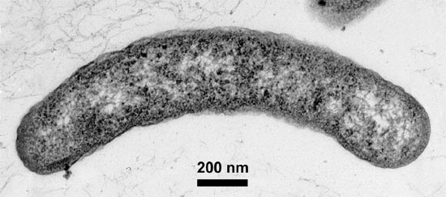
ARCOBACTER INFECTİONS

Slide 36
General Features
Gram negative, curved rods or helical shape
Spore-free and without capsules
Motile with a single polar flagella
Differentiate from Campylobacter species by growing under aerobic conditions at 15 ° C
Oxidase and catalase positives

Slide 37
Important Species and Diseases
A. cryaerophilus:Abortion in cattle, sheep and pig
A. skirrowi: Abortion in cattle, sheep and pig
A.butzleri: Abortion in pig
A. nitrofigilis

Slide 38
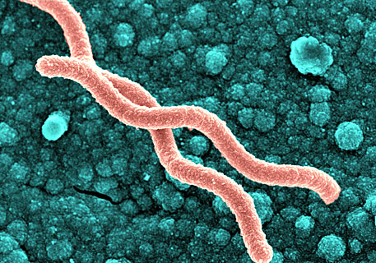
HELİCOBACTER Infections

Slide 39
General Features I
Helical and spiral-shaped bacteria that cause inflammatory changes especially in stomach of human and various animals
They do not conform to in vitro conditions
For this reason, they are not found in soil and water

Slide 40
General Features II
Gram negative
Comma, "S" or spiral-shaped
Motile with polarized polar flagellas
Without spore, without capsules
Microaerophilic
Non-fermentative bacteria

Slide 41
General Features III
Amino acid, blood and serum are added into the media
Optimum temperature at 37 ° C, 4-14 days
Oxidase, catalase and urease are positive
Gastric Helicobacters have strong urease activity and can be placed in the acidic stomach environment

Slide 42
Important Species
30 species of Helicobacter have been found in humans and animals, some of them have been adapted to the liver and some have been adapted to intestine-liver
H. pylori
H. felis
H. heilmannii
H. bizzozeronii
H. rappini
H. salomonis
H. canis
H. muridarum
H. cinaedi
H. fennelliae
H. hepaticus
Adapted to stomach important species
Adapted to intestine-liver important species

Slide 43
Helicobacter pylori infetions
It is associated with chronic active gastritis, peptic ulcer and stomach cancer in humans
Carries general characteristics of Helicobacter genus
Can not ferment carbohydrates
Enriched brain-heart infusion agar with blood or serum supplementation and Brucella agar can be used at at 37 ° C under microaerobic condition containing 5% O2, 7% CO2 and 88% H2
Colonies are "S" typed, transparent, convex smooth edges
Resistant to Polymyxin, Vancomycin, Trimethoprim

Slide 44
Epidemiology
The most common pathogen in human populations
Isolated from cats
Individuals with infection and latent infection
It usually enters the body in pre-adulthood and occurs in adulthood
It is more common in crowded families
Transmission is by oral-oral route
Morbidity high
Mortality low

Slide 45
Patogenesis
Several virulence factors such as urease, anti-acid protein, catalase, musinase, flagella, hemaglutinin, cytotoxin, lipase, phospholipase play roles in the pathogenesis
Urease enzyme and anti-acid protein protect the agent from stomach acidity
Spiral-shaped, active movement and the mucinase enzyme allow the bacteria to pass through the mucous layer

Slide 46
Clinical Symptoms
Human: Chronic active gastritis, gastric or duedenal ulcer, loss of weigh, heartburn, stomach pain and stomach cramps, vomiting and stomach bleeding
Cat: Restlessness, loss of weigh, vomiting and weakness

Slide 47
Diagnosis
Clinical symptoms:
Undiagnosed
Necropsy findings:
Usually stomach biopsy is taken, mucosal thickening, abnormal mucus accumulation, diffuse hyperemia, lymphoid hyperplasia and cell infiltration

Slide 48
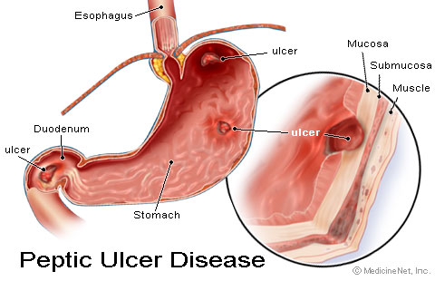
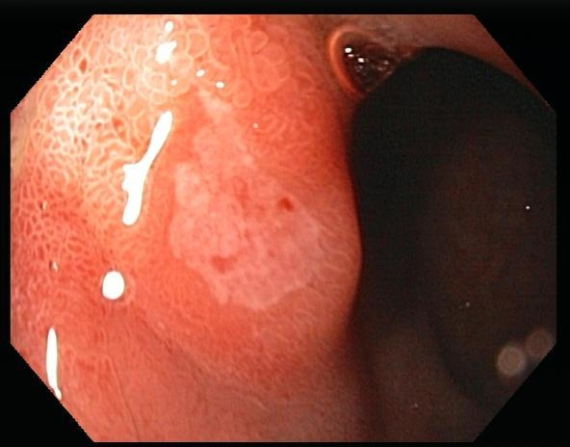
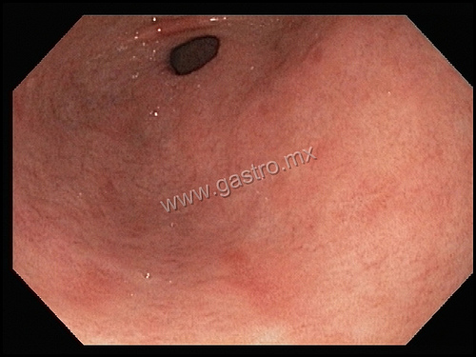

Slide 49
Laboratory Diagnosis
Bacterioscopy:
Microaerobic condition at 37°C, 5-7 days incubation
Helical shaped bacteria with Gram, Giemsa, Steiner, Warthin Starry and Fontana stain prepared from stomach samples
Culture:
Gastric samples are cultured on Skirrow selective medium with antibiotic supplement and containing 7% defibrinated horse blood
Incubated at 37°C for 5-7 days

Slide 50
Rapid urease test:
A small piece of stomach tissue is placed in the broth with urea and changes in indicator color are detected within 2-3 hours
Molecular diagnosis:
For direct diagnosis from biopsy samples urease, 16S rRNA, cagA or specific PCR to other gene regions are performed

Slide 51
H. felis Infections
H. felis causes chronic active gastritis in cats and dogs
It has similar characteristics to Helicobacter genus

Slide 52
Types of Entero-Hepatic Helicobacter
H. canis enteritis and hepatitis in dogs
H. muridarum gastritis in rodents
H. cinaedi human proctitise, sepsis, meningitise
H. fennelliae human
H. hepaticus chronic hepatitis in mice
H. pametensis wild birds and in pigs in the bowel
H. pullorum chickens, zoonotic, in situ gastroenteritis

