Slide 1
Yükselmiş kıyılarda aşınım ve birikim şekilleri
11. Hafta

Slide 2
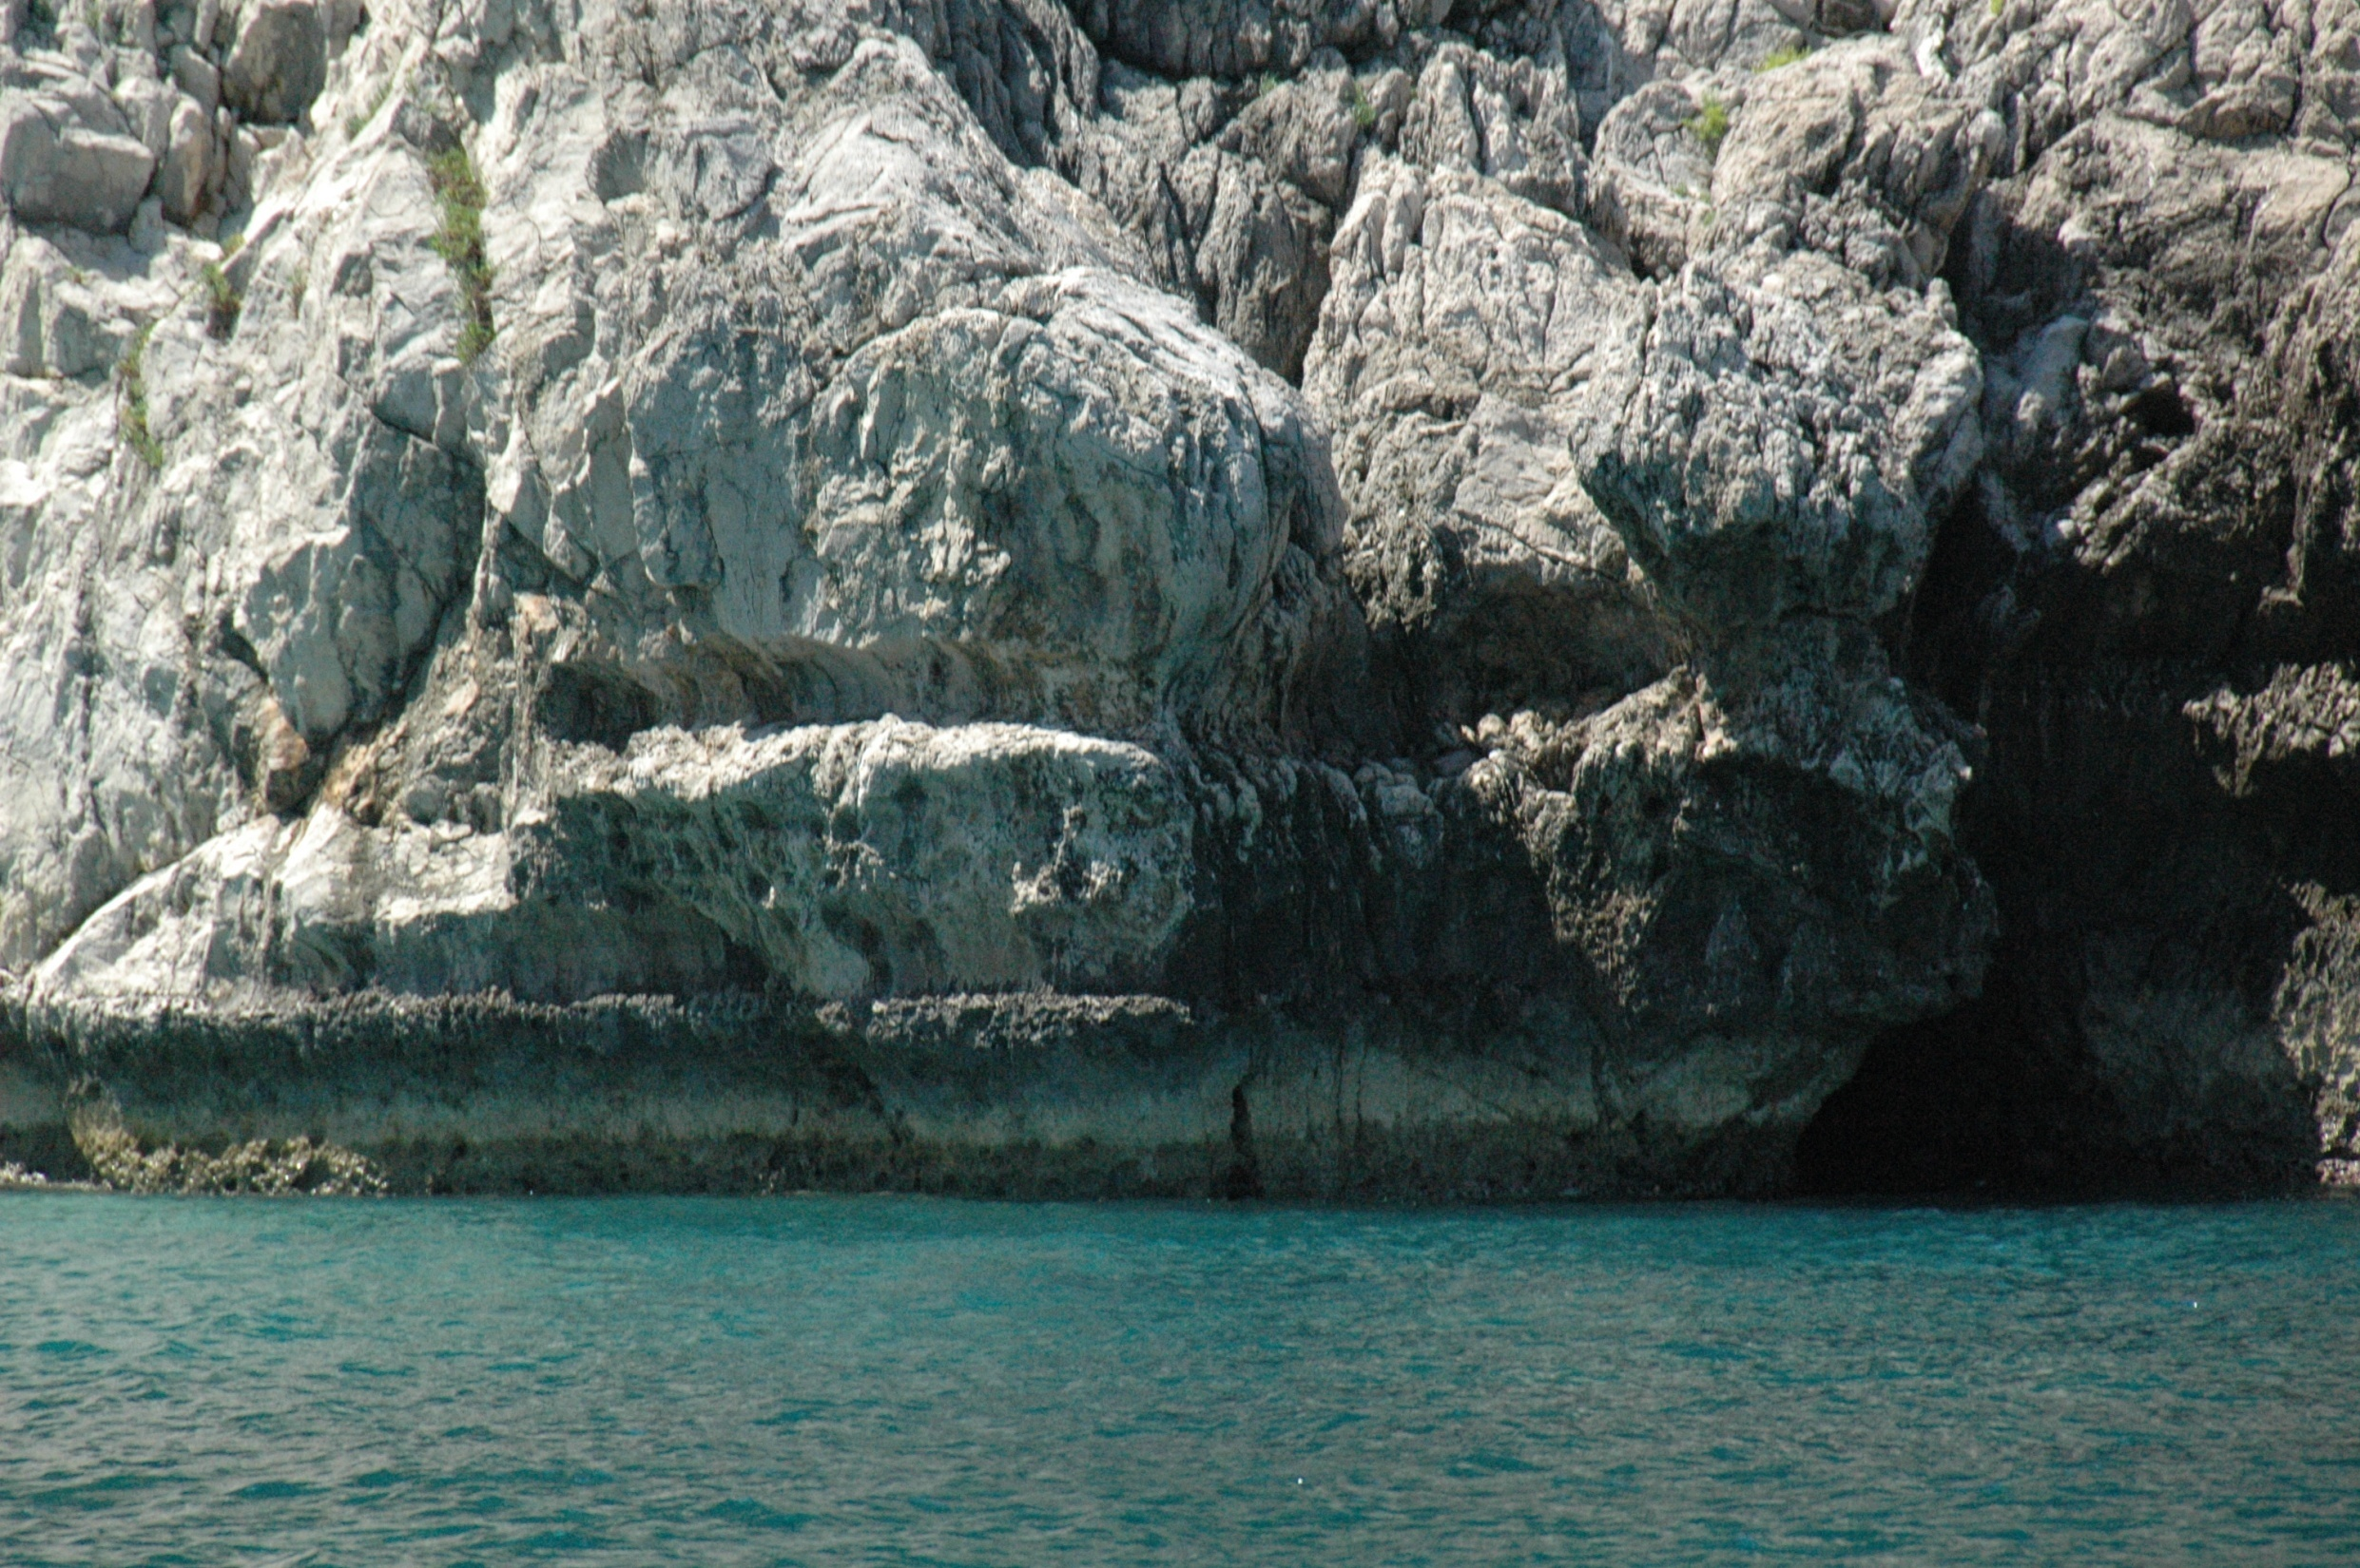
Güncel Dendropoma reef’i (rim)

Slide 3
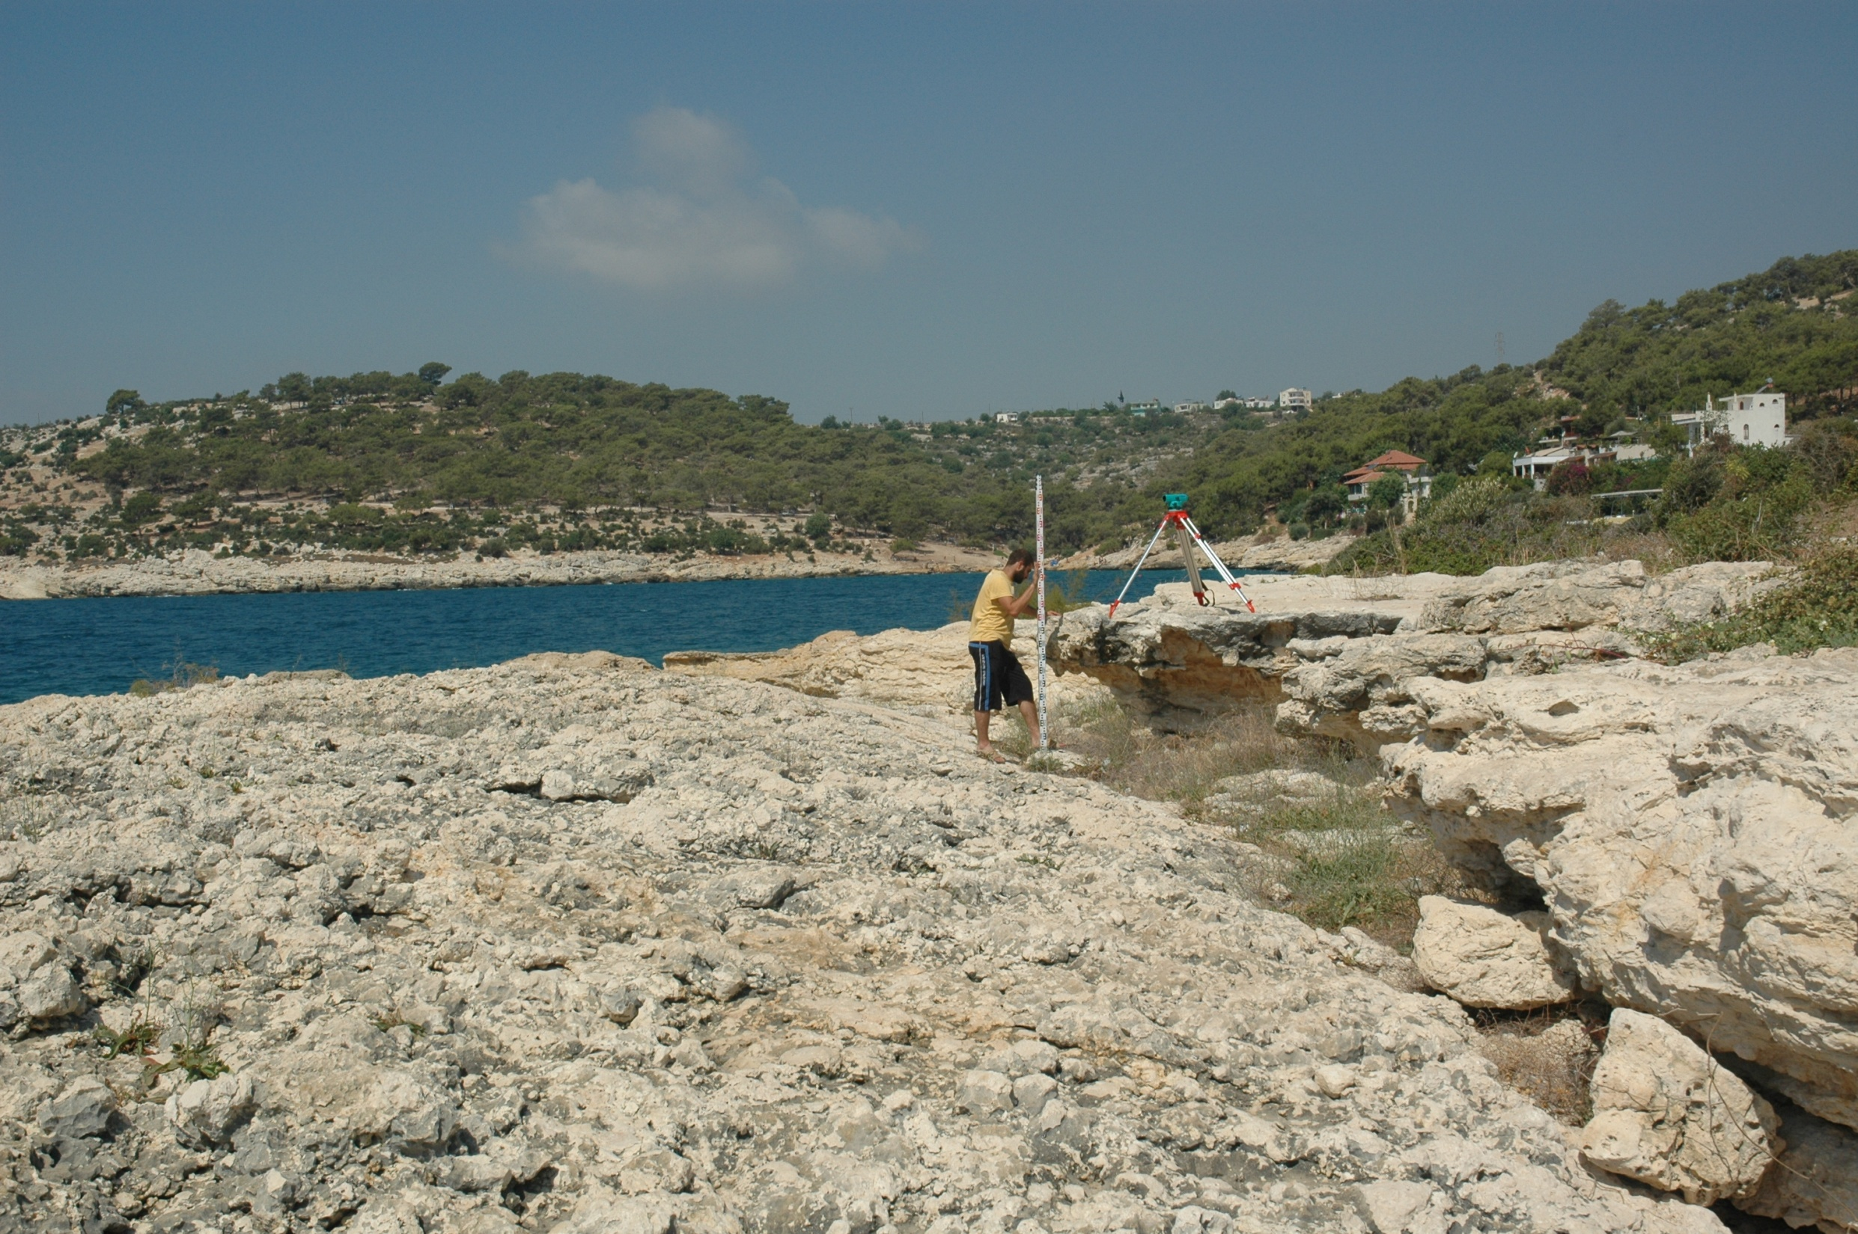

Slide 4
Doğan, U., Koçyiğit, A., Varol, B., Özer, İ., Molodkov, A., Zöhra, A., 2012. MIS 5a and MIS 3 relatively high sea-level stands on the Hatay-Samandağ Coast,Eastern Mediterranean, Turkey. Quaternary International 262, 65-79.

Slide 5
Doğan, U., Koçyiğit, A., Varol, B., Özer, İ., Molodkov, A., Zöhra, A., 2012. MIS 5a and MIS 3 relatively high sea-level stands on the Hatay-Samandağ Coast,Eastern Mediterranean, Turkey. Quaternary International 262, 65-79.

Slide 6
Doğan, U., Koçyiğit, A., Varol, B., Özer, İ., Molodkov, A., Zöhra, A., 2012. MIS 5a and MIS 3 relatively high sea-level stands on the Hatay-Samandağ Coast,Eastern Mediterranean, Turkey. Quaternary International 262, 65-79.

