Slide 1
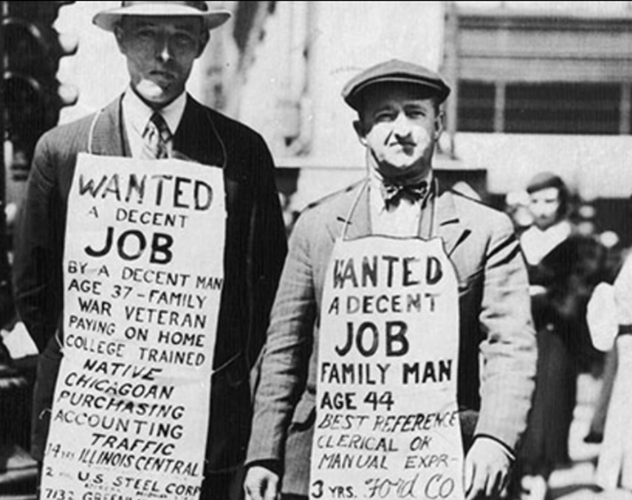
The Great Depression (1929-1939)
AKE 118 Dr. Gamze Kati Gumus

Slide 2
The Great Bull Market Crashes…
With the rising prospects of the Roaring 20s, some Americans invested in the stock market.
However, on October 1929, people started to sell their stocks, no longer confident about the financial gain it would provide.
This sudden change led to the crash of the Great Bull market, which eventually triggered the Great Depression.

Slide 3
As a result…
Consumption dropped
Business retrenched.
Marginal enterprises in farming, banking, and business went bankrupt.
Labor income, salaries, national income, industrial production, manufacturing wages, dividends and farm incomes fell.

Slide 4
Why Was Depression that devastating?
By 1929, there was a maldistribution of income between workers+farmers and industrialists.
This reduced consumer purchasing power and the demand for manufactured goods.
Construction and auto making industries reduced production.
This caused cutbacks in other industries and led to a downturn in the economy.
Monetary, tariff and federal tax policies of the government favored special business interests over national ones.
Faulty banking system
Excesses in consumer credit

Slide 5
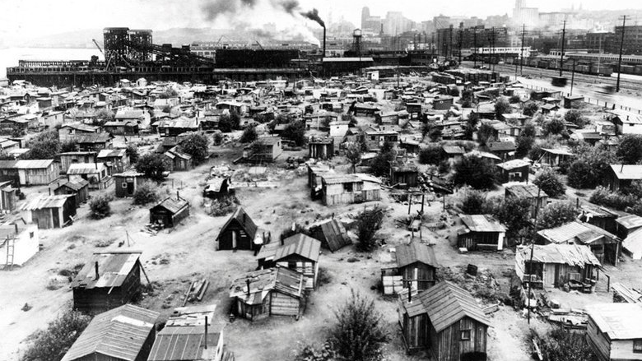
The Great Depression
When banks failed, the life savings were lost, leaving many Americans destitute.
With no job and no savings, thousands of Americans lost their homes.
The poor congregated in cardboard shacks in so-called Hoovervilles on the edges of cities across the nation; hundreds of thousands of the unemployed roamed the country on foot and in boxcars in futile search of jobs.
Although few starved, hunger and malnutrition affected many; soup kitchens and bread lines could be found in every US city.

Slide 6
Al Capone’s Soup Kitchen

Slide 9
Average Unemployment Rate
1879-89: 8 percent
1889-99: 10 percent
1899-1909: 4 percent
1909-19: 4 percent
1919-29: 4 percent
1929-39: 18 percent
1939-49: 5 percent
1949-59: 4 percent
1959-69: 5 percent
1969-79: 6 percent
Notes:
https://www.gilderlehrman.org/history-resources/teaching-resource/statistics-impact-depression

Slide 10
The Great Depression
By 1933, when the Great Depression reached its lowest point, some 15 million Americans were unemployed.
Notes:
https://www.history.com/topics/great-depression/great-depression-history

Slide 11
Life expectancy at birth (years, right scale), unemployment rate (percentage unemployed among the civilian labor force, left scale), and economic growth (annual percentage growth of real GDP, left scale), United States, 1920–1940.
Notes:
https://www.pnas.org/content/106/41/17290

Slide 12
Life expectancy at birth (years), for males and females, and whites and nonwhites.
Notes:
https://www.pnas.org/content/106/41/17290

Slide 13
Crude mortality rate (per 100,000 population) for selected major causes of death.
Notes:
https://www.pnas.org/content/106/41/17290

Slide 14
POLITICS
Herbert Hoover’s administration was replaced by Franklin Delano Roosevelt, who served three terms of presidency, and led the US through the Great Depression and WWII.

Slide 15
THE HUNDRED DAYS AND THE NEW DEAL
When FDR took his office, he started his new deal through the establishment of 15 major laws that helped the country to get back to its feet.

Slide 16
Through the Establishment of the National Recovery Administration (NRA)
The FDR administration
fostered a national pattern of maximum hours and minimum wages
eliminated child labor and sweatshops
gave jobs to 2 million people
reduced business competition that harmed the economy

Slide 17
Through the Establishment of the Agricultural Adjustment Administration (AAA)
The FDR administration
paid cash relief to farmers to plow under their crops and slaughter their livestock
To plow under: to bury (crops or vegetation) by plowing, so as to enrich the soil or in seeking to prevent overproduction
each farmer was expected to grow a particular crop to reduce production by a nationally fixed percentage
This helped to rise the gross farm income and reduce rural debt

Slide 18
Through the Establishment of the Federal Deposit Insurance Corporation (FDIC)
The FDR administration
guaranteed that ordinary citizens would not lose their savings if a bank failed

Slide 19
THE NEW DEAL
Although the New Deal brought some relief to Americans and American economy suffering from Depression, it did not provide a full recovery.
One of the reasons behind this failure was the drought on the Great Plains.

Slide 20
THE DUST BOWL

Slide 21
THE DUST BOWL
The acts below led to a massive influx of new and inexperienced farmers across the Great Plains:
The Homestead Act of 1862
provided settlers with 160 acres of public land
The Kinkaid Act of 1904
The Enlarged Homestead Act of 1909.
Notes:
https://www.history.com/topics/great-depression/dust-bowl

Slide 22
THE DUST BOWL
Many of these late nineteenth and early twentieth century settlers lived by the superstition “rain follows the plow.” Emigrants, land speculators, politicians and even some scientists believed that homesteading and agriculture would permanently affect the climate of the semi-arid Great Plains region, making it more conducive to farming.
Notes:
https://www.history.com/topics/great-depression/dust-bowl

Slide 23
THE DUST BOWL
This false belief was linked to Manifest Destiny—an attitude that Americans had a sacred duty to expand west.
A series of wet years during the period created further misunderstanding of the region’s ecology and led to the intensive cultivation of increasingly marginal lands that couldn’t be reached by irrigation.
Notes:
https://www.history.com/topics/great-depression/dust-bowl

Slide 24
THE DUST BOWL
Rising wheat prices in the 1910s and 1920s and increased demand for wheat from Europe during World War I encouraged farmers to plow up millions of acres of native grassland to plant wheat, corn and other row crops.
But as the United States entered the Great Depression, wheat prices plummeted.
Farmers tore up even more grassland in an attempt to harvest a bumper crop and break even.
Notes:
https://www.history.com/topics/great-depression/dust-bowl

Slide 25
THE DUST BOWL
Crops began to fail with the onset of drought in 1931, exposing the bare, over-plowed farmland.
Without deep-rooted prairie grasses to hold the soil in place, it began to blow away. Eroding soil led to massive dust storms and economic devastation—especially in the Southern Plains.
Notes:
https://www.history.com/topics/great-depression/dust-bowl

Slide 26
THE DUST BOWL
1930
The Dust Bowl, also known as “the Dirty Thirties,” started in 1930 and lasted for about a decade, but its long-term economic impacts on the region lingered much longer.
1930
Severe drought hit the Midwest and Southern Great Plains in 1930. Massive dust storms began in 1931. A series of drought years followed.
1934
By 1934, an estimated 35 million acres of formerly cultivated land had been rendered useless for farming, while another 125 million acres—an area roughly three-quarters the size of Texas—was rapidly losing its topsoil.
Notes:
https://www.history.com/topics/great-depression/dust-bowl

Slide 27
THE DUST BOWL
Regular rainfall returned to the region by the end of 1939, bringing the Dust Bowl years to a close.
The economic effects, however, persisted. Population declines in the worst-hit counties—where the agricultural value of the land failed to recover—continued well into the 1950s.
Notes:
https://www.history.com/topics/great-depression/dust-bowl

Slide 28
BLACK BLIZZARDS
During the Dust Bowl period, severe dust storms, often called “black blizzards” swept the Great Plains. Some of these carried Great Plains topsoil as far east as Washington, D.C. and New York City, and coated ships in the Atlantic Ocean with dust.
Billowing clouds of dust would darken the sky, sometimes for days at a time. In many places, the dust drifted like snow and residents had to clear it with shovels. Dust worked its way through the cracks of even well-sealed homes, leaving a coating on food, skin and furniture.
Some people developed “dust pneumonia” and experienced chest pain and difficulty breathing. It’s unclear exactly how many people may have died from the condition. Estimates range from hundreds to several thousand people.
Notes:
https://www.history.com/topics/great-depression/dust-bowl

Slide 29
BLACK BLIZZARDS
The worst dust storm occurred on April 14, 1935. News reports called the event Black Sunday. A wall of blowing sand and dust started in the Oklahoma Panhandle and spread east. As many as three million tons of topsoil are estimated to have blown off the Great Plains during Black Sunday.
An Associated Press news report coined the term “Dust Bowl” after the Black Sunday dust storm.
Notes:
https://www.history.com/topics/great-depression/dust-bowl

Slide 37
Great Depression Worldwide
The economic troubles of the 1930s were worldwide in scope and effect. Economic instability led to political instability in many parts of the world.
Political chaos, in turn, gave rise to dictatorial regimes such as Adolf Hitler's in Germany and the military's in Japan.
These regimes pushed the world ever-closer to war in the 1930s. When world war finally broke out in both Europe and Asia, the United States tried to avoid being drawn into the conflict.

Slide 38
Brother, can you spare a dime?
They used to tell me I was building a dream And so I followed the mob When there was earth to plow or guns to bear I was always there right on the job
They used to tell me I was building a dream With peace and glory ahead Why should I be standing in line Just waiting for bread?
Once I built a railroad, I made it run Made it race against time Once I built a railroad, now it's done Brother, can you spare a dime?
Once I built a tower up to the sun Brick and rivet and lime Once I built a tower, now it's done Brother, can you spare a dime?
Once in khaki suits, gee we looked swell Full of that yankee doodly dum Half a million boots went sloggin' through hell And I was the kid with the drum
Say, don't you remember, they called me Al It was Al all the time Why don't you…

