Slide 1
AVIAN PHYSIOLOGY The Cardiovascular System
Doç. Dr. Dr. Yasemin SALGIRLI DEMİRBAŞ
Resident ECAWBM (BM)

Slide 2
INTRODUCTION
Modern birds are derived from theropod dinosaurs,
Mammals have descended from a group of carnivorous reptiles, the cynodonts.
These ancestral lines originated in the Triassic period more than 200 million years ago,
In evolutionary terms avian and mammalian stocks have been separated for a substantial period of time.

Slide 3
INTRODUCTION
Significant differences in cardiovascular structure and function have arisen in the two groups,
A number of similarities in their circulatory systems are also evident.
Such similarities probably represent;
the conservation of characteristics common to organisms ancestral to the two groups,
a shared endothermic phenotype,
and the results of convergent evolution once the stocks had divided.
Notes:
As one might expect, significant differences in cardiovascular structure and function have arisen in the two groups since their separation, yet a number of similarities in their circulatory systems are also evident.
Such similarities probably represent both the conservation of characteristics common to organisms ancestral to the two groups, a shared endothermic phenotype, and the results of convergent evolution once the stocks had divided.

Slide 4
HEART
is a four-chambered, muscular fluid pump that intermittently pressurizes the central arteries,
The right ventricle pressurizes the pulmonary circulation
The left ventricle pressurizes the systemic circulation.
The pressure differential between the central mean arterial pressure and the central venous pressure drives blood flow
Notes:
The avian heart, like that of the mammal, is a four-chambered, muscular fluid pump that intermittently pressurizes the central arteries, inducing blood flow to the capillary beds of both the systemic and pulmonary circulations.
Functionally, these circuits lie in series with each other, and blood returns to the heart to be pressurized before entering either circuit.

Slide 5
HEART
The left and right atria receive blood at central venous pressure before it enters the ventricles.
These chambers probably function more as blood reservoirs for their respective ventricles
The difference in ventricular pressure is reflected in the anatomy of the ventricles
Myocardium of the right ventricle being thinner than that of the more powerful left ventricle
Notes:
The left and right atria receive blood at central venous pressure before it enters the ventricles.
In common with the atria of mammals, these chambers probably function more as blood reservoirs for their respective ventricles than as important “ superchargers” for ventricular pressure.
The difference in ventricular pressure is reflected in the gross anatomy of the ventricles, with the myocardium of the right ventricle being thinner than that of the more powerful left ventricle

Slide 6
HEART
The heart is located in the cranial part of the common thoracoabdominal cavity, with its long axis slightly to the right of the midline.
It is partly enclosed dorsally and laterally by the lobes of the liver.
A very thin, but tough, fibrous pericardial sac encloses the heart.
This sac contains a small volume of serous fluid that provides lubrication for the rhythmic motion of the cardiac contraction cycle.

Slide 7
Cardiac Variables
The avian heart is cone-shaped,
A muscular flap separates the right atrium and ventricle.
The muscle flap is a continuation of muscle from the right ventricle wall.
Other valves are similar to the mammalian heart.
A cartilaginous plaque is found in the wall of the aorta where the major vessels leave the heart.
Notes:
The avian heart is cone-shaped,
A muscular flap rather than mammalian type valves separates the right atrium and ventricle.
The muscle flap is a continuation of muscle from the right ventricle wall. Hypertrophy of the RV Wall results in thickening of the valve and leads to valvular insufficiency.
Other valves are similar to the mammalian heart.
A cartilaginous plaque is found in the wall of the aorta where the major vessels leave the heart.
Lymphoid foci and foci of extramedullary granulopoiesis are common in the myocardium of broilers
Birds have a renal portal system and the kidney has no capsule.
In turkeys, if there is sudden failure of forward flow through the kidney, blood returning from the legs may pool around the lobules and on the ventral surface of the kidney (2).

Slide 8
Cardiac Variables
The ventricles of the bird heart have more muscle mass and less chamber space than those of a human.
Externally, the ventricles appear more slender and pointed than in a human heart.
The inside walls of the atria and ventricles are much smoother than those of the human
Notes:
The avian heart is cone-shaped,
A muscular flap rather than mammalian type valves separates the right atrium and ventricle.
The muscle flap is a continuation of muscle from the right ventricle wall. Hypertrophy of the RV Wall results in thickening of the valve and leads to valvular insufficiency.
Other valves are similar to the mammalian heart.
A cartilaginous plaque is found in the wall of the aorta where the major vessels leave the heart.
Lymphoid foci and foci of extramedullary granulopoiesis are common in the myocardium of broilers
Birds have a renal portal system and the kidney has no capsule.
In turkeys, if there is sudden failure of forward flow through the kidney, blood returning from the legs may pool around the lobules and on the ventral surface of the kidney (2).

Slide 9
Cardiac Variables
Lymphoid foci and foci of extramedullary granulopoiesis are common in the myocardium of broilers
Birds have a renal portal system and the kidney has no capsule.
In turkeys, if there is sudden failure of forward flow through the kidney, blood returning from the legs may pool around the lobules and on the ventral surface of the kidney.
Notes:
The avian heart is cone-shaped,
A muscular flap rather than mammalian type valves separates the right atrium and ventricle.
The muscle flap is a continuation of muscle from the right ventricle wall. Hypertrophy of the RV Wall results in thickening of the valve and leads to valvular insufficiency.
Other valves are similar to the mammalian heart.
A cartilaginous plaque is found in the wall of the aorta where the major vessels leave the heart.
Lymphoid foci and foci of extramedullary granulopoiesis are common in the myocardium of broilers
Birds have a renal portal system and the kidney has no capsule.
In turkeys, if there is sudden failure of forward flow through the kidney, blood returning from the legs may pool around the lobules and on the ventral surface of the kidney (2).

Slide 10
Heart Size and Cardiac Output
Birds of a given body mass have a significantly heavier heart.
This may be due to the high aerobic power input needed to sustain flapping flight.
Furthermore, in birds the exponent denoting proportionality is significantly less than 1.
This means that larger birds like swans, ducks, and geese tend to have proportionally smaller hearts in relation to their body mass than do smaller birds.
Notes:
When compared with mammals, birds of a given body mass have a significantly heavier heart.
This may be due to the high aerobic power input needed to sustain flapping flight.
Furthermore, unlike mammals, in which heart mass is almost directly proportional to body mass, in birds the exponent denoting proportionality is significantly less than 1.
This means that larger birds like swans, ducks, and geese tend to have proportionally smaller hearts in relation to their body mass than do smaller birds.

Slide 11
Heart Size and Cardiac Output
In a number of migrating species, the heart becomes hypertrophic before migration.
Migrating birds may have the genetic potential to increase heart size, and therefore CO,
through either seasonal humoral mechanisms
or in the long term through natural selection.
Hummingbirds have proportionally larger hearts than all other birds, probably reflecting the high aerobic demands of hovering flight.

Slide 12
Heart Size and Cardiac Output
Heart mass as a fraction of body mass may also be age dependent.
Prior to hatching, the ventricle of Pekin ducks (Anas platyrhynchos) represents about 0.4% of body mass and increases significantly upon hatching to 0.75% of body mass.
This increase in heart mass coincides with an increase in aerobic capacity of the hatchling.
Similar increases have been observed in the chicken and northern bobwhite quail (Colinus virginianus) after hatching.

Slide 13
Heart Size and Cardiac Output
The heart rate of birds is quite variable and dependent on body size, level of activity, and special physiologic needs.
Rapid heart rates in combination with large heart sizes contribute to higher cardiac outputs when compared with mammals.
Total peripheral resistance in birds is lower than in mammals; thus, a higher arterial pressure is needed to maintain a high cardiac output.

Slide 14
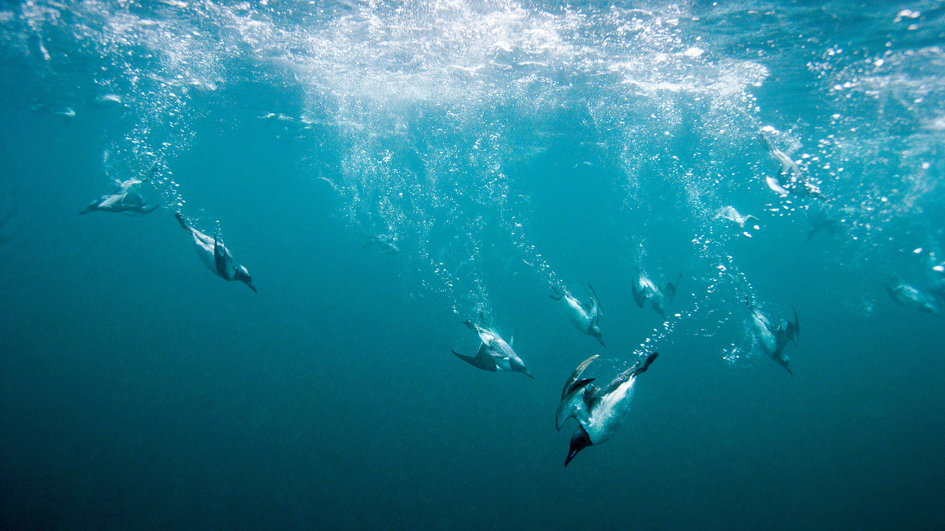
Diving reflex
In diving mammals and birds, reflex bradycardia and vasoconstriction occur when the nostrils are submerged in water*.
The magnitude of the reflex response increases as water temperature decreases.
Blood flow to skeletal muscles and other tissues is thus restricted so that most of the blood flow is channeled to the heart and brain, conserving oxygen for these vital organs.
Arteriovenous shunts in the skin remain patent, allowing a small venous return of blood that has not lost oxygen within the tissues.
When the animal resurfaces, these changes are reversed; cardiac output and muscle blood flow promptly increase, the accumulated oxygen debt is repaid, and metabolites are removed from the muscles and other tissues that were poorly perfused.
*The afferent limb of the reflex is in the trigeminal nerve (cranial nerve V) and the initial response to submersion is vagally mediated bradycardia, followed by increased sympathetic nerve activity and peripheral vasoconstriction.

