Slide 1
Plant Morphology

Slide 9
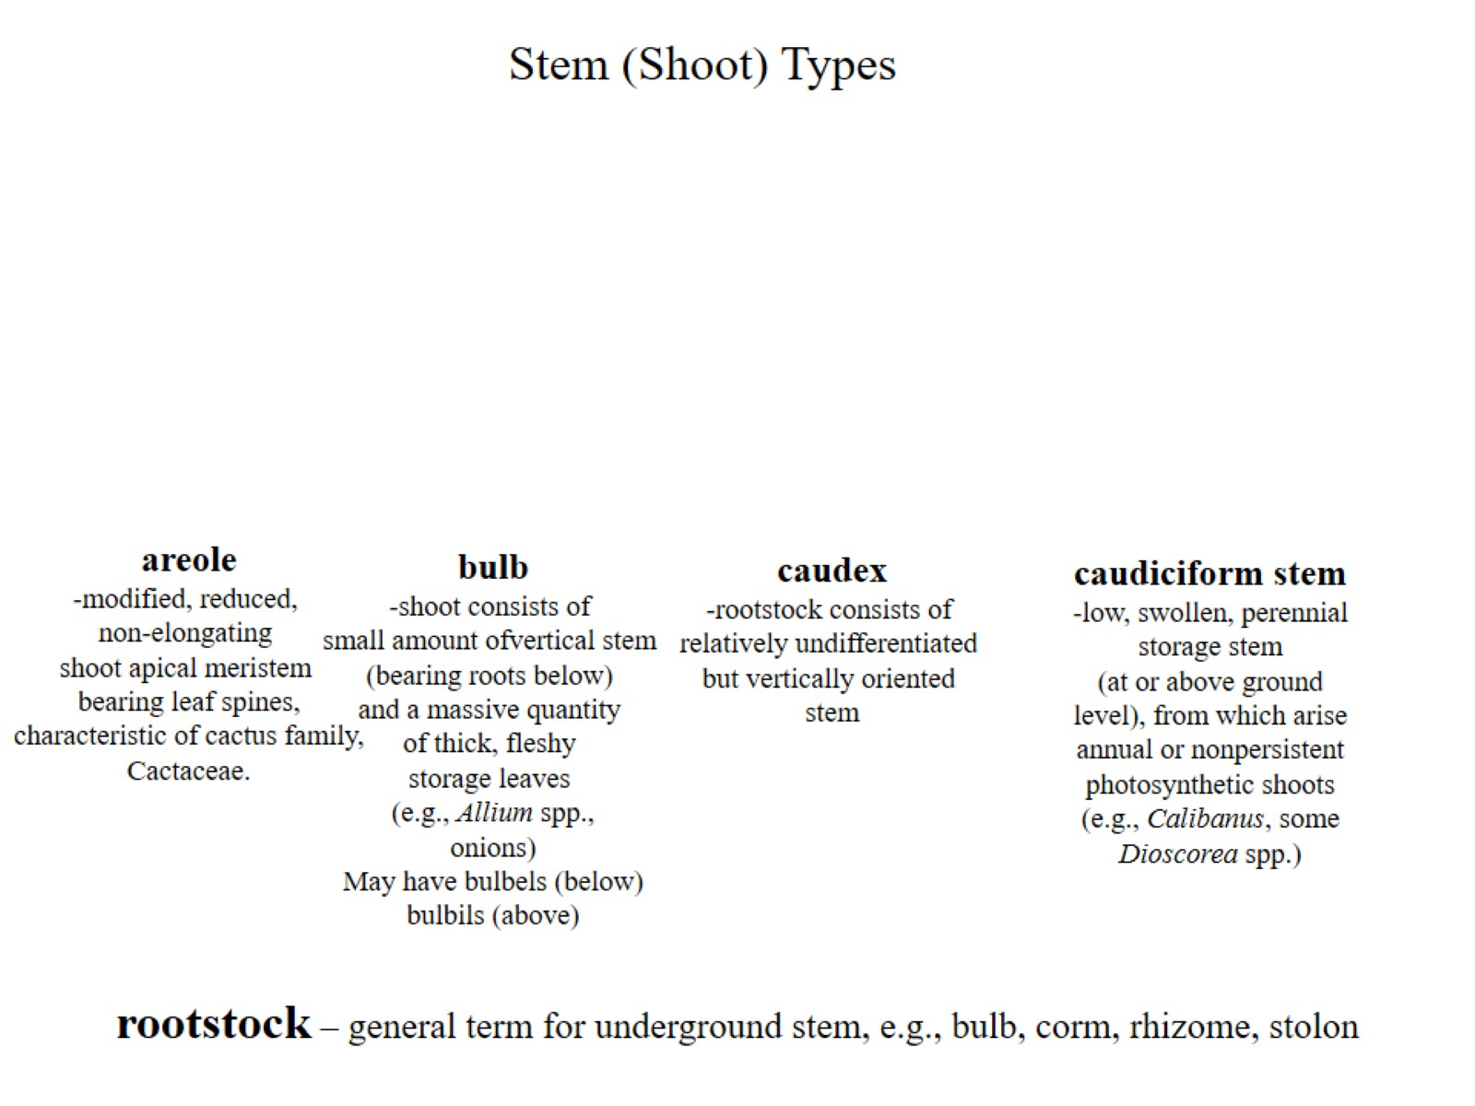

Slide 12
Flower

