Slide 1
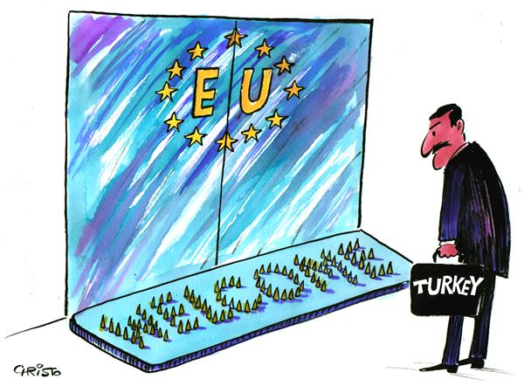
HISTORICAL DEVELOPMENT OF TURKEY-EU RELATIONS
CHAPTER 4
Res. Assist. PhD. Arzu Gökdai

Slide 2
The European Economic
Community (EEC) that described as the biggest peace project in human history, shortly after its establishment in 1957, Turkey has been applied for partnership with the Community in 31 July 1959.

Slide 3
What were the reasons for applying to EEC?
to continue westernization and modernization efforts
to get rid of political and economic isolation and the pressure of the Soviet Union during the cold war period
to support its place in the Western Block with economic integration
the search for balance against the USA
to benefit from the assistance of the European Economic Community and maintaining its current market share in the member states of the European Economic Community
to prevent attempts against Greece in Europe

Slide 4
Our request for full membership was rejected on the grounds that Turkey's level of development is not sufficient to fulfill the requirements of full membership.
However, it was proposed to sign a partnership agreement that will be valid until full membership conditions were met.
In this context, "the Ankara Agreement” which opens a way for Turkey to join as a full member status was signed in Ankara on 12 September 1963 and entered into force on 1 December 1964.

Slide 5
Thus Turkey has become the second country that partner with the Community after Greece !!

Slide 6
Ankara Agreement (1963)
Main text: The purpose of the partnership relations, customs union, agriculture, goods, persons, free movement of capital and services, transport, competition, harmonization of economic and trade policies with legislation, partnership institutions, Turkey's full membership opportunities, resolution of disputes that may arise in the partnership relations

Slide 7
Ankara Agreement's objective is to ensure Turkey's integration into the Community.

Slide 8
Ankara Agreement
Economic purpose:
to ensure the accelerated development of Turkey's economy and to raise the level of employment and living conditions of Turkish people.
to encourage continuous and balanced strengthening of commercial and economic relations between the parties

Slide 9
Ankara Agreement
Political purpose
To establish increasingly tight connections between the Turkish people and the peoples that come together within the European Economic Community.

Slide 10
Ankara Agreement
Thus this treaty can be called "partnership agreement that leads to full membership".
such a treaty in the European Union practices, not signed with any country except Turkey and Greece.

Slide 11
Treaty Periods
Preparatory period (forming the first phase of the partnership)
It is the period when the Turkish economy will be prepared for the customs union to be established between the parties. This period started on 1 December 1964, when the agreement entered into force.

Slide 12
Treaty Periods
Transition Period: With the end of the “preparatory period”, the “Additional Protocol” signed on November 13, 1970 and entered into force in 1973, determined the provisions of the transition period and the obligations to be undertaken by the parties.
"Transition period" aimed to gradually place the Customs Union between Turkey and EU!

Slide 13
Treaty Periods
Last period of partnership
It will be based on the Customs Union and will strengthen the coordination between the economic and social policies of the parties.

Slide 14
Since the Ankara treaty stipulates an ongoing legal relationship, it was decided to implement the partnership regime and to establish a partnership council where the parties could come together.

