Slide 1
System Suitability Parameters
The system suitability parameters which are generally accepted by regulatory authorities and independent auditor are depicted below:

Slide 2
• Peak retention time,
• Peak area,
• Amount,
• Peak height,
• Peak width at half height,
• Peak symmetry,
• Peak tailing,
• Capacity factor (k´),
• Plate numbers,
• Resolution between peaks,
• Selectivity relative to preceding peak

Slide 3
Peak symmetry and tailing factor
Our treatment of chromatography in this section assumes that a solute elutes as a symmetrical Gaussian peak, such as that shown in Figure 1 as dotted line. This ideal behaviour occurs when the solute’s partition coefficient, KD is the same for all concentrations of solute

Slide 4
KD = [Ss ] / [Sm] [S]
s= concentration of solute in the stationary phase, and [S]m = concentration of in the mobile phase, If this is not the same, then the chromatographic peak has an asymmetric peak shape similar to those shown in (Figure 1a).

Slide 5
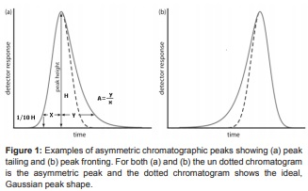

Slide 6
The chromatographic peak in Figure 1a is an example of peak tailing,
which occurs when some sites on the stationary phase retain the solute more strongly than other sites. (Figure 1b), which is an example of peak fronting is most often the result of overloading the column with sample. As shown in (Figure 1a), we can report a peak’s asymmetry by drawing a horizontal line at 10% of the peak’s maximum height and measuring the distance from each side of the peak to a line drawn vertically through the peak’s maximum. The asymmetry factor, A, is defined as

Slide 7
A= y / x
The Tailing Factor is defined by the USP as the distance from the front edge of the peak to the back edge, divided by the distance from the front edge to the centreline, with all distances measured at 5% of the maximum peak height (Figure 2). Peak Tailing (T) can be expressed as
T =(x+y)/2x

Slide 8
Capacity factor (k)
Theory of HPLC retention based on the adsorption from solutions can help to establish the relationships of measurable retention values (VR, tR, and k’) with the thermodynamic parameters, such as adsorption equilibrium constant (K), or free Gibbs energy ( ∆G ). Capacity factor is the ratio of the reduced retention volume to the dead volume:

