Slide 1
Fluid Theraphy
Assoc. Prof.Dr. Murat ÇALIŞKAN

Slide 2
Fluid therapy in clinical medicine is used to fulfill the following objectives:
(1) to replace dehydration deficits,
(2) to maintain normal hydration,
(3) to replace essential electrolytes and nutrients, and
(4) to serve as a vehicle for the infusions of certain intravenous medications

Slide 3
ROUTES OF ADMINISTRATION
In general, fluids can be given by the following routes:
(1) oral,
(2) subcutaneous,
(3) intraperitoneal,
(4) intravenous, and
(5) intraosseous.

Slide 4
İntravenous -iv
Intravenous infusion is the preferred means of delivering fluids to severely dehydrated animals and medium to large dogs.
It allows for a controlled delivery rate to meet the patient's changing needs. Intravenous treatment requires the insertion of a cannula into a vein using sterile technique and the subsequent sterile maintenance of the intravenous delivery system.
The more common complications include phlebitis, catheter sepsis, fluid overload, and the inadvertent flow of fluid into the surrounding perivascular subcutaneous tissue
Intravenous catheters should be changed and rotated to another site every 72 hours in order to avoid most of these iatrogenic complications.
.

Slide 5
İntraosseus -io
Intraosseous fluid therapy is a preferred route for animals weighing less than 5 kg when the intravenous approach is impossible.
Actually, because of the bone marrow's direct access to the systemic circulation, it can be considered as a large rigid vein through which most medications can be safely delivered.
The intraosseous method for fluid therapy is a safe and efficacious route in the critically ill patien

Slide 6
Determining the Route of Fluid Administration

Slide 7
Recommended Maintenance Fluid Rates (mL/kg/hr)

Slide 8
Changes in Fluid Volume
The physical exam will help determine if the patient has
whole body fluid loss (e.g., dehydration in patients with renal disease),
vascular space fluid loss (e.g., hypovolemia due to blood loss), or
hypervolemia (e.g., heart disease, iatrogenic fluid overload).
Acute renal failure patients, if oliguric/anuric, may be hypervolemic, and if the patient is polyuric they may become hypovolemic.
Reassessment of response to fluid therapy will help refine the determination of which fluid compartment (intravascular or extravascular) has the deficit or excess.

Slide 9
Dehydration
Estimating the percent dehydration gives the clinician a guide in initial fluid volume needs; however, it must be considered an estimation only and can be grossly inaccurate due to comorbid conditions such as age and nutritional status
Fluid deficit calculation:
Body weight (kg) 3 % dehydration 1⁄4 volume (L) to correct

Slide 10
Dehydration Assessment

Slide 11
Hypovolemia
Hypovolemia refers to a decreased volume of fluid in the vascular system with or without whole body fluid depletion.
Dehydration is the depletion of whole body fluid. Hypovolemia and dehydration are not mutually exclusive nor are they always linked

Slide 12
Patients may be hypovolemic, dehydrated, hypotensive, or a combination of all three.

Slide 13
Crystalloid Solutions
Crystalloids are solutions containing electrolyte and nonelectrolyte solutes capable of entering all body fluid compartments.
Advantages of crystalloid fluid therapy include replacement of interstitial and intravascular fluid losses, minimal impairment of coagulation, and no risk for allergic reaction, as well as low cost and wide availability.
The main disadvantage is the limited duration of IV volume expansion when using crystalloid therapy alone. Large volume of crystalloid administration can contribute to decreased colloid oncotic pressure, resulting in tissue edema and other serious consequences.

Slide 14
How to administer crystalloids
Standard crystalloid shock doses are essentially one complete blood volüme.,
Shock rates are 80–90 mL/kg IV in dogs and 50–55 mL/kg IV in cats.
Begin by rapidly administering 25% of the calculated shock dose.
Reassess the patient for the need to continue at each 25% dose increment.
In general, if 50% of the calculated shock volume of isotonic crystalloid has not caused sufficient improvement, consider either switching to or adding a colloid.
Once shock is stabilized, replace initial calculated volume deficits over 6–8 hr depending on comorbidities such as renal function and cardiac disease.

Slide 15
Examples of crystalloid solutions include Normosol-R, lactated Ringer’s solution, 5% dextrose, Plasma-lyte A, and normal saline (0.9%).
Supplementation of these fluids with potassium chloride (KCl) is indicated if the patient is hypokalemic or likely to become so (e.g., from vomiting).
The choice of fluid to administer depends on the nature of the disease process and the composition of the body fluid losses.

Slide 16
Patients vomiting gastric contents may become hypokalemic or hypochloremic.
They can develop metabolic alkalosis , in which case 0.9% NaCl with 20 to 30 mEq KCl per liter is a reasonable choice, or they can become acidotic.
The acid-base status cannot be accurately predicted. If the vomitus is not primarily stomach contents, lactated Ringer’s may be used initially while awaiting laboratory results.

Slide 17
Hypertonic saline (7.2%)
Hypertonic saline (7.2%) can be used for restoration of intravascular volume in patients with severe hypovolemic shock or head trauma.
Its use requires preexisting normal hydration, and thus hypertonic saline is primarily useful in dogs or cats with sudden development of hypovolemia rather than hypovolemia from untreated dehydration.
If it is given as a rapid bolus, hypotension may occur and can be fatal.
Lower doses should be used in patients with cardiac disease, and central venous pressure should be monitored during administration.
Hypertonic saline should be avoided in patients with severe dehydration and hyperosmolar conditions.
It is given as an IV infusion (1 mL/ kg per minute) at a dose of 4 to 6 mL/kg, or can be used for low-volume fluid resuscitation.

Slide 20
Colloid Solutions
Colloids are large-molecular-weight substances (e.g., plasma, dextrans, and hetastarch) that are restricted to the plasma compartment because of their size.
These solutions are often used in animals in shock or that are severely hypoalbuminemic (i.e., serum albumin <1.5 g/dL); however, colloids should be used with caution due to the potential for adverse outcomes

Slide 21
The benefits of colloid therapy include rapid volume expansion with low volume administration as compared with crystalloids. The calculated volume of required crystalloid therapy can be reduced by 40% to 60% when administered concurrently with synthetic or natural colloid to achieve the same anticipated outcomes.
Disadvantages of colloid solutions include possible allergic reactions, possible renal impairment, interference with coagulation, and increased expense.

Slide 22
When to administer colloids
When it is difficult to administer sufficient volumes of fluids rapidly enough to resuscitate a patient and/or when achieving the greatest cardiovascular benefit with the least volume of infused fluids is desirable (e.g., large patient, emergency surgery, large fluid loss).
In patients with large volume losses where crystalloids are not effectively improving or maintaining blood volume restoration.
When increased tissue perfusion and O delivery is needed
If edema develops prior to adequate blood volume restoration.
When decreased oncotic pressure is suspected or when the total protein is , 35 g/L (or albumin is , 15 g/L).
When there is a need for longer duration of effect. Preparations vary, and some colloids are longer lasting than crystalloids (up to 24 h)

Slide 25
Catheter Maintenance and Monitoring
Clip the hair and perform a sterile preparation.
·Maintain strict aseptic placement and maintenance protocols to
permit the extended use of the catheter.
Place the largest catheter that can be safely and comfortably
Used
Very small catheters (24 gauge) dramatically reduce flow.
Flush the catheter q 4 hr unless continuous fluid administration is being performed. Research suggests that normal saline is as effective as heparin solutions for this purpose.

Slide 26
Unwrap the catheter and evaluate the site daily.
Aspirate and flush to check for patency. Replace if the catheter dressing becomes damp, loosened, or soiled.
Inspect for signs of phlebitis, thrombosis, perivascular fluid administration, infection, or constriction of blood flow due to excessively tight bandaging.
To minimize the risk of nosocomial infection, the Centers for Disease Control recommend that fluid administration lines be replaced no more than q 4 days.

Slide 27
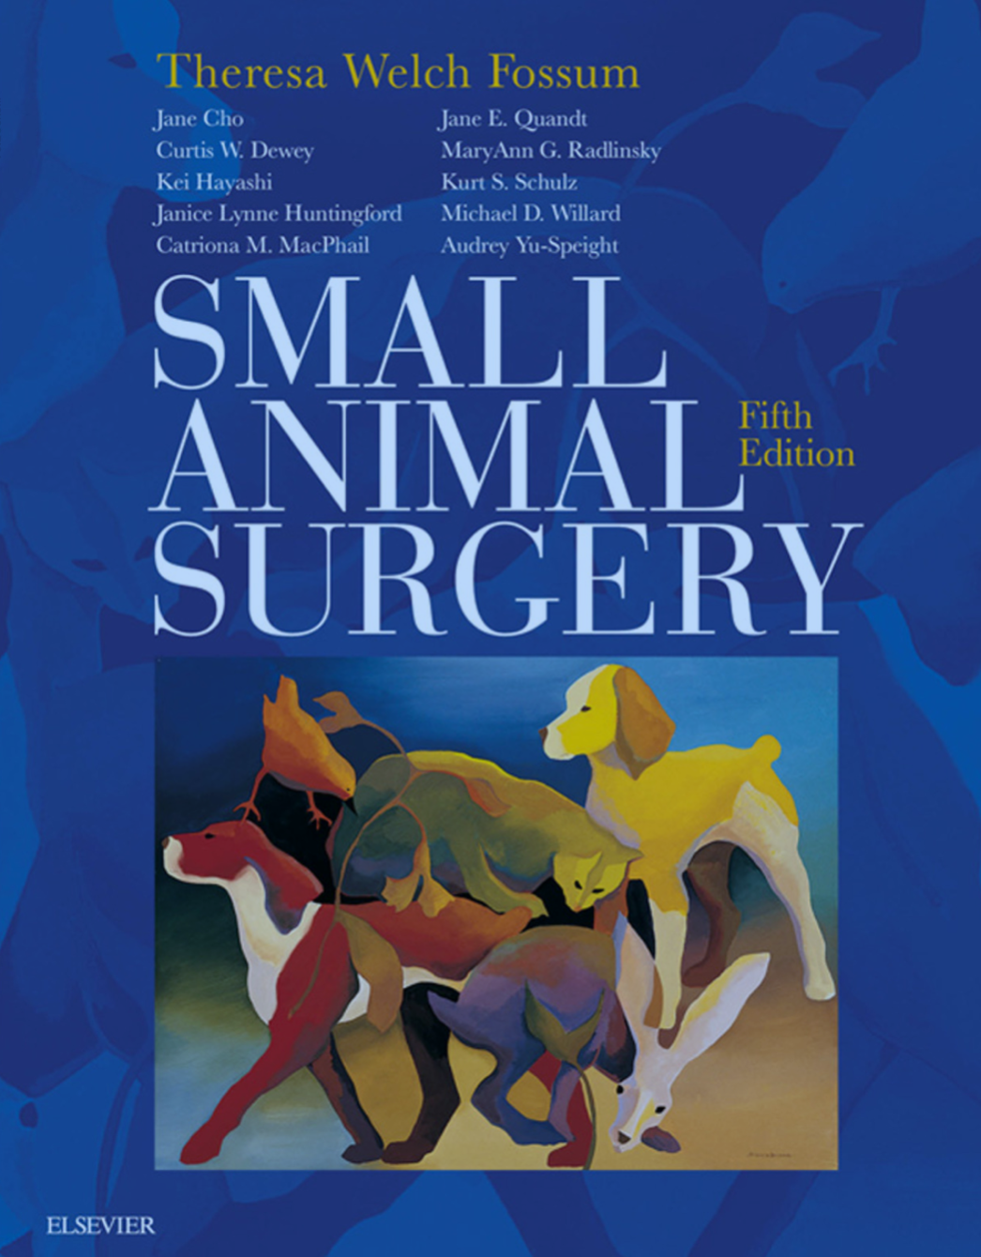
Fluid Therapy for Critically Ill Dogs and Cats . World Small Animal Veterinary Association World Congress Proceedings, 2005
Michael Schaer, DVM, DACVIM, ACVECC
University of Florida, College of Veterinary Medicine Gainesville, FL, USA
2013 AAHA/AAFP Fluid Therapy Guidelines for Dogs and Cats*
Harold Davis, BA, RVT, VTS (ECC), Tracey Jensen, DVM, DABVP, Anthony Johnson, DVM, DACVECC, Pamela Knowles, CVT, VTS (ECC), Robert Meyer, DVM, DACVAA, Renee Rucinsky, DVM, DAVBP (Feline), Heidi Shafford, DVM, PhD, DACVAA

