Slide 1
Inspiration from Plants
Dr. Arzu Gürsoy Ergen
Science Faculty
Biology Department
Gölalan-Samsun

Slide 2
Self cleaning paint
GreenShield™ textile coating
Velcro – Burdock from a plant sticking to a dog’s coat
BMW to use pomelo fruit to protect its workers
Fruit of Aluminum: Scientists Invent Peel-Inspired Metal
Water Mixer
Burj Khalifa
Optimal arrangement of solar array mirrors based on Fibonacci spirals
Photovoltaic panels
The Venus flytrap to clean up nuclear waste
UK Armed Forces Clothing Inspired by Pine Cones
Sydney Opera house
Ankara Üniversitesi 10. Yıl yerleşkesi

Slide 3
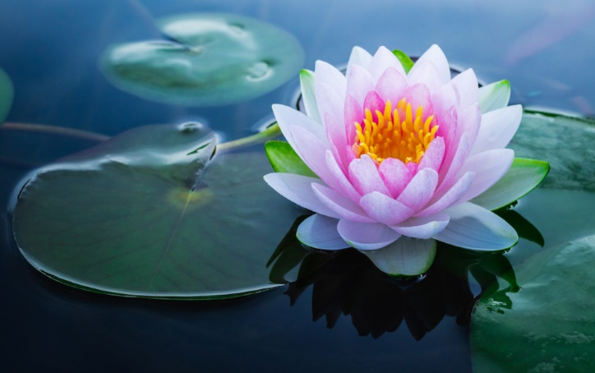
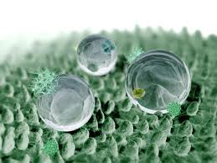
Self Cleaning Paint-How does nature clean? Learning from Lotus Plants How to Clean without Cleaners
The lotus flower is sort of like the sharkskin of dry land.
The flower's micro-rough surface naturally repels dust and dirt particles, keeping its petals sparkling clean.
If you've ever looked at a lotus leaf under a microscope, you've seen a sea of tiny nail-like protuberances that can fend off specks of dust.
When water rolls over a lotus leaf, it collects anything on the surface, leaving a clean and healthy leaf behind.
A German company, Ispo, spent four years researching this phenomenon and has developed a paint with similar properties.
The micro-rough surface of the paint pushes away dust and dirt, diminishing the need to wash the outside of a house.

Slide 4
Lotus = Paint
The lotus leaf is one of the cleanest plants in nature, even though it lives in a swamp.
The many crevices on the lotus leaf’s rough leaf surface trap a maze of air upon which water droplets float
The slightest breeze or tilt in the leaf causes balls of water to roll cleanly off
Taking attached dirt particles with them
Notes:
But have you ever noticed how things in nature are often so clean?
How does nature manage this? You don’t see janitors out there in the woods, dusting off the trees!
What if we learned to clean like leaves do, for example? Any idea how leaves clean themselves? [students may respond that leaves are so smooth that water rolls right off of them]. They seem so smooth that water just rolls of them, right? Well, let’s take a closer look…

Slide 5
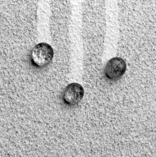
Lotus = Paint
This is the surface of the lotus leaf magnified many times
Tiny bumps on the leaf’s surface.
These bumps cause water to ball up.
The balls of water then roll along the leaf using an abundant, free energy source – gravity – pulling off dirt particles as they go
The balls of water slide along the leaf pulling off dirt particles as they go.
Lotus leaf
Wall
Notes:
This is the surface of the lotus leaf you saw in the previous photo magnified many times. It’s not its smoothness at all that keeps it clean. In fact, tiny, tiny bumps on the leaf’s surface are what causes it to remain clean. These bumps cause water to ball up (because the surface tension of the droplets – which pulls the water together -- is greater than the adhesion possible on the bumpy surface of the leaf*). The balls of water then roll along the leaf using an abundant, free energy source – gravity – pulling off dirt particles as they go.
Just imagine how we might be able to apply this leaf technology to our world and reduce the need to use toxic cleansers.
*[You can go into more detail here, and discuss how the bumps reduce the leaf surface area for the water to contact with, which reduces the hydrostatic force of the water droplet to the leaf and allows the internal cohesive force of water instead to create a droplet]
[This is a good place to address part of the Science Content Standard C for Grades 5-8: Structure and Function in living systems. You can emphasize here the relationship between leaf structure (specifically, that the cuticle of many leaves have specialized physical structures – papillose epidermal cells coated with epicuticular wax crystals -- which create a microscopically roughened surface) and function, namely, superhydrophicity, which both prevents water from adhering to the leaf surface where it might support pathogens (e.g., bacteria) and causes dirt to be cleansed away before it blocks photosynthesis or provides habitat for pathogens. You can also further discuss the role of cells, multicellularity, cellular specialization, and disease as a consequence of cellular breakdown in structure and function.]

Slide 6
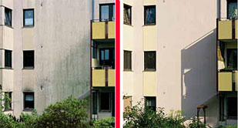
Biologists have discovered the secret of the success of lotus leaves.
paint manufactures have mimicked the texture of lotus leaves
A new paint, called Lotisan, mimics this design producing a painted surface that naturally cleans itself during a rainstorm.
Dirt particles are unable to obtain a hold on the leaves of the lotus plant and simply flow off with the rain droplets that fall on the plant.
Its microstructure has been modeled on the lotus plant to minimize the contact area for water and dirt.
Notes:
The good news is, that’s exactly what’s starting to happen. Biologists have discovered the secret of the success of lotus leaves. And paint manufactures have mimicked the texture of lotus leaves and infused their paints with it; you can literally just roll on a self-cleaning surface. Another application is in fabric finishes, which use the lotus effect to protect fabrics from stains, and reduce the amount of fluoropolymers needed for this purpose. As a persistent organic chemical, meaning it breaks down very slowly in the environment, there has been long-standing concern that fluoropolymers are harmful to people and the environment, so this bio-inspired innovation is a very welcome development.

Slide 7
Biomimicry
Designer:
What is the product made from?
How has the product been ‘inspired by nature’?
Level 1
Level 2
Level 3
How is the product designed for the whole cycle (product in a system)?
Image/s

