Slide 1
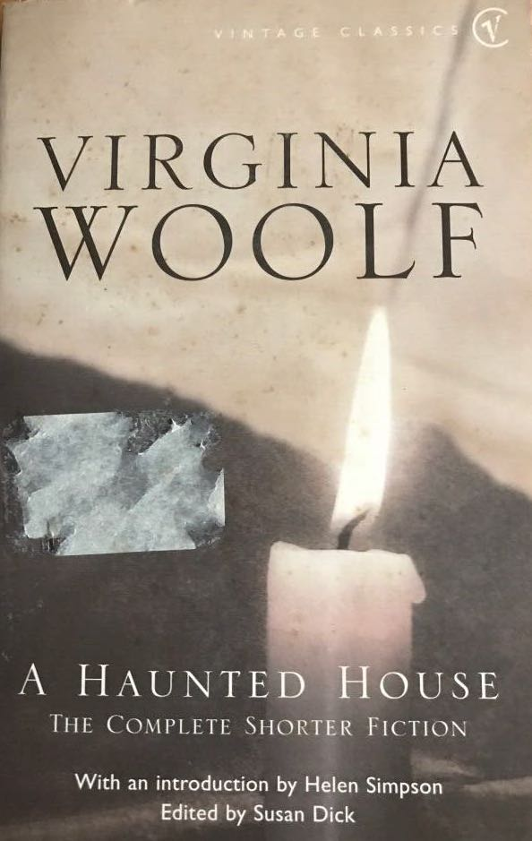
Virginia Woolf
A Haunted House: The Complete Shorter Fiction

Slide 2
Stories to be discussed:
“Kew Gardens”
“Mrs Dalloway in Bond Street”

Slide 3
Woolf’s Works
The Voyage Out
Night and Day
Jacob’s Room
Mrs Dalloway
To the Lighthouse
Orlando
The Waves
The Years
Between the Acts

Slide 4
“Kew Gardens”
the style is similar to Joyce’s
an impression
a portrait of the garden through the eyes of the people walking in it
third person narrator
focalizers
the symbolism

Slide 5
General to Specific: Zooming into the Portrait
Description of the garden: flowers, colours, light, people
The movement of the people
A specific couple
a married couple with children
two men – one younger, one older
two lower middle class elderly women
a young man and a young woman

Slide 6
green-blue: the Earth
People are born; they have substance
They keep moving around
Substance dissolves: they die
Life: walking in the garden
“Thus one couple after another with much the same irregular and aimless movement passed the flower-bed and were enveloped in layer after layer of green-blue vapour, in which at first their bodies had substance and a dash of colour, but later both substance and colour dissolved in the green-blue atmosphere.”

Slide 7
How each couple perceives the garden and what they talk about depends on their individual circumstances:
their social standing
their age
their circumstances
their outlook on life

Slide 8
Themes
memory of the past & relationships
the war
social differences
past vs present
young vs old

Slide 9
Symbols
the dragonfly
the square silver shoe buckle
the snail
the green insect
the garden

Slide 10
The Snail vs The Insect
The Snail
The Insect
moving very slightly
has a definite goal
makes progress
looks for solutions, considers possibilities, makes decisions: “whether to circumvent the arched tent of a dead leaf or to breast it”
high-stepping, rapid movements
impulsive: “stepped off as rapidly and strangely in the opposite direction.”
moves back and forth

Slide 11
Experimental
Human & non-human figures, colours, sounds are all blended in one narrative.
When the snail comes to the foreground, the couples turn into mere colours; the snail becomes the focalizer.
Life is happening around the snail and its struggle to go past the dead leaf.
Everyone has different struggles, different memories, different goals, and they are ignorant of the struggles, memories, goals of the others.
Life goes on either way (the final paragraph).

